Slide 1
SMART SKILLS
Week 6 – Map 2
© 2023 Clairmont Press

Slide 2
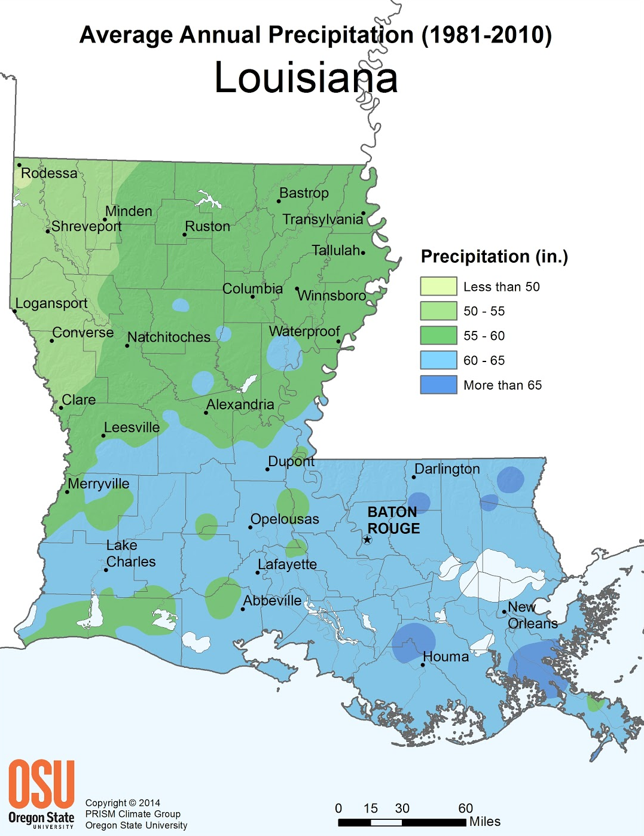
Monday
Study the map.
What does the map depict?
Notes:
The average amount of rainfall in different parts of Louisiana.

Slide 3
Tuesday
What is the range of average annual rainfall for the entire state of Louisiana?
Notes:
Less than 50 to more than 65 inches.

Slide 4
Wednesday
What region of the state has the least rainfall? Which has the most? How much rain, on average, does our region receive?
Notes:
The northwest corner receives the least rainfall; the southeast gets the most. Answers will depend your school’s location for the last question.

Slide 5
Thursday
Why do you think the mapmaker chose these colors to represent the range of precipitation?
Notes:
Answers will vary. Perhaps some colors looked “drier” and some “wetter.”

Slide 6
Friday
List three professions in Louisiana that may use a map like this in their work.
Explain your thinking.
Notes:
Answers will vary but must be supported by a logical connection for using the map.

Slide 7
Image Credits
Title Slide: Old Louisiana State Capitol, Public Domain, Wikimedia Commons
End Slide: Monroe, Louisiana skyline in 2021, by TheLionHasSeen, Uploaded 12 April 2021, Wikimedia Commons

