Slide 1
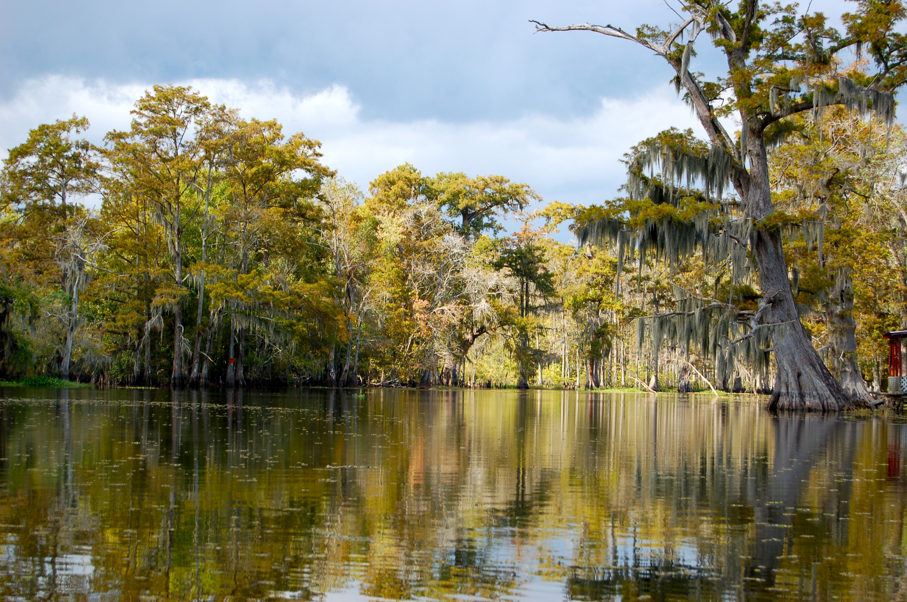

Chapter 7: A Growing Young Nation
STUDY PRESENTATION
© 2023 Clairmont Press

Slide 2
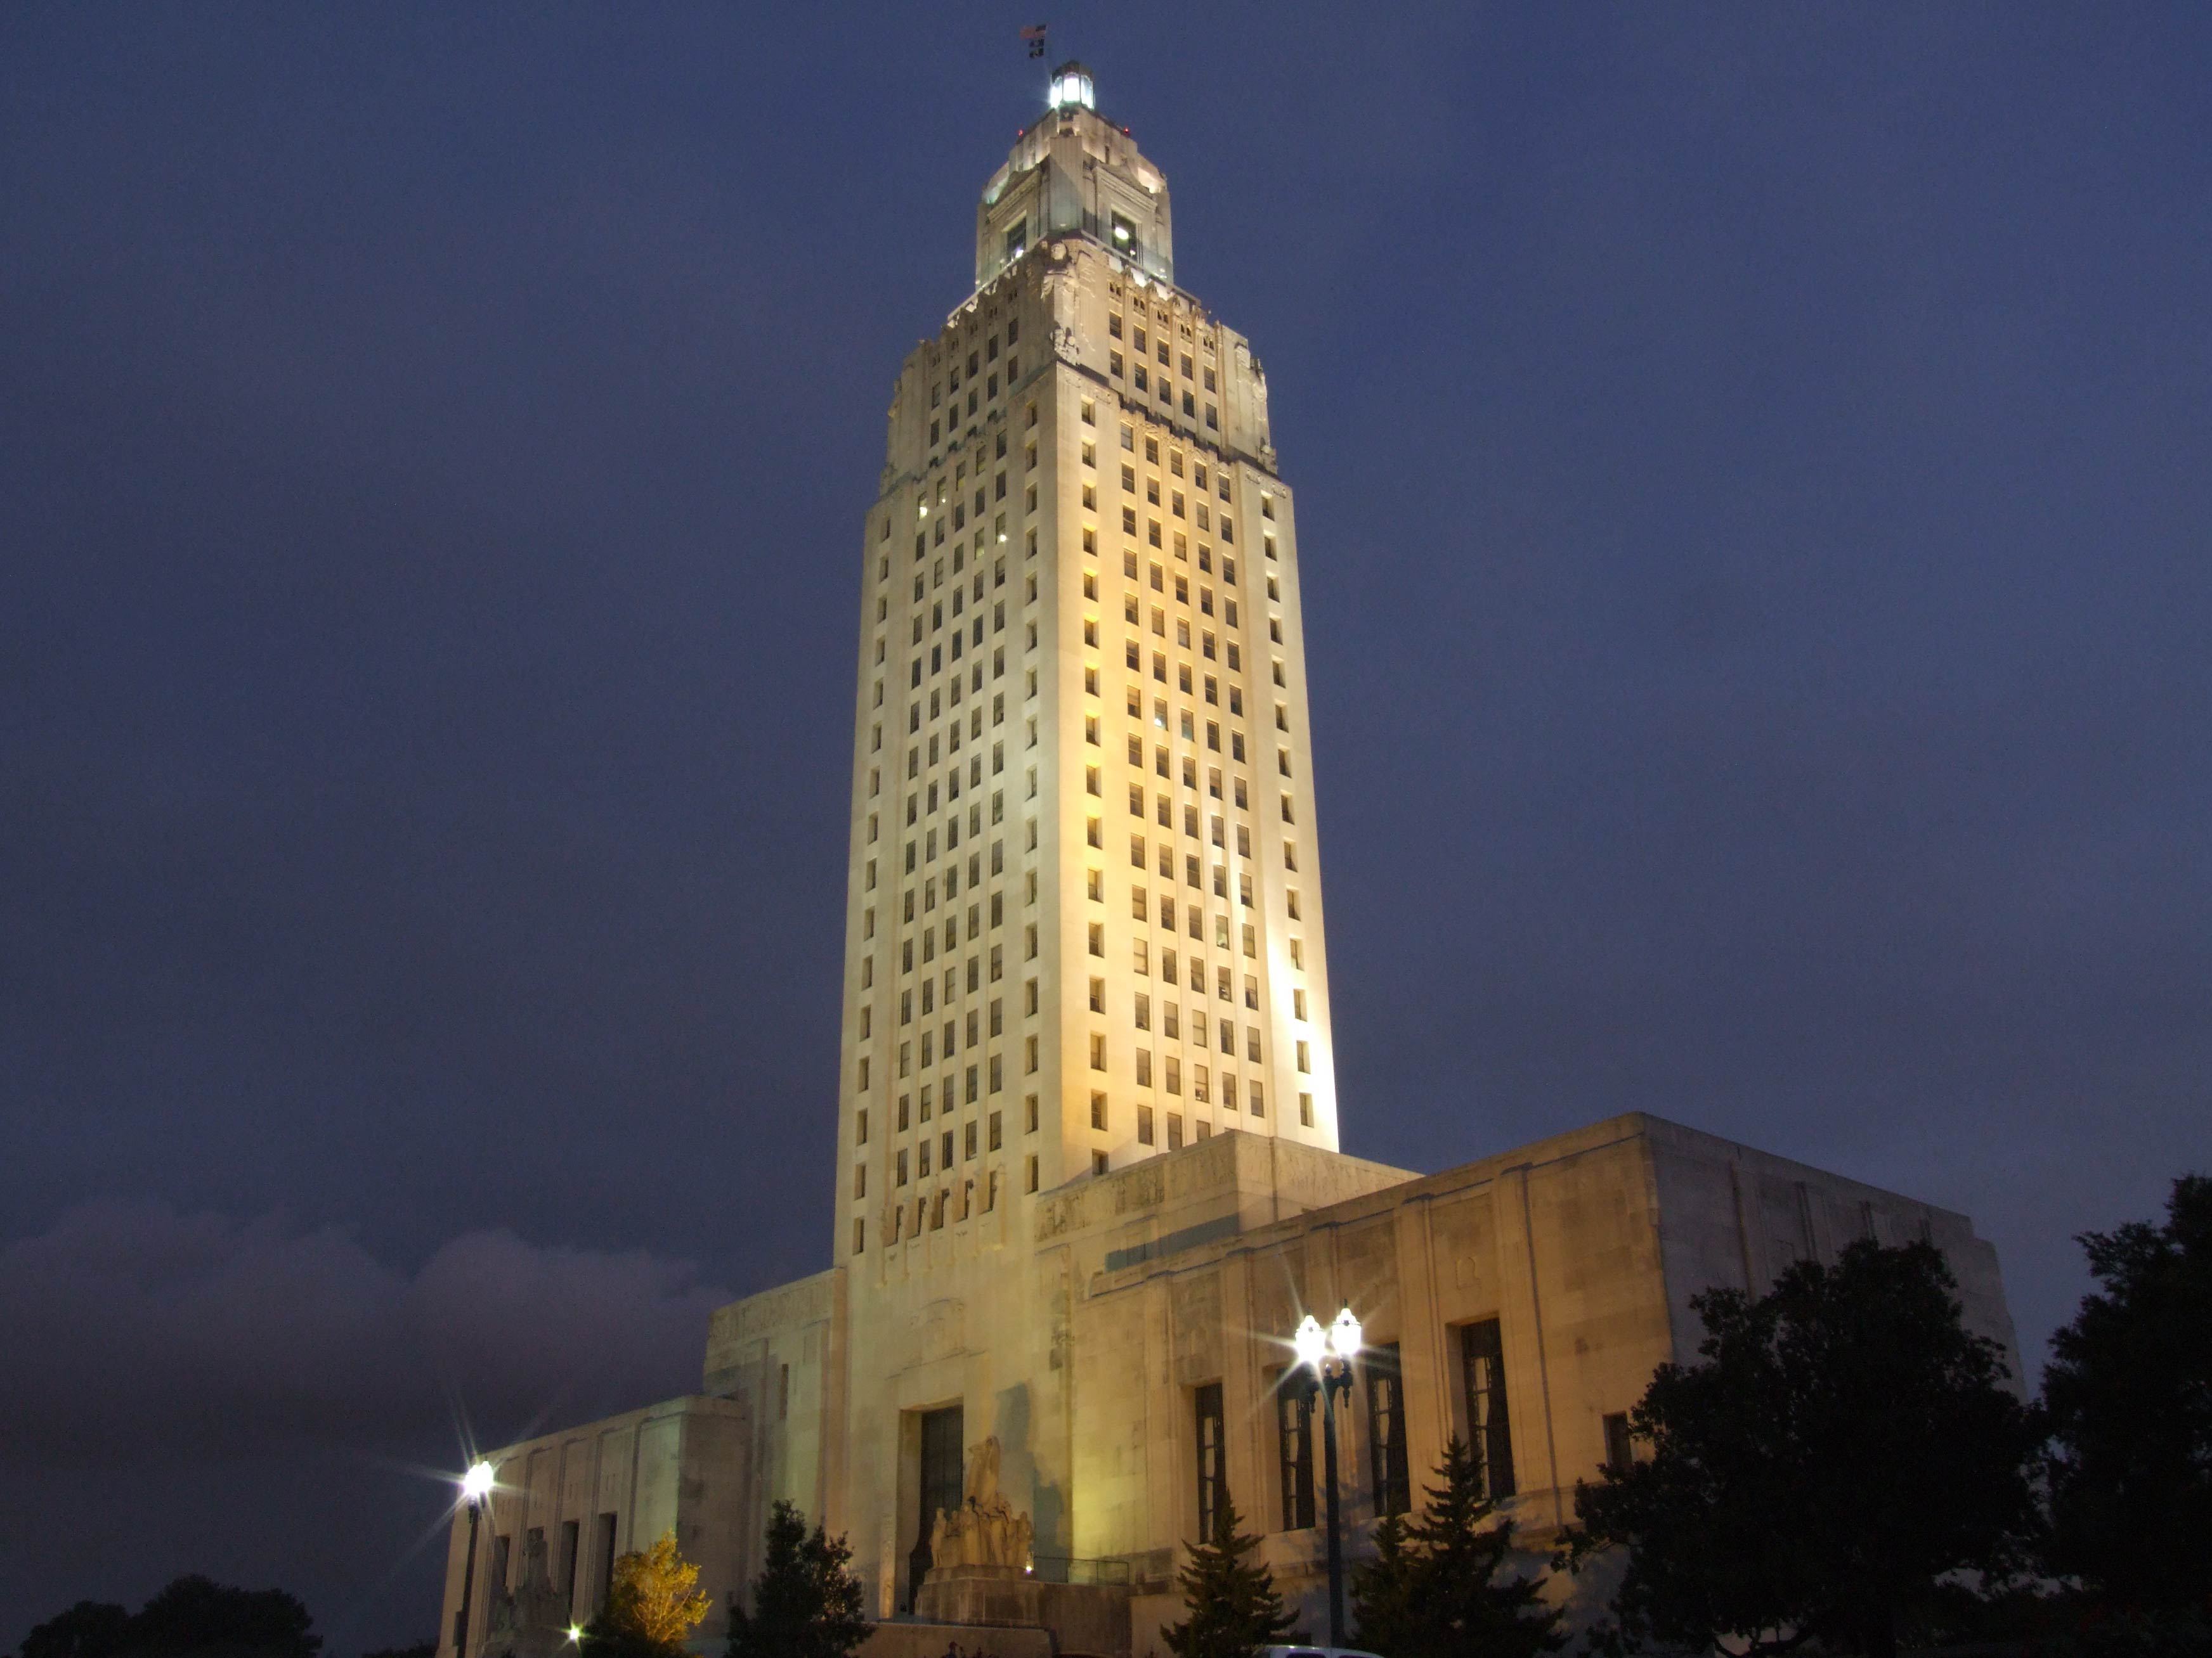
Louisiana State Capitol building, Baton Rouge
Section 1: President Jefferson’s Administration Section 2: The Louisiana Purchase
Section 3: Louisiana’s Territorial Period
Section 4: Exploring the Louisiana Purchase

Slide 3
Section 1: President Jefferson’s Administration
Essential Question
  What was the unusual problem of the election of 1800?

Slide 4
Section 1: President Jefferson’s Administration
What terms do I need to know?
  Marbury v. Madison
  Convention of 1800
  tribute
  Embargo Act of 1807

Slide 5
President Jefferson’s Administration
Thomas Jefferson was sworn in as president on March 4, 1801.
There was fierce negativity around the campaign due to news media and the emergence of political parties.
However, Jefferson focused his efforts on uniting the country for the future.

Slide 6
The Election of 1800
According to the rules of the Constitution, electors gathered in December to cast two votes for president.
While the two Democratic-Republican candidates took 74% of the votes and left the Federalists with 26%, Thomas Jefferson and Aaron Burr were tied.
The House of Representatives was responsible with deciding the winner, and 35 votes were taken over one week, each time left without a clear winner.

Slide 7
The Election of 1800 Pt. 2
Alexander Hamilton, leader of the Federalists, and Jefferson had been political rivals for years, but Hamilton viewed Burr as dishonest and dangerous.
He urged Federalist congressmen to vote for Jefferson, and Jefferson made political promises to the Federalists.
Jefferson was elected president and Burr was made vice president, but Jefferson no longer trusted him.

Slide 8
The 12th Amendment
After the issues of the past two elections, Congress was ready to correct these flaws in the election process.
The 12th Amendment, which separated votes for President and Vice President, was passed by Congress in December 1803 and was ratified by the states in only six months.
The House determined the winner if there were a tie for president, and the Senate determined the winner if there were a tie for vice president.

Slide 9
The Case of Marbury v. Madison
President John Adams passed the Judiciary Act of 1801 with only a few weeks left in his presidency, creating quite a few new circuit judgeship and justice of the peace positions.
Adams then quickly appointed several Federalists judges to fill these new positions.
Some of the new judges’ signed and sealed commissions were still on Adam’s desk when he left office, and the new secretary of state, James Madison, chose not to deliver them.

Slide 10
The Case of Marbury v. Madison Pt. 2
William Marbury, one of these judges, sued Madison, asking the United States Supreme Court to force the president to honor his appointment.
The court ruled that part the Judiciary Act of 1789 was unconstitutional, and since Marbury was using this law, the court ruled against him.
This Marbury v. Madison decision established the principle of judicial review, the power of the court to review laws and declare them unconstitutional.

Slide 11
Relationship with France
In 1799, French general Napoleon Bonaparte seized power and gained unparalleled power to run the country.
Napoleon signed the Convention of 1800 with the United States to end their Quasi-War, diverting the resources used to fight elsewhere.
With this, the United States economy began to recover, as both trading became easier and military spending could be reduced.

Slide 12
Signs of Prosperity
There were several signs of growth and prosperity during Jefferson’s presidency.
Hamilton’s Whiskey Tax was repealed, helping farmers keep more of the money they earned, but Hamilton’s National Bank provided a safe place to keep and manage government funds.
The creation of the bank and the government’s reduced spending meant they could focus on reducing the country’s debt.

Slide 13
Signs of Prosperity Pt. 2
Settlers continued to move west, and Ohio became the seventeenth state in 1803, and the country’s population increased from about 5.3 million in 1800 to 7.2 million people in 1810.
Jefferson sent a delegation to France to purchase New Orleans and West Florida to protect shipping on the Mississippi River, which was crucial to western development.

Slide 14
The First Barbary War
Muslim pirates along the Barbary Coast, known as Barbary pirates, robbed and stole ships at sea and raided European costal towns for centuries.
American merchant ships were a prime target, so the United States tried working out a solution with the Ottoman Empire, such as paying tribute (payment by one ruler or nation to another as the price of protection).
In 1801, a large part of the federal budget was being paid in tribute, and the pasha of Tripoli demanded even more. Jefferson realized something had to be done, so he stopped making the payments. He also ordered the navy to the Mediterranean Sea.
The navy began with four ships in the region and was instructed to protect American ships and citizens. When the ships arrived, they joined the Swedish navy and blockaded the port of Tripoli. By 1805, more than 15 ships had been sent to the region. The war ended in 1805. The tribute payments did not cease entirely, but they were significantly reduced. A benefit of the war was that the navy and the marines showed they could defend American interests far from home. They also gained experience, which helped protect the country in future conflicts.

Slide 15
The First Barbary War Pt. 2
When a leader of the empire demanded more payment in 1801, Jefferson acted, stopping payments and ordering the navy to the Mediterranean Sea.
The navy joined the Swedish navy to blockade the port of Tripoli, and by 1805, the war ended, resulting in far smaller payments.
The American navy also gaining experience in the field and notoriety for their ability to protect American interests abroad.

Slide 16
The Embargo Act of 1807
A new war broke out between the British and French, and the United States tried to claim neutrality.
However, Napoleon ordered his navy to seize any ships trading with Britain, and the British would also capture and force American sailors to work for them.
The last straw came after a British navy vessel attacked an American warship of the coast of Virginia.

Slide 17
The Embargo Act of 1807 Pt. 2
The attack against a ship of the U.S. Navy so close to home was intolerable, and popular opinion was that this was an act of war.
Jefferson, wanting to remain neutral because the United States was weaker than either Britain or France, was put in a tough situation.
The United States demanded the British apologize for the attack and pay for repairs, but the British government refused.

Slide 18
The Embargo Act of 1807 Pt. 3
The Embargo Act of 1807 was made to punish Britain and give the United States an advantage in future negotiations, but it backfired.
The act closed all ports in the United States to export shipping and placed restrictions on British imports.
Other countries now had less competition for trade and increased their own profits.

Slide 19
The Embargo Act of 1807 Pt. 4
American goods began filling warehouses, and American farmers, tradesmen, and merchants were losing money.
Citizens began to complain loudly to Congress, and soon the embargo was lifted, ports were fully opened, and the economy started to improve.
Return to Main Menu

Slide 20
Section 2: The Louisiana Purchase
Essential Question
  What was the constitutional problem Jefferson faced with the Louisiana Purchase?

Slide 21
Section 2: The Louisiana Purchase
What terms do I need to know?
  Treaty of San Ildefonso
  yellow fever
  Louisiana Purchase
  Adams-Onís Treaty

Slide 22
The Louisiana Purchase
Migrants began pouring into Louisiana after 1787, and they started to depend on the Mississippi River as a trade route.
The Americans and Spanish disagreed about the borders that separated Spanish and American claims.
The Spanish were sometimes blocked American citizens wanting to use the New Orleans port, which they used to transport goods out of the middle territories and to the rest of the world.

Slide 23
International Events and Intrigue
By 1794, France had abolished slavery at home and in its colonies, but there was a rebellion in its most profitable colony, Saint-Domingue.
Napoleon planned to reestablish slavery on the island and use the profits to pay for his military campaigns.
Napoleon also wanted to reestablish control over Louisiana and use it to grow the food supply for the French Empire.

Slide 24
International Events and Intrigue Pt. 2
One month after signing the Convention of 1800 with the United States, Napoleon secretly reclaimed Louisiana in the Treaty of San Ildefonso with Spain.
Napoleon then sent more than 30,000 soldiers to Saint-Domingue to reestablish slavery.
However, more than 80% of his soldiers died to yellow fever (a disease that causes fever and yellowing of the skin) within a few weeks.
With this disastrous turn of events, Napoleon abandoned his plans and decided he no longer benefited from the possession of Louisiana.

Slide 25
The Louisiana Purchase
Hearing rumors about the transfer of Louisiana’s ownership, Jefferson sent James Monroe and Robert Livingston to France to negotiate the purchase of New Orleans.
Unaware that Napoleon’s plans for the west had changed, Livingston and Monroe were shocked when they were offered to purchase both New Orleans AND all of Louisiana.

Slide 26
The Louisiana Purchase Pt. 2
They were not authorized by Jefferson to make such an expensive purchase.
Because slow communication meant they could not ask for permission quickly, Monroe and Livingston were in a tough position.
After deliberation, they went ahead and accepted the offer to purchase all of Louisiana for $15 million.

Slide 27
The Treaty
The terms of the treaty were sent to Washington, DC, for approval.
Jefferson, believing such a purchase was in the country’s best interests, pushed for quick approval of the terms.
The Senate ratified the treaty for the Louisiana Purchase (the purchase of the Louisiana Territory) on October 19, 1803.

Slide 28
Two Transfers
Two transfers had to take place in New Orleans to finalize the process.
Spain transferred control of Louisiana to Napoleon’s representative in New Orleans in November 1803.
The representative, Pierre Clément de Laussat, acted as governor for only three weeks before transferring Louisiana to the United States in December 1803, marking a new era in the nation’s history.

Slide 29
The Territory
The Adams-Onís Treaty, a treaty establishing the border between Spanish and American claims signed in 1819, specified the United States added roughly 530,000,000 acres to the nation’s territory.
The United States spent approximately 4 cents an acre on the Louisiana Purchase.
With the addition of so much land so fast, the United States went from a small, young nation to a potential world power.
Return to Main Menu

Slide 30
Section 3: Louisiana’s
Territorial Period
Essential Question
  How did Aaron Burr threatened to destabilize the new territory?

Slide 31
Section 3: Louisiana’s
Territorial Period
What terms do I need to know?
  filibustering
  dueling
  manumission

Slide 32
Louisiana’s Territorial Period
William Charles Cole Claiborne was already governor of the Mississippi Territory and a supporter of Jefferson, so he was a convenient choice to be the governor of the new territory.
However, he didn’t speak French or Spanish, the common languages in the territory, so many were worried about his ability to communicate with citizens.
General James Wilkinson was Claiborne’s co-commissioner and military commander, and unknown to many, he had been a secret agent for the Spanish since 1787.

Slide 33
Louisiana’s Territorial Period Pt. 2
Jefferson told Claiborne to make slow changes, but Claiborne had essentially unlimited powers because Louisiana was still a colony.
The treaty for Louisiana Purchase included a promise to incorporate and admit Louisiana into the United States as soon as possible.
In 1804, Congress divided the lands into two administrative units: the Territory of Orleans, governed by Claiborne, and the Territory of Louisiana.

Slide 34
Administrative Challenges and Change
When the Territory of Orleans was created, Claiborne divided it into twelve administrative units called “counties.”
By 1807, the territorial legislature changed those “counties” back to “parishes,” resulting in Louisiana being the only state with parishes rather than counties.
Laws also reflected a compromise between American ideas and Louisiana’s French and Spanish past.

Slide 35
The Burr Conspiracy
Those who wanted to run from the law or filibuster (to overthrow legitimate rule) looked to Louisiana and its uncertain borders as a place of opportunity.
Aaron Burr, former vice president of Jefferson’s, was an unexpected filibusterer.
After his position as Jefferson’s vice president during Jefferson’s second term was denied, he decided to run for governor of New York.

Slide 36
The Burr Conspiracy Pt. 2
Alexander Hamilton actively worked against Burr’s election, writing Burr would doom the country.
When Burr lost the election, he loudly blamed Hamilton and challenged him to a duel (combat between two persons with weapons in front of witnesses), which was outlawed.
Hamilton agreed, and their duel resulted in Hamilton’s death.
Murder charges being filed, but no trial was ever called, and Burr still finished his term as vice president.

Slide 37
The Burr Conspiracy Pt. 3
Burr then allegedly plotted to take over New Orleans, strip the city of its valuables, and then invade Mexico, where he would be its ruler.
However, his co-conspirator, General James Wilkinson, decided to inform the president of Burr’s plans, instead.
Burr was tried and acquitted of conspiracy charges, but his political reputation was ruined.
After exile in Great Britain, he eventually returned to the United States to spend his final years practice law.

Slide 38
West Florida Rebellion
Despite Spanish control of Spanish West Florida (the Florida Parishes) in 1810, the English-speaking majority from America dominated the region’s population and wanted to join the States.
To accomplish this, they revolted against the Spanish and declared themselves an independent republic, called the Republic of West Florida.
Three months later, Governor Claiborne declared West Florida part of the Territory of Orleans, and the Florida Parishes were added to Louisiana in 1812.

Slide 39
Free People of Color and Enslaved People
Louisiana’s diverse population, specifically the free people of color, created unexpected and unfamiliar challenges for its new government.
Claiborne was shocked when he learned there were two local militia units made up of free men of color.
Free men of color wrote Claiborne asking that their militia units be retained, and in 1804, Claiborne decided to keep the militia units but put white officers in charge of them.

Slide 40
Free People of Color and
Enslaved People Pt. 2
Claiborne oversaw the adoption of a new slave code in 1806 that allowed for manumission (setting enslaved people free).
However, self-purchase was no longer allowed, making it almost impossible for an enslaved person to be freed.
Enslaved people were not allowed to complain about their masters, and crimes committed by these people were tried in a separate and harsh court system.

Slide 41
Free People of Color and
Enslaved People Pt. 3
After 1804, the federal government also made it illegal to import enslaved people into Louisiana from any place outside the United States.
This rose the importance of the domestic slave trade, and enslaved people were now transported from coastal states to be sold in the Deep South.
Claiborne made an exception to the law in 1809, allowing 9000 refugees from Saint-Domingue, 3000 of which were enslaved people, to live in the territory.
This wave of immigration nearly doubled the size of New Orleans in a single year.

Slide 42
The 1811 Slave Revolt
The uprising of enslaved people and the revolution in Saint-Domingue cost the lives of thousands of people, and some feared refugees would lead to violence in Louisiana.
In 1811, enslaved people north of New Orleans rebelled against their enslavers in the largest slave revolt in United States history.
Led by an enslaved man named Charles, the enslaved people led others to take control of a plantation and take up arms.

Slide 43
The 1811 Slave Revolt Pt. 2
Most of the slaves were armed only with farm tools as they began their approach toward New Orleans and convinced other enslaved people to join them.
Despite their numbers, the poorly armed rebels were no match for the local militia and U.S. Army forces, and many rebels were killed or captured.
Although the enslaved rebels were defeated, the sheer number of people involved made the revolt an important part of the nation’s history.
Return to Main Menu

Slide 44
Section 4: Exploring the Louisiana
Purchase
Essential Question
  What were the challenges of exploring the Red River?

Slide 45
Section 4: What is Economics?
What terms do I need to know?
  Corps of Discovery
  pirogue
  flotilla

Slide 46
The Lewis and Clark Expedition
In 1803, Jefferson asked Congress to fund an expedition explore the land to the Pacific Ocean, as he was interested in the West’s geography.
Jefferson asked Meriwether Lewis to lead the exploration party, and Lewis asked retired army friend William Clark to share the command.
In May 1804, the expedition, known as the Corps of Discovery, set out with 45 men in a large keelboat and two smaller pirogues (canoe-shaped boats) on the Missouri River.

Slide 47
The Lewis and Clark Expedition Pt. 2
A year into their journey, the Corps was joined by Toussaint Charbonneau and Sacagawea, who served as guides and interpreters, along with their infant son, Jean Baptiste.
Sacagawea was a Shoshoni and had been raised in the West, and her experience helped guide the group to the Rocky Mountains as well as gain assistance from indigenous people they encountered.
The Corps traveled over 4,000 miles to reach the Pacific Ocean, built a fort in present-day Oregon to spend the winter of 1805.

Slide 48
The Lewis and Clark Expedition Pt. 3
They survived by trading with the nearby Clatsop people, and when the snow in the Rocky Mountains thawed, the Corps headed home.
They returned in September 1806 with journals, maps, and sketches detailing their encounters, and the Corps also claimed the land west of the Rocky Mountains for the United States.
Lewis was later named governor of the Louisiana Territory, and Clark was made the Indian agent for the West and brigadier general of the territory’s militia.

Slide 49
Exploring the Red River
Jefferson wanted another expedition to explore the southwest territory to establish the border between Spanish and American claims.
He also wanted to understand the ecology and geography of the region.
Jefferson’s first choice for the task was scientist William Dunbar of Natchez, Mississippi.
Dunbar asked Dr. George Hunter, a chemist, to assist him in a trial run.

Slide 50
The Dunbar-Hunter Expedition
Due to a possible conflict with the Osage up the Red River, Dunbar and Hunter led a small group up the Ouachita River in present-day Louisiana and Arkansas in October 1804.
The group traveled north to the Ozark Mountains on a three-month journey providing the first written details of the region.
These records provided the scientists with much to study, including the presence of microorganisms in natural hot springs.

Slide 51
The Red River Expedition
A 24-man military team was assembled in 1806 and included an astronomer and surveyor, a medical student, and Captain Richard Sparks, the ranking army officer.
The president tasked the team with exploring and noting details of the Red River, with the goal of finding a trade route to Santa Fe.
The flotilla (fleet of boats) traveled north on the Red River, adding 26 men to the team and encountering a logjam.

Slide 52
The Red River Expedition Pt. 2
Sparks learned from Caddo Indians that a Spanish army was tracking them, and they were confronted at the edge of present-day Oklahoma by a large Spanish army that demanded they turn back.
Jefferson had told the explorers to turn around if they faced a superior force, so the group turned back.
Despite the knowledge gained, the expedition did not accomplish all Jefferson wanted, and the results of the Lewis and Clark Expedition gained far more public interest.

Slide 53
The Pike-Wilkinson Expedition
In 1806, Zebulon Pike, Lieutenant James Wilkinson, and their team were ordered to explore Arkansas, the Red Rivers, and contact various tribes.
Pike’s party left St. Louis up the Missouri River, across the Kansas plains, to a Pawnee village, then along the Santa Fe Trail to the Arkansas River.
Wilkinson, five privates, and an Osage guide then left Pike and the others to explore the river.

Slide 54
The Pike-Wilkinson Expedition Pt. 2
Despite the hazardous winter conditions, Wilkinson’s team safely returned to St. Louis 73 days later, and his journal mentioned Osage villages, native hunting camps, and rich lead mines and salt prairies.
Pike’s team reached the Rocky Mountains, but frostbite, inadequate clothing, and low rations plagued them, and Pike and the survivors were later arrested by a Spanish patrol in 1807.

Slide 55
The Sibley Expedition
George C. Sibley, business agent at Fort Osage, and an Osage guide “San Oreille” were sent by Jefferson in 1811 to locate a rumored “salt mountain,” since salt was important to diets, preserve foods, and tan hides.
They encountered the 20-mile “Grand Saline” salt hills in present-day Kansas and Oklahoma.
About 75 miles northwest of the Grand Saline, they found the “Rock Saline”, deep layers of salt at the bottom of a bluff near the Cimarron River.
Sibley wrote that there was an “inexhaustible store of ready-made salt in the area.”

Slide 56
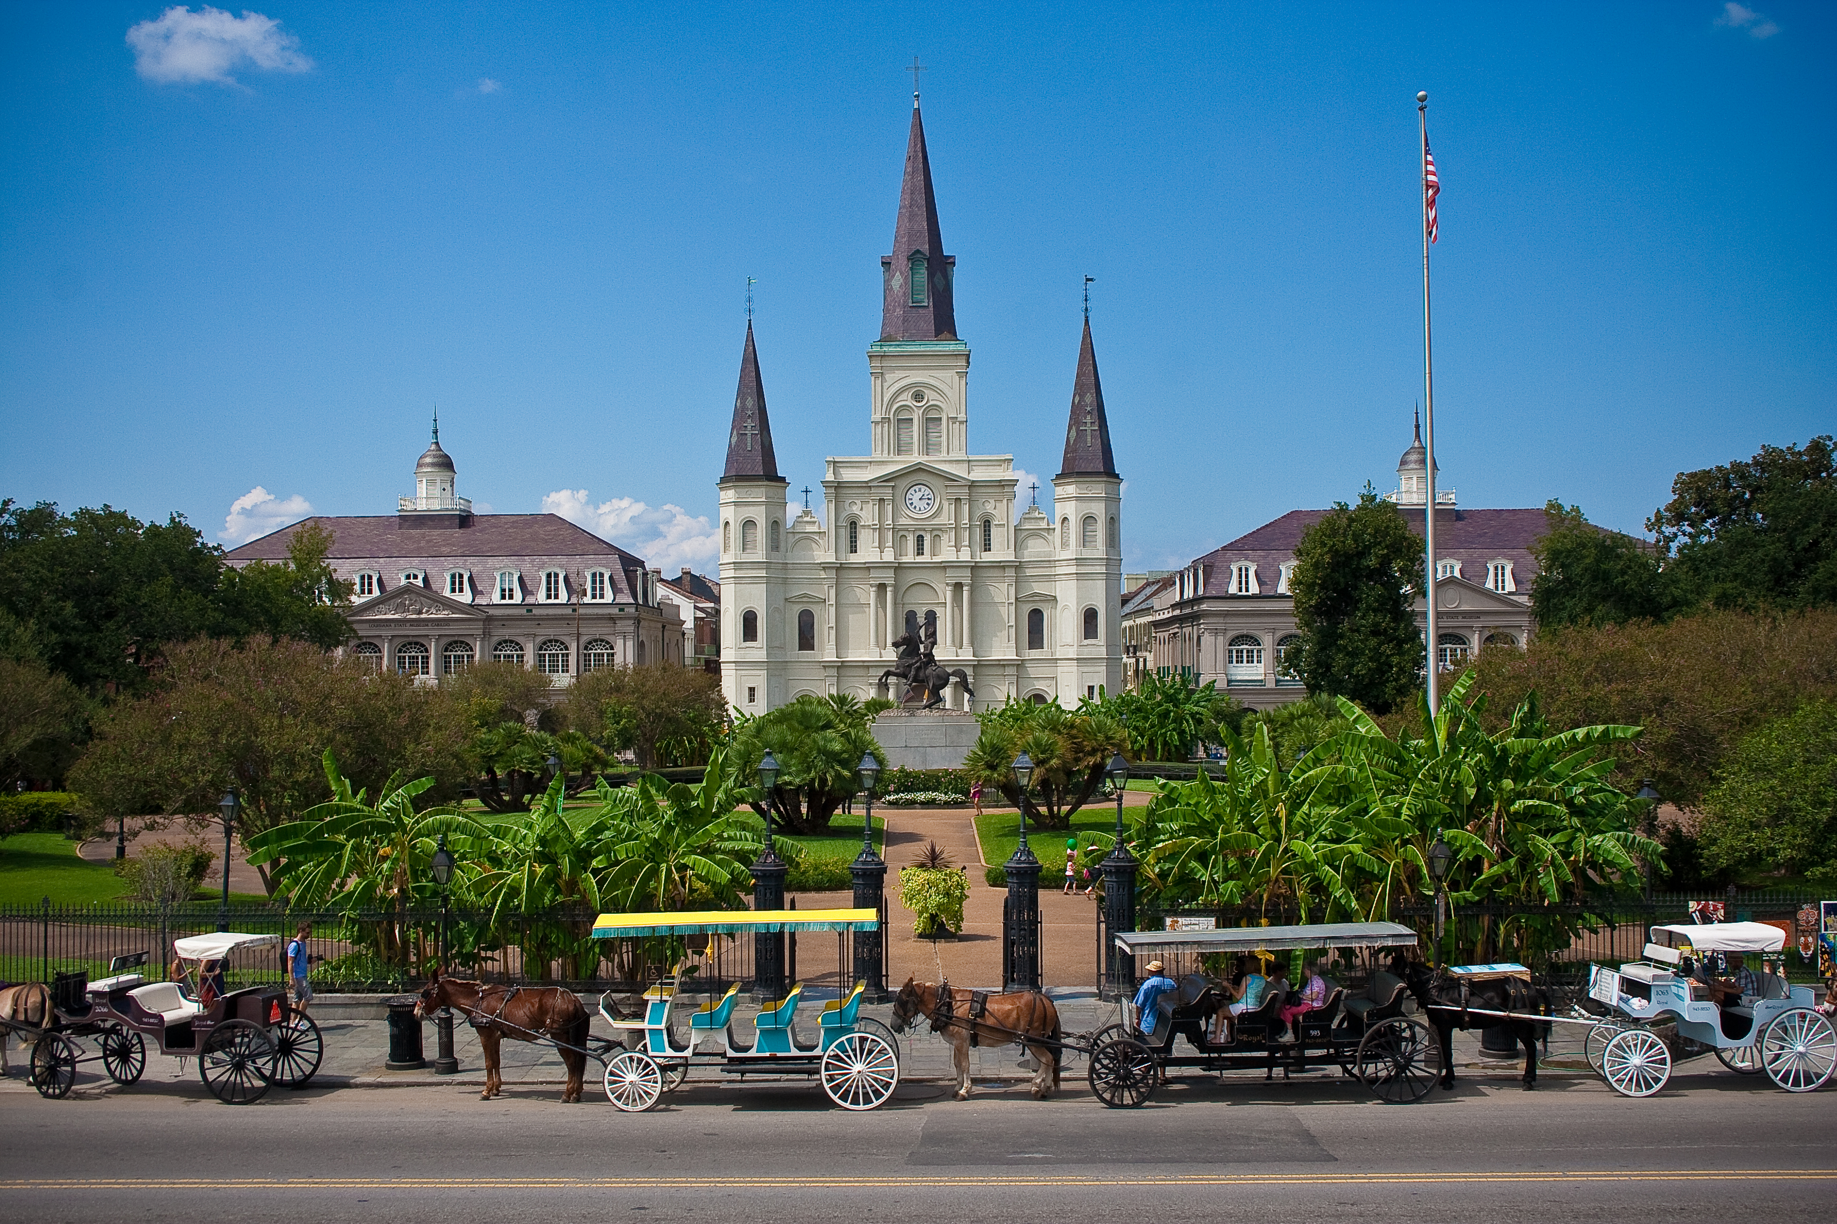
St. Louis Cathedral, New Orleans
Image Credits
Slide 1: jc.winkler, https://creativecommons.org/licenses/by/2.0/deed.en, Wikimedia Commons
Slide 2: Bluepoint951, https://creativecommons.org/licenses/by-sa/2.5/deed.en, Wikimedia Commons
Final Slide: Royalpt78, https://creativecommons.org/licenses/by-sa/3.0/deed.en, Wikimedia Commons
Return to Main Menu

