Slide 1
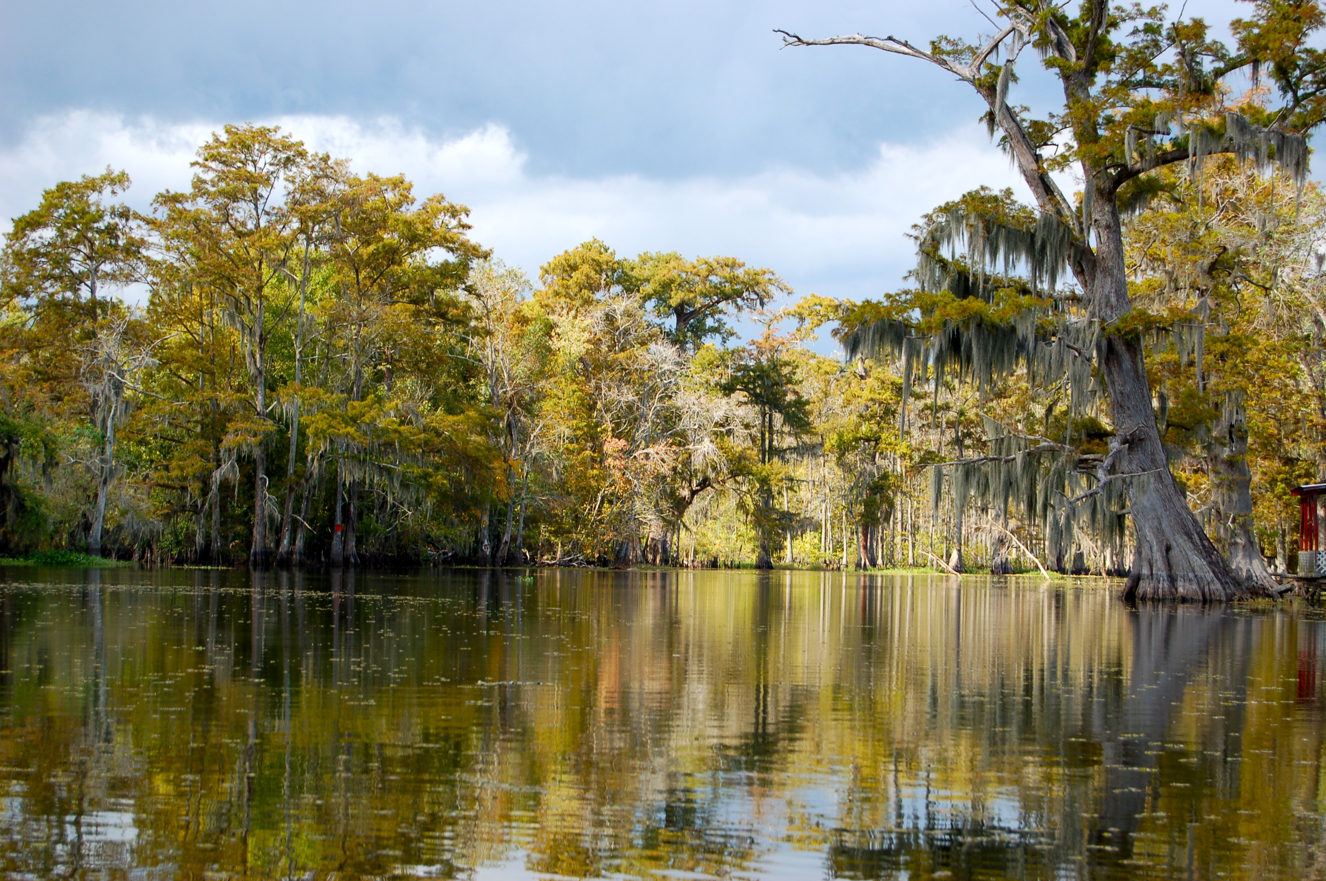

Chapter 1: Inquiry and the Social Studies
STUDY PRESENTATION
© 2023 Clairmont Press

Slide 2
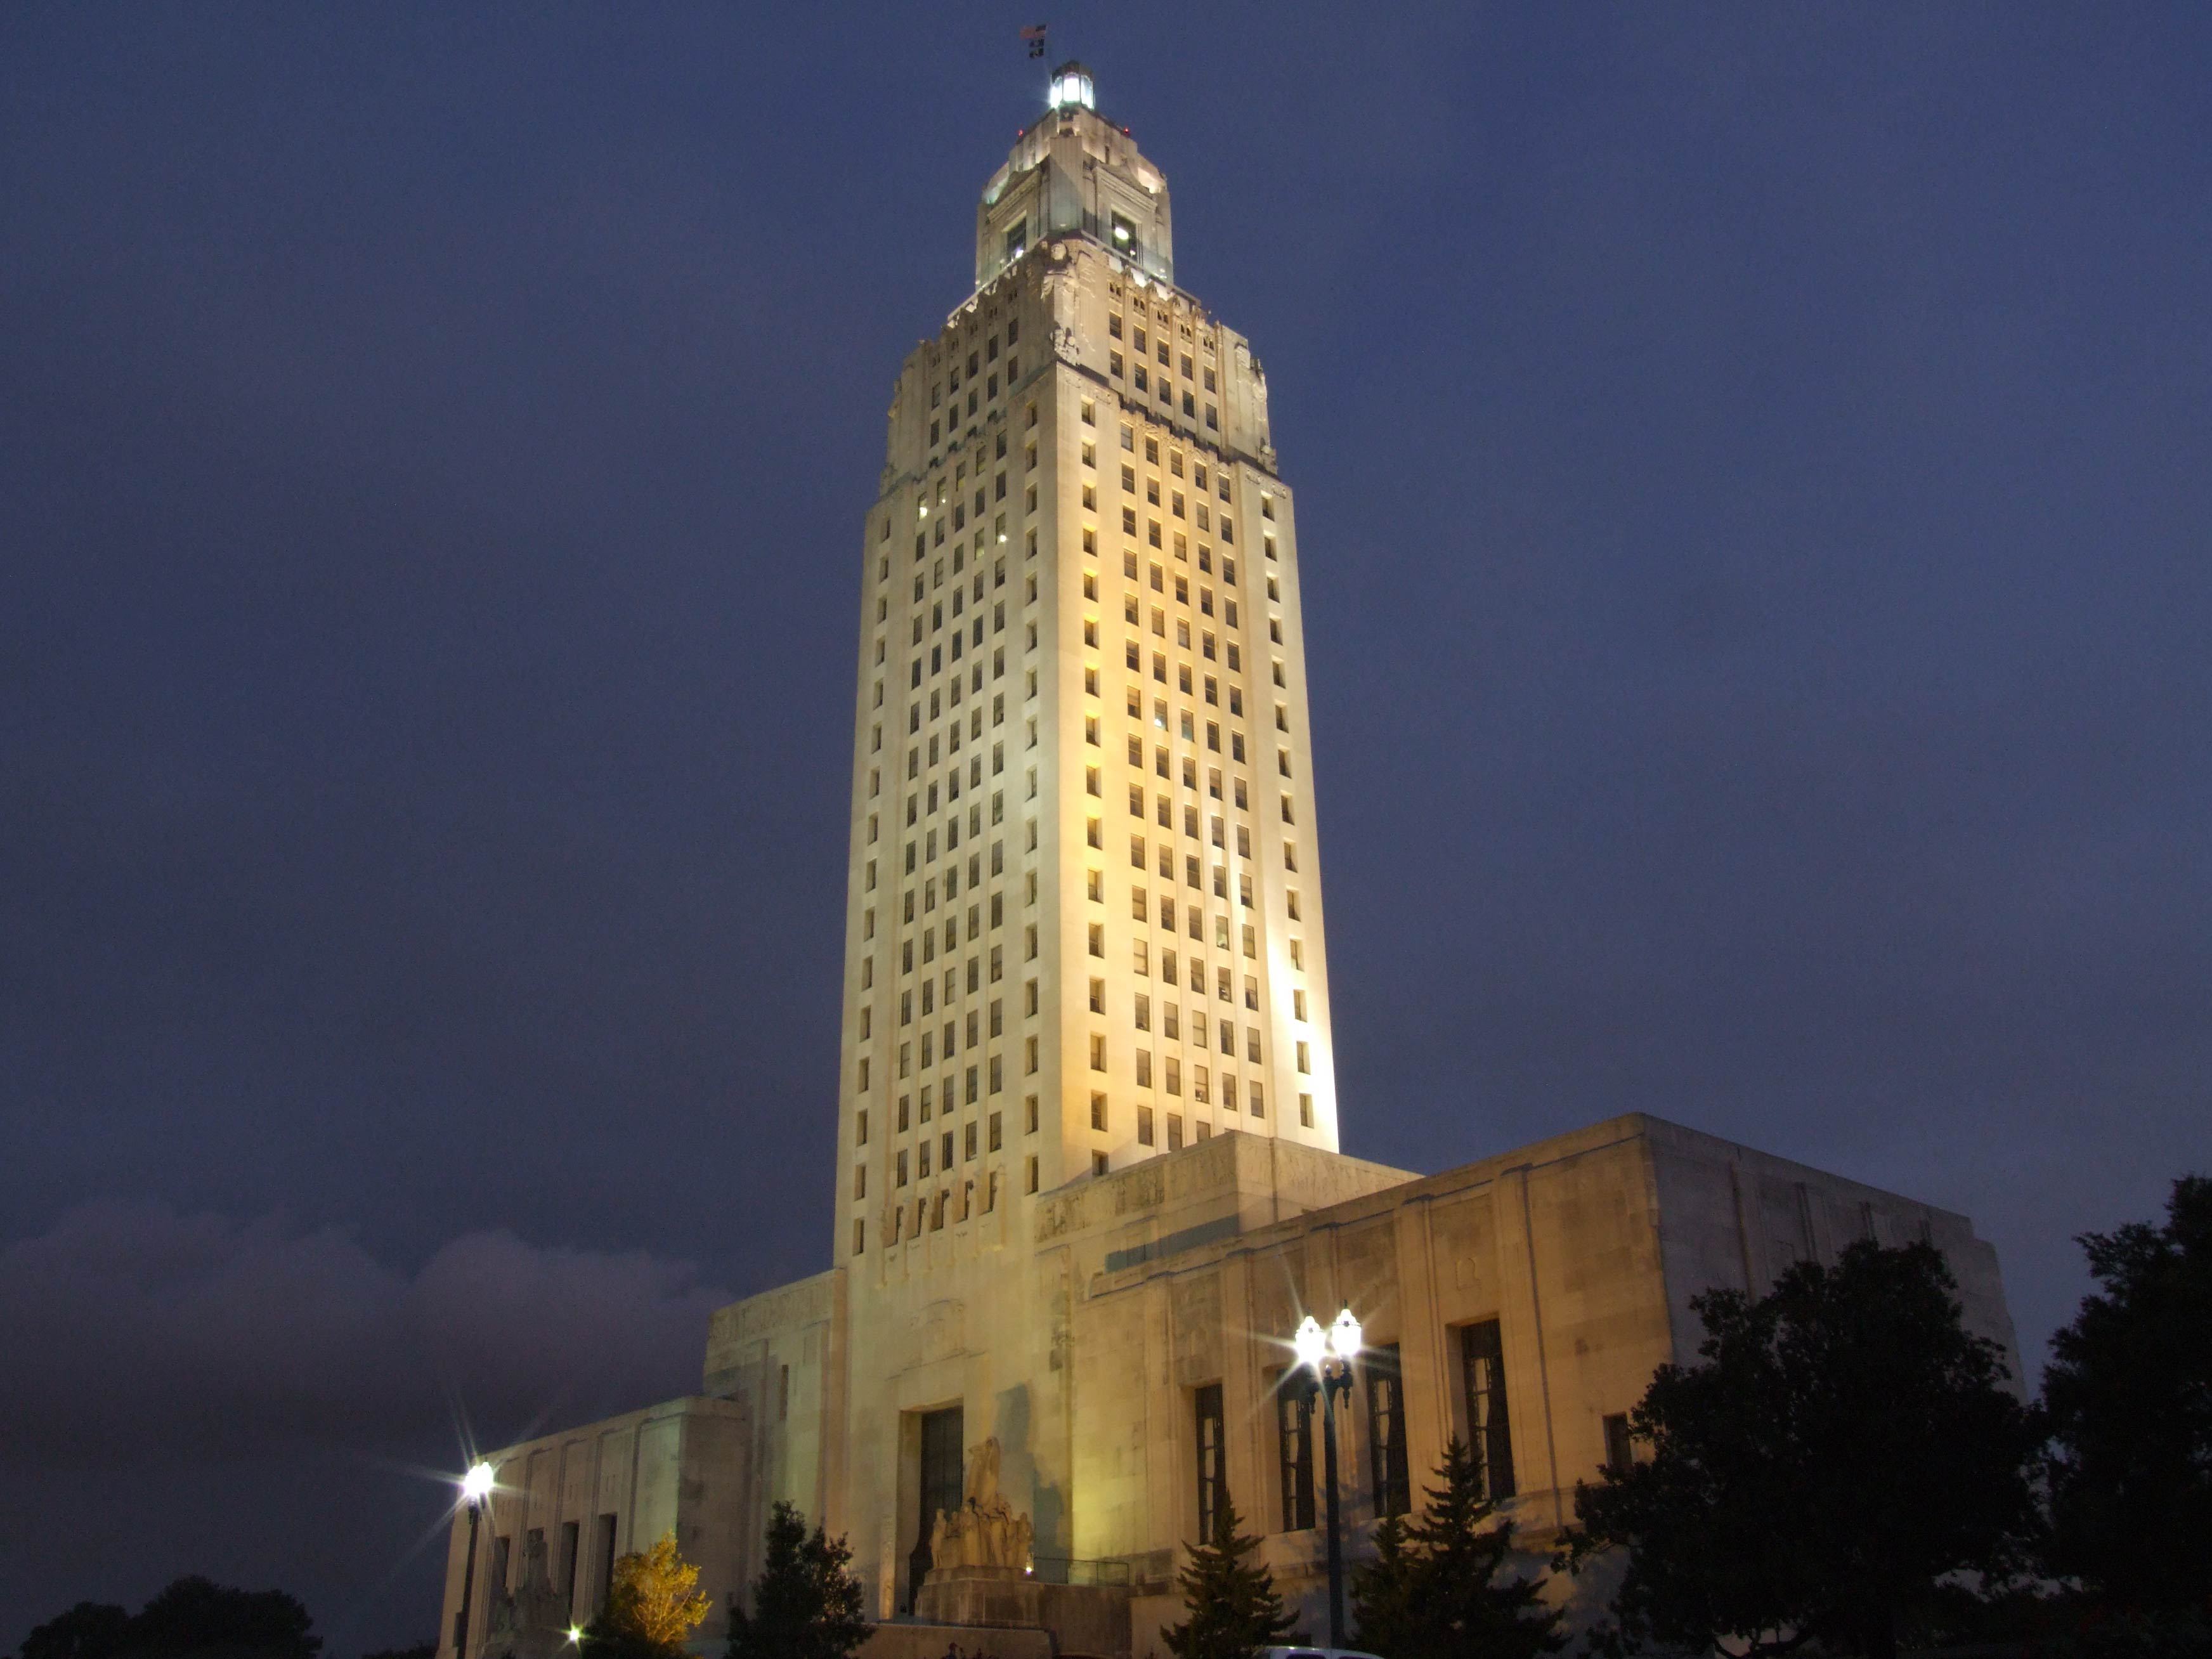
Louisiana State Capitol building, Baton Rouge
Section 2: What Is Geography?

Slide 3
Section 2: What is Geography?
Essential Question
  What is the importance of studying relationships between people and their environment?

Slide 4
Section 2: What is Geography?
What terms do I need to know?
  geography
  environment
  absolute location
  latitude
  longitude
  relative location
  human geography
  physical geography
  geographer

Slide 5
What is Geography?
Geography is the study of the physical features that describe places on Earth and how people make decisions about how to adapt to their environment (surroundings).
The study of geography can be described by five themes, which help us ask and answer questions about our world.
These themes are location, place, human/environment interaction, movement, and regions.

Slide 6
Location: Position on Earth’s Surface
Location describes where a place is on Earth.
Absolute location uses latitude (an imaginary line that measures a location’s distance north or south of the equator) and longitude (an imaginary line that measures a location’s distance east or west of the prime meridian) to find the exact location of a place on Earth.
Relative location is a location described by where it is in relation, or compared, to somewhere else.

Slide 7
Place: Physical and Human Characteristics
All places have physical and human characteristics that make them unique.
Places defined by human geography characteristics include languages spoken, customs practiced, and belief systems.
Places described by physical geography characteristics include landforms, climate, vegetation, and other natural characteristics.
When learning about a place, it is important to understand the relationship between culture and location.

Slide 8
Human/Environment Interaction:
Shaping the Landscape
This theme describes how people make decisions about interacting with their environment and how the environment responds.
People may clear land for farming or housing, redirect water sources, and so on, but this can cause erosion to wash away fertile soil and cause animals and plants to lose their habitats.
There can be short-term and long-term consequences to decisions humans make about how they choose to live in their environment.

Slide 9
Movement: People and Ideas Travel
Movement is when people, goods, and ideas travel from one location to another.
Major examples of movement in history have been European explorers, the invention of airplanes, and the creation of the Internet.
Today, goods and people can move freely and quickly around the world thanks to advancements in movement.

Slide 10
Regions: How They Form and Change
Regions are areas with distinctive human and/or physical characteristics that are united by the presence of some common characteristic.
It is important to remember that regions are not the same as countries.
Regions usually involve an area that includes partial or whole countries or can be found across more than one country.
These could include plains, mountains, farms, and so on.

Slide 11
Inquiry
Learning geography means learning to ask and answer questions like a geographer, a person who is an expert on the physical features of Earth and its atmosphere.
Geographers also study ways that humans affect, and are affected by, these features.
Geographers ask various kinds of questions such as where an event took place, how the location affected the event, and so on.

Slide 12
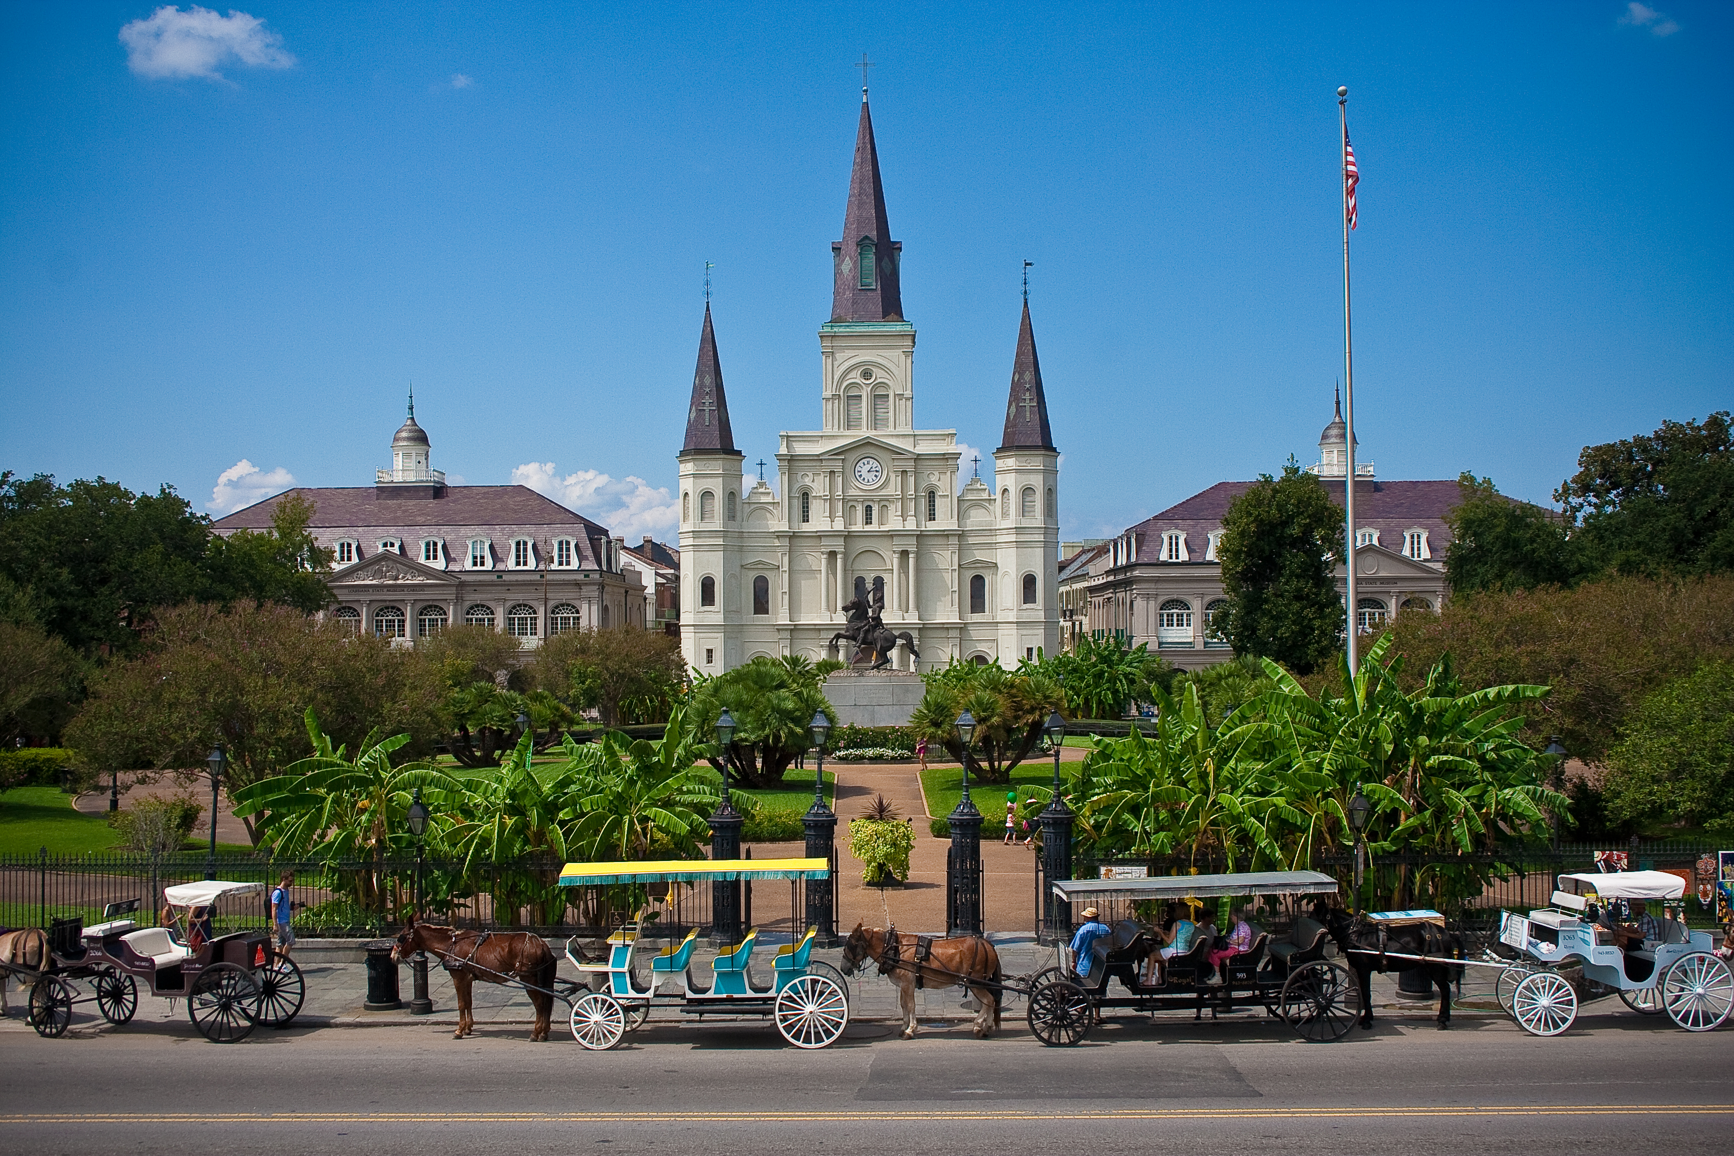
St. Louis Cathedral, New Orleans
Image Credits
Slide 1: jc.winkler, https://creativecommons.org/licenses/by/2.0/deed.en, Wikimedia Commons
Slide 2: Bluepoint951, https://creativecommons.org/licenses/by-sa/2.5/deed.en, Wikimedia Commons
Final Slide: Royalpt78, https://creativecommons.org/licenses/by-sa/3.0/deed.en, Wikimedia Commons
Return to Main Menu

