Slide 1
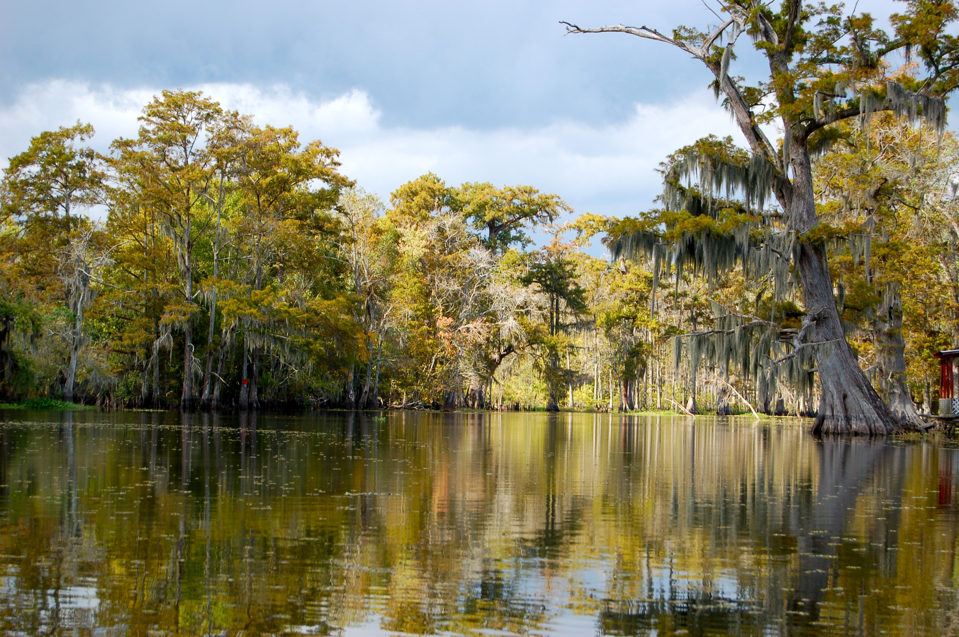
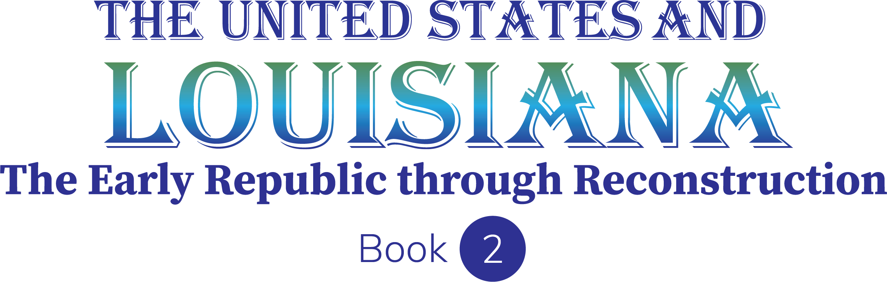
Chapter 1: Inquiry and the Social Studies
STUDY PRESENTATION
© 2023 Clairmont Press

Slide 2
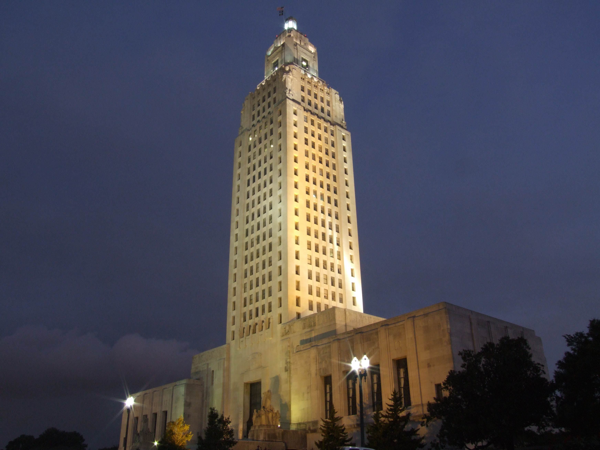
Louisiana State Capitol building, Baton Rouge
Section 3: What Is Political Science?

Slide 3
Section 3: What is Political Science?
Essential Question
  Why do people study government?

Slide 4
Section 3: What is Political Science?
What terms do I need to know?
  political science
  politics
  government
  political scientist

Slide 5
What is Political Science?
Political science is the study of governments and how they are organized.
Understanding different types of government can help people understand how governments make decisions and how those choices affect citizens.
Political science has three main parts: civic life, politics, and government.

Slide 6
Civic Life
Civic (public) life is the part of your life you live out in the world, while going to school, shopping, participating in a sporting event, or going to church.
Personal life is that part of your life you spend alone or with your family.
Civic life looks at how citizens’ decisions affect the local community, while private or personal life includes decisions that people make about their own personal interests.

Slide 7
Politics
Politics is a process through which every social group reaches decisions that are agreed to and enforced, and they can help people reach goals not achievable by themselves.
Many people see politics negatively and avoid it, but it is a necessary part to any community.
It is through politics that voices can be heard and issues can be debated, and citizens can have an active role in their communities and governments.

Slide 8
Government
Government is made up of the people and institutions in a society that have the authority to make, carry out, and enforce laws, as well as settle disputes.
Most government decisions are focused on the distribution of resources, how to share (or fairly distribute) benefits and burdens, and how to manage conflict.

Slide 9
It is important for citizens to understand that people have different opinions and views about civic life, politics, and government.
Citizens must be able to make informed, or educated, decisions about their government and what their government should and should not do.
Citizens must also be able to make decisions about how they live their lives together and how they can support the proper use of power by the government.
An important part of citizenship education is understanding the relationship between historical events and government.

Slide 10
In this textbook, you will learn about the purposes and functions of government at the start of the new nation of the United States.
Your study will examine the power, duties, and responsibilities exercised at each level of government, as well as actions in the three branches of government.
This knowledge will help you understand the rights and responsibilities of citizens in a democracy and the importance of being an active citizen in your country.

Slide 11
Inquiry
Learning geography means learning to ask and answer questions like a political scientist, a person who is an expert in the study of government and politics.
Political scientists ask various questions, such as who leaders were, how they were chosen, the rules or laws at play, and so on.

Slide 12
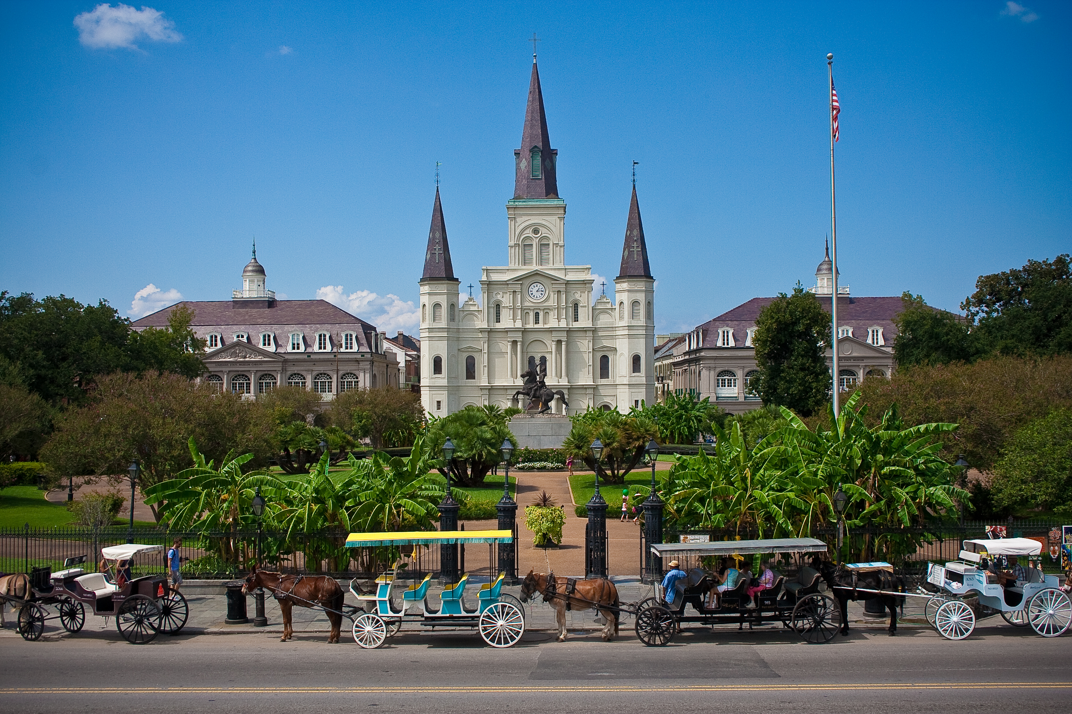
St. Louis Cathedral, New Orleans
Image Credits
Slide 1: jc.winkler, https://creativecommons.org/licenses/by/2.0/deed.en, Wikimedia Commons
Slide 2: Bluepoint951, https://creativecommons.org/licenses/by-sa/2.5/deed.en, Wikimedia Commons
Final Slide: Royalpt78, https://creativecommons.org/licenses/by-sa/3.0/deed.en, Wikimedia Commons
Return to Main Menu

