Slide 1


Chapter 1: Inquiry and the Social Studies
STUDY PRESENTATION
© 2023 Clairmont Press

Slide 2

Louisiana State Capitol building, Baton Rouge
Section 4: What Is Economics?

Slide 3
Section 4: What is Economics?
Essential Question
  What role do scarcity and specialization play in trade?

Slide 4
Section 4: What is Economics?
What terms do I need to know?
  economics
  scarcity
  trade
  specialization
  economist

Slide 5
What is Economics?
Economics is the study of how decisions are made about how to allocate/distribute limited resources to satisfy our unlimited wants.
Individuals, groups, and societies all experience scarcity (the situation that exists when there is unlimited demand but not enough supply of a good or service).
Effective decision-making requires a person to compare the additional costs of alternatives, or choices, with the additional benefits.

Slide 6
Trade
Trade, or the voluntary exchange of goods and services among people and countries, occurs as a result of scarcity and specialization.
Specialization occurs when a person, business, or country focuses on producing the goods and services they can make best and trading for what they are unable to produce.
Scarcity and specialization lead to trade among individuals/organizations within the same or different countries.

Slide 7
Production, Distribution, and Consumption
Production use resources to create goods or services, and a manufacturing leap in the 19th century revolutionized the production of many goods.
Distribution involves transporting goods from where they are produced to a market, and various inventions and improvements of the 19th century related to travel increased the delivery speed of goods.
Consumption is the use of goods and services by consumers, and the overall wealth of the United States increased in the 19th century, allowing for increased demand of goods and services.

Slide 8
Production, Distribution, and Consumption
Social studies is more than just one subject in school.
It brings together experts from at least four areas:
  history
  geography
  political science
  economics
You will have a better understanding of our past, present, and future when studying Louisiana and the United States from these points of view.

Slide 9
Inquiry
Learning geography means learning to ask and answer questions like an economist, a person who is an expert on the choices people and societies make about production, distribution, and consumption of goods and services.
Economists ask various kinds of questions such as what is produced, how do people satisfy their wants and needs, and how are scare resources used.

Slide 10
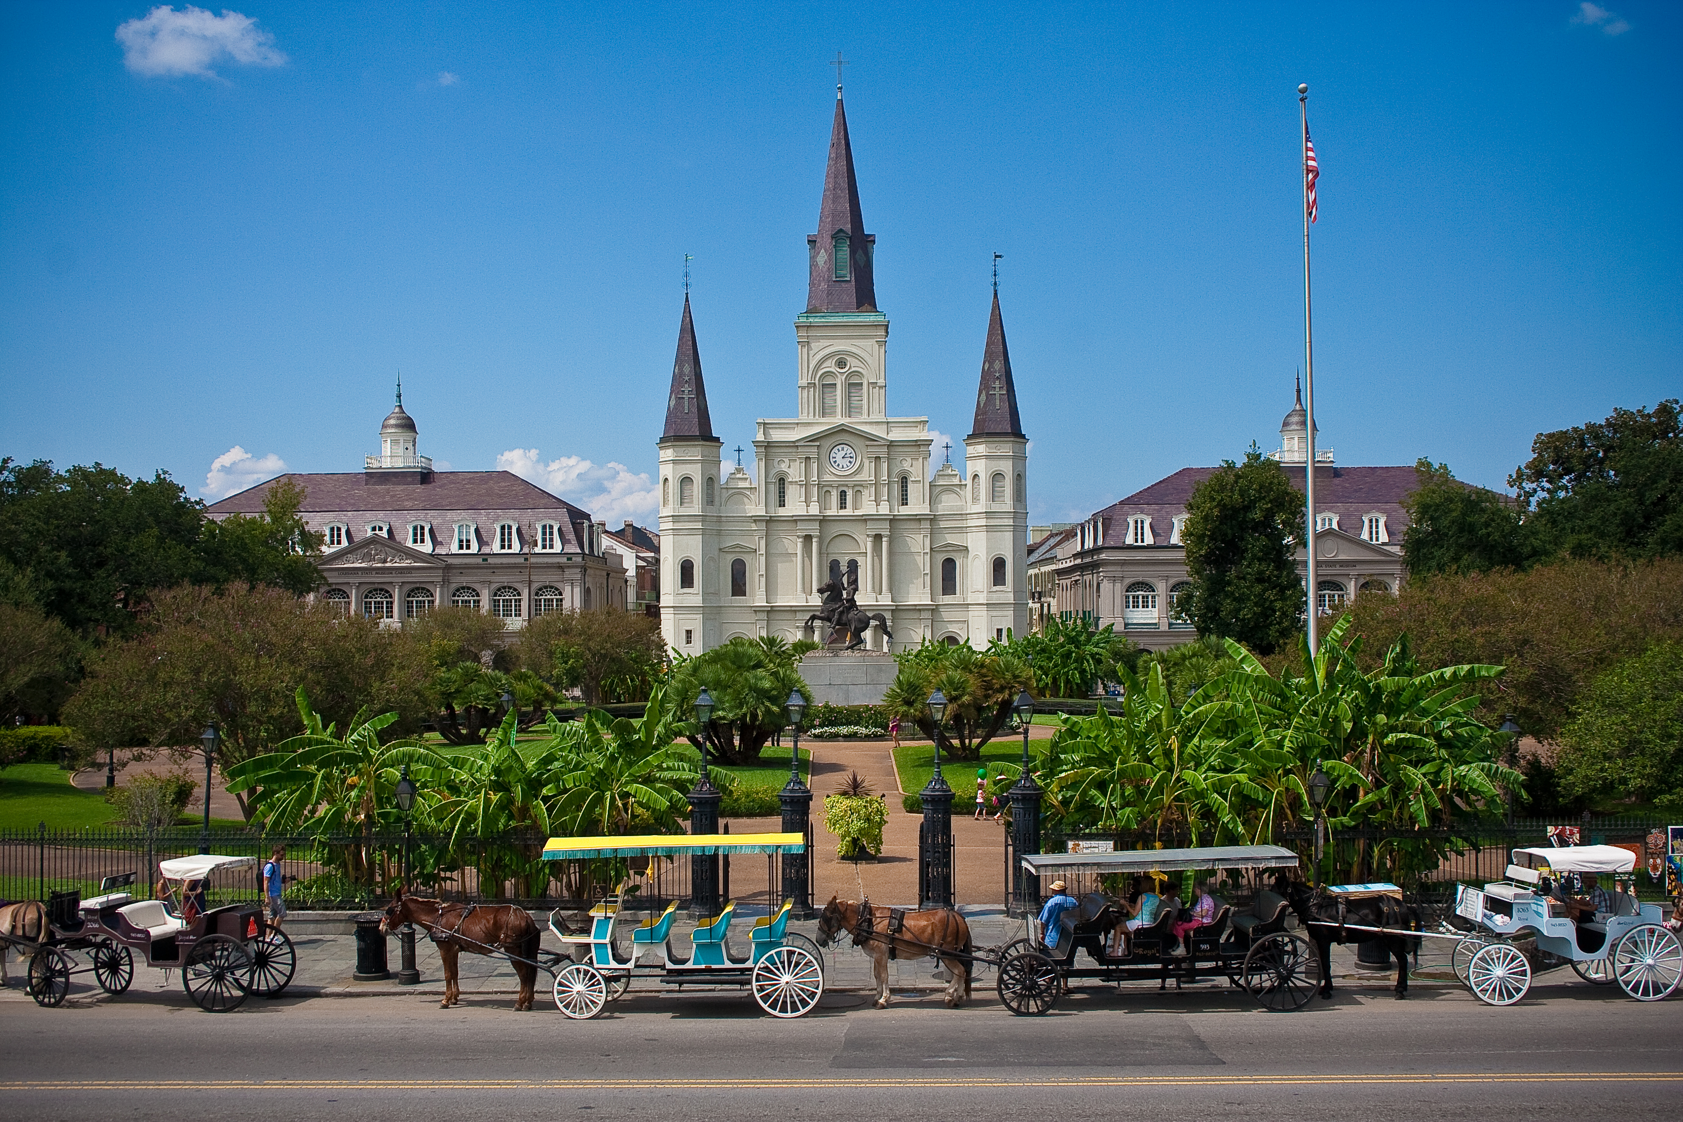
St. Louis Cathedral, New Orleans
Image Credits
Slide 1: jc.winkler, https://creativecommons.org/licenses/by/2.0/deed.en, Wikimedia Commons
Slide 2: Bluepoint951, https://creativecommons.org/licenses/by-sa/2.5/deed.en, Wikimedia Commons
Final Slide: Royalpt78, https://creativecommons.org/licenses/by-sa/3.0/deed.en, Wikimedia Commons
Return to Main Menu

