Slide 1
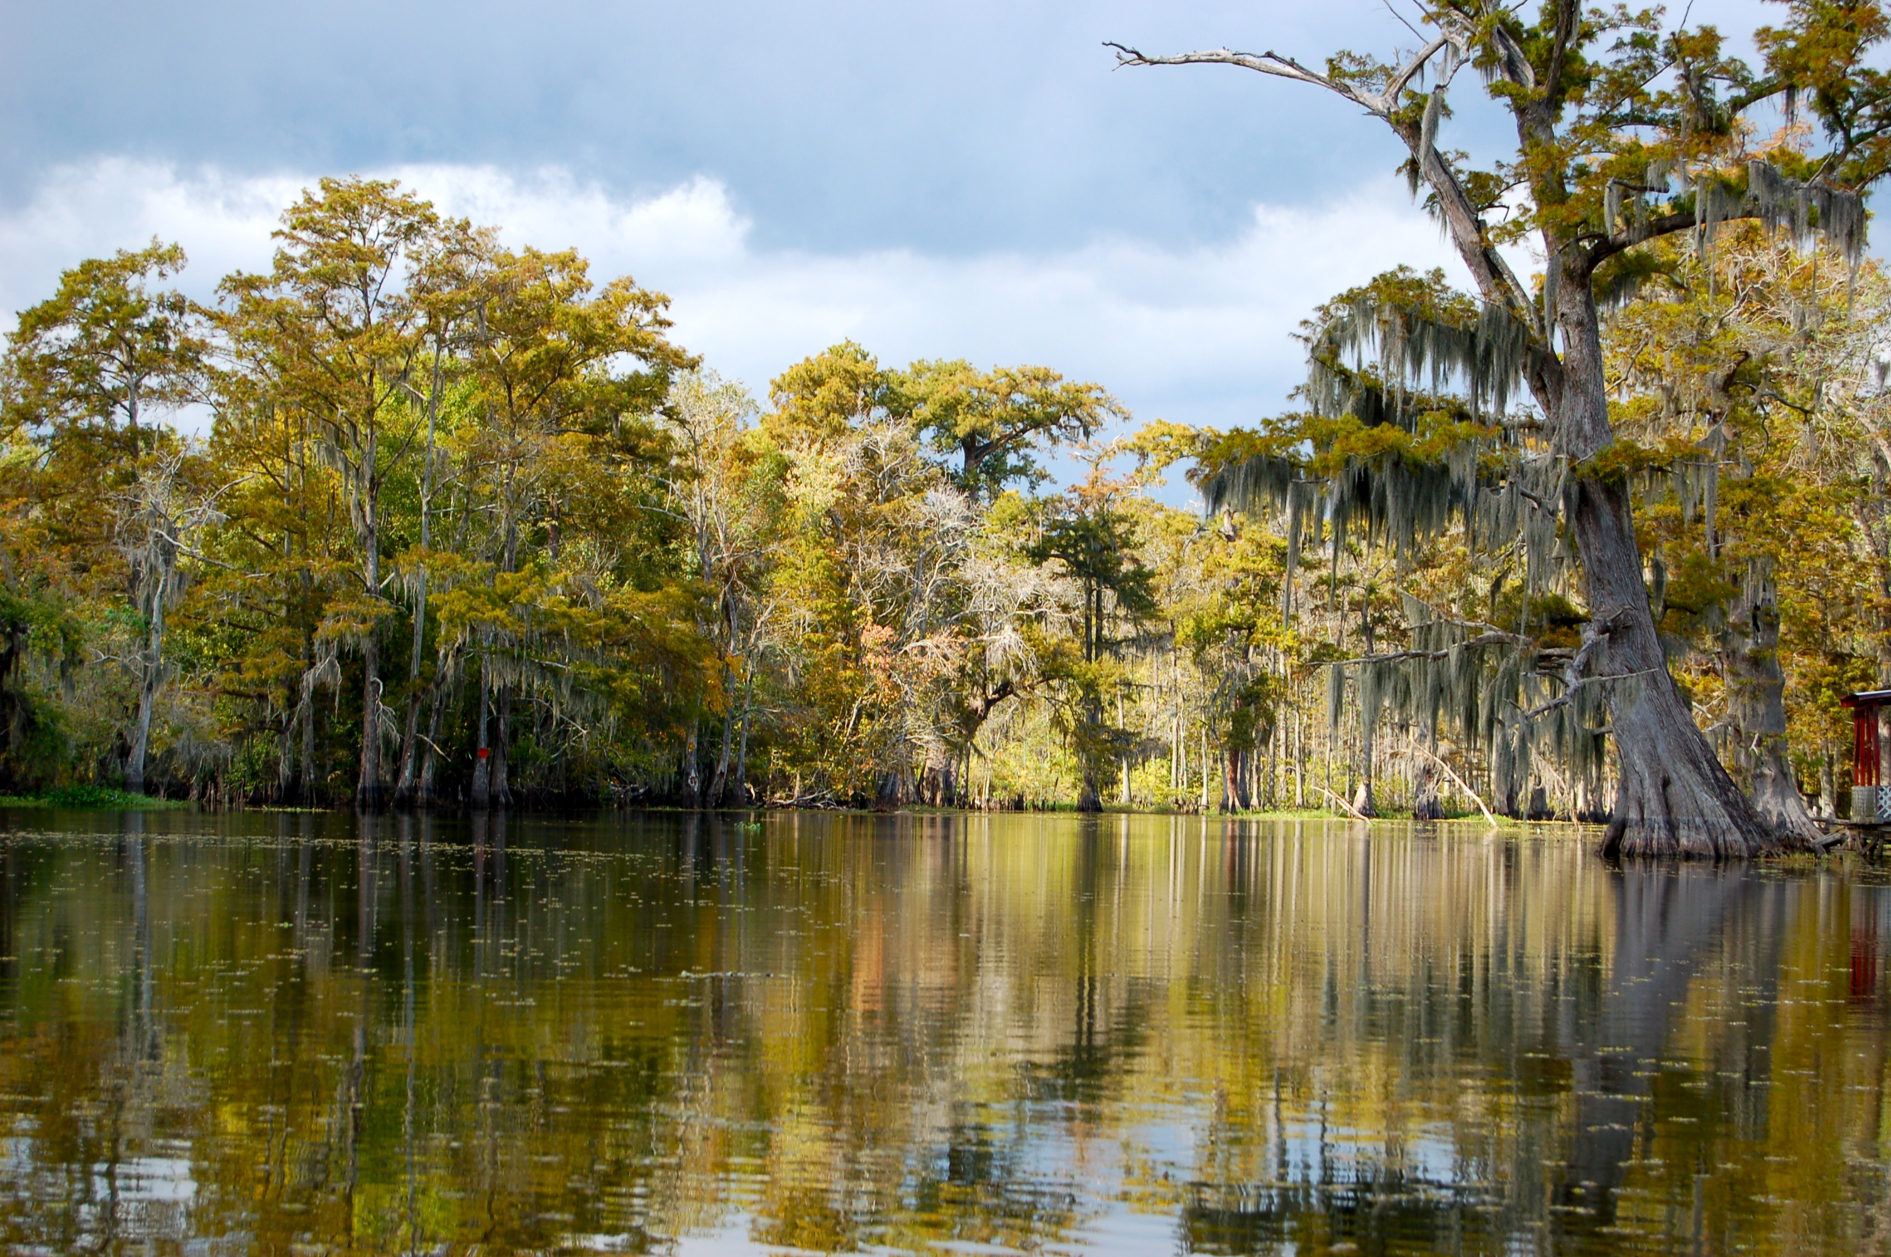

Chapter 7: A Growing Young Nation
STUDY PRESENTATION
© 2023 Clairmont Press

Slide 2
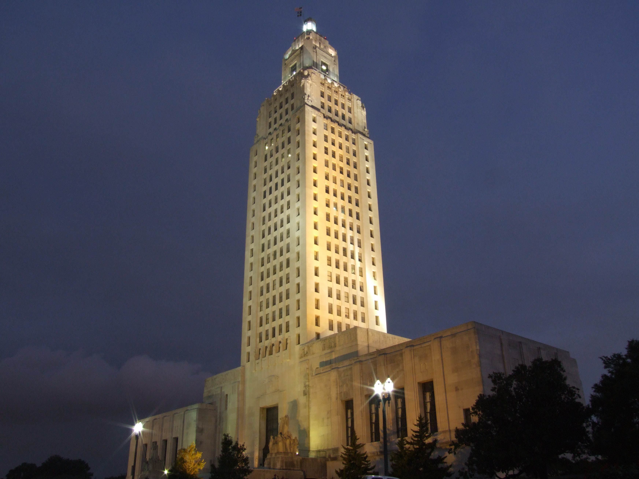
Louisiana State Capitol building, Baton Rouge
Section 2: The Louisiana Purchase

Slide 3
Section 2: The Louisiana Purchase
Essential Question
  What was the constitutional problem Jefferson faced with the Louisiana Purchase?

Slide 4
Section 2: The Louisiana Purchase
What terms do I need to know?
  Treaty of San Ildefonso
  yellow fever
  Louisiana Purchase
  Adams-Onís Treaty

Slide 5
The Louisiana Purchase
Migrants began pouring into Louisiana after 1787, and they started to depend on the Mississippi River as a trade route.
The Americans and Spanish disagreed about the borders that separated Spanish and American claims.
The Spanish were sometimes blocked American citizens wanting to use the New Orleans port, which they used to transport goods out of the middle territories and to the rest of the world.

Slide 6
International Events and Intrigue
By 1794, France had abolished slavery at home and in its colonies, but there was a rebellion in its most profitable colony, Saint-Domingue.
Napoleon planned to reestablish slavery on the island and use the profits to pay for his military campaigns.
Napoleon also wanted to reestablish control over Louisiana and use it to grow the food supply for the French Empire.

Slide 7
International Events and Intrigue Pt. 2
One month after signing the Convention of 1800 with the United States, Napoleon secretly reclaimed Louisiana in the Treaty of San Ildefonso with Spain.
Napoleon then sent more than 30,000 soldiers to Saint-Domingue to reestablish slavery.
However, more than 80% of his soldiers died to yellow fever (a disease that causes fever and yellowing of the skin) within a few weeks.
With this disastrous turn of events, Napoleon abandoned his plans and decided he no longer benefited from the possession of Louisiana.

Slide 8
The Louisiana Purchase
Hearing rumors about the transfer of Louisiana’s ownership, Jefferson sent James Monroe and Robert Livingston to France to negotiate the purchase of New Orleans.
Unaware that Napoleon’s plans for the west had changed, Livingston and Monroe were shocked when they were offered to purchase both New Orleans AND all of Louisiana.

Slide 9
The Louisiana Purchase Pt. 2
They were not authorized by Jefferson to make such an expensive purchase.
Because slow communication meant they could not ask for permission quickly, Monroe and Livingston were in a tough position.
After deliberation, they went ahead and accepted the offer to purchase all of Louisiana for $15 million.

Slide 10
The Treaty
The terms of the treaty were sent to Washington, DC, for approval.
Jefferson, believing such a purchase was in the country’s best interests, pushed for quick approval of the terms.
The Senate ratified the treaty for the Louisiana Purchase (the purchase of the Louisiana Territory) on October 19, 1803.

Slide 11
Two Transfers
Two transfers had to take place in New Orleans to finalize the process.
Spain transferred control of Louisiana to Napoleon’s representative in New Orleans in November 1803.
The representative, Pierre Clément de Laussat, acted as governor for only three weeks before transferring Louisiana to the United States in December 1803, marking a new era in the nation’s history.

Slide 12
The Territory
The Adams-Onís Treaty, a treaty establishing the border between Spanish and American claims signed in 1819, specified the United States added roughly 530,000,000 acres to the nation’s territory.
The United States spent approximately 4 cents an acre on the Louisiana Purchase.
With the addition of so much land so fast, the United States went from a small, young nation to a potential world power.

Slide 13
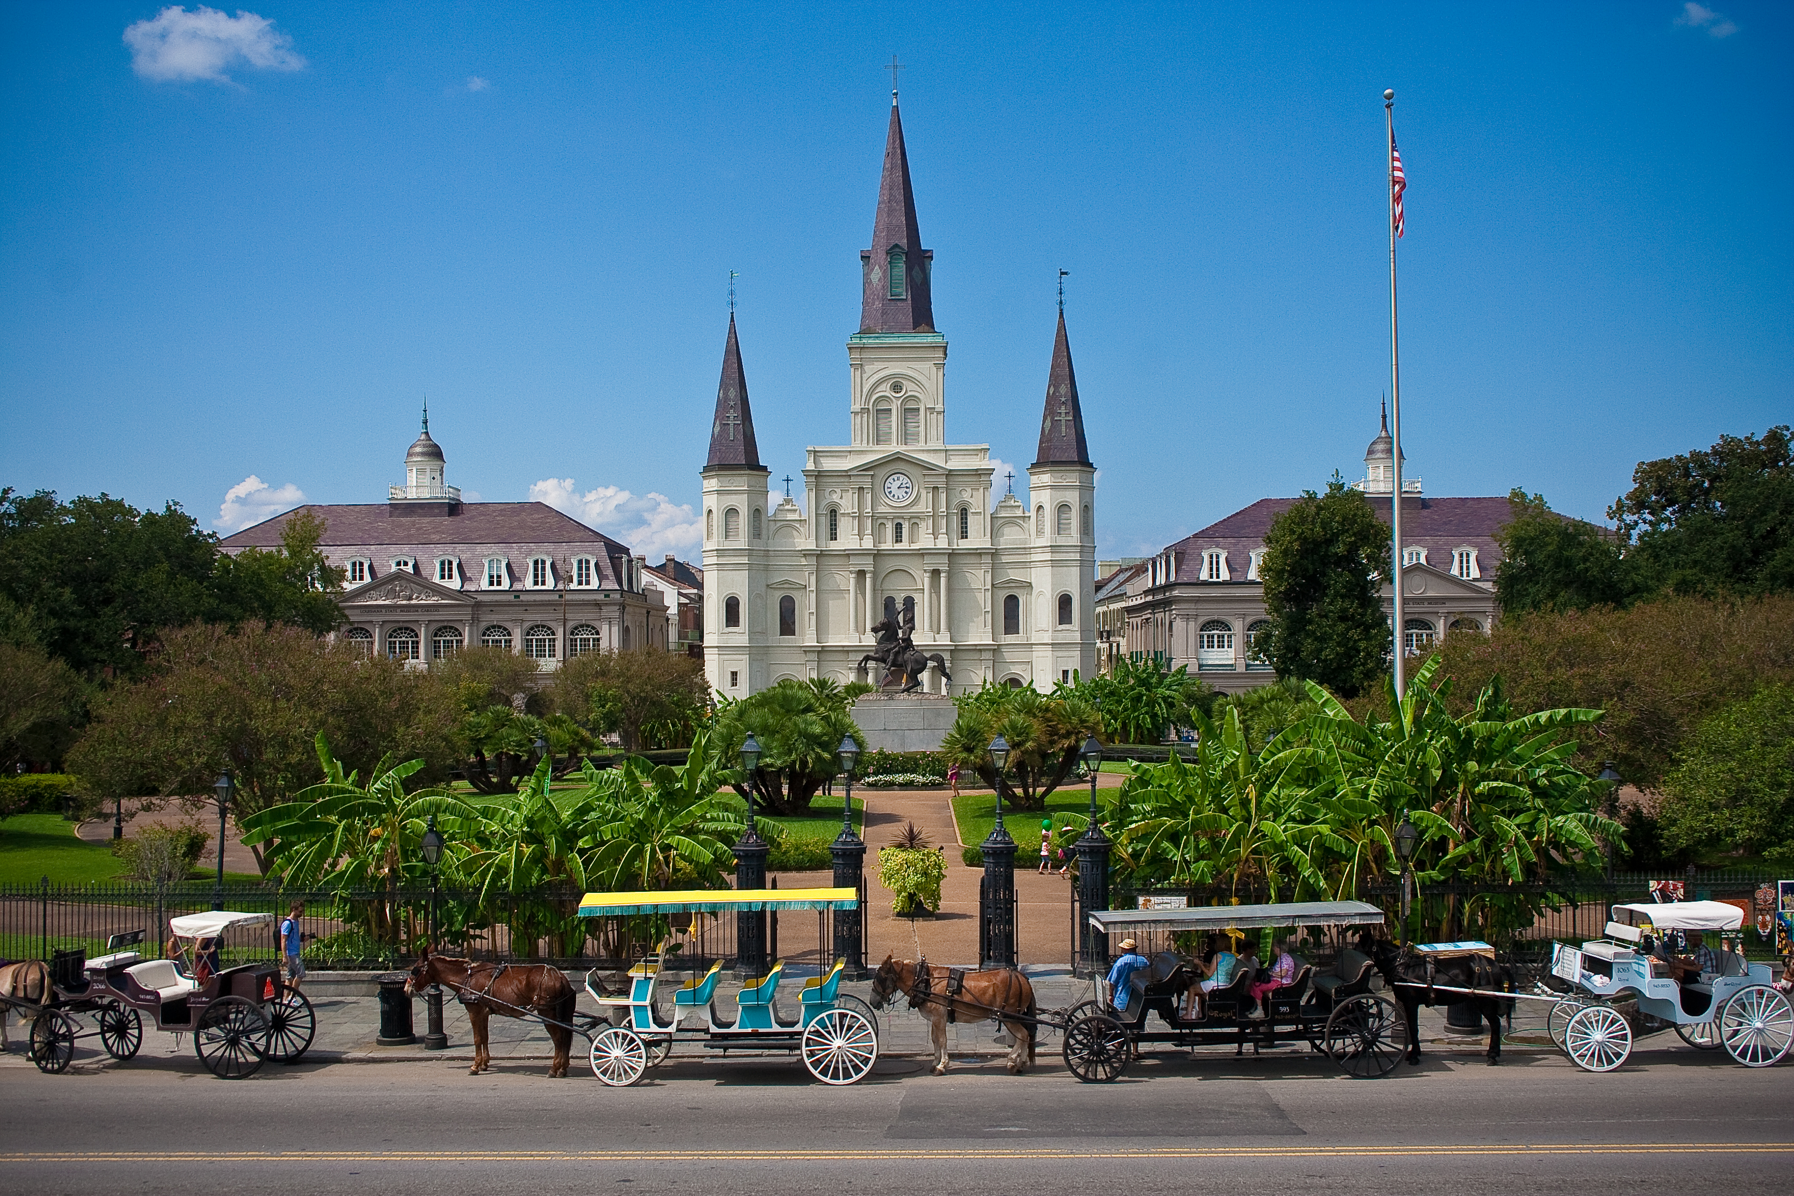
St. Louis Cathedral, New Orleans
Image Credits
Slide 1: jc.winkler, https://creativecommons.org/licenses/by/2.0/deed.en, Wikimedia Commons
Slide 2: Bluepoint951, https://creativecommons.org/licenses/by-sa/2.5/deed.en, Wikimedia Commons
Final Slide: Royalpt78, https://creativecommons.org/licenses/by-sa/3.0/deed.en, Wikimedia Commons
Return to Main Menu

