Slide 1
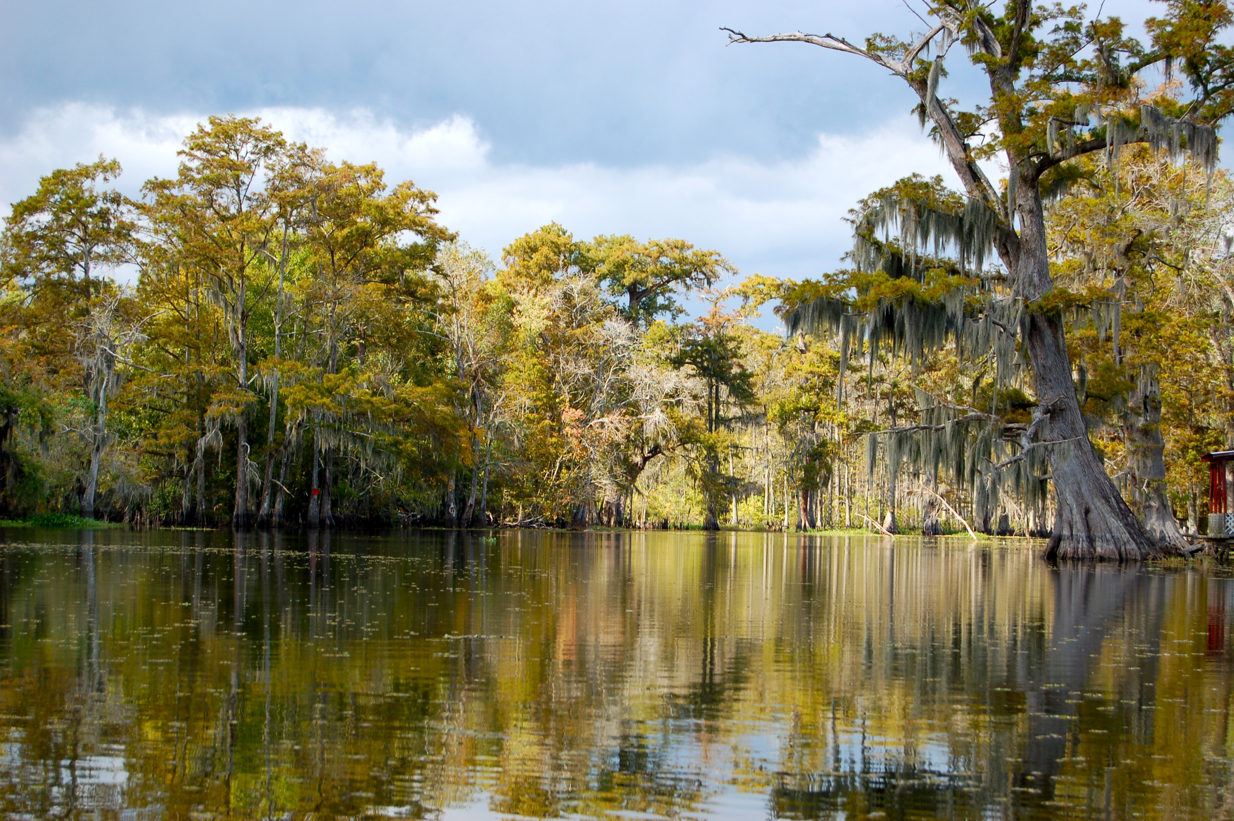

Chapter 7: A Growing Young Nation
STUDY PRESENTATION
© 2023 Clairmont Press

Slide 2
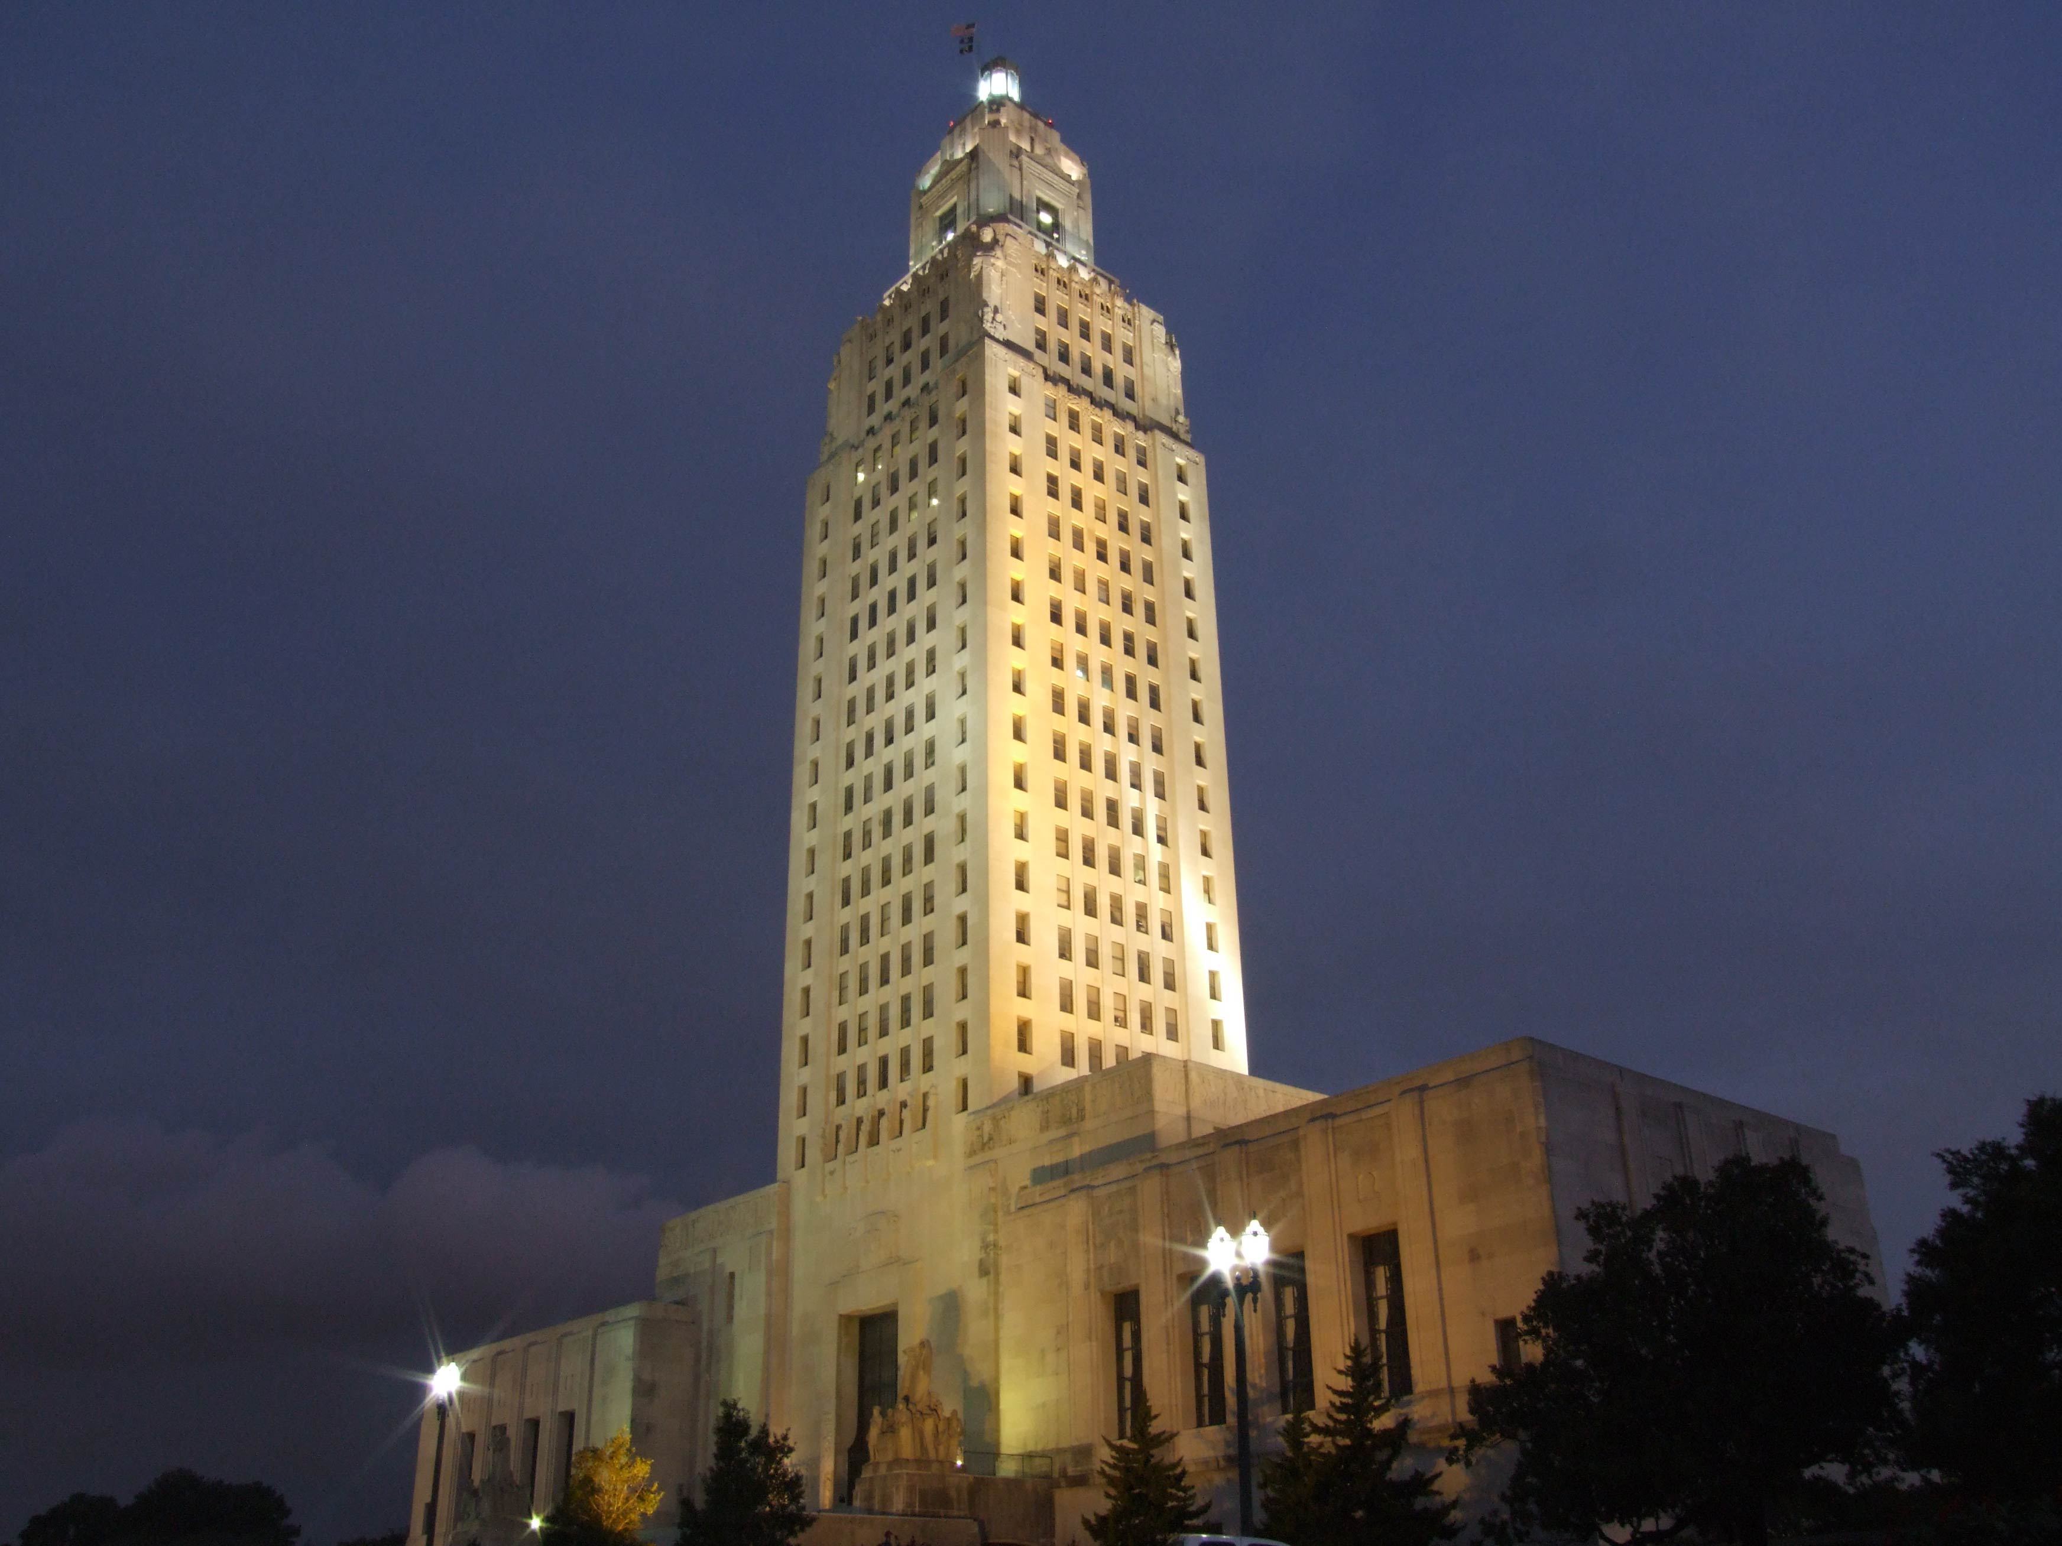
Louisiana State Capitol building, Baton Rouge
Section 4: Exploring the Louisiana Purchase

Slide 3
Section 4: Exploring the Louisiana
Purchase
Essential Question
  What were the challenges of exploring the Red River?

Slide 4
Section 4: What is Economics?
What terms do I need to know?
  Corps of Discovery
  pirogue
  flotilla

Slide 5
The Lewis and Clark Expedition
In 1803, Jefferson asked Congress to fund an expedition explore the land to the Pacific Ocean, as he was interested in the West’s geography.
Jefferson asked Meriwether Lewis to lead the exploration party, and Lewis asked retired army friend William Clark to share the command.
In May 1804, the expedition, known as the Corps of Discovery, set out with 45 men in a large keelboat and two smaller pirogues (canoe-shaped boats) on the Missouri River.

Slide 6
The Lewis and Clark Expedition Pt. 2
A year into their journey, the Corps was joined by Toussaint Charbonneau and Sacagawea, who served as guides and interpreters, along with their infant son, Jean Baptiste.
Sacagawea was a Shoshoni and had been raised in the West, and her experience helped guide the group to the Rocky Mountains as well as gain assistance from indigenous people they encountered.
The Corps traveled over 4,000 miles to reach the Pacific Ocean, built a fort in present-day Oregon to spend the winter of 1805.

Slide 7
The Lewis and Clark Expedition Pt. 3
They survived by trading with the nearby Clatsop people, and when the snow in the Rocky Mountains thawed, the Corps headed home.
They returned in September 1806 with journals, maps, and sketches detailing their encounters, and the Corps also claimed the land west of the Rocky Mountains for the United States.
Lewis was later named governor of the Louisiana Territory, and Clark was made the Indian agent for the West and brigadier general of the territory’s militia.

Slide 8
Exploring the Red River
Jefferson wanted another expedition to explore the southwest territory to establish the border between Spanish and American claims.
He also wanted to understand the ecology and geography of the region.
Jefferson’s first choice for the task was scientist William Dunbar of Natchez, Mississippi.
Dunbar asked Dr. George Hunter, a chemist, to assist him in a trial run.

Slide 9
The Dunbar-Hunter Expedition
Due to a possible conflict with the Osage up the Red River, Dunbar and Hunter led a small group up the Ouachita River in present-day Louisiana and Arkansas in October 1804.
The group traveled north to the Ozark Mountains on a three-month journey providing the first written details of the region.
These records provided the scientists with much to study, including the presence of microorganisms in natural hot springs.

Slide 10
The Red River Expedition
A 24-man military team was assembled in 1806 and included an astronomer and surveyor, a medical student, and Captain Richard Sparks, the ranking army officer.
The president tasked the team with exploring and noting details of the Red River, with the goal of finding a trade route to Santa Fe.
The flotilla (fleet of boats) traveled north on the Red River, adding 26 men to the team and encountering a logjam.

Slide 11
The Red River Expedition Pt. 2
Sparks learned from Caddo Indians that a Spanish army was tracking them, and they were confronted at the edge of present-day Oklahoma by a large Spanish army that demanded they turn back.
Jefferson had told the explorers to turn around if they faced a superior force, so the group turned back.
Despite the knowledge gained, the expedition did not accomplish all Jefferson wanted, and the results of the Lewis and Clark Expedition gained far more public interest.

Slide 12
The Pike-Wilkinson Expedition
In 1806, Zebulon Pike, Lieutenant James Wilkinson, and their team were ordered to explore Arkansas, the Red Rivers, and contact various tribes.
Pike’s party left St. Louis up the Missouri River, across the Kansas plains, to a Pawnee village, then along the Santa Fe Trail to the Arkansas River.
Wilkinson, five privates, and an Osage guide then left Pike and the others to explore the river.

Slide 13
The Pike-Wilkinson Expedition Pt. 2
Despite the hazardous winter conditions, Wilkinson’s team safely returned to St. Louis 73 days later, and his journal mentioned Osage villages, native hunting camps, and rich lead mines and salt prairies.
Pike’s team reached the Rocky Mountains, but frostbite, inadequate clothing, and low rations plagued them, and Pike and the survivors were later arrested by a Spanish patrol in 1807.

Slide 14
The Sibley Expedition
George C. Sibley, business agent at Fort Osage, and an Osage guide “San Oreille” were sent by Jefferson in 1811 to locate a rumored “salt mountain,” since salt was important to diets, preserve foods, and tan hides.
They encountered the 20-mile “Grand Saline” salt hills in present-day Kansas and Oklahoma.
About 75 miles northwest of the Grand Saline, they found the “Rock Saline”, deep layers of salt at the bottom of a bluff near the Cimarron River.
Sibley wrote that there was an “inexhaustible store of ready-made salt in the area.”

Slide 15
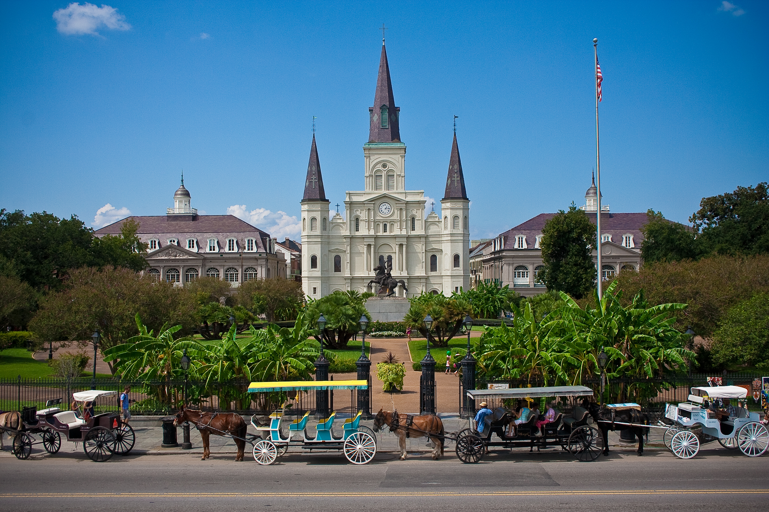
St. Louis Cathedral, New Orleans
Image Credits
Slide 1: jc.winkler, https://creativecommons.org/licenses/by/2.0/deed.en, Wikimedia Commons
Slide 2: Bluepoint951, https://creativecommons.org/licenses/by-sa/2.5/deed.en, Wikimedia Commons
Final Slide: Royalpt78, https://creativecommons.org/licenses/by-sa/3.0/deed.en, Wikimedia Commons
Return to Main Menu

