Slide 1
SMART SKILLS
Week 2 – Charts/Graphs 1
© 2023 Clairmont Press

Slide 2
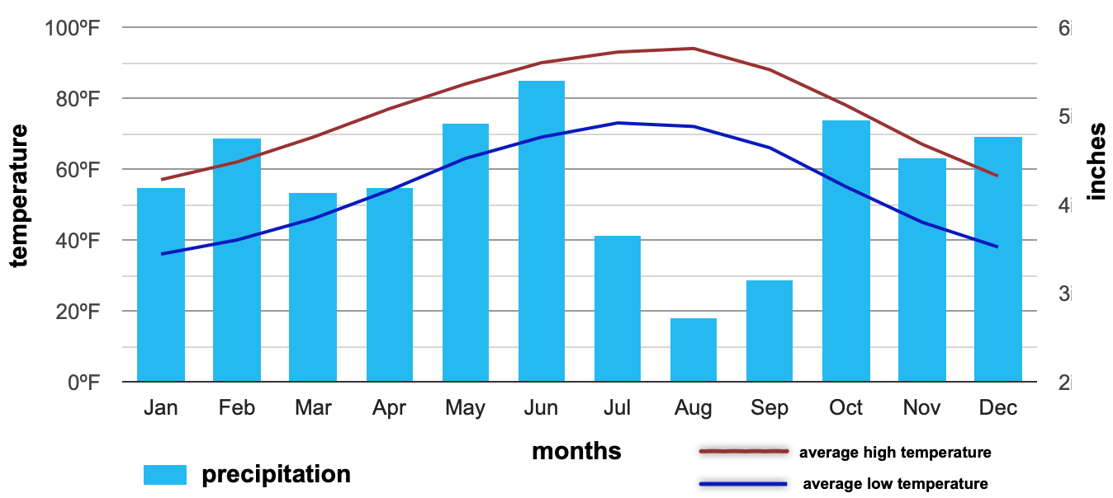
Monday
Climograph for Shreveport, Louisiana
Study the graph. What do you notice? What information is contained on the x-axis and y-axis?
Notes:
Answers will vary. The x-axis represents months; the y-axis shows temperature on the left and inches of precipitation on the right.

Slide 3
Tuesday
Climograph for Shreveport, Louisiana
Based on the graph, what is the average high temperature for Shreveport in summer? What is the average low temperature? When is the driest month? When is the wettest?
Notes:
Average high around 93 degrees; average low around 72 degrees
August is typically the driest month, and June is the wettest.

Slide 4
Wednesday
Climograph for Shreveport, Louisiana
When is the temperature variance the greatest (difference between the average high and average low)? What is the typical temperature variance throughout the year?
Notes:
The greatest variance is in August, although it is almost the same all year at about 20 degrees difference.

Slide 5
Thursday
Climograph for Shreveport, Louisiana
Write a question that could be answered using this climograph. Have another student answer it and check their work. Discuss any errors.
Notes:
Answers will vary. You may want to select some students questions and answers for class discussion.

Slide 6
Friday
Climograph for Shreveport, Louisiana
What type of worker or profession would find this information helpful? How would they use the information? Explain your thinking.
Notes:
Answers may vary but students should be able to explain how they determined which professions would find this information most useful. Examples include farmers, landscapers, power company employees, water department employees, etc.

Slide 7
Image Credits
Title Slide: Old Louisiana State Capitol, Public Domain, Wikimedia Commons
End Slide: Monroe, Louisiana skyline in 2021, by TheLionHasSeen, Uploaded 12 April 2021, Wikimedia Commons

