Slide 1
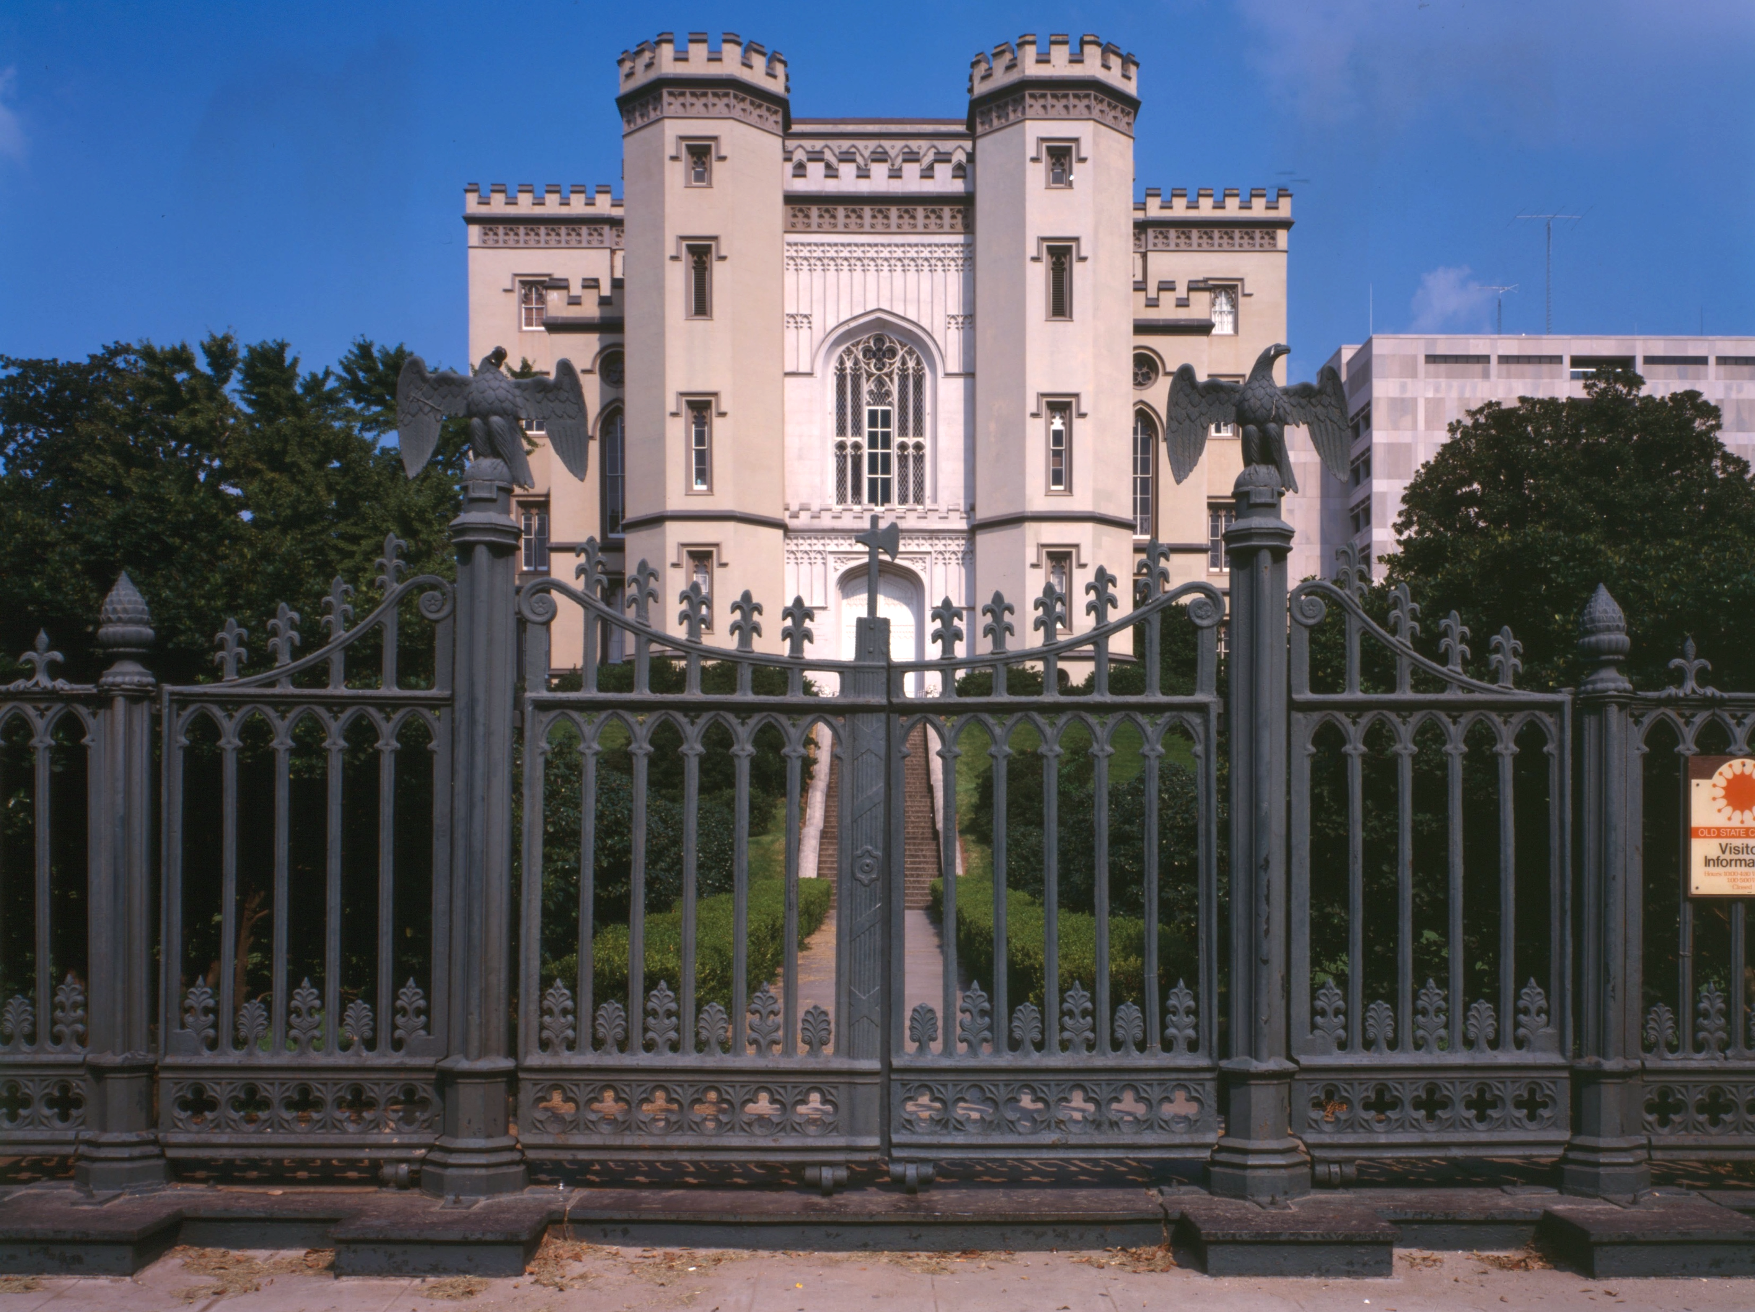

SMART SKILLS
Week 7 – Charts/Graphs 2
© 2023 Clairmont Press

Slide 2
Monday
PARISH | 2020 POPULATION |  | PARISH | 2020 POPULATION |  | PARISH | 2020 POPULATION
Acadia | 57,576 |  | Iberia | 69,929 |  | St. Charles | 52,549
Allen | 22,750 |  | Iberville | 30,241 |  | St. Helena | 10,920
Ascension | 126,500 |  | Jackson | 15,031 |  | St. James | 20,192
Assumption | 21,039 |  | Jefferson | 440,781 |  | St. John the Baptist | 42,477
Avoyelles | 39,693 |  | Jefferson Davis | 32,250 |  | St. Landry | 82,540
Beauregard | 36,549 |  | La Salle | 14,791 |  | St. Martin | 51,767
Bienville | 12,981 |  | Lafayette | 241,753 |  | St. Mary | 49,406
Bossier | 128,746 |  | Lafourche | 97,557 |  | St. Tammany | 264,570
Caddo | 237,848 |  | Lincoln | 48,396 |  | Tangipahoa | 133,157
Calcasieu | 216,785 |  | Livingston | 142,282 |  | Tensas | 4,147
Caldwell | 9,645 |  | Madison | 10,017 |  | Terrebonne | 109,580
Cameron | 5,617 |  | Morehouse | 25,629 |  | Union | 21,107
Catahoula | 8,906 |  | Natchitoches | 37,515 |  | Vermilion | 57,359
Claiborne | 14,170 |  | Orleans (New Orleans) | 383,997 |  | Vernon | 48,750
Concordia | 18,687 |  | Ouachita | 160,368 |  | Washington | 45,463
De Soto | 26,812 |  | Plaquemines | 23,515 |  | Webster | 36,967
East Baton Rouge | 456,781 |  | Pointe Coupee | 20,758 |  | West Baton Rouge | 27,199
East Carroll | 7,459 |  | Rapides | 130,023 |  | West Carroll | 9,751
East Feliciana | 19,539 |  | Red River | 7,620 |  | West Feliciana | 15,310
Evangeline | 32,350 |  | Richland | 20,043 |  | Winn | 13,755
Franklin | 19,774 |  | Sabine | 22,155
Grant | 22,169 |  | St. Bernard | 43,764
  Study the table. What do you notice?
Notes:
Allow students 1-2 minutes to make observations. Answers will vary. Limit discussion to what students OBSERVE.
TEACHER NOTE: One purpose of this lesson is to reinforce number sense. In this year of study, there are many statistics. It’s helpful if students have a frame of reference when making comparisons. For example, in the War of 1812, an estimated 2,260 Americans were killed. That’s about half of the number of people in Tensas Parish. Other useful numbers to remember for comparisons would be the number of students in the school, the number of people in the town, etc.

Slide 3
Tuesday
PARISH | 2020 POPULATION |  | PARISH | 2020 POPULATION |  | PARISH | 2020 POPULATION
Acadia | 57,576 |  | Iberia | 69,929 |  | St. Charles | 52,549
Allen | 22,750 |  | Iberville | 30,241 |  | St. Helena | 10,920
Ascension | 126,500 |  | Jackson | 15,031 |  | St. James | 20,192
Assumption | 21,039 |  | Jefferson | 440,781 |  | St. John the Baptist | 42,477
Avoyelles | 39,693 |  | Jefferson Davis | 32,250 |  | St. Landry | 82,540
Beauregard | 36,549 |  | La Salle | 14,791 |  | St. Martin | 51,767
Bienville | 12,981 |  | Lafayette | 241,753 |  | St. Mary | 49,406
Bossier | 128,746 |  | Lafourche | 97,557 |  | St. Tammany | 264,570
Caddo | 237,848 |  | Lincoln | 48,396 |  | Tangipahoa | 133,157
Calcasieu | 216,785 |  | Livingston | 142,282 |  | Tensas | 4,147
Caldwell | 9,645 |  | Madison | 10,017 |  | Terrebonne | 109,580
Cameron | 5,617 |  | Morehouse | 25,629 |  | Union | 21,107
Catahoula | 8,906 |  | Natchitoches | 37,515 |  | Vermilion | 57,359
Claiborne | 14,170 |  | Orleans (New Orleans) | 383,997 |  | Vernon | 48,750
Concordia | 18,687 |  | Ouachita | 160,368 |  | Washington | 45,463
De Soto | 26,812 |  | Plaquemines | 23,515 |  | Webster | 36,967
East Baton Rouge | 456,781 |  | Pointe Coupee | 20,758 |  | West Baton Rouge | 27,199
East Carroll | 7,459 |  | Rapides | 130,023 |  | West Carroll | 9,751
East Feliciana | 19,539 |  | Red River | 7,620 |  | West Feliciana | 15,310
Evangeline | 32,350 |  | Richland | 20,043 |  | Winn | 13,755
Franklin | 19,774 |  | Sabine | 22,155
Grant | 22,169 |  | St. Bernard | 43,764
  Based on the table, what parish has the most people? Which has the least? What is the population of your parish?
Notes:
East Baton Rouge Parish has the largest population, and Tensas has the smallest.
The answer for the last question is based on school location.

Slide 4
Wednesday
PARISH | 2020 POPULATION |  | PARISH | 2020 POPULATION |  | PARISH | 2020 POPULATION
Acadia | 57,576 |  | Iberia | 69,929 |  | St. Charles | 52,549
Allen | 22,750 |  | Iberville | 30,241 |  | St. Helena | 10,920
Ascension | 126,500 |  | Jackson | 15,031 |  | St. James | 20,192
Assumption | 21,039 |  | Jefferson | 440,781 |  | St. John the Baptist | 42,477
Avoyelles | 39,693 |  | Jefferson Davis | 32,250 |  | St. Landry | 82,540
Beauregard | 36,549 |  | La Salle | 14,791 |  | St. Martin | 51,767
Bienville | 12,981 |  | Lafayette | 241,753 |  | St. Mary | 49,406
Bossier | 128,746 |  | Lafourche | 97,557 |  | St. Tammany | 264,570
Caddo | 237,848 |  | Lincoln | 48,396 |  | Tangipahoa | 133,157
Calcasieu | 216,785 |  | Livingston | 142,282 |  | Tensas | 4,147
Caldwell | 9,645 |  | Madison | 10,017 |  | Terrebonne | 109,580
Cameron | 5,617 |  | Morehouse | 25,629 |  | Union | 21,107
Catahoula | 8,906 |  | Natchitoches | 37,515 |  | Vermilion | 57,359
Claiborne | 14,170 |  | Orleans (New Orleans) | 383,997 |  | Vernon | 48,750
Concordia | 18,687 |  | Ouachita | 160,368 |  | Washington | 45,463
De Soto | 26,812 |  | Plaquemines | 23,515 |  | Webster | 36,967
East Baton Rouge | 456,781 |  | Pointe Coupee | 20,758 |  | West Baton Rouge | 27,199
East Carroll | 7,459 |  | Rapides | 130,023 |  | West Carroll | 9,751
East Feliciana | 19,539 |  | Red River | 7,620 |  | West Feliciana | 15,310
Evangeline | 32,350 |  | Richland | 20,043 |  | Winn | 13,755
Franklin | 19,774 |  | Sabine | 22,155
Grant | 22,169 |  | St. Bernard | 43,764
  How many more people live in East Baton Rouge Parish than West Baton Rouge?
  What is the difference in population between your parish and one that borders it?
Notes:
There were 429,582 more people in East Baton Rouge Parish than West Baton Rouge Parish.
Answers to the second question depend on the school location.

Slide 5
Thursday
PARISH | 2020 POPULATION |  | PARISH | 2020 POPULATION |  | PARISH | 2020 POPULATION
Acadia | 57,576 |  | Iberia | 69,929 |  | St. Charles | 52,549
Allen | 22,750 |  | Iberville | 30,241 |  | St. Helena | 10,920
Ascension | 126,500 |  | Jackson | 15,031 |  | St. James | 20,192
Assumption | 21,039 |  | Jefferson | 440,781 |  | St. John the Baptist | 42,477
Avoyelles | 39,693 |  | Jefferson Davis | 32,250 |  | St. Landry | 82,540
Beauregard | 36,549 |  | La Salle | 14,791 |  | St. Martin | 51,767
Bienville | 12,981 |  | Lafayette | 241,753 |  | St. Mary | 49,406
Bossier | 128,746 |  | Lafourche | 97,557 |  | St. Tammany | 264,570
Caddo | 237,848 |  | Lincoln | 48,396 |  | Tangipahoa | 133,157
Calcasieu | 216,785 |  | Livingston | 142,282 |  | Tensas | 4,147
Caldwell | 9,645 |  | Madison | 10,017 |  | Terrebonne | 109,580
Cameron | 5,617 |  | Morehouse | 25,629 |  | Union | 21,107
Catahoula | 8,906 |  | Natchitoches | 37,515 |  | Vermilion | 57,359
Claiborne | 14,170 |  | Orleans (New Orleans) | 383,997 |  | Vernon | 48,750
Concordia | 18,687 |  | Ouachita | 160,368 |  | Washington | 45,463
De Soto | 26,812 |  | Plaquemines | 23,515 |  | Webster | 36,967
East Baton Rouge | 456,781 |  | Pointe Coupee | 20,758 |  | West Baton Rouge | 27,199
East Carroll | 7,459 |  | Rapides | 130,023 |  | West Carroll | 9,751
East Feliciana | 19,539 |  | Red River | 7,620 |  | West Feliciana | 15,310
Evangeline | 32,350 |  | Richland | 20,043 |  | Winn | 13,755
Franklin | 19,774 |  | Sabine | 22,155
Grant | 22,169 |  | St. Bernard | 43,764
  Write a question that could be answered using this table. Have another student answer it and check their work. Discuss any errors.
Notes:
Answers will vary. You may want to select some students’ questions and answers for class discussion.

Slide 6
Friday
PARISH | 2020 POPULATION |  | PARISH | 2020 POPULATION |  | PARISH | 2020 POPULATION
Acadia | 57,576 |  | Iberia | 69,929 |  | St. Charles | 52,549
Allen | 22,750 |  | Iberville | 30,241 |  | St. Helena | 10,920
Ascension | 126,500 |  | Jackson | 15,031 |  | St. James | 20,192
Assumption | 21,039 |  | Jefferson | 440,781 |  | St. John the Baptist | 42,477
Avoyelles | 39,693 |  | Jefferson Davis | 32,250 |  | St. Landry | 82,540
Beauregard | 36,549 |  | La Salle | 14,791 |  | St. Martin | 51,767
Bienville | 12,981 |  | Lafayette | 241,753 |  | St. Mary | 49,406
Bossier | 128,746 |  | Lafourche | 97,557 |  | St. Tammany | 264,570
Caddo | 237,848 |  | Lincoln | 48,396 |  | Tangipahoa | 133,157
Calcasieu | 216,785 |  | Livingston | 142,282 |  | Tensas | 4,147
Caldwell | 9,645 |  | Madison | 10,017 |  | Terrebonne | 109,580
Cameron | 5,617 |  | Morehouse | 25,629 |  | Union | 21,107
Catahoula | 8,906 |  | Natchitoches | 37,515 |  | Vermilion | 57,359
Claiborne | 14,170 |  | Orleans (New Orleans) | 383,997 |  | Vernon | 48,750
Concordia | 18,687 |  | Ouachita | 160,368 |  | Washington | 45,463
De Soto | 26,812 |  | Plaquemines | 23,515 |  | Webster | 36,967
East Baton Rouge | 456,781 |  | Pointe Coupee | 20,758 |  | West Baton Rouge | 27,199
East Carroll | 7,459 |  | Rapides | 130,023 |  | West Carroll | 9,751
East Feliciana | 19,539 |  | Red River | 7,620 |  | West Feliciana | 15,310
Evangeline | 32,350 |  | Richland | 20,043 |  | Winn | 13,755
Franklin | 19,774 |  | Sabine | 22,155
Grant | 22,169 |  | St. Bernard | 43,764
  What type of worker or profession would find this information helpful? How would they use the information? Explain your thinking.
Notes:
Answers may vary.

Slide 7

Image Credits
Title Slide: Old Louisiana State Capitol, Public Domain, Wikimedia Commons
End Slide: Monroe, Louisiana skyline in 2021, by TheLionHasSeen, Uploaded 12 April 2021, Wikimedia Commons

