Slide 1
SMART SKILLS
Week 6 – Map 2
© 2023 Clairmont Press

Slide 2
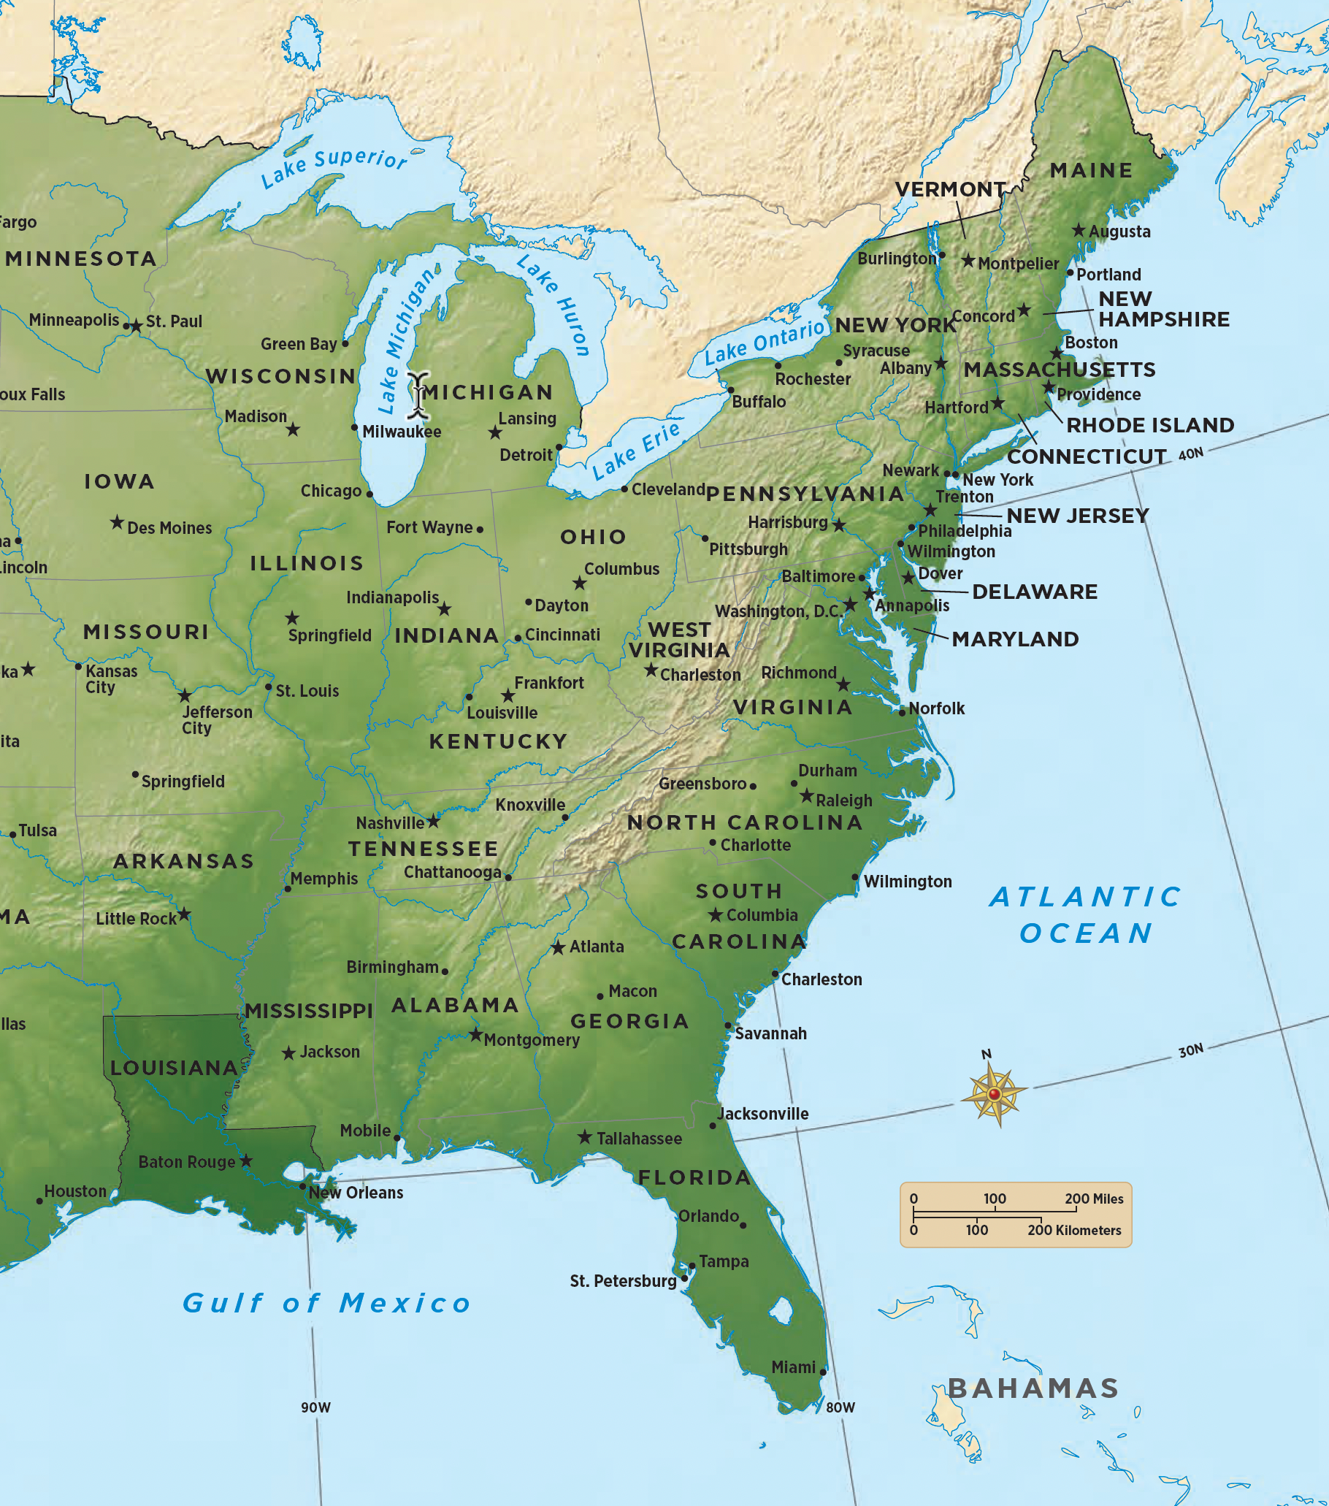
Monday
Study the map. What information on the map would help someone answer questions about the geography of the United States?
Notes:
Allow 1-2 minutes for students to make OBSERVATIONS. Discuss students’ written responses and be sure to discuss the compass rose, the scale of miles, colors used on the map, latitude and longitude, etc.

Slide 3
Tuesday
According to the map, how far is it from New York City to Boston?
What’s the distance from New York City to Philadelphia?
How far is it from New York City to New Orleans?
Notes:
It’s about 200 miles from New York to Boston.
It’s about 80 miles from New York to Philadelphia.
It’s about 1,100 miles from New York to New Orleans.
If students are having difficulty using the map scale, this is a good time for review.

Slide 4
Wednesday
What states border Virginia?
What states border Pennsylvania?
What states border South Carolina?
Notes:
Virginia: Maryland, North Carolina, Tennessee, Kentucky, West Virginia (District of Columbia is not a state, and its borders are not on the map)
Pennsylvania: New York, New Jersey, Delaware, Maryland, West Virginia, Ohio (Lake Erie)
South Carolina: North Carolina, Georgia (Atlantic Ocean)

Slide 5
Thursday
What city is closest to 33°N 80°W?
What city is closest to 39°N 90°W?
Notes:
Charleston, South Carolina
St. Louis, Missouri

Slide 6
Friday
Write a question that could be answered using the map. Share it with another student to answer. Check their work and explain any errors.
Notes:
Answers will vary. You may want to allow some students to ask their questions to the larger group for discussion.

Slide 7
Image Credits
Title Slide: Old Louisiana State Capitol, Public Domain, Wikimedia Commons
End Slide: Monroe, Louisiana skyline in 2021, by TheLionHasSeen, Uploaded 12 April 2021, Wikimedia Commons

