Slide 1
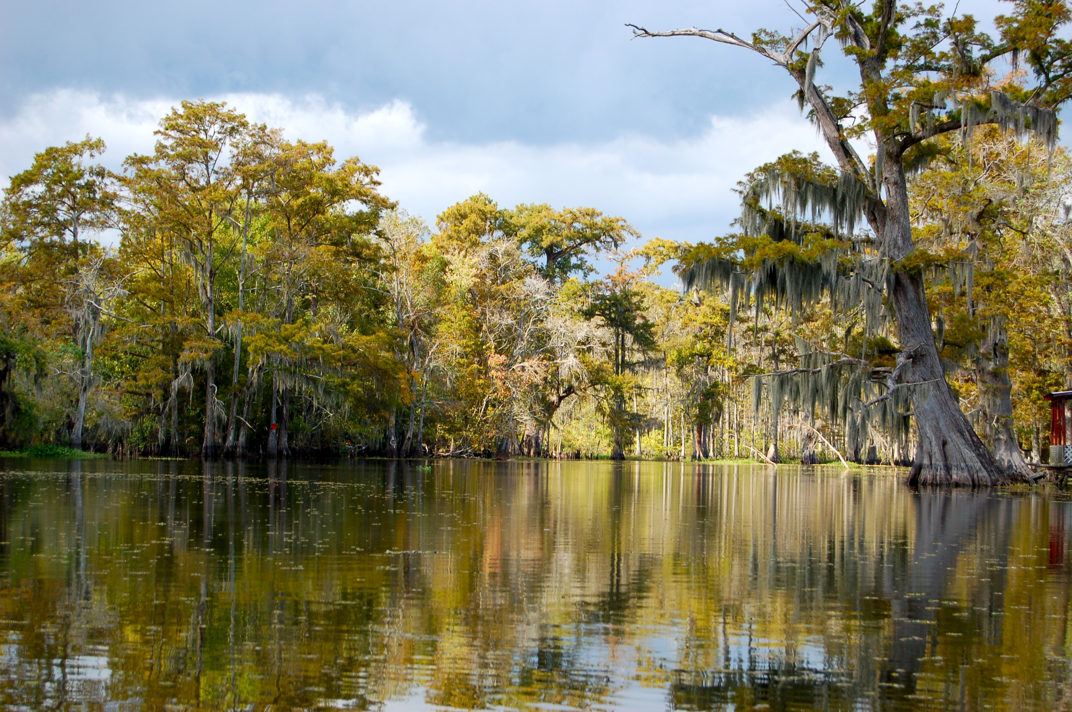

Chapter 9: The Era of Huey Long
STUDY PRESENTATION
© 2023 Clairmont Press

Slide 2
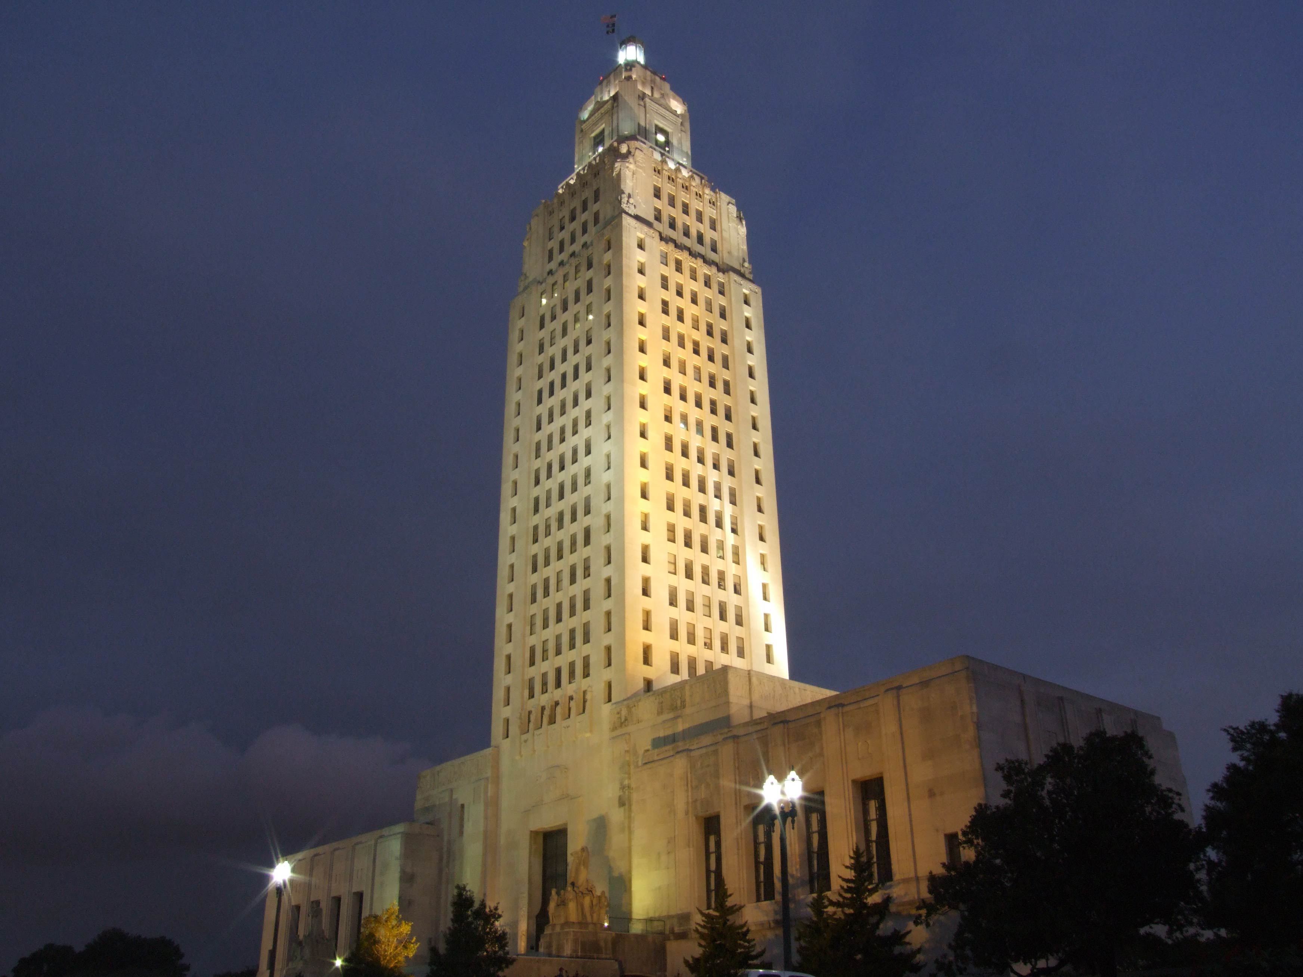
Louisiana State Capitol building, Baton Rouge
Section 1: Politics of the 1920s

Slide 3
Section 1: Politics in the 1920s
Essential Question
  What were some of the contrasting views on prohibition in North and South Louisiana?

Slide 4
Section 1: Politics in the 1920s
What terms do I need to know?
  prohibition
  Public Service Commission
  Flood of 1927

Slide 5
Politics in the 1920s
The adoption of the Eighteenth Amendment to the United States Constitution made the manufacture and sale of alcoholic drinks illegal as of January 1, 1920.
Many people in North Louisiana supported prohibition (forbidding production and sale of alcoholic beverages).
However, Roman Catholics, who were dominant in South Louisiana, did not support the ban and aided in the smuggling of illegal alcohol.

Slide 6
Reforming Governors
John Parker, wealthy Louisiana businessman and planter, became a member of the National Progressive Party, organized by former president Theodore Roosevelt.
In 1916, Parker ran for governor of Louisiana on the Progressive Party ticket, but he lost to the Democratic candidate, J. Y. Sanders.
Afterward, Parker returned to the Democratic Party and became governor in 1920.

Slide 7
Reforming Governors Pt. 2
As he entered office, Parker was determined to continue reforming Louisiana in line with his progressive ideas.
He continued gravel road program started by Sanders, but he was hampered by the 1913 Constitution’s ban on borrowing money to undertake such projects.
Many concerns with the 1913 Constitution led to the creation of a new constitution adopted in 1921.

Slide 8
Reforming Governors Pt. 3
Louisiana’s timber and oil generated large profits, but most of the money was going to out-of-state businesses and corporations.
Parker made a severance tax, which required companies to pay a percent of the value of the resources removed from the land.
Some praised Parker for the move, but others criticized him for letting oil and timber companies play a role in making legislation.

Slide 9
Huey Long and the
Railroad Commission
Huey Long, years before he held any office, wrote to the state’s politicians and gave legislators pamphlets to spread his ideas.
Long’s successful law practice gave him a good record to use for his election to the state’s Railroad Commission in 1918, which he won at age 25.
The Railroad Commission, which regulated operations and safety of public services and utilities, changed its name in 1921 to the Public Service Commission.

Slide 10
Huey Long and the
Railroad Commission Pt. 2
Long’s energized pursuit of his new job on the Commission gained public notoriety.
Long became chairman of the Commission in 1921 and established a statewide reputation as a champion for common people against companies and corporations.
He won a fight to make telephone companies pay back an overcharge and took credit for the small refund checks that customers received.

Slide 11
Huey Long and the
Railroad Commission Pt. 3
Huey began campaigning for governor in 1923, promising a statewide system of paved roads and improvements in education for children.
He worked hard, visiting small and remote towns, and he secured loyal voters among the rural population, who often felt ignored.
He did not pole well in Southern Louisiana in the 1924 election, so he knew he had to find ways to appeal to city voters next time.

Slide 12
The 1927 Flood
The Flood of 1927 was one of the worst natural disasters in the nation’s history.
Rainfall across the Midwest and Mississippi valley throughout the spring combined with the usual spring flooding, lead to the massive Mississippi River flood.
Unfortunately, the “levees-only” policy by the Army Corps of Engineers to control the river and protect cities worsened the flooding.

Slide 13
The 1927 Flood Pt. 2
When the river could not hold the rainfall and flooding, the levees were breached as far north as Illinois.
Flooding extended to the Gulf of Mexico, and in some places, flooding spread more than fifty miles beyond the riverbanks.
Arkansas, Mississippi, and Louisiana suffered the worst, with more than 100 breaches in their levees.

Slide 14
The Citizens Flood Relief Committee
New Orleans business leaders worried about business in the city if it and its ports flooded, and so a group of powerful and wealthy men formed the Citizens Flood Relief Committee.
Despite no authority from the state, they decided preventing flooding in New Orleans was their top priority.
They created a plan to dynamite the levees below New Orleans to ease pressure on the city’s levees.

Slide 15
The Citizens Flood
Relief Committee Pt. 2
Citizens of St. Bernard and Plaquemines Parishes would be flooded instead, and they clashed with committee members.
The Committee promised to make payments to people who would be flooded and provide them with temporary housing in New Orleans.
With the blessing of state officials, the Committee used 39 tons of dynamite at Caernarvon, located about a dozen miles downriver from New Orleans.

Slide 16
Political Impact
President Calvin Coolidge sent Herbert Hoover to assist with flood relief, and the memory of Hoover aiding people contributed to his victory in the 1928 presidential election.
Due to the floods, many of the poor became poorer, and Long’s message, which focused on the common people’s needs, gained lots of support from the downtrodden and ignored.
Due to this discontent, Long won the election for governor of the state.

Slide 17
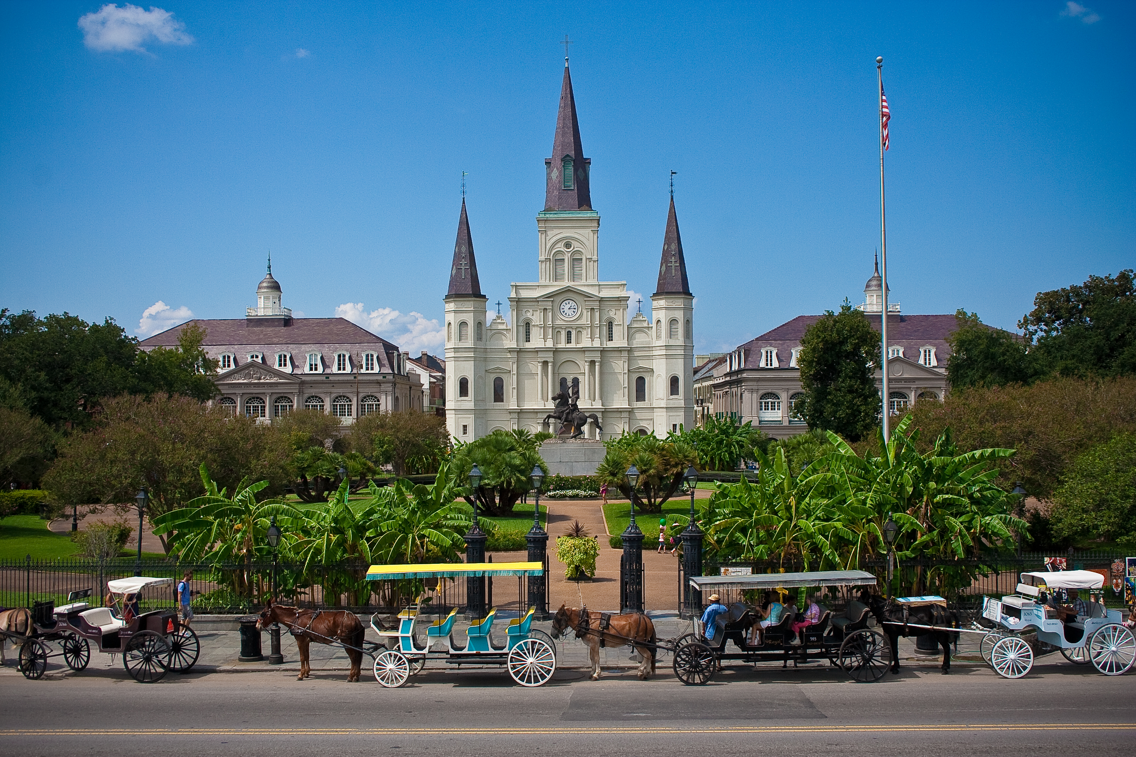
St. Louis Cathedral, New Orleans
Image Credits
Slide 1: jc.winkler, https://creativecommons.org/licenses/by/2.0/deed.en, Wikimedia Commons
Slide 2: Bluepoint951, https://creativecommons.org/licenses/by-sa/2.5/deed.en, Wikimedia Commons
Final Slide: Royalpt78, https://creativecommons.org/licenses/by-sa/3.0/deed.en, Wikimedia Commons
Return to Main Menu

