Slide 1
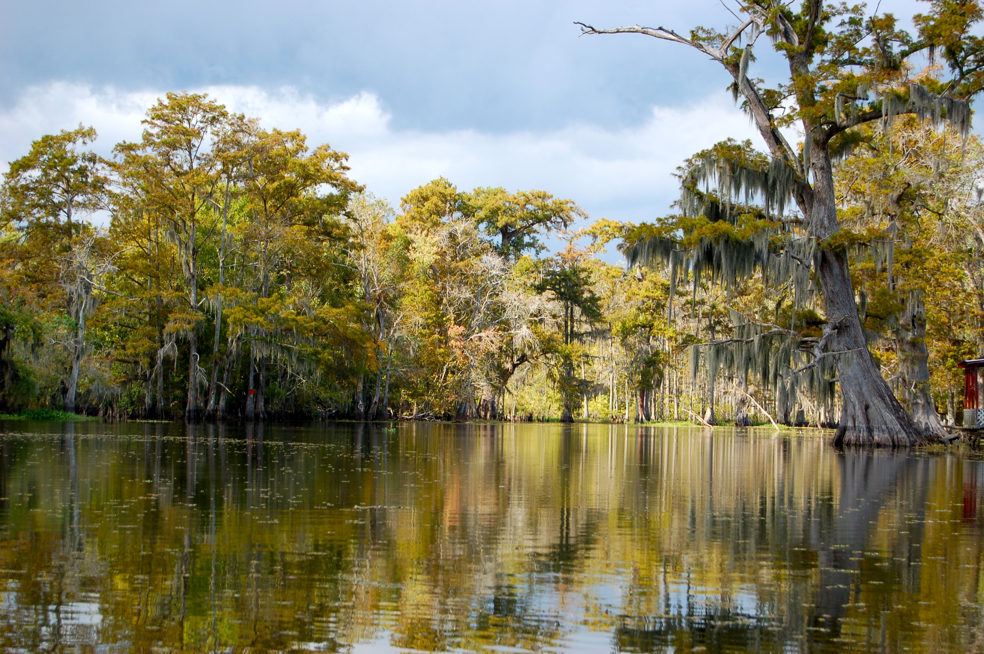

Chapter 9: The Era of Huey Long
STUDY PRESENTATION
© 2023 Clairmont Press

Slide 2
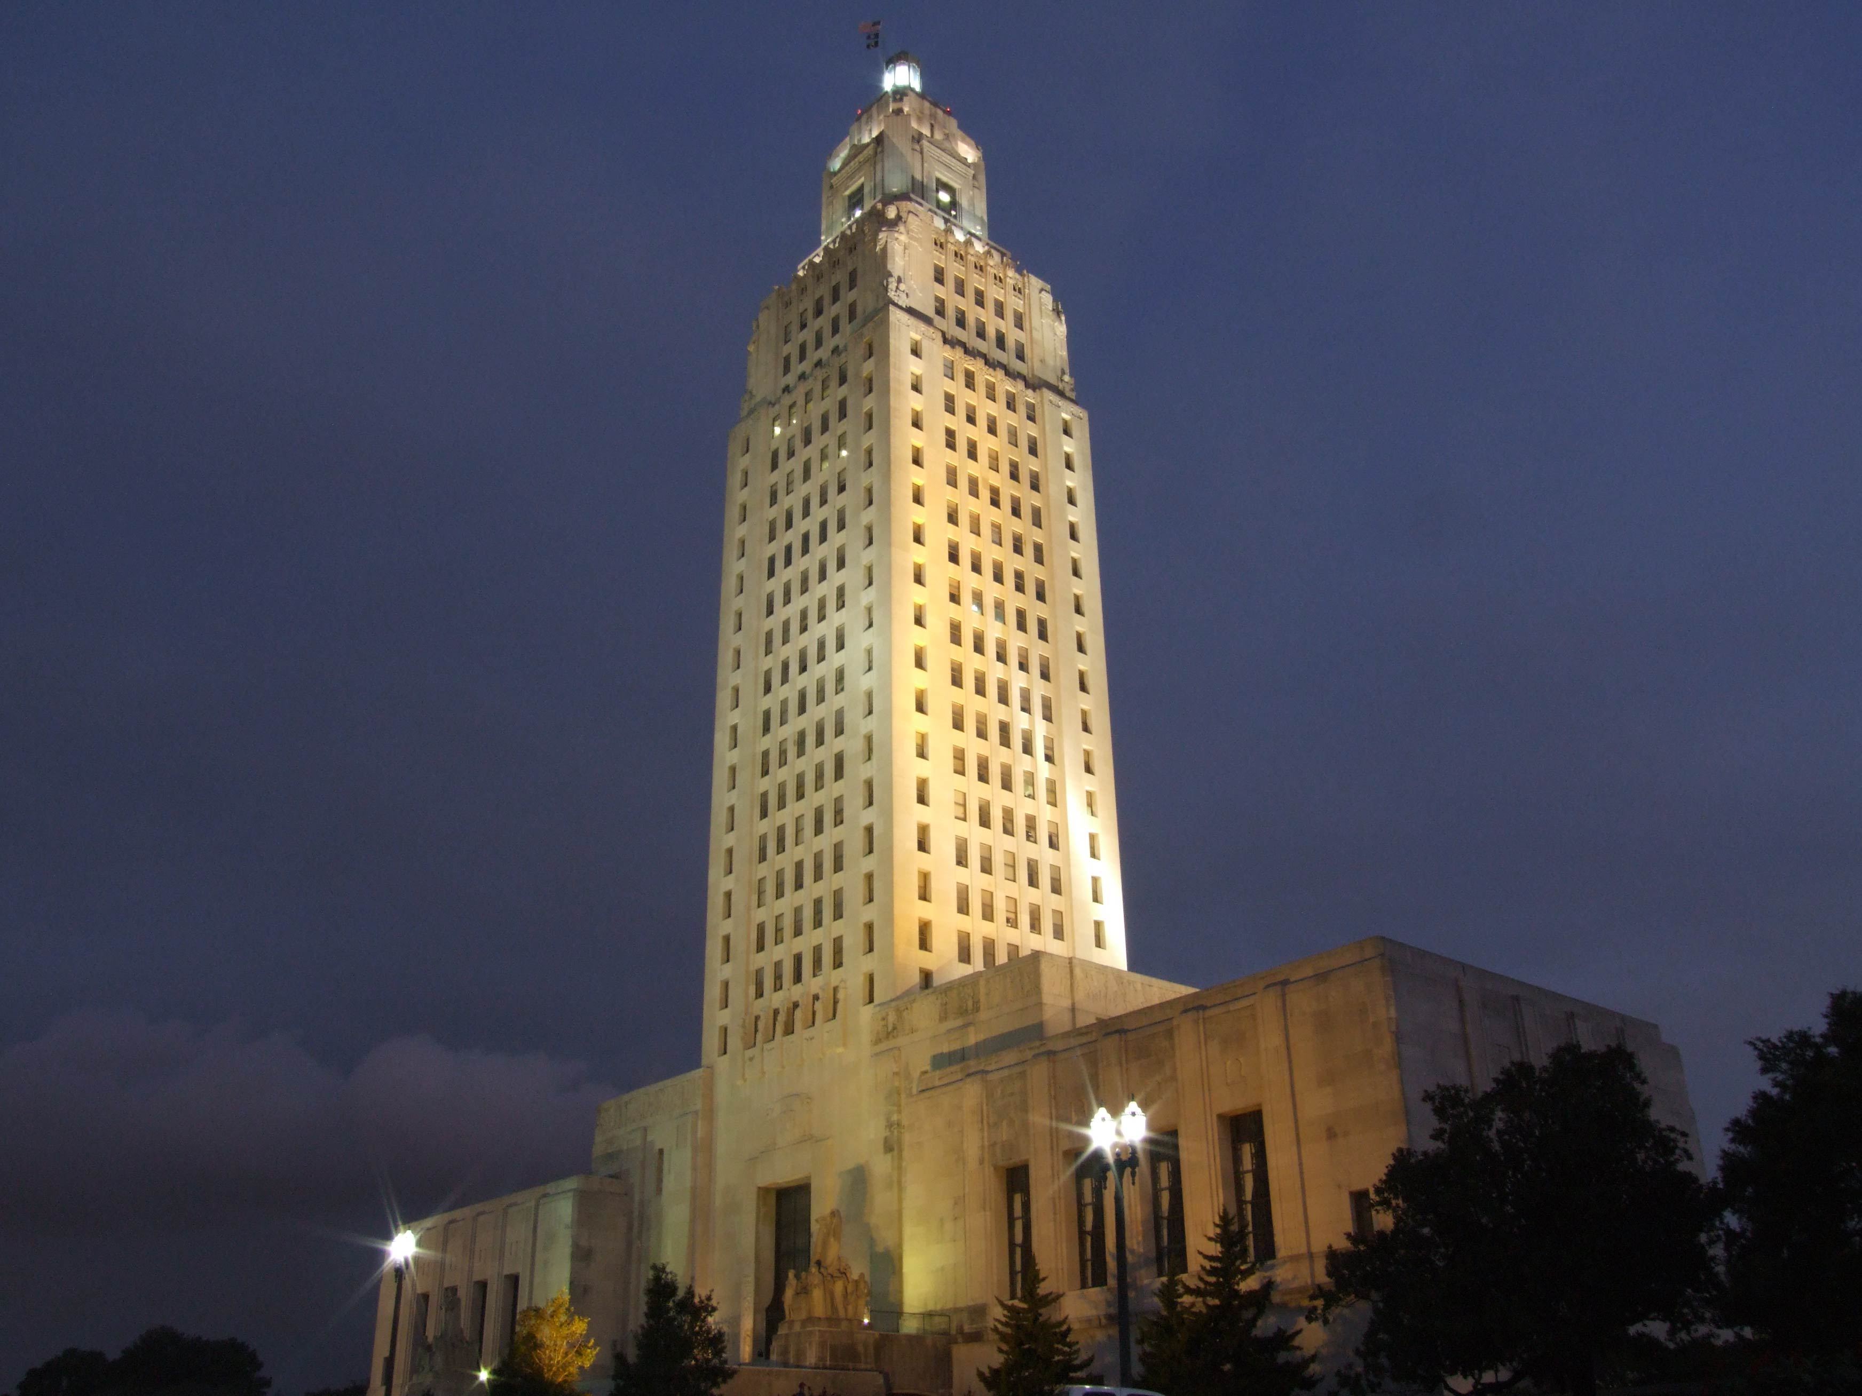
Louisiana State Capitol building, Baton Rouge
Section 3: Huey Long in the United States Senate

Slide 3
Section 3: Huey Long in the
United States Senate
Essential Question
  What were Long’s attempts to broaden his national appeal while still controlling state politics?

Slide 4
Section 3: Huey Long in the
United States Senate
What terms do I need to know?
  Great Depression
  Share Our Wealth program
  grassroots support

Slide 5
Huey Long in the
United States Senate
Long won one of Louisiana’s two United States Senate seats in 1930.
Long waited to be sworn in until he could help his friend, O. K. Allen, win the election to be Louisiana’s governor, which happened in 1932.
Long, now referring to himself as the Kingfish, was sworn into the United States Senate on January 25, 1932, but his sights were set on the White House.

Slide 6
Senator Long Goes to Washington
While tradition stated new Senate members work behind the scenes, shadowing and cooperating with other members, Long had no intention of following tradition.
Long ignored established rules or found ways to bypass those who tried to block his ideas or ambitions.
Long spent a lot of time giving speeches to the American people, and when he addressed the Senate, it was usually in the form of filibustering, or long floor speeches to block legislation he opposed.

Slide 7
Broadening His Appeal
In 1932, Long traveled with his fleet of campaign trucks to Arkansas, where he rallied and spoke in support of Senator Hattie Caraway’s re-election.
Caraway had been appointed to finish her deceased husband’s term, and she sat next to Long in the Senate, where there seemed to be a genuinely good relationship between the two.
However, Long felt helping Caraway win would show he could influence elections beyond his own state.
With Long’s help, Caraway won the race, making her the first woman elected to the United States Senate.

Slide 8
Louisiana during the Great Depression
Long was sworn in during the Great Depression, which was the severe economic downturn that began with the stock market crash of 1929 and continued into the 1940s.
In October 1929, the stock market, the value of which had climbed very high, collapsed, and the nation’s wealth disappeared.
Unemployment rates skyrocketed, and many Americans suffered extreme poverty, especially farm families.
Farm families were hit especially hard. In a largely rural and agriculture-dependent state like Louisiana, the poor faced economic challenges that they could not overcome, no matter how hard they worked. And while farm families could usually grow enough to feed themselves, people who lived in cities had no places to plant gardens. Many families came close to starvation.

Slide 9
Louisiana during the Great Depression Pt. 2
The mostly rural and agriculture-dependent Louisiana faced many economic challenges for the poor that just could not be overcome.
Farming families could usually grow enough to feed themselves, but city families had no room to plant gardens.
Many families came close to starvation.

Slide 10
Share Our Wealth
Long’s populist messages during the Great Depression appealed to the poor and vulnerable like the 1927 Flood in Louisiana.
Long used every opportunity to promote his proposals for ending the depression, which included a set of ideals called Share Our Wealth.
The Share Our Wealth program focused on making certain that no American was too rich or too poor.

Slide 11
Share Our Wealth Pt. 2
Long felt all Americans should have a home, food, and economic security in their old age.
Long argued the money to achieve these proposals could be raised from higher taxes on the nation’s wealthiest citizens.
These ideas of income redistribution were very appealing to large segments of the nation’s poor.
Share Our Wealth societies sprang up around the country, providing a forum for people to talk about their problems and discuss possible solutions, most of them proposed by Long.

Slide 12
Share Our Wealth Pt. 3
Now with a nationwide network of more than 4 million members and a mailing list of 7 million, Long began considering his final step: running for the presidency of the United States.
Long’s speeches, broadcasts, and Share Our Wealth societies yielded grassroots support (support from ordinary people), and he was still actively controlling politics in Louisiana.
He would travel to Louisiana to oversee legislative sessions and ensure his priorities and plans passed before returning to Washington, DC.

Slide 13
Public Works
Long oversaw many public works projects, including continued road construction, a new bridge across the Mississippi River in 1935, and a new, tall State Capitol building in 1932.
Long cut corners to extend his programs, and many were receiving kickbacks throughout the process.
One historian estimated the roads cost taxpayers 4 to 5 times as much as they should have because of all the illegal money-handling.

Slide 14
Was Long a Dictator?
The idea of Long as a dictator was not far off, as he was serving as a US Senator while still controlling the state government.
Despite the growing number of supporters, Long still made plenty of enemies, and most of the state’s newspapers were critical of him.
Concerns rose that his dictatorial tactics may spread to the nation if he was elected, and soon, talk of his assassination began.
As such, Long travelled with several armed bodyguards and created the Bureau of Investigation, a state police force he controlled and directed.

Slide 15
Long’s Final Days
In August 1935, Long announced his intentions to seek the presidency in 1936, and he returned home the following month to run a special session of the legislature.
As Long was hurrying around a corner in the State Capitol, a young surgeon Carl Austin Weiss, approached him, with Long’s bodyguards testifying he shot Long point-blank.
Long ran while the bodyguards riddled Weiss with gunfire, killing him instantly.

Slide 16
Long’s Final Days Pt. 2
Surgeons removed the bullet that struck Long, but they didn’t detect a nick in his kidney that continued to bleed internally until his death in September 10, 1935.
Long’s supporters considered him a hero and were saddened by his death, leading to tens of thousands of mourners coming to the Capitol.
While few questioned Weiss’s guilt in the matter, evidence uncovered in more recent decades have raised several questions.

Slide 17
Long’s Final Days Pt. 3
Photos taken of Weiss’s body right after the shooting show no gun in his hand or near his body.
The gun allegedly used had a poor chain of custody, eventually discovered decades later in possession of the daughter of one of the policemen involved in the initial investigation.
Theories suggest Weiss approached to confront Long about legislation, and his bodyguards opened fire, striking Long in the process, but there is no evidence for this theory.

Slide 18
Long’s Successors
Even before burial, discussion about succession got underway.
Due to Governor Allen dying from a heart attack, Rose Long was appointed to the seat until a special election could be held.
James A. Noe, a business partner of Long’s, was lieutenant governor and served as interim governor from January through May.
Despite his hopes to be the Long candidate for governor, the Long machine backed New Orleans judge Richard Leche, a controllable supporter.

Slide 19
The Louisiana Scandals
Leche became governor in 1936, but he continued many of the Long era problems and corruptions.
Friends profiting from state deals, misusing construction materials for personal use, and illegal kickbacks are just a few examples.
While Long did many of these things, his iron grip on the government made it difficult for federal investigators to prove the corruption.

Slide 20
The Louisiana Scandals Pt. 2
After Long’s death, investigators were finally able to uncover and document proof of the widespread corruption rampant in Louisiana.
In 1939, more than 250 federal charges were filed against Louisiana citizens and officials, including Richard Leche.
Leche was forced to resign as governor, and a year later, he and many others were found guilty and sentenced to prison.

Slide 21
Huey Long’s Legacy
Long drastically improved the state’s transportation and education system, as well as access to healthcare.
He also overhauled the state’s government to favor the common people rather than serving the wealthy.
However, he imposed heavy costs on the state, and many of his actions threatened the freedoms for those who disagreed with him.
He and his allies also enriched themselves at the expense of the taxpayers.
While Long did bring Louisiana into the modern world, he damaged the state and its reputation.

Slide 22
Huey Long’s Legacy Pt. 2
After Leche resigned, Earl K. Long, Huey Long’s younger brother, was sworn in to finish his term.
Entering the 1940s, Earl Long continued many of his brother’s political, social, and economic practices.
However, events beyond Louisiana in the 1940s would drastically change the state and nation for decades to come.

Slide 23
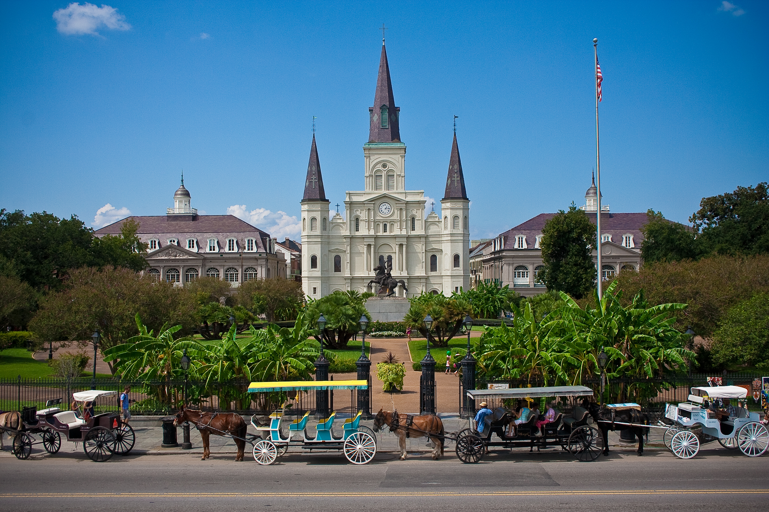
St. Louis Cathedral, New Orleans
Image Credits
Slide 1: jc.winkler, https://creativecommons.org/licenses/by/2.0/deed.en, Wikimedia Commons
Slide 2: Bluepoint951, https://creativecommons.org/licenses/by-sa/2.5/deed.en, Wikimedia Commons
Final Slide: Royalpt78, https://creativecommons.org/licenses/by-sa/3.0/deed.en, Wikimedia Commons
Return to Main Menu

