Slide 1
SMART SKILLS
Week 28 – Art & Artifacts 6
© 2023 Clairmont Press

Slide 2
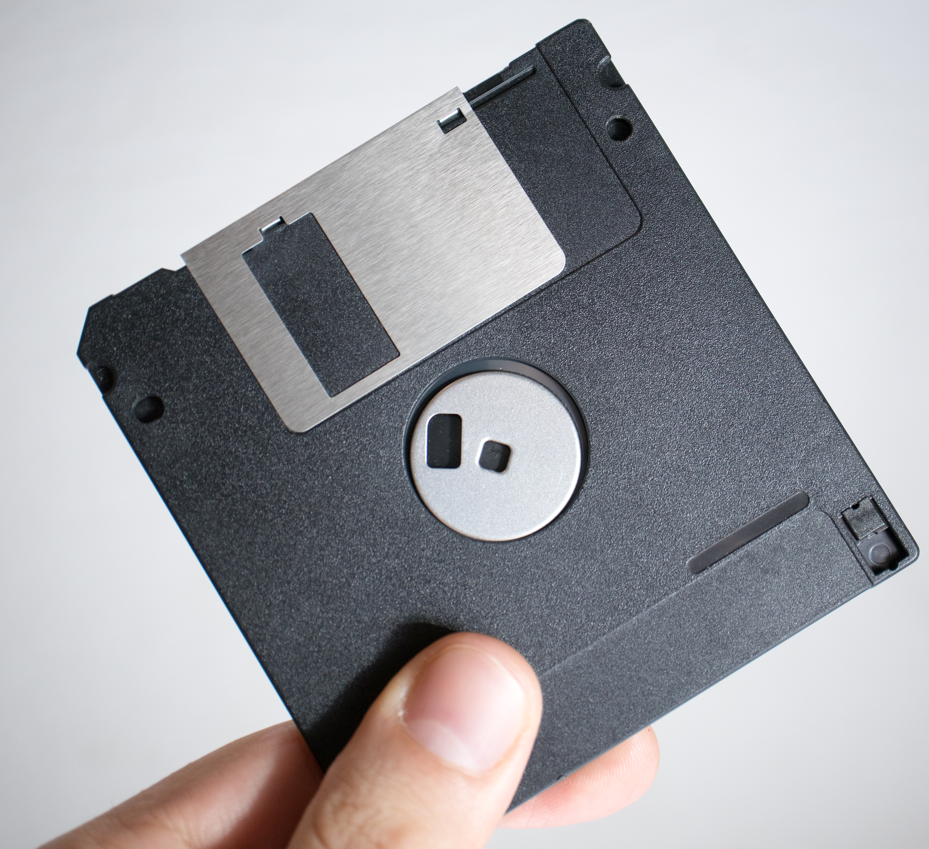
Monday
Study the picture. What do you notice about the artifact? Record observations only.
Notes:
Answers will vary. Discuss only OBSERVATIONS.

Slide 3
Tuesday
How does having the finger and thumb in the image help you understand it?
Notes:
Sample: The finger and thumb help the viewer understand the artifact's relative size.

Slide 4
Wednesday
Are there any indications that the artifact may have moving parts? What evidence do you have to support your thinking?
Notes:
Sample: The silver piece looks like it might slide over because there is space for it in the black plastic. The round part in the middle looks like it might turn like a wheel. The bottom right has a piece of plastic that looks like it could slide back and forth.

Slide 5
Thursday
What do you think is the purpose of the artifact? What evidence or experience do you have to support your thinking?
Notes:
Answers will vary. Some students may recognize the artifact as a 3.5-inch floppy disc for computer data storage. The shape of the disc is often drawn today in apps to symbolize the “Save” function.

Slide 6
Friday
The artifact is a 3.5-inch disc for saving computer data.
Such discs were used in computers to store and move data. Their use peaked in the mid-1990s.
What technologies allow computers to move data today? How have these technologies changed the demand for 3.5-inch discs?
Notes:
Today, data may be transferred to cloud storage systems, on thumb drives, or over the Internet. Data on phones can be transferred wirelessly to another phone.
TEACHER NOTE: Billions of 3.5-inch discs were produced from the 1980s to the early 2000s. They were replaced by CDs, which could hold about 450 times more data. The 3.5-inch disc could only hold the data for about one photo taken on a smartphone. A smartphone with 8 GB of memory holds more data than over 5,700 of these 3.5-inch discs. Demand for the discs fell and the last disc producer quit production around 2011, although some vendors still sell the remaining discs to people using older computers.

Slide 7
Image Credits
Title Slide: Old Louisiana State Capitol, Public Domain, Wikimedia Commons
Slides 2-6: The Morgan Effigy, http://vermilionhistorical.com/archives/features/topics/morgan_effigy.htm.
End Slide: Monroe, Louisiana skyline in 2021, by TheLionHasSeen, Uploaded 12 April 2021, Wikimedia Commons

