Slide 1
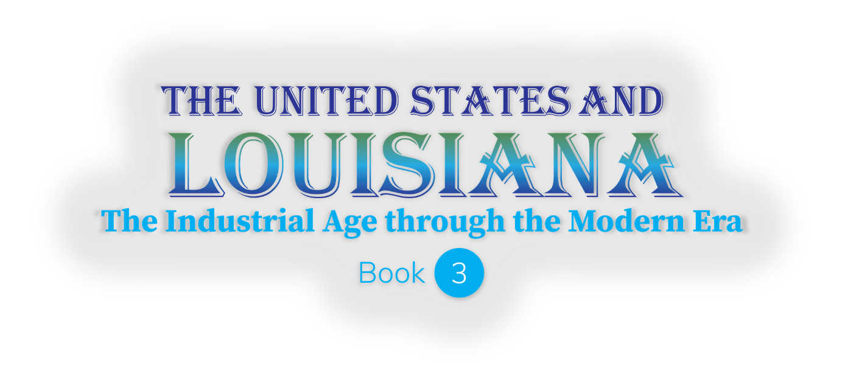
SMART SKILLS
Week 15 – Political Cartoon 3
© 2023 Clairmont Press

Slide 2
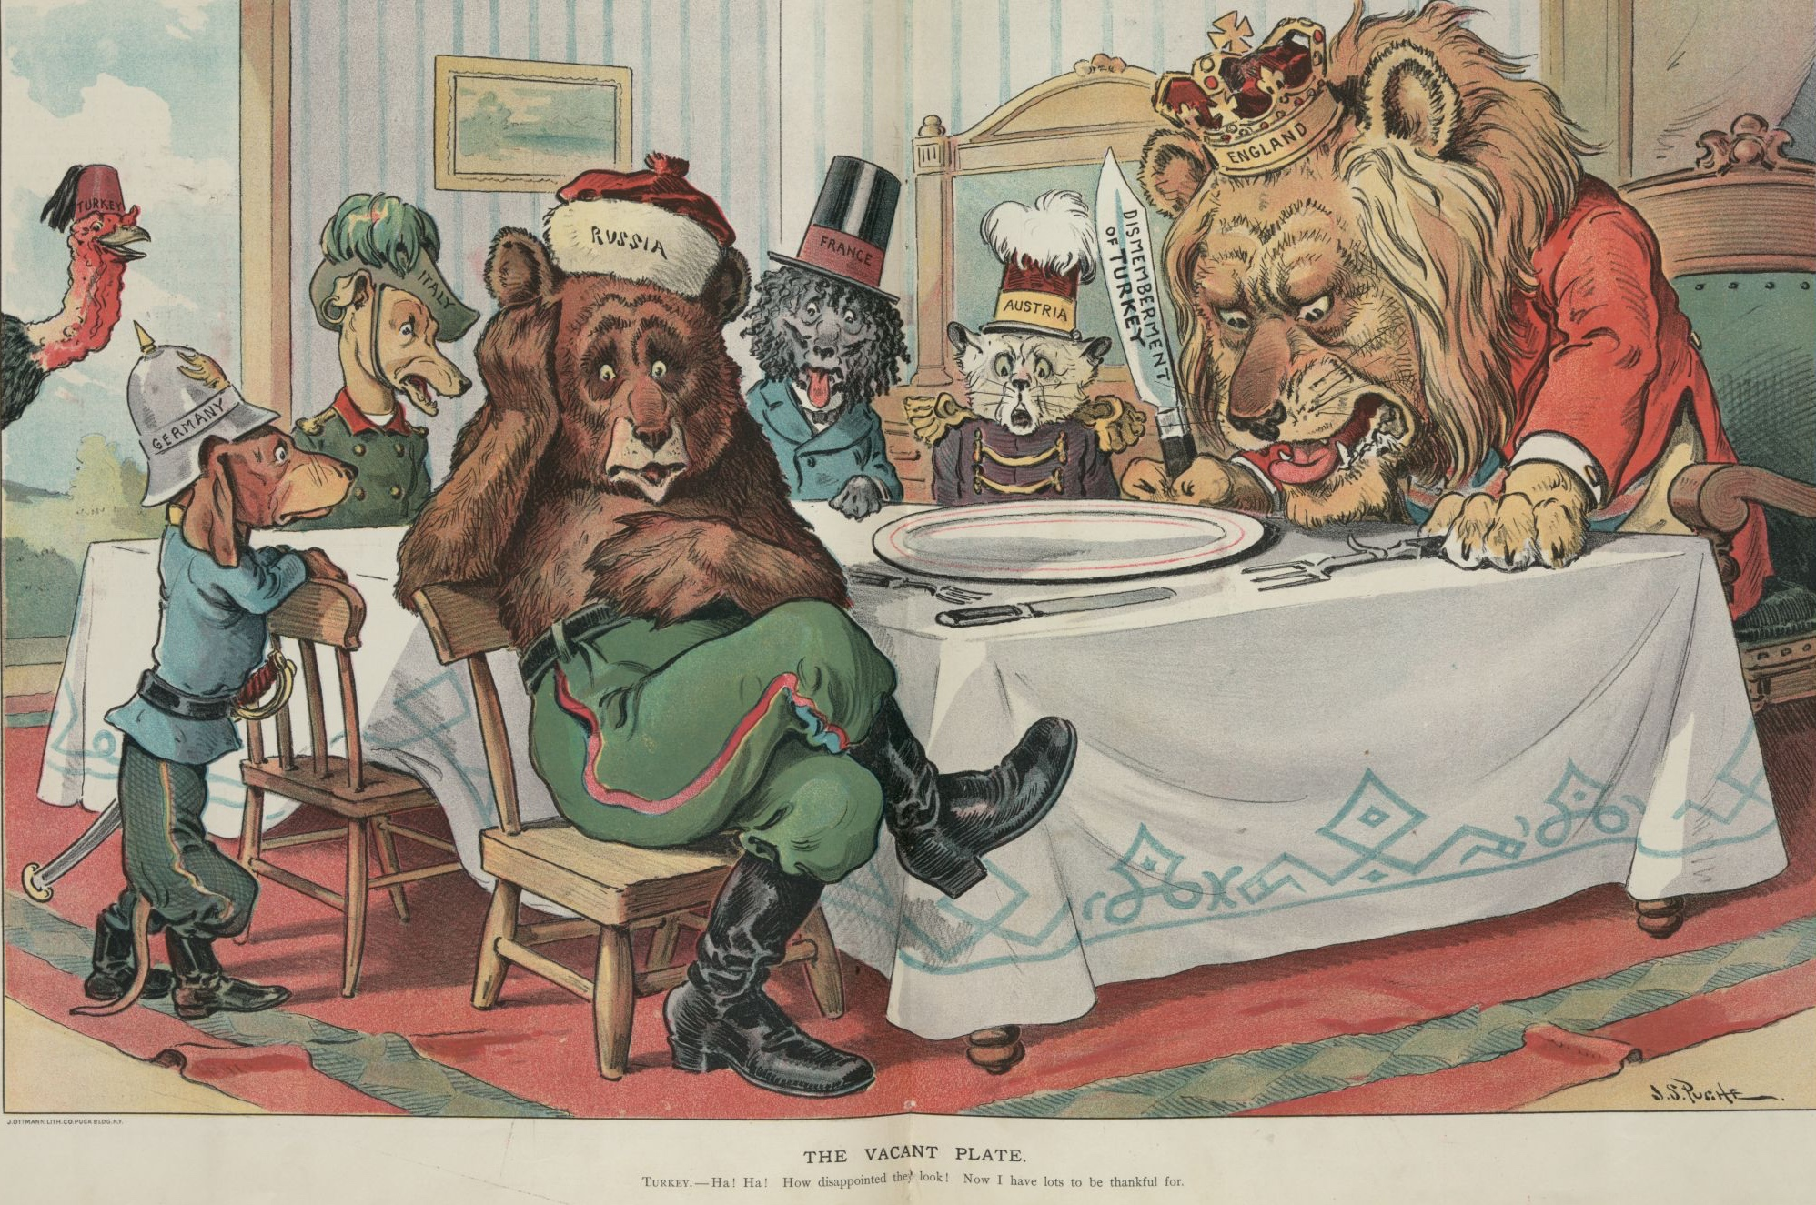
Monday
Title: The Vacant Plate
Caption: Turkey -- Ha! Ha! How disappointed they look! Now I have lots to be thankful for. 11/25/1903
Study the political cartoon. Record your observations.
Notes:
Allow 1-2 minutes for students to record observations. Discussion should focus on what can be observed.

Slide 3
Tuesday
Title: The Vacant Plate
Caption: Turkey -- Ha! Ha! How disappointed they look! Now I have lots to be thankful for. 11/25/1903
The Ottoman Empire was once vast, but by 1903, it was falling apart. The region of Turkey remained. What connection was the artist making with the date and the situation?
Notes:
This cartoon was from around Thanksgiving, 1903. The word “Turkey” in English is associated with a game bird that is symbolic of the Thanksgiving holiday. The fez on the Turkey’s head connects the bird to a regional symbol.

Slide 4
Wednesday
Title: The Vacant Plate
Caption: Turkey -- Ha! Ha! How disappointed they look! Now I have lots to be thankful for. 11/25/1903
How would you describe the animals’ expressions? How do they help the artist convey his message?
Notes:
Answers may vary, but may include: England - angry; Austria – surprise or shock; France – hungry and surprised, etc. Note that the turkey is laughing since there is really nothing left for the colonial powers to take.

Slide 5
Thursday
Title: The Vacant Plate
Caption: Turkey -- Ha! Ha! How disappointed they look! Now I have lots to be thankful for. 11/25/1903
What is the message of the knife in the lion’s hand? What is its importance for the artist’s message?
Notes:
The knife is labeled “Dismemberment of Turkey.” That implies that the country would be cut up. A knife also sends a message of violence that might be involved.

Slide 6
Friday
Title: The Vacant Plate
Caption: Turkey -- Ha! Ha! How disappointed they look! Now I have lots to be thankful for. 11/25/1903
The United States tried to remain uninvolved in conflicts between European powers at this time. If the artist wanted to include the United States in the image, what animal and hat might he have used? Where would the animal have been positioned? Explain your thinking.
Notes:
Sample answer. An eagle could represent the United States. The eagle could wear a tricorn hat like the American Revolution. The eagle could be standing outside the room, watching from a distance to show that it was not invited to the feast.

Slide 7
Image Credits
Title Slide: Old Louisiana State Capitol, Public Domain, Wikimedia Commons
End Slide: Monroe, Louisiana skyline in 2021, by TheLionHasSeen, Uploaded 12 April 2021, Wikimedia Commons

