Slide 1
SMART SKILLS
Week 24 – Timeline 5
© 2023 Clairmont Press

Slide 2
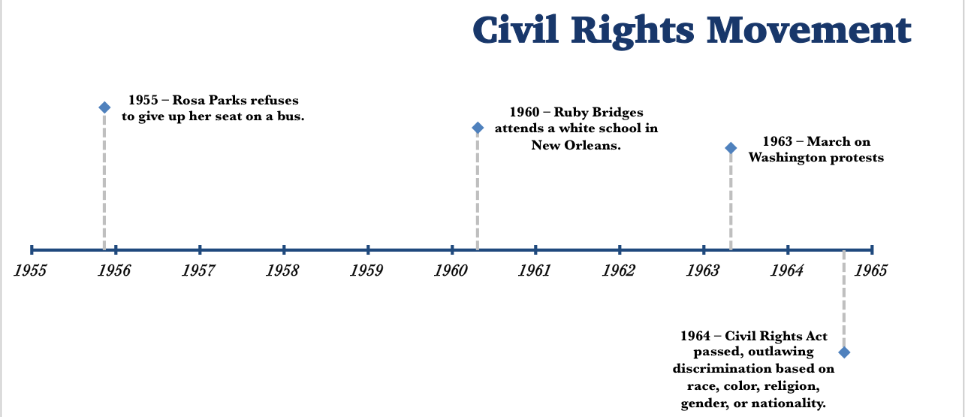
Monday
Study the timeline. What do you observe?
Notes:
Allow students 1-2 minutes to record observations. Discuss only what students have noticed from the timeline.

Slide 3
Tuesday
What is the date range of this timeline? How many years are included?
How many years passed between Rosa Parks’ actions on the bus and the Civil Rights Act being passed?
Notes:
The timeline shows 1955-1965, which is ten years.
Nine years passed between Rosa Parks’ refusal to give up her bus seat and the passage of the Civil Rights Act.

Slide 4
Wednesday
Use your textbook to identify three events that would fit the time range and title of the timeline.
Notes:
Students’ responses will vary. You may want to record some of the events for discussion and allow students to show where the event would be on the graphic.

Slide 5
Thursday
Write a question that could be asked using the timeline. Share it with another student and check their response. Correct any errors.
Notes:
Answers will vary. You may want to choose a few good questions for class discussion.

Slide 6
Friday
How could the title of this timeline be improved? What would make it more accurate?
Notes:
Answers will vary. The Civil Rights movement does not follow exact dates. Also, every event from the movement is not included. Sample answer: Key Events Leading to the Passage of the Civil Rights Act.

Slide 7
Image Credits
Title Slide: Old Louisiana State Capitol, Public Domain, Wikimedia Commons
Slides 2-6: The Morgan Effigy, http://vermilionhistorical.com/archives/features/topics/morgan_effigy.htm.
End Slide: Monroe, Louisiana skyline in 2021, by TheLionHasSeen, Uploaded 12 April 2021, Wikimedia Commons

