Slide 1
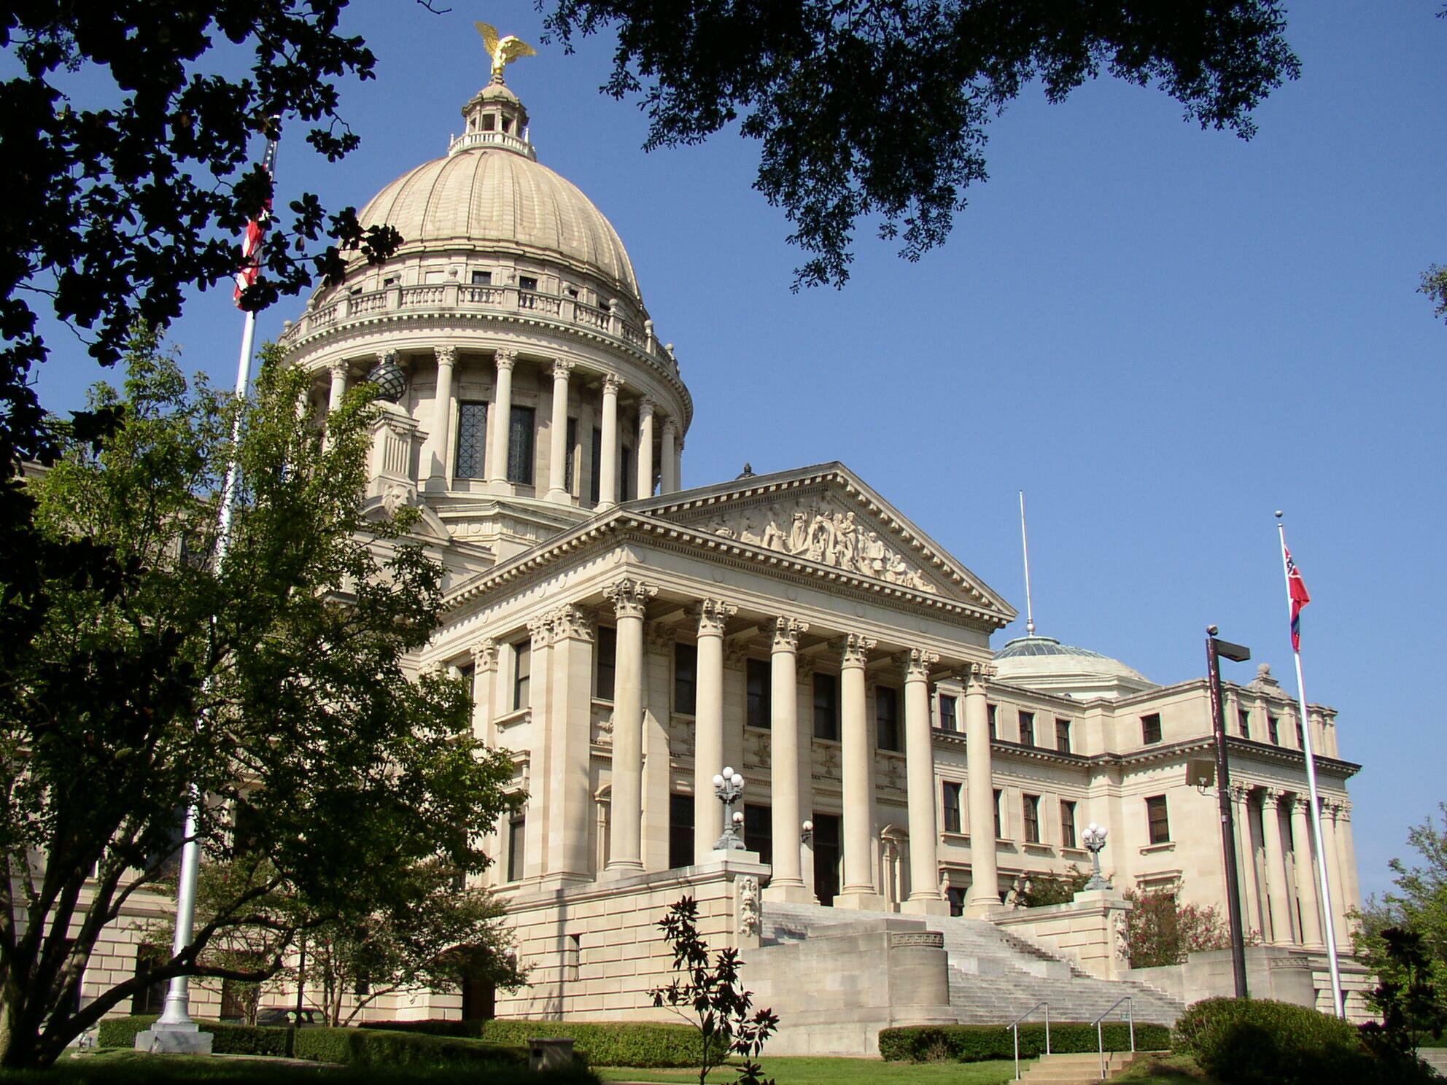
A Place Called Mississippi
Chapter 12: Mississippi in the Global Village
STUDY PRESENTATION
© 2020 Clairmont Press

Slide 2
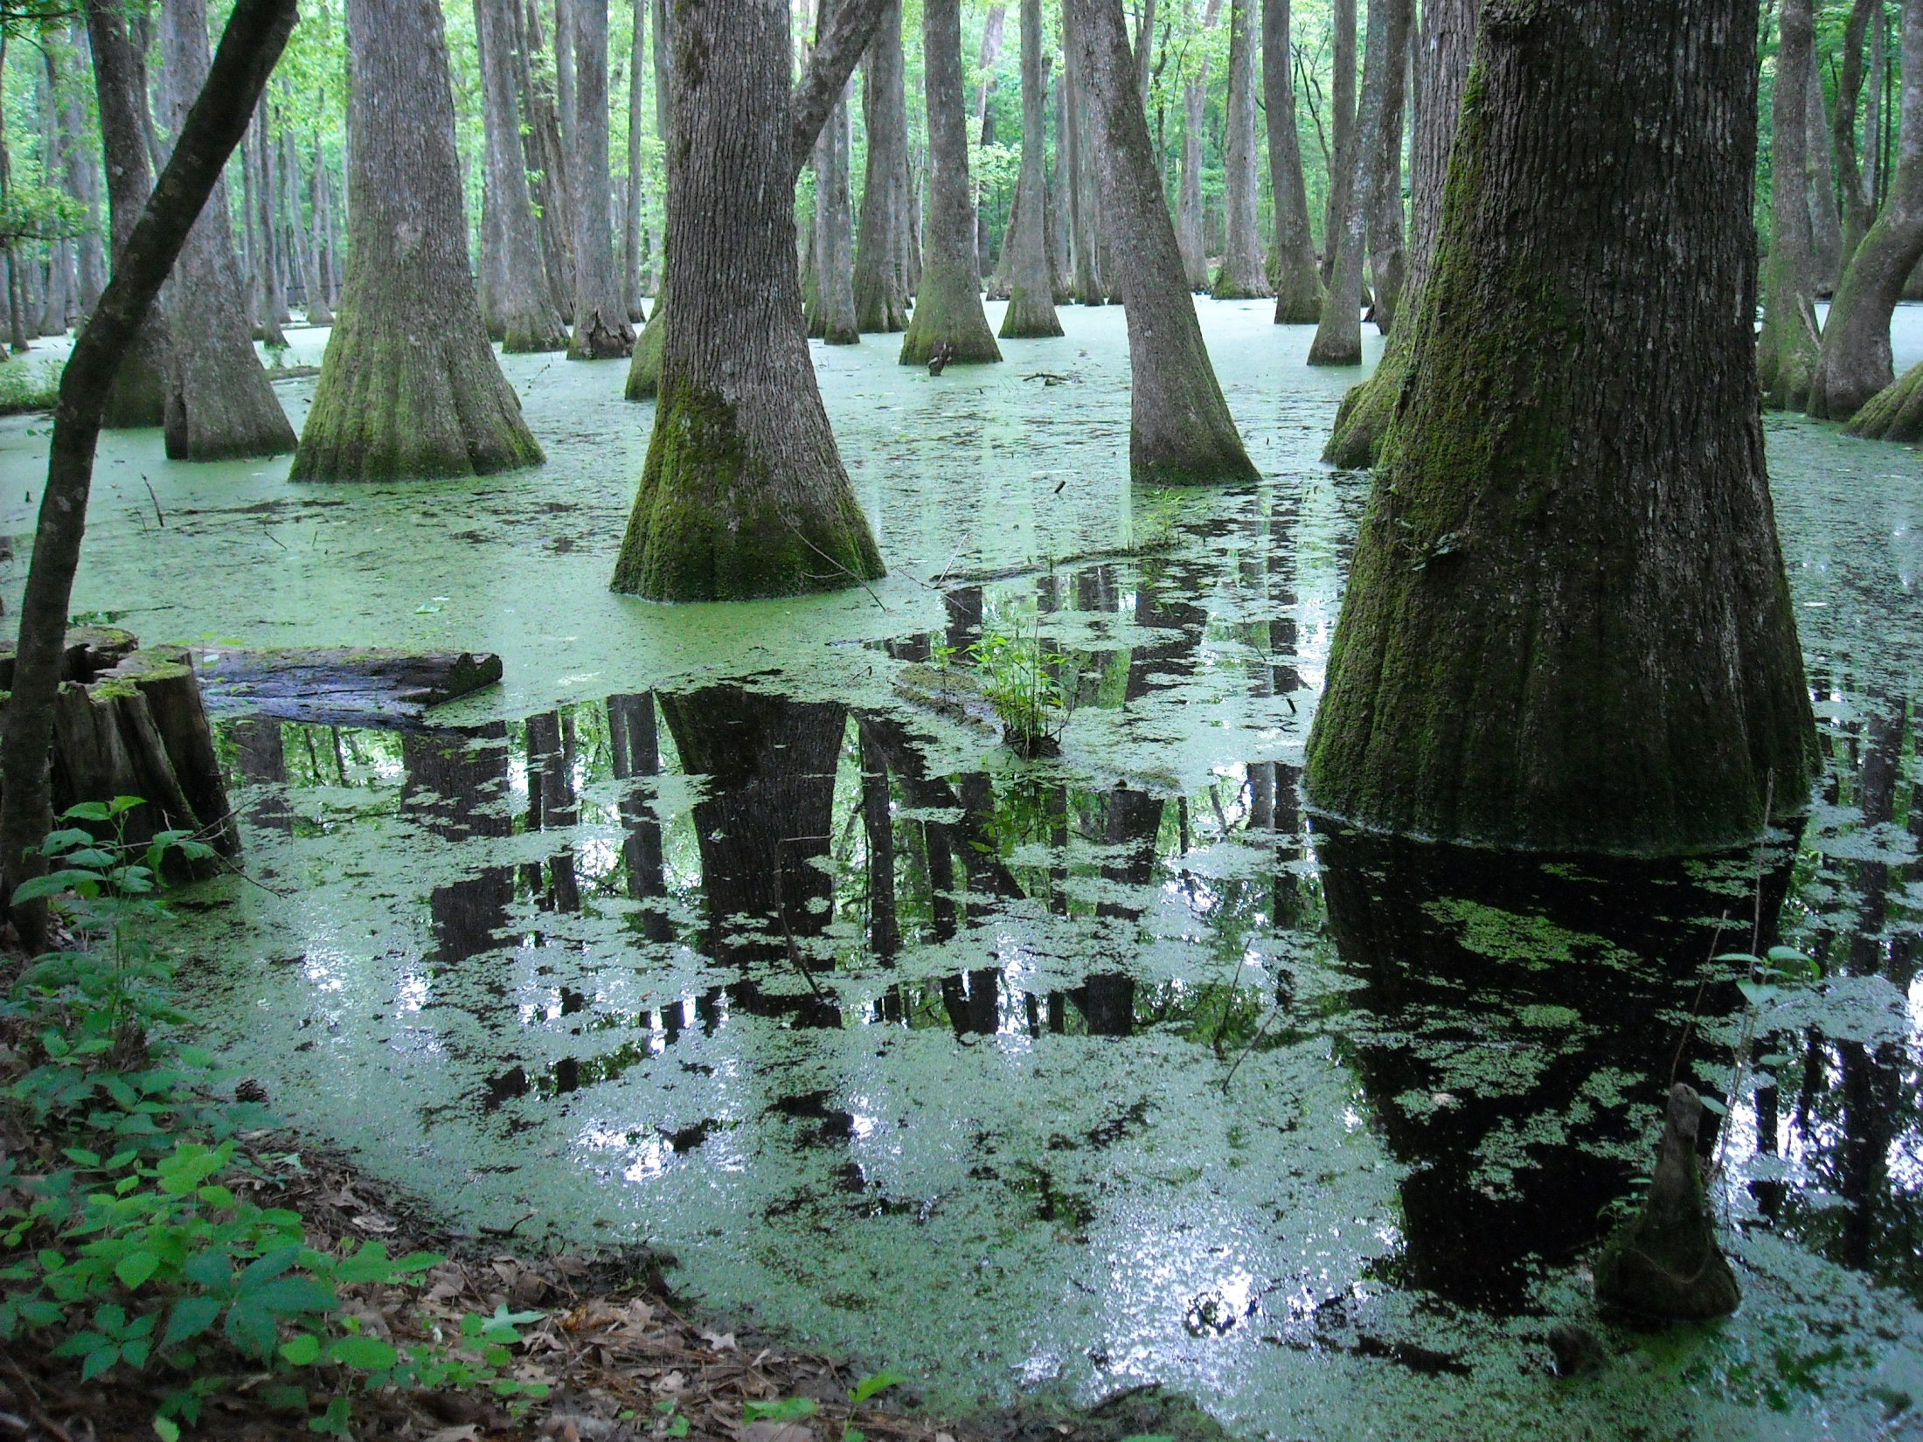
Section 1: The People of Mississippi

Slide 3
Section 1: The People of Mississippi
Essential Question: What types of people live in Mississippi?

Slide 4
Section 1: The People of Mississippi
What terms do I need to know?
  ethnic
  Latino
  gaming

Slide 5
Section 1: The People of Mississippi
Mississippi is ranked 31st out of the 50 states for population with almost 3 million residents.

Slide 6
Population Distribution
Mississippi’s population is not evenly distributed.
Hinds County has the largest population.
The least populated county is Issaquena with 1,406 people.
The two most populated areas are Jackson and the Gulf Coast.
Mississippi’s population increased greatly after it became a state.

Slide 7
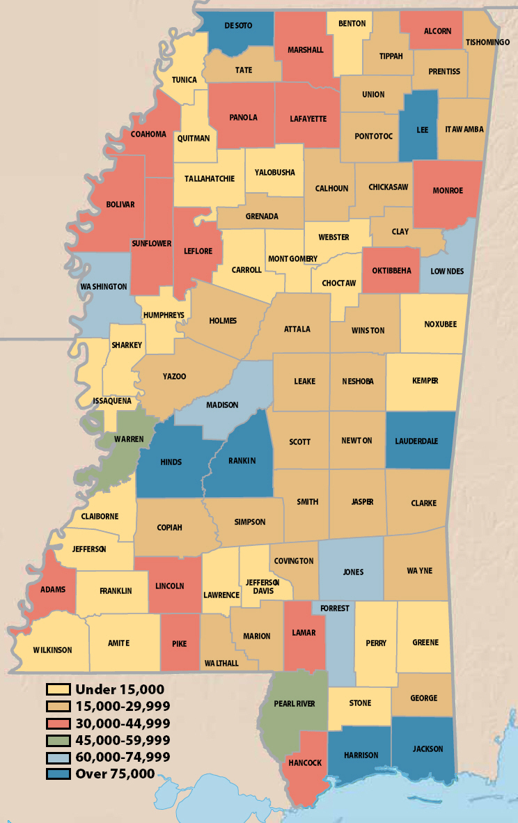
Mississippi Population

Slide 8
Ethnic Diversity
Mississippi has diversified greatly since World War II.
Many ethnic groups (people with a common racial, national, linguistic or cultural heritage) are a part of the state.
Mississippi now has Hispanics, Latinos, blacks, whites, Native Americans, and Asian Americans.

Slide 9
Ethnic Diversity: Native Americans
During the 1830s, almost 13,000 Choctaw Indians migrated to Oklahoma.
A Choctaw Reservation was established in 1944.
The Mississippi Band of Choctaw Indians have successfully blended the new with the old.
95% can speak their native language, while 90% can also speak, read, and write in English.
Choctaw children attend public and tribal schools to learn about their history and culture.
The gaming (gambling, games of chance) industry has brought in a lot of wealth for the Choctaw.
Recently, the tribe made history by electing the first woman chief (or miko) of their tribe.

Slide 10
Ethnic Diversity: A Nation of Immigrants
Immigrants have come to America for generations.
The United States Citizenship and Immigration Services helps immigrants who want to be American citizens.
In the past 10 years, over 7 million people have become citizens of the United States.

Slide 11
Ethnic Diversity: European Americans
While most European Americans don’t celebrate their cultural heritage, there are still a few small festivals that do, such as Oktoberfest (Germans) and the Scottish Highland Festival.
There are small groups that have retained their cultural identity, however, such as the Slovenians on the Gulf Coast and the Lebanese in Vicksburg.

Slide 12
Ethnic Diversity: African Americans
After Mississippi became a state, African Americans accounted for 43.4% of the population.
By 1840, the African American population was at 51.9%, making it the majority.
By 1860, the African American population was 55.2%.

Slide 13
Ethnic Diversity: Asian Americans
Mississippi’s Chinese population immigrated here in the 1870s.
Many of them opened grocery stores.
The Chinese have retained their traditions.
Many still live in the Delta.
The first Vietnamese came to the Gulf in the 1980s.
Many of them worked in the seafood industry.
There are several other smaller populations also, such as the Indians, Filipinos, Japanese, and Koreans.

Slide 14
Ethnic Diversity: Hispanic or Latino Americans
The number of Hispanic and Latino people has increased drastically.
The state’s Latino population could number as high as 100,000.

Slide 15
Languages and Religions
Most citizens of Mississippi speak English.
Only 6% of families speak only another language.
Religion is important to 85% of the people living in Mississippi- that’s the highest percentage in the nation.
Baptists, Methodists, Catholics, and Presbyterians account for 90% of the religious population.
There is a growing number of mosques and Hindu temples.

