Slide 1
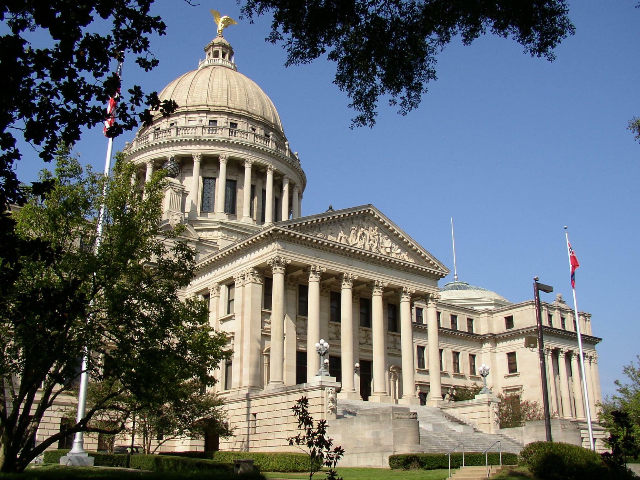
A Place Called Mississippi
Chapter 12: Mississippi in the Global Village
STUDY PRESENTATION
© 2020 Clairmont Press

Slide 2
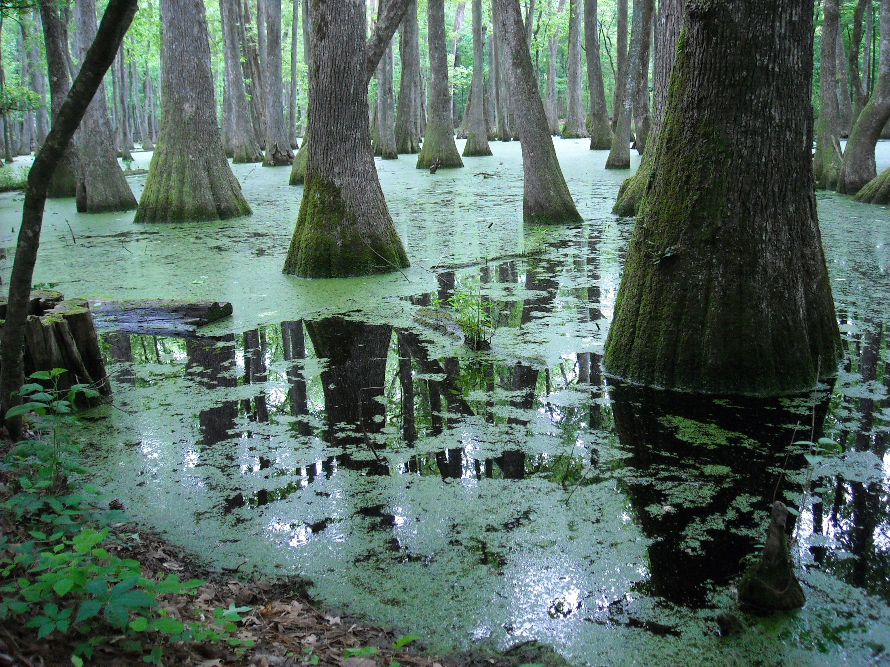
Section 2: Urbanization

Slide 3
Section 2: Urbanization
Essential Question: How has urbanization changed the lives of Mississippians?

Slide 4
Section 2: Urbanization
What terms do I need to know?
  municipality
  city
  town
  village
  census designated place
  suburbs

Slide 5
Section 2: Urbanization
World War II ended the Great Depression and caused an economic boom for the state and the nation.
The large number of newly available jobs in industry attracted thousands to the cities and towns.
Urbanization altered the state’s social customs.
Black servicemen who returned from war were not willing to accept life as second-class citizens.

Slide 6
Municipalities
A municipality is a political subdivision within the state.
Municipalities are called cities if they have more than 2,000 residents.
Those with between 300 and 2,000 citizens are called towns.
A village is a municipality with 100-300 inhabitants.

Slide 7
Growth of Towns and Cities
In 1698, the first capital of Mississippi, Natchez, began with only 1,511 residents.
By 1870, the state’s population had increased to 872,922 people.
Vicksburg was the most populated city from 1870 to 1910.
In 1910, Meridian became the most heavily populated.
Since 1930, Jackson has been the largest city.
In 1970, many people began moving to the suburbs.

