Slide 1
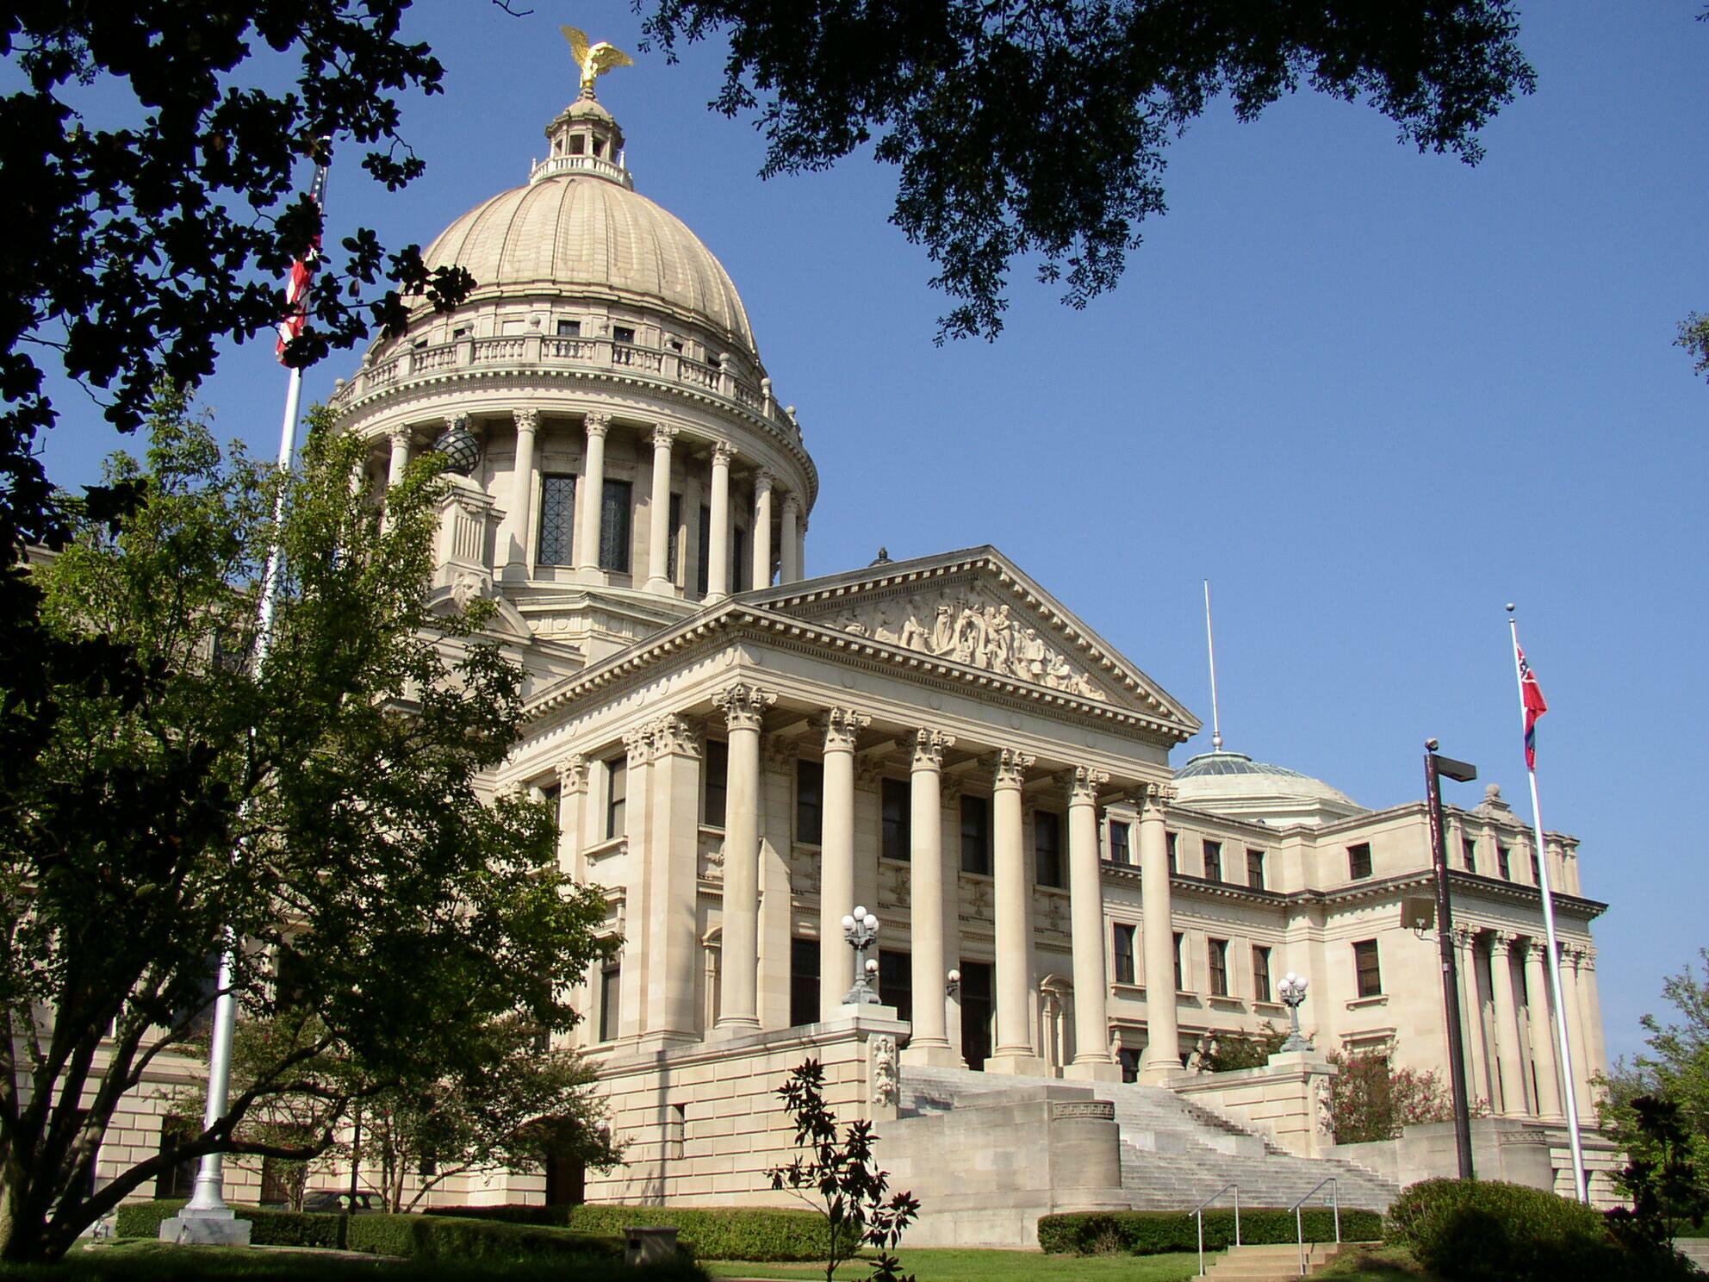
A Place Called Mississippi
Chapter 12: Mississippi in the Global Village
STUDY PRESENTATION
© 2020 Clairmont Press

Slide 2
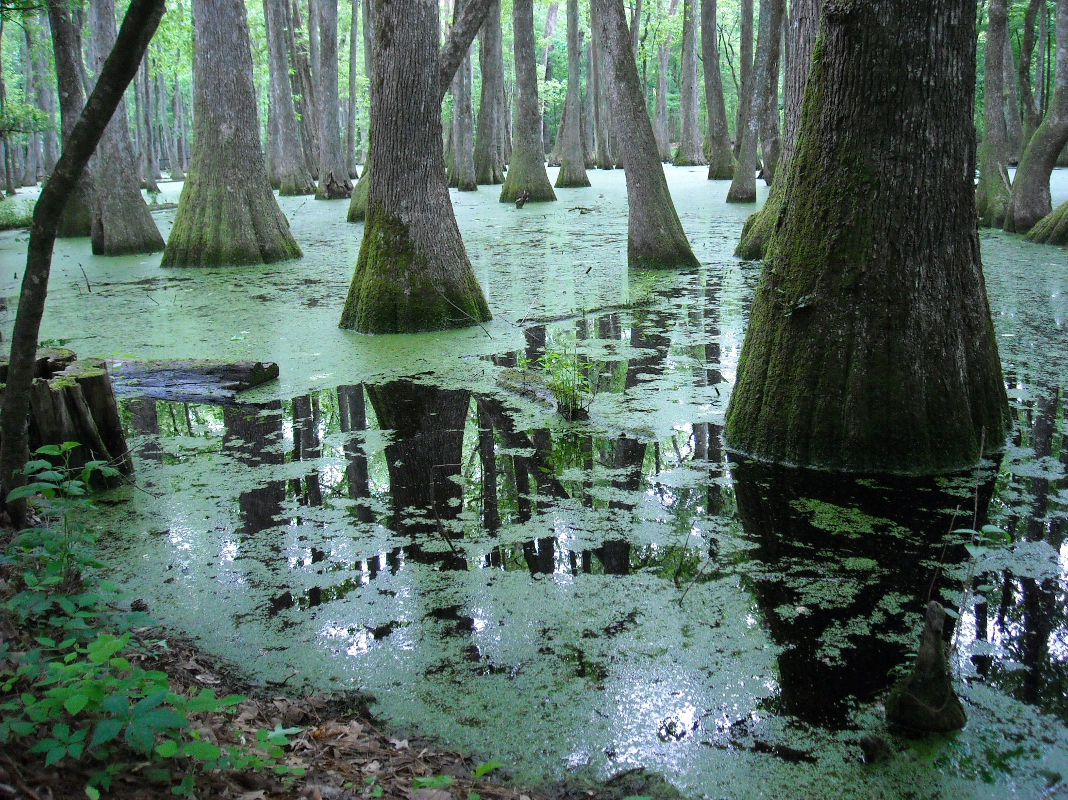
Section 3: Mississippi’s Changing Economy

Slide 3
Section 3: Mississippi’s Changing Economy
Essential Question: How have changes in the economy affected the lives of Mississippians?

Slide 4
Section 3: Mississippi’s Changing Economy
What terms do I need to know?
  poverty level
  economy
  primary sector
  biofuels
  secondary sector
  export
  durable goods
  nondurable goods
  tertiary sector
  quaternary sector
  quinary sector
  renewable resources
  nonrenewable resources
  recyclable resources

Slide 5
Section 3: Mississippi’s Changing Economy
Mississippi’s economy is one of the poorest in the nation.
In 2009, the state had a poverty rate of 21.9%, the highest in the country.
The Delta and the area along the Mississippi River are the most highly concentrated areas of people living below the poverty level.
Since Hurricane Katrina and the BP oil spill, the number of people below the poverty level has increased significantly.
Economic activities are divided into three sectors: the primary, secondary, and tertiary.

Slide 6
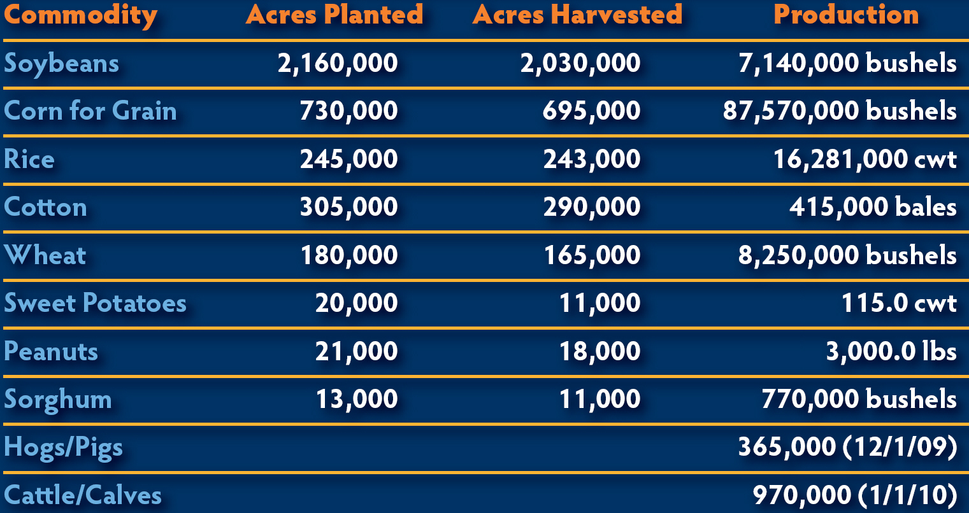
Mississippi Commodities

Slide 7
The Primary Sector: Agriculture
29% of Mississippi’s workforce is in some way involved with agriculture, making it the dominant industry in the state.
Even with $6.3 million in agriculture business, the number of farms has decreased since World War II.
The highest concentration of farms is in the Delta.
Soybeans are the most valuable crop that comes from Mississippi. They are followed by corn, rice, and cotton.
Poultry and eggs make the most income for farmers.
Cal-Maine Foods, Inc., located in Jackson produces the most shell eggs in the United States.
Catfish farming is also a popular new business. Mississippi is first in the nation for catfish production.

Slide 8
The Primary Sector: Forestry and Biofuels
Timber is one of the state’s most important resources. In 2009, the estimated value of forest products was $817 million.
Biofuels (fuels from plants) are the up-and-coming energy source.
There is a possibility that Mississippi could become the first place where woodchips are converted into a crude oil substitute.

Slide 9
The Primary Sector: Mining
In 1939, oil was discovered in Mississippi and the state has been an important producer of oil ever since.
The state also has good supplies of gravel, clay and lignite.

Slide 10
Manufacturing and Construction:
The Secondary Sector
The secondary sector includes manufactured goods and construction.
Most factories in Mississippi produce goods that can be used longer than three years.
Mississippi also has several high-tech companies such as the Stennis Space Center and Howard Industries.
The most famous manufacturing plant in Mississippi is the Viking Range Company.
Many other big companies such as Nissan have plants in Mississippi.

Slide 11
The Service Industry: The Tertiary through Quinary Sectors
The third sector provides services to the other sectors.
This sector includes the third, fourth, and fifth industries.

Slide 12
The Service Industry: Tertiary Sector
This sector involves transportation, communication and utility services.
There are only a few airports in Mississippi that offer commercial airline services.
19 different railroad companies criss-cross the state.
22 cities publish daily newspapers.

Slide 13
The Service Industry: Quaternary Sector
This sector includes insurance, trade, legal services, retailing, and many other services.
There is also an important service that involves computerized information.

Slide 14
The Service Industry: Quinary Sector
The fifth sector includes education, government and healthcare services.
Gaming and tourism are also included in this sector.

Slide 15
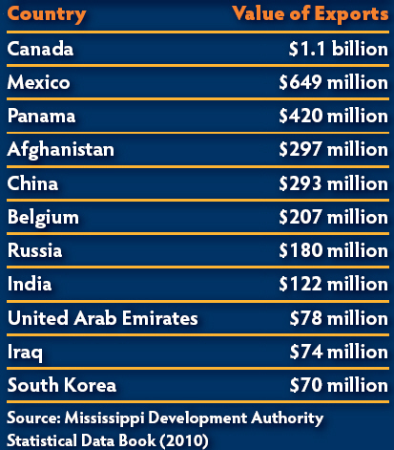
Mississippi in the Global Economy
Governor Bill Waller introduced foreign trade missions in the 1970s. After he left office, his mission continued.
19 countries own 112 manufacturing plants in Mississippi.

Slide 16
Environmental Resources
A resource is anything that can be consumed or used by people.
Renewable resources are resources that can naturally renew themselves like plants and animals.
Coal, oil, and gas are non-renewable resources that cannot be replaced once they are used.
Plastic, aluminum, and paper products are recyclable resources.

Slide 17
Environmental Resources: Protecting the Environment
Consumers must be aware of the effect they have on the environment.
We must remember to manage our resources carefully because pollution and waste management is a concern for everyone on Earth.
Fortunately, things are becoming more environmentally friendly, but more can still be done to preserve our resources.

Slide 18
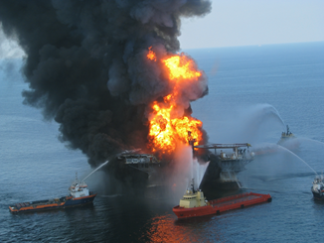
Environmental Resources:
The BP Oil Spill
On April 20, 2010, BP experienced an explosion on one of its oil rigs in the Gulf of Mexico.
For five months, oil leaked out, killing wildlife and the tourism and fishing industries.
The damage went from Florida to Texas and is probably the most expensive environmental disaster in history.
BP spent $20 billion to help the reconstruction of the Gulf Coast.
In September 2012, the Department of the Interior released new regulations that would reduce the likelihood of another oil spill.

Slide 19
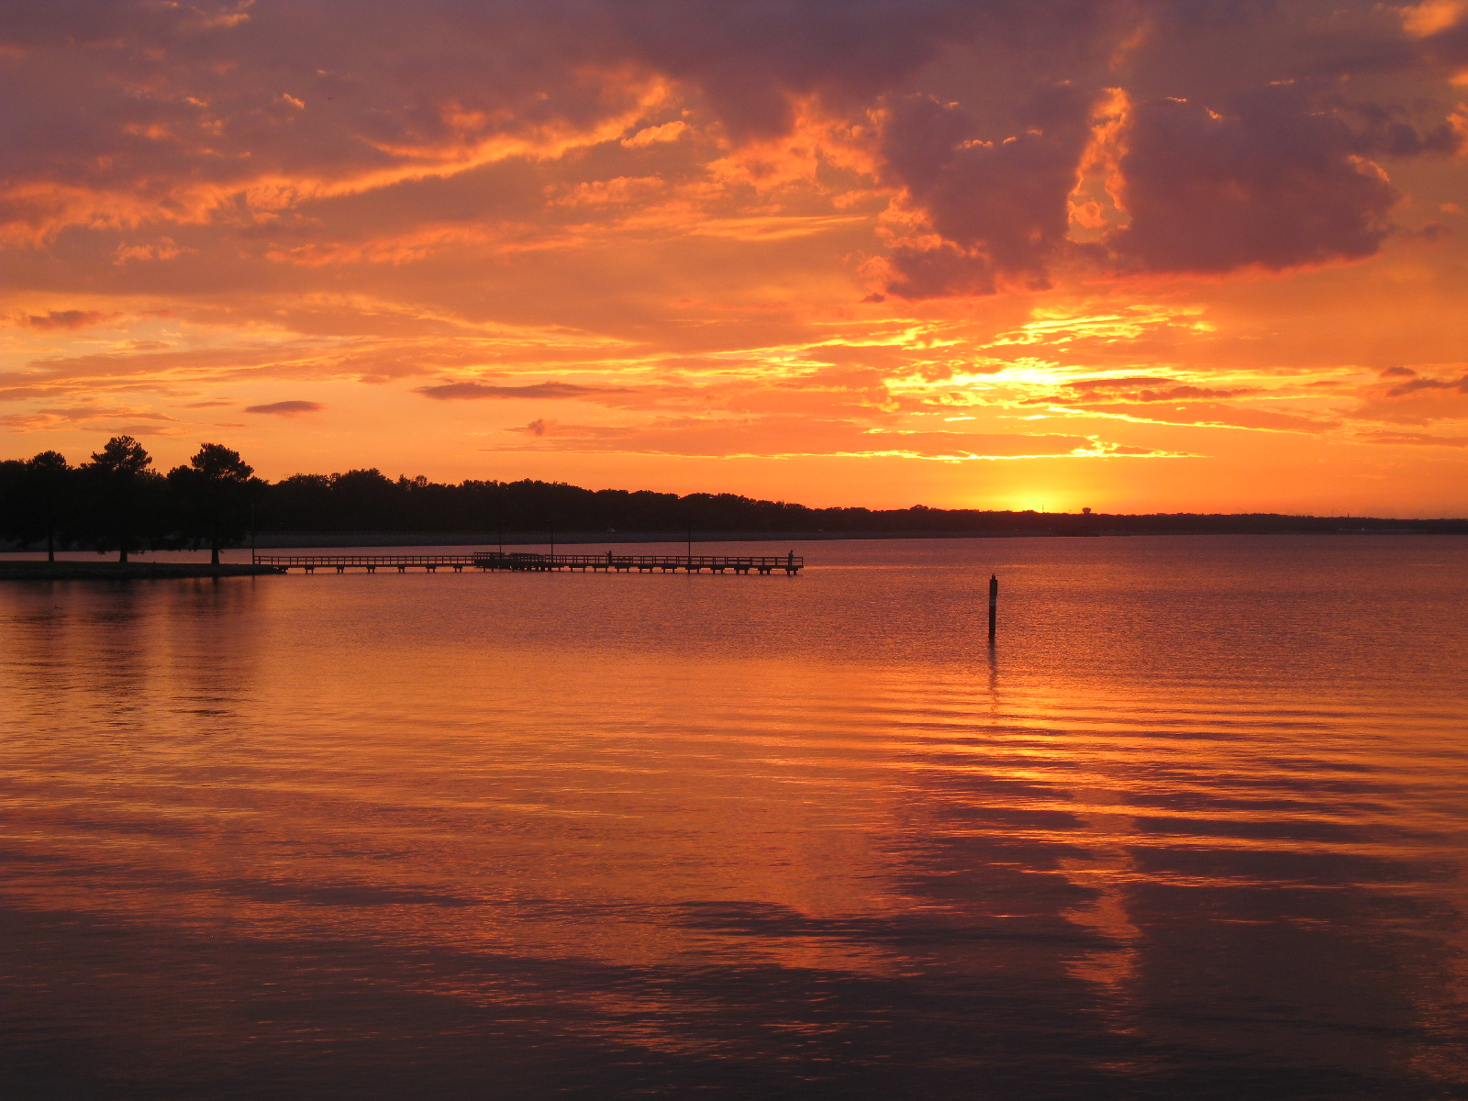
Image Credits
Slide 1: allstarecho on Wikimedia Commons; Slide 2: Public Domain Wikimedia Commons; Image Credits slide: Thomas R. Machnitzki on Wikimedia Commons; all others Clairmont Press or public domain
Return to Main Menu

