Slide 1
OKLAHOMA:
Our History Our Home
Chapter 3:
European Quest for New Land
STUDY PRESENTATION
© 2020 Clairmont Press

Slide 2
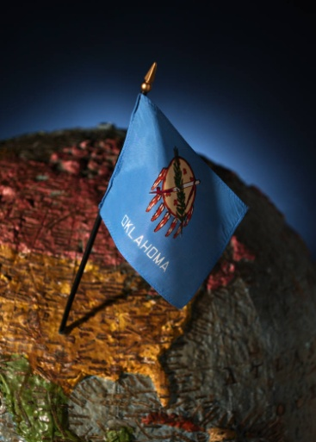
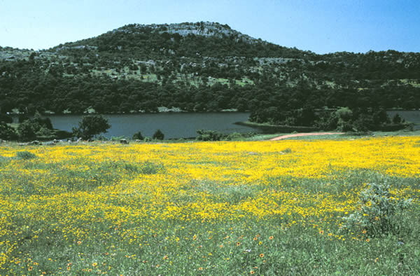
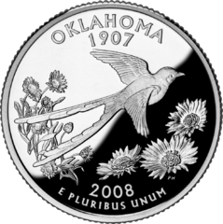
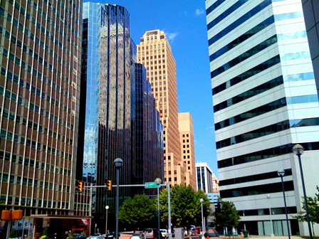
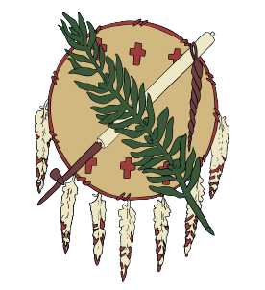
Section 2: European-Indian Contact

Slide 3
Section 2: European-Indian Contact
Essential Question:
What were the effects on Indians of contact with Europeans?

Slide 4
Section 2: European-Indian Contact
What terms do I need to know?
economy
calumet
immunity

Slide 5
Introduction
Many Native Americans were involved in trade networks.
Some tribes very skilled at trading when the Spanish and French arrived.
Food, clothes, and shelter were primarily for their own use.
Trade among Indians was traditional.
Demand for fur and hides, desired by Europeans, changed the Indians’ economy.

Slide 6
Horse Sense
Horses had an immediate and significant impact on Indian life.
They were called “magic dogs” and “wonder dogs.”
Their power updated the Indians and allowed more permanent villages.
Their endurance extended the range of Indian life and adventure.
Other animals adopted by Indians included pigs, chickens, sheep, and goats.

Slide 7
Plants
New world food included maize (corn), beans, potatoes, squash, pumpkins, cacao, tomatoes, bell peppers, peanuts, passion fruit, sunflowers, and almost 50 varieties of berries.
Indians, for thousands of years, grew, chewed, and smoked tobacco; it became a major export to Europe.
Coffee, wheat, rice, melons, and onions were among the food plants brought to the New World by Europeans.

Slide 8
Disease
Europeans brought diseases to Indians for which the Indians were unprepared.
In Mexico, as many as 9 million out of 10 million may have died from diseases and/or battle.
Smallpox was deadliest to all Indians.
Immunity came too late to rebuild Indian populations before being conquered.

Slide 9
Image Credits
Slide 1: Daniel Mayer on Wikimedia Commons; Slide 2: Public Domain; Image Credits Slide: Thomas Jones on Wikimedia Commons; all other public domain
Return to Main Menu

