Slide 1
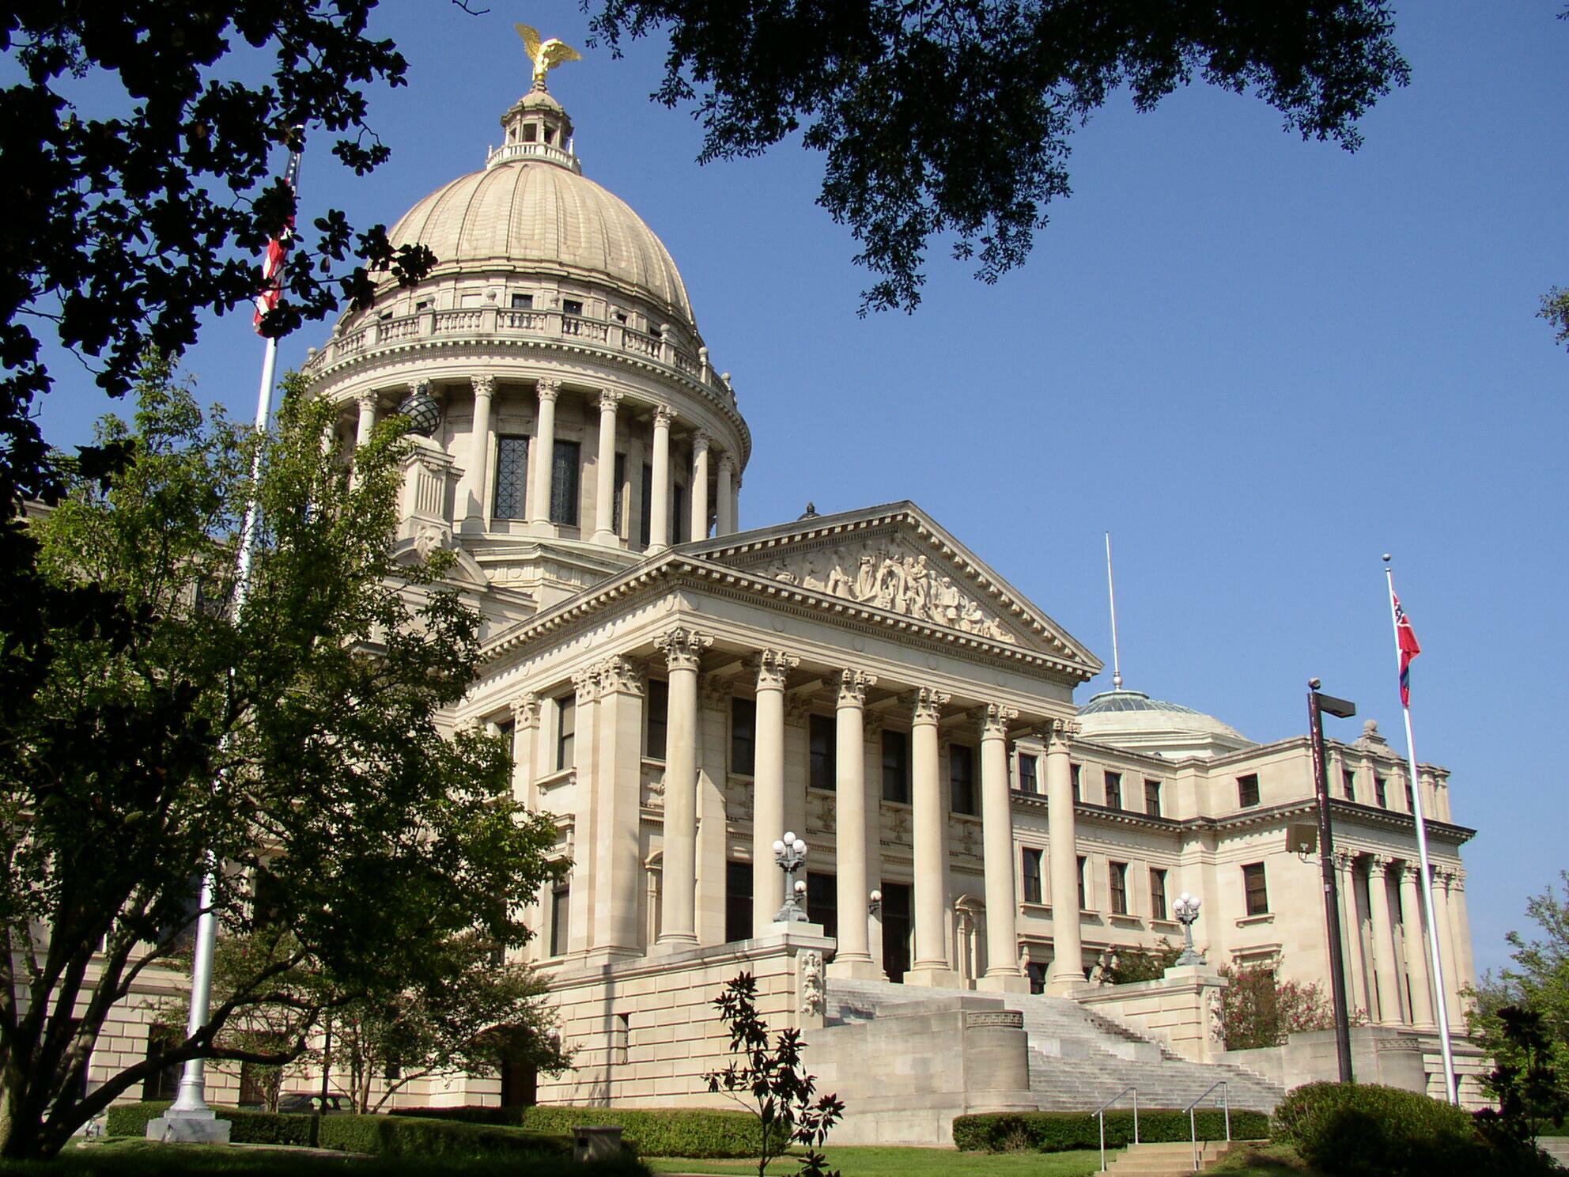
A Place Called Mississippi
Chapter 3: The European Period, 1540-1798
STUDY PRESENTATION
© 2020 Clairmont Press

Slide 2
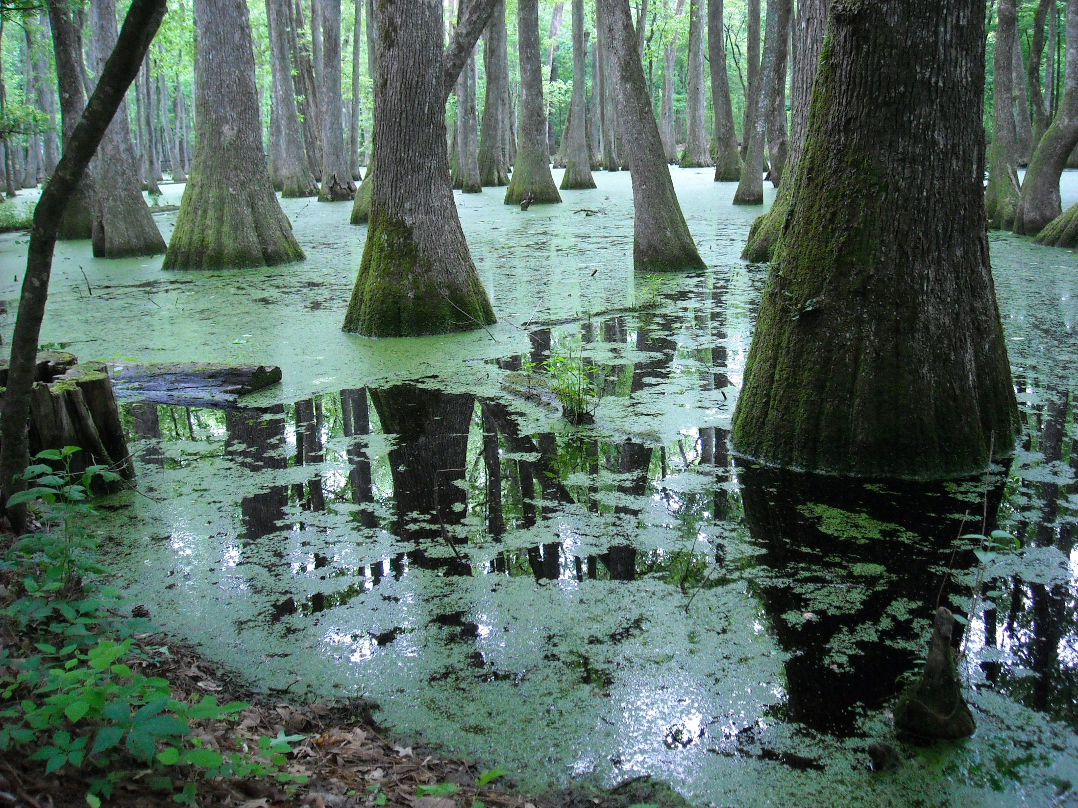
Section 4: A Spanish Province, 1783-1798

Slide 3
Section 4: A Spanish Province,
1783-1798
Essential Question: What effects did Spanish rule have on the people of Mississippi?

Slide 4
Section 4: A Spanish Province,
1783-1798
What terms do I need to know?
  militia
  Treaty of San Lorenzo
  right of deposit

Slide 5
Introduction
The Natchez District experienced growth and prosperity under Spanish control.
Spain was a Catholic nation, but Jews and Protestants were guaranteed religious freedom by the Spanish government.
The majority of the Natchez District population spoke English rather than Spanish.

Slide 6
Governor Manuel Gayoso de Lemos
Manuel Gayoso de Lemos was appointed governor of the Natchez District in 1789.
Gayoso ruled wisely and had the respect and cooperation of its citizens.
Gayoso became famous for parties and festivities held at his mansion.

Slide 7
Spanish Forts
Fort Rosalie was falling apart when Gayoso came to Natchez.
Instead of repairing Fort Rosalie, Gayoso decided to build several new forts.
Fort Nogales was built in Vicksburg in 1795 and a fort on Chickasaw Bluffs was built the same year.

Slide 8
Population Increase
Population growth in the Natchez District kept up with economic development.
As cotton culture increased, the Spanish encouraged settlers to bring their slaves to the Natchez District; additional land grants were given to slave owners.

Slide 9
Slave Revolt in 1795
Rumors of a slave revolt spread throughout the Natchez District in 1795.
The supposed revolt slave leaders were arrested and killed.
Rumors of the specific slave revolt were ended, but several rumors continued throughout the period of slavery, keeping the Southern whites fearful.

Slide 10
America Acquires Mississippi
In 1795, the Spanish gave up their claim to land north of the 31° parallel.
Under the Treaty of San Lorenzo in 1795, Americans were given free navigation of the Mississippi River, and they were given the right of deposit in New Orleans.
Spain also promised to help keep Native Americans from attacking the American settlements along the Spanish Florida border.
Spanish authorities did not want to leave Natchez but had no reason to stay; Mississippi became an American possession.
From 1798 to 1861, Mississippi became the leading cotton-producing state in America (Heartland of the Cotton Kingdom).

Slide 11
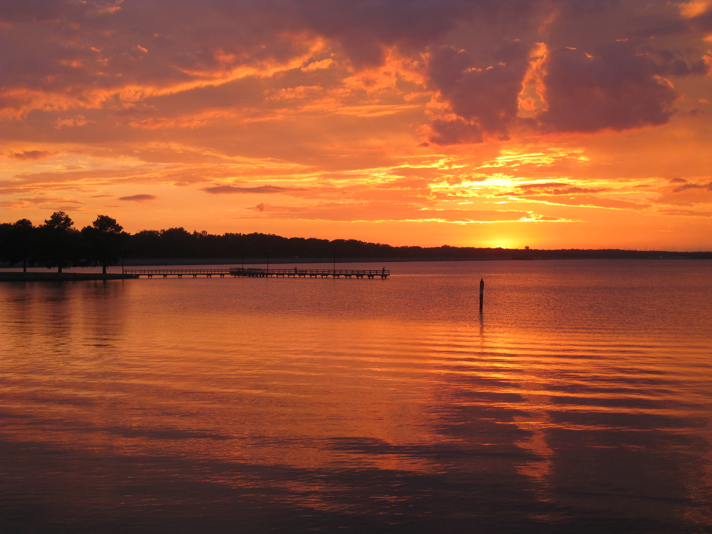
Image Credits
Slide 1: allstarecho on Wikimedia Commons; Slide 2, 18, 19, 32: Public Domain Wikimedia Commons; Image Credits slide: Eskimo.the on Wikimedia Commons
Return to Main Menu

