Slide 1
SMART SKILLS
Week 1 – Map 1
© 2017 Clairmont Press

Slide 2
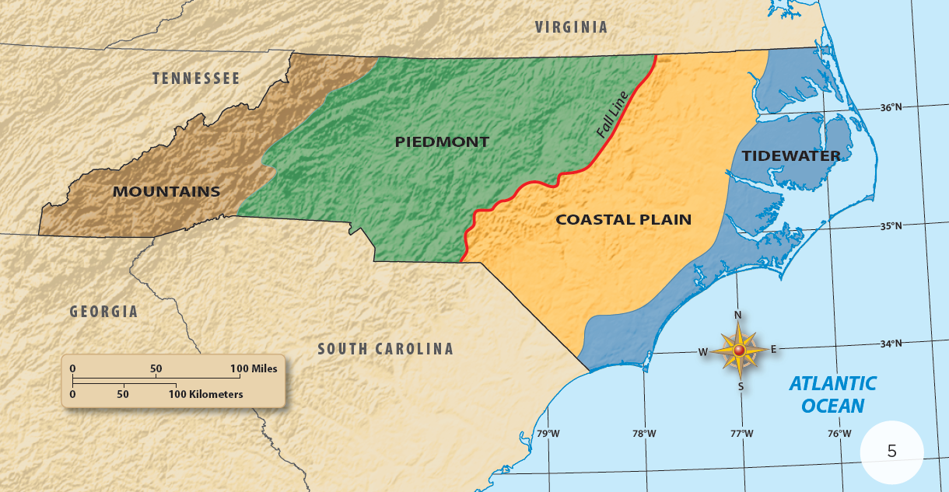
Monday
Where do you live on the map? What clues on the map help you to locate your home? What could be added to make it easier to locate your home on the map?

Slide 3
Tuesday
What do the colors on the map indicate? What do the colors tell you about where you live?

Slide 4
Wednesday
Give an example of one place you know about in each of the colored areas on the map.

Slide 5
Thursday
Choose two of the regions marked by the colored areas. Describe the land in the two regions.

Slide 6
Friday
Choose one of the regions colored on the map as a place you would like to visit for a vacation. Explain why you would like to go there.

Slide 7
Image Credits
Title Slide: Public Doman, Wikimedia Commons; End Slide: Reginald Lankford, Clairmont Press
Shown here: Manteo, NC
Return to Main Menu

