Slide 1
OKLAHOMA:
Our History Our Home
Chapter 1:
Where in the World is Oklahoma?
STUDY PRESENTATION
© 2020 Clairmont Press

Slide 2
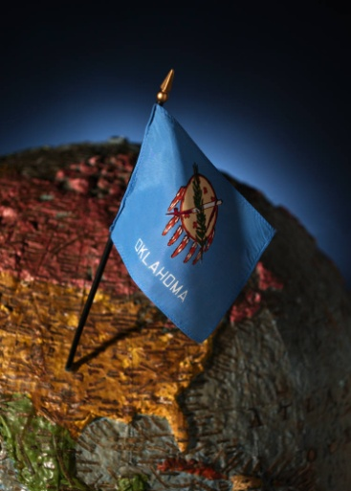
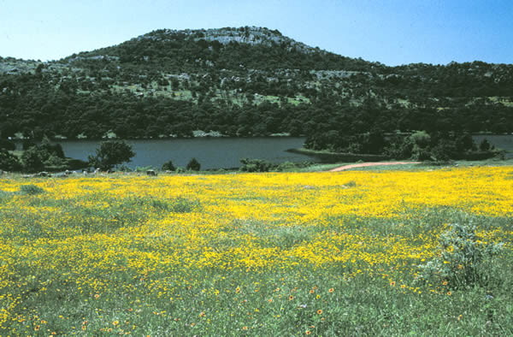
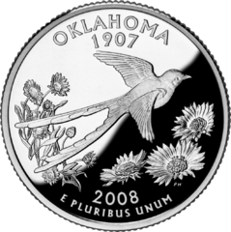
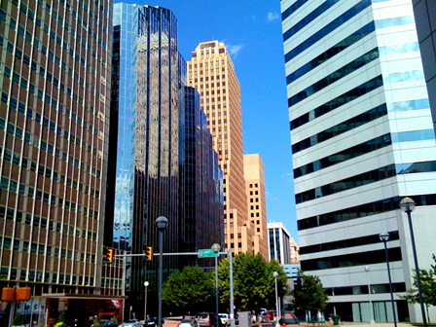
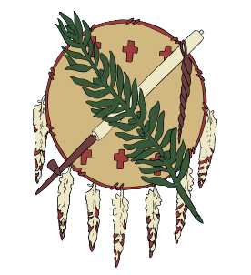
Section 1: What is Geography?
Section 2: Geographic Regions
Section 3: Oklahoma’s Natural Resources
Section 4: Oklahoma’s Climate

Slide 3
Section 1: What is Geography?
Essential Question:
How does geographic location affect our state?

Slide 4
Section 1: What is Geography?
What terms do I need to know?
geography
latitude
longitude

Slide 5
Introduction
geography: the study of Earth’s physical features and how people interact with them
all life affected by geography, and geography is affected by life
helps us learn about ourselves, history, relationships, and the globe

Slide 6
Location
Oklahoma is located between 94°29' and 103° W longitude.
It lies between 33°39' and 37°N latitude.
The 1829 Missouri Compromise set 36°30' N latitude as the boundary where slavery could exist and included the territory that became our state.

Slide 8
Oklahoma Geographic Statistics
Area (mi²) | About 70,000
Widest (miles) | 464
Longest (miles) | 320
Rank (U.S. states) | 18
# of Counties | 77
Relative Location | about halfway between Los Angeles, CA and Washington, DC

Slide 9
Section 2: Geographic Regions
Essential Question:
How do Oklahoma’s geographic regions differ?

Slide 10
Section 2: Geographic Regions
What terms do I need to know?
erosion
basin
topography
mesa
butte
ecosystem
plateau

Slide 11
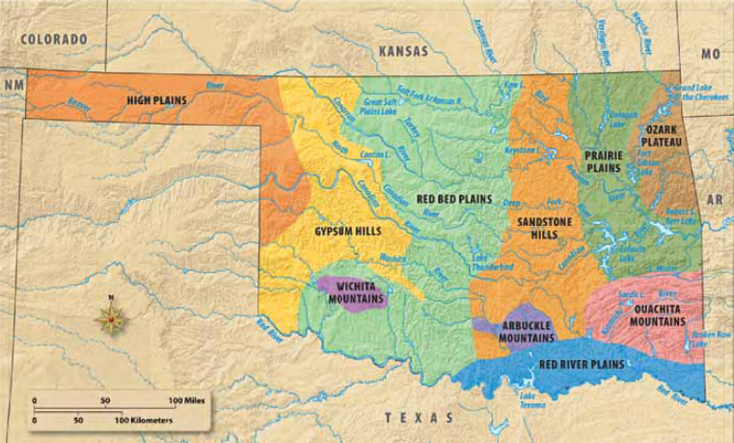
Section 2: Geographic Regions

Slide 12
High Plains
Panhandle and land along part of the western border
Black Mesa in Cimarron County formed by prehistoric volcano eruption in southeastern Colorado
Antelope Hills rise in gypsum peaks south of the Canadian River.
Region favored by stargazers due to lack of electric lights
Wildlife: quail, dove, duck, wild turkey, pheasant, deer, elk, antelope, and prairie dog
Lake Optima and Beaver Dunes State Park: great recreational opportunities
Guymon: largest city in the region
Major economic producers: cattle, hog feed lots, farming, ranching, petroleum & natural gas
This marker in Black Mesa State Park and Nature Preserve marks the state’s highest point.
Regions Map

Slide 13
Gypsum Hills
The hills cover a large area from the Kansas border to the southwestern corner of the state.
Features are a result of the evaporation of ancient seas.
The area named for the white gypsum buttes.
Springs and caves found in the region include the Alabaster Caverns and Selman Bat Cave.
Rich soils produce winter wheat, hay, alfalfa, soybeans, & cotton.
Cattle are the primary livestock.
Oil and natural gas are in many areas.
Regions Map

Slide 14
Red Bed Plains
Red-orange shale and clay soil partly formed from ancient shallow seas; salt deposits were left when the seas evaporated.
State rock: the rose rock is found near Noble.
The Great Salt Plains National Wildlife Refuge: only place in the world one can dig for hourglass selenite crystals; a major resting site for thousands of migratory birds
Roman Nose State Park: once a Cheyenne campground
Little Sahara State Park: over 1,600 acres of sand dunes ranging from 25 – 75 feet high
Fertile soil ideal for growing wheat, hay, peanuts, and cotton – grasslands for cattle and horses
Oil and natural gas wells dot the countryside.
Oklahoma City: state’s largest city (532,517)
Regions Map

Slide 15
Wichita Mountains
500 million years ago mountains began to form from ancient lava flows.
Peaks are now eroded by climatic forces.
Huge granite boulders are popular for rock climbing.
The Wichita Mountains Wildlife Refuge was set aside from the Comanche-Kiowa-Apache Reservation in 1901.
The area around the base of the mountains is a mixed grass prairie.
Home to longhorn cattle, elk, deer, wild turkey, and numerous smaller animals and birds
The town Medicine Park is a planned resort of homes and shops made of granite cobblestones.
Meers began as a mining camp resulting from stories of gold.
A large granite “knob” in the Wichita Mountains is shaped by forces of erosion.
Regions Map

Slide 16
Sandstone Hills
The Tallgrass Prairie Preserve: north of Pawhuska in the Flint Hills, one of North America’s former major ecosystems
Sandstone and shale are main rocks with sandstone hills up to 400 feet
Buffalo graze on tall bluestem, Indian grass, and switchgrass
Oilman, Frank Phillips - responsible for Woolaroc Wildlife Preserve and Museum
Poultry and egg farms, ranching, oil, and natural gas are important industries.
1920s: the Osage Indians among the wealthiest people in the country due to the discovery of oil
Coal mining spurred growth in the McAlester area.
Part of metropolitan Tulsa is in the region.
Regions Map

Slide 17
Arbuckle Mountains
The range runs east to west and is part of a very old mountain system.
Exposed granite in Murray County is 1.4 billion years old.
The region is composed of limestone, dolomite, sandstone, and shale.
Mineral resources are limestone, dolomite, glass sand, granite, sand and gravel, shale, iron ore, lead, zinc, tar sands, oil and gas.
Initial Point Mark: established in 1870 to divide most of the state into townships and sections.
The Chickasaw National Recreation Area is the oldest park in Oklahoma.
Turner Falls Park has two natural swimming pools and a 77-foot waterfall.
Turner Falls is in south-central Oklahoma.
Regions Map

Slide 18
Prairie Plains
The prairie plains contain many hard sandstone hills and ridges.
Rich soil grows everything from strawberries to tomatoes.
Water is a major feature of region.
Eufaula and Oologah are important lakes.
The Oklahoma Aquarium is in Jenks.
Port of Catoosa: international shipping port and the most inland, ice-free port in the United States.
The McClellan-Kerr Arkansas River Navigation System covers 445 river miles.
The region includes Tulsa, the state’s second largest city.
Major coal areas and most is surface mined.
The Eufaula Dam was constructed by the U.S. Army Corps of Engineers.
Regions Map

Slide 19
Ozark Plateau
The plateau is part of the Ozark Mountain chain of Missouri and Arkansas.
Much of the region is heavily wooded with oak, hickory, and elm.
Many fruits, berries, and vegetables are grown in area.
Lead and zinc were mined in past.
The Illinois and Grand are two main rivers.
The Pensacola Dam created the Grand Lake O’ the Cherokees.
Regions Map

Slide 20
Ouachita Mountains
The region has towering pine and hardwood trees and is some of the roughest land in the state.
Ouachita-Ozark was once a part of a mighty mountain range from the Appalachian Highlands to southwest Texas.
Rich Mountain is the highest peak in the region at 2,666 feet.
The mountains once provided safety for Indian people and hideouts for outlaws.
Very popular parks in the region: Beavers Bend, Robbers Cave, Spiro Mounds, Heavener Runestone, Talimena, Clayton Lake & Lake Wister.
Talimena Drive is known for its fall foliage.
Grazing lands, small farms, and lumbering are important to the region’s economy.
Regions Map

Slide 21
Red River Plains
The Red River Plains is a southeastern region that lies along the Red River and has rich, sandy soils and a long growing season.
The area was ideal for melons, squash, corn, and pumpkins used by early Indians.
Red River dams provide better flood control and more area available for farming.
The eastern part of region includes cypress swamps and forests.
Lakes include the Texoma, Murray, and Hugo.
“Great Raft”: 150-mile jam of logs & debris along the Red River in early 1800s
Forts Towson, Washita, and Arbuckle became centers for Choctaw and Chickasaw cotton plantations.
Regions Map

Slide 22
Section 3: Oklahoma’s Natural Resources
Essential Question:
How do Oklahomans make use of the state’s natural resources?

Slide 23
Section 3: Oklahoma’s Natural Resources
What terms do I need to know?
natural resources
irrigation
drought
fossil fuels
wildcatter
aquifer

Slide 24
Soils
One of state’s important natural resources
Soil: composed of organic matter, loose rock material, water, and air
Mollisols: largest soil group of Oklahoma
Port silt loam soil: named as one of Oklahoma’s state symbols
Good for growing alfalfa, grains, cotton and other sown crops, range, pasture, and woodland
Soil types: sand, silt, or clay
1920s: new technology produced more crops
The Dust Bowl (1930s) affected the panhandle of Oklahoma.
U.S. Soil Conservation Service (1935) was created to manage erosion and use soils wisely.

Slide 25
Vegetation
Western part of the state - early settlers found grasses as tall as the wagon bed
Paths cleared: allowed children to walk to school
Climate changes and humans cause a tug-of-war between grasslands & woodlands
20% of the land, about 10 million acres, is forested; about 140 tree species native to the state
6 million acres of commercial forest
Oak & pine: most valuable timber commercially
Trees: milled into fiberboard, plywood, & paper
By 1956 the U.S. Forest Service estimated only 15% of original hardwoods remained.
Forests slowly being reforested with new trees, better management, and wildlife containment.
Cedar wood products: mulch, litter box chips, lumber, and insect repellent

Slide 26
Mineral Resources: Oil and Natural Gas
First oil seepages spotted by Indians; petroleum produced in 1882
Nellie Johnston No. 1 (1887) near Bartlesville: first major oil discovery; wildcatters streamed in the territory
1901: Red Fork field near Tulsa first well to be financially significant
The Glenn Pool (1905): another early successful oil well
Tulsa became known as the “Oil Capital of the World”
By statehood, Oklahoma produced 40 million barrels of oil a year.
1920: production up to more than a billion barrels a year
1928: oil boom moved to Oklahoma City
1930: “Wild Mary Sudik” began gushing out oil and natural gas
Oklahoma: ranks in the top six states in the nation in oil production and top three in natural gas
2004: output = 171,000 barrels a day

Slide 27
Mineral Resources: Coal
Coal dug first by hands of Indians and sold by the basket
1873: commercial coal mining began in Oklahoma
Coal deposits all in the eastern part of the state including Arkoma Basin
Most mining done in surface operations; nearly 1.6 million tons of coal produced in Hartshorne and McAlester

Slide 28
Mineral Resources: Nonfuel Minerals
Zinc, lead, manganese, and iron mined in the past
Sand and gravel are found throughout the state and are used for building construction and roadways.
Oklahoma granite called “grey gold”: found mainly in the Arbuckle & Wichita mountains
The state capitol built of granite from Tishomingo and black granite from Cold Springs.
Limestone is mined in more than 30 counties and used for making cement and fertilizer.
Clay found in the state is used for making bricks to build homes and buildings and for pottery.
Glass is produced from silica sands from south-central Oklahoma.
Oklahoma is 3rd in the country in helium production: a byproduct of natural gas wells.
Gypsum is used to make drywall and plaster for construction, cement, chalk, dental molds, surgical casts, paint filler, toothpaste, soil additives, tofu, and plaster of Paris.
Oklahoma is the only state that produces iodine.

Slide 29
Mineral Resources: Salt
State’s salt resources in use for centuries
Salt plains: contained within several counties in northwestern Oklahoma
Eastern part of the state: numerous salt springs
Removing the salt from the springs requires boiling the water until the water evaporates, leaving the salt.
Salt on the plains: only needs to be loaded

Slide 30
Groundwater
One of the most valuable resources to human life
Underground basins called aquifers: porous gravel, rock and sand that hold water that seeps down from rainfall, lakes, and ponds
Nearly half Oklahoma’s water is taken from aquifers.
Ogallala aquifer: runs from Texas into the edge of South Dakota & from portions of five other states
Stretches across the Panhandle & part of northwestern Oklahoma
Ogallala aquifer is perhaps the most important aquifer in the state and provides millions of gallons of water used to irrigate fields.
Water is being used for irrigation and development faster than it can be replenished by rainfall, a major ecological problem for the future.

Slide 31
Waterways
More than 500 rivers and streams or 78,578 miles; 34 major reservoirs
Hundreds of lakes and ponds supply 60% of water consumed
Much water used for agricultural irrigation
Surface water used for municipal water supplies, mining, and recreation
Manmade lakes and dams were an effort to provide water for city, industrial, & agricultural growth and flood control; more manmade lakes than any other state in the nation
Eufaula and Texoma are the state’s largest lakes.
The U.S. Army Corps of Engineers, the U.S. Bureau of Reclamation, and the Grand River Dam Authority are responsible for building the lakes.
Western streams tend to be wide and sandy with high gypsum and salt concentrations.
Streams in the east receive more rainfall and are generally deeper with rock banks and more rapid flow.
Rivers in Oklahoma usually flow from northwest to southeast.
The Arkansas and the Red Rivers have large drainage systems in Oklahoma.

Slide 32
Section 4: Oklahoma’s Climate
Essential Question:
How has climate affected life in Oklahoma?

Slide 33
Section 4: Oklahoma’s Climate
What terms do I need to know?
weather
climate
elevation
tornado

Slide 34
Temperatures
Average temperature: about 60°F
Winters: short and mild
Below-freezing temperatures about 60 days in the south and 95 days in the north
January: coldest month averaging 36°F
Summers: long and hot
July and August: temperatures exceed 90°F
Indian Summer: periods that extend high temperatures into fall and provide long growing season for agriculture – 168 days in north to 225 days along the Red River

Slide 35
Precipitation
Great variation in rainfall influenced by latitude and elevation.
Southeastern section averages 51 inches of rain per year
The Panhandle: about 15 inches per year
Snowfall averages two inches in the southeast and up to 30 inches in the Panhandle.
Hail storms, torrential rain, and lightning all cause damage.
Water control projects are a great help to flood-prone areas.
Severe weather can result in dangerous lightning – about $1 million/year in Oklahoma

Slide 36
Tornadoes
Oklahoma is a part of “Tornado Alley.”
Funnels result with winds rotating counterclockwise.
They are usually less than a quarter-mile wide but may be two miles wide.
Average 54 per year
1999: most active with 145
1988: only 17
The National Severe Storms Laboratory is located in Norman.
A truck was wrapped around a utility pole as a result of a tornado near Moore, OK in 1999.

Slide 37
Climate and the Economy
Winds are both damaging and appreciated.
They provide power for windmills to pump water and generate electricity to rural homes.
Wind “farms” consist of giant wind turbines that generate electricity when the wind blows.
Transmission lines move electricity to the consumer.
The Blue Canyon wind farm is located near Lawton, OK.

Slide 38
Image Credits
Slide 1: Daniel Mayer on Wikimedia Commons; Slide 2: Public Domain; Slide 3: Gilderian on Wikimedia Commons; Slide 15: U.S. Fish and Wildlife Service; Slide 17: Emerson Biggins on Wikimedia Commons; Slide 18: U.S. Army Corps of Engineers; Slide 36: NOAA; Slide 37: James Fleeting; Image Credits Slide: Thomas Jones on Wikimedia Commons; all others public domain
Return to Main Menu

