Slide 1
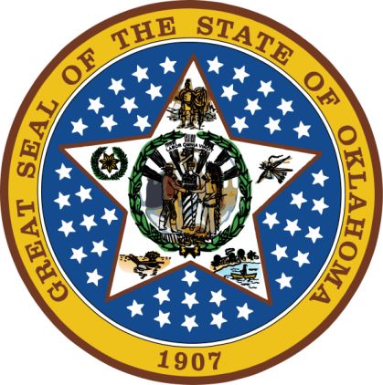
OKLAHOMA:
Our History Our Home
Chapter 4:
Oklahoma in Early America
STUDY PRESENTATION
© 2020 Clairmont Press

Slide 2
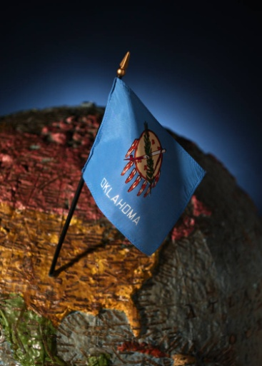
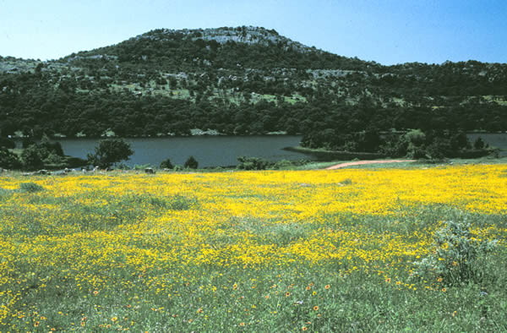
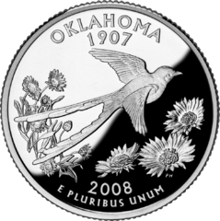
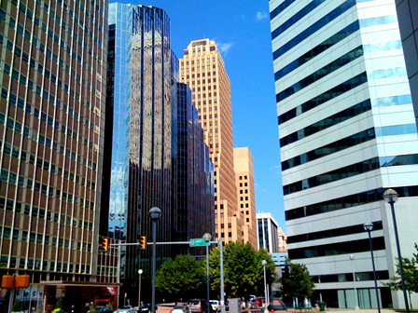
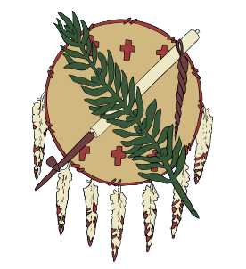
Section 1: Colonial America
Section 2: The Louisiana Purchase

Slide 3
Section 1: Colonial America
Essential Question:
How did the ambitions of European countries affect North America in the 17th and 18th centuries?

Slide 4
Section 1: Colonial America
What terms do I need to know?
frontier
confederacy
treaty
encroachment
long hunter
constitution
manifest destiny

Slide 5
European Claims
Spain claimed Florida and settled St. Augustine in 1565 along with Texas and California.
The English settled Jamestown (Virginia) in 1607, and added other colonies on the Atlantic coast into extreme northern Canada.
France built trading posts in Canada, the Great Lakes, and the western Mississippi River basin south to lands that would become Oklahoma.
Holland and Sweden failed to keep settlements on the Atlantic coast.
Russia advanced into Alaska.

Slide 6
European Claims in North America

Slide 7
Indian Relations
Europeans sometimes pitted tribe against tribe, or befriended or traded with tribes, depending on their needs.
Tribes sometimes pitted the Europeans against each other.
Choctaws usually favored the French.
The French usually treated natives as equals and were less harsh than the Spanish.
Chickasaw occupied the Mississippi Valley and were friendly with the British, but against the Choctaws and French.
Trade issues continued to cause problems amongst all parties.
The battle of the Twin Villages resulted along the Red River between Spanish-supported Apache and French-supported Wichita as Spain tried to slow the advance of the French.

Slide 8
The French and Indian War
The French and Indian War (1689-1763) was a series of wars between Britain, France, and Spain.
In 1754, George Washington led a small troop west to warn the French not to push into British territory.
Iroquois Confederacy fighters and British troops fought against the French and their Indian allies for six years.
In 1762, Spain entered war in North America on the side of France in exchange for the Louisiana territory (including Oklahoma) and the “Isle of Orleans” by the Treaty of Fontainebleau.
Fighting ended in 1760 with the Treaty of Paris signed in 1763.
France lost Canada and lands in the Mississippi Valley to Britain.
Spain traded Florida to Britain for Cuba.
No provisions were made for the Indians living on these lands.
British settlers desired more land in areas occupied by Indians
In 1763, a treaty signed regarding encroachment onto Indian lands (by the governors of Virginia, North Carolina, South Carolina, and Georgia, with leaders of the Creeks, Choctaws, Cherokees, and Chickasaws)
Lines were established beyond which the British promised not to settle.

Slide 9
Repairing Relations
Spain worked to improve relations with Indians living in “Spanish Louisiana.”
Many French remained, including traders.
Pierre Laclede and Auguste Chouteau established St. Louis in 1764 at the confluence of the Mississippi and Missouri rivers.
Long hunters, hunters gone for an extended time, were numerous (e.g. Daniel Boone).
Oklahoma was part of Spanish-controlled Louisiana; the British kept pushing westward toward that territory.

Slide 10
The Colonists Revolt
The Stamp Act (1765) was enacted by the British Parliament to help pay debts from the war. It taxed printed goods and legal documents.
Colonists did not elect members of Parliament, so they felt they were being taxed without a chance to vote, violating English law and tradition.
“No taxation without representation” was a common slogan.
The Revolutionary War began on April 19, 1775 with battles at Lexington and Concord, Massachusetts,
The Declaration of Independence signed July 4, 1776.
France pledged support for the United States in 1778.
Spain entered the war against Britain and regained Florida.
War ended in 1781 and the Treaty of Paris was signed (1783).
In 1787, the United States Constitution was written to improve government functions.
Cherokee and Creek Indians joined the British in the war and suffered great loss.
The Treaty of Hopewell (1785) confirmed Cherokee boundaries, but white settlers continued to push westward.

Slide 11
New Political Power
Americans wanted access to more lands and travel on the Mississippi River.
This caused conflict with Spain.
In Pinckney’s Treaty (1795), Americans gained navigation rights on the Mississippi, the right to store goods in New Orleans, and, to set the southern boundary of the United States.
Trails were found to connect trading posts.
Pedro Vial and Francisco Fragoso made a trail from Santa Fe to the Wichita Mountains in OK, then followed the Red River to Natchitoches, LA. It was called the Great Spanish Road.

Slide 12
Section 2: The Louisiana Purchase
Essential Question:
How did the Louisiana Purchase influence the development of Oklahoma?

Slide 13
Section 2: The Louisiana Purchase
What terms do I need to know?
epidemic
ratify
appropriate
pirogue
protégé
renegade

Slide 14
Introduction
Napoleon Bonaparte seized power in France after the French Revolution, 1799.
Bonaparte wanted to conquer the world and restore the French empire in North America.
Thomas Jefferson feared French control of New Orleans.
Napoleon tried to regain control of Haiti.
The U.S. was able to purchase the Louisiana Territory from France. The new territory had to be explored, organized, and governed.
Oklahoma was part of the District of Louisiana.

Slide 15
Louisiana Purchase

Slide 16
Exploring the Louisiana Purchase
1803: President Jefferson asked Congress to fund an expedition to explore the new lands to the Pacific Ocean.
Meriwether Lewis was commander along with William Clark.
The Corps of Discovery began in 1804 with the team venturing up the Missouri River.
The group returned in 1806 and had traveled 4,000 miles to the Pacific Ocean and back.
Lewis became governor of Louisiana; Clark served as Indian agent for the West and later governor of Missouri Territory.

Slide 17
The Sparks Expedition
The Sparks Expedition was a “Grand Excursion” to explore the southwestern part of the Louisiana Purchase (1806).
Scientists William Dunbar and George Hunter, headed the team, but chose not to complete the expedition.
Capt. Richard Sparks, Thomas Freeman, and Peter Custis led the journey up the Red River.
The expedition was stopped by a Spanish army near the edge of Oklahoma.
Sparks decided to turn back, but they did gather much information.

Slide 18
The Pike-Wilkinson Expedition
Zebulon Pike explored the upper Mississippi region in 1805 and followed with another in 1806 along the Arkansas and Red Rivers.
Lt. James Wilkinson led a part of Pike’s group to explore the Arkansas River.
Wilkinson’s team survived winter hardships to share information about the Osage, Cherokee, Choctaw, and Creek in Oklahoma.
Pike continued west to the Rocky Mountains (Pike’s Peak) and was arrested by Spanish soldiers and held until 1807.

Slide 19
The Sibley Expedition
Salt was an important commodity. It was used for preserving food and tanning hides.
George C. Sibley was sent to search for a rumored “salt mountain” (1811).
He explored Nebraska, Kansas, and into northwest Oklahoma.
He described the “Grand Saline”, 20 miles of salt, 2-6 inches deep.
Salt was also found near the Cimarron River and along the Salt Fork of the Arkansas River.

Slide 20
The Long Expedition
Stephen H. Long made five expeditions covering 26,000 miles including two trips into Oklahoma.
Fort Smith (1817) was built where the Arkansas and Poteau rivers meet.
Expeditions were made along the Red and Arkansas Rivers into Nebraska and along the Platte River.
Long returned with much information about plant and animal life and geography of the region.
The area was called the “Great American Desert” and was determined unsuitable for farming; it would be a good buffer between the U.S. and Spanish Mexico.

Slide 21
The Adams-Onis Treaty of 1819
John Quincy Adams (U.S.) and Luis de Onís (Spain) worked out a treaty.
Spain sold Florida to the U.S. for $5 million.
The boundary was set between Texas and Louisiana at the Sabine River.
Spain claimed all land south of the Red River and along various lines to the Pacific Ocean.
Spain gave up claims on Oregon territory.
Major William Bradford was ordered to expel people illegally entering eastern Oklahoma.
Botanist Thomas Nuttall joined this group to document plants and animals of the region.

Slide 22
The Three Forks Area
Trading posts were established at the meeting of the Arkansas, Verdigris, and Grand Rivers.
Nearby Osage villages traded fur, fowl, honey, bear oil, buffalo robes for beads, blankets, knives, trinkets, and cloth.
Game became scarce, and fur trade slowed in eastern Oklahoma by the 1830s.
Salt, lead, pecans, and grain were exported from Three Forks.
Western Creek exported dried peaches, beans, peanuts, snake root, sarsaparilla, ginseng, corn and rice.

Slide 23
Opening Trade Routes
Mexico won independence from Spain in 1821.
Thomas James, Hugh Glenn, and Nathaniel Pryor led groups from St. Louis toward Santa Fe to establish trade connections.
William Becknell established a trade route that become known as the Santa Fe trail.
Hundreds of people and wagons began to move westward.
These events caused rapid changes in the lives of American Indians in the region.

Slide 24
Image Credits
Slide 1: Daniel Mayer on Wikimedia Commons; Slide 2: Public Domain; Image Credits Slide: Thomas Jones on Wikimedia Commons
Return to Main Menu

