Slide 1
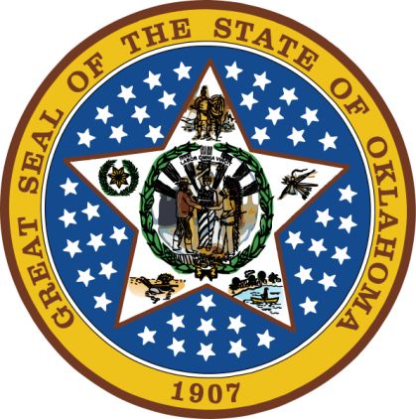
OKLAHOMA:
Our History Our Home
Chapter 6:
New Land, New Beginnings
STUDY PRES6hh6ENTATION
© 2020 Clairmont Press

Slide 2
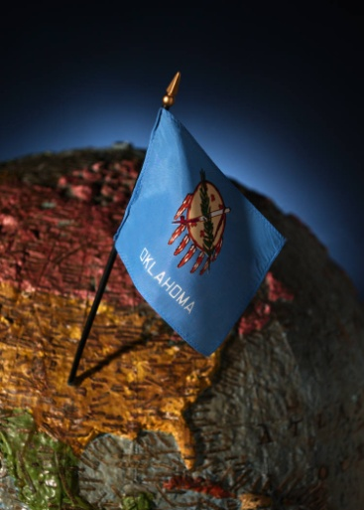
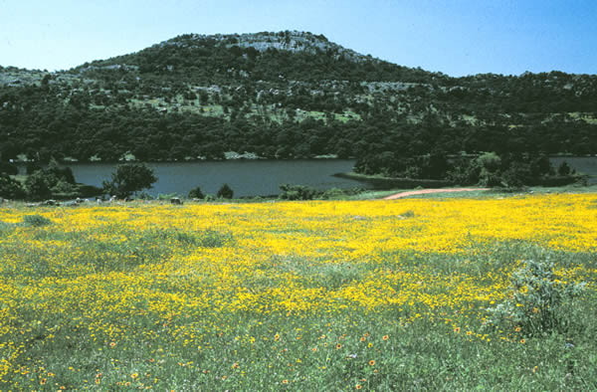
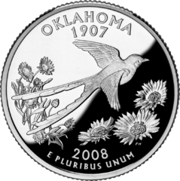
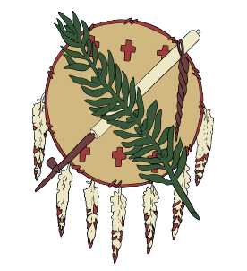
Section 1: Forts
Section 2: Adapting to Indian Territory

Slide 3
Section 1: Forts
Essential Question:
What purposes did forts in Indian Territory serve in the early 1800s?

Slide 4
Section 1: Forts
What terms do I need to know?
negotiations
academy
peacekeeping mission
survey

Slide 5
Negotiating Peace
The Cutthroat Gap Massacre (1833) led by the Osage against the Kiowa led to a push for negotiations and military force to stop attacks.
General Henry Leavenworth led 4000 highly armed and ornamented mounted troops (dragoons) to the region to impress Indians with their military power (1834).
The group suffered from disease and injury; Col. Dodge led 250 dragoons to Wichita Mountains and exchanged prisoners.
Famous painter, George Catlin, was with the group.
Camp Mason (1835) was established for further negotiations which ended with a treaty to allow peace among tribes and with traders.

Slide 6
New Forts
Fort Coffee (1834) was built near Swallow Rock on the Arkansas River and served as an entry point for relocated Choctaw. It was a site for stopping whisky imports, and it became an academy for Choctaw boys.
Fort Wayne (1838), Fort Durant (1842), and Fort Arbuckle (1851) were founded to protect Cherokee, Chickasaw, and Choctaw.
Camp Radziminski (1858) and Fort Cobb (1859) were founded as peacekeeping missions.

Slide 7
Surveying the Land
Confusion and conflict resulted from treaties signed without precise land surveys.
Isaac McCoy (1831) was commissioned to survey the Cherokee Nation.
Further surveys done of Seneca, Ottawa, and Shawnee reservations and the Cherokee Outlet (1837).
Full surveys were not complete until 1866.

Slide 8
Surrounding Changes
The panhandle was claimed by Mexico until Texas’ claim in 1836.
Texans refused to follow Mexican laws (no slavery, convert to Catholicism) and stop American immigrants.
Battle of the Alamo (1836): Texans were defeated but became legendary.
Mexico (Gen. Santa Anna) defeated at San Jacinto and Texans won independence.
The statehood of Arkansas (1836) and Texas (1845) resulted in relocation of 10,000 Native Americans to Indian Territory.
Click for map of Texas (1844)
Return to Main Menu

Slide 9
Section 2: Adapting to Indian Territory
Essential Question:
How did the various tribes settle and govern themselves in Indian Territory?

Slide 10
Section 2: Adapting to Indian Territory
What terms do I need to know?
destitute
human rights
literacy
mission
annuity
emigrant
desperado
minority

Slide 11
Introduction
There were no established towns in Indian Territory when tribes moved west.
Indians lacked shelter, had very little or lost everything, households goods and livestock were stolen or destroyed, and many family members were sick or dead.
The government did not keep promises of tools, household goods, livestock, food, or money.
The first weeks and months in the new land were the hardest.
There were both dishonest traders and trusted traders.
Some tribes were torn apart.

Slide 12
The Five Nations
Food, clothing, and shelter were basic needs on arrival in Indian Territory.
Government had to be established to regain order.
Farms, homes, towns, schools had to be built.
Some had money; some did not.

Slide 13
Indian Territory 1850

Slide 14
Choctaw
1825: The Choctaw constitution was written in Mississippi.
The capital was relocated several times; by 1860 it was in Doaksville.
Government was led by a 27-member council.
Missionaries had been working among Choctaw and encouraging education of children, etc. Presbyterian missionaries followed them during relocation.
1821: Choctaw schools were established before relocation; Wheelock Academy (1833) started after relocation.
Cyrus Byington and Alfred Wright were missionaries that helped develop a written form of Choctaw language.
By 1837, Choctaw had successful farming, cotton gins, grist mills, sawmills, and salt works.
Slaves were used as labor on growing plantations.
Newspapers were The Choctaw Telegraph (1848) and Choctaw Intelligencer (1850).
Fort Towson became the capital (1854) as the population moved toward the Red River.
Light Horsemen policed the area.

Slide 15
Creek
The Muscogee Confederacy relocated in two groups, the Lower Creeks along the Arkansas and Verdigris Rivers and the Upper Creeks along the Canadian River.
They built homes of log cabins with each town (talwa) having its own leader and government (chief, subchief, lawyers to enforce laws).
1839: The two groups created a National Council at High Springs with capital at O-hi-a-hul-way (1848), now Council Hill, OK.
Light Horse became the policemen.
Town members worked in fields and tended farms; slaves were owned by some Creek.
Whiskey, drought, and raids by Plains Indians were each challenges to the Creek.
Missionaries were sent by the Presbyterian and Baptist churches and encouraged development of schools; some Creek opposed this, but others saw the value of skilled labor.
1860: A constitution was written with a central government.
First principal chiefs: Motey Kennard (Lower Creek); Echo Harjo (Upper Creek)

Slide 16
Chickasaw
The Chickasaw district was within in Choctaw lands headed by the minko, or hereditary chief.
Cyrus Harris built a home in Old Boggy Depot; Harris was governor (1856-1858 & 1866-1870).
They raised many crops to sell and supplied emigrants to Texas and California (gold rush).
Light Horsemen tried to stop desperados, whiskey runners, and raids of hostile Indians.
Methodist missionaries started Chickasaw Academy (1848), a school for reading, writing, and farming; girls learned household skills.
1848: first constitution; wanted to be separate from the Choctaw Nation (Treaty of 1855).
The Tishomingo constitution (1856) had three branches of government and four counties.
The Chickasaw and Choctaw Herald (1858) was published in Tishomingo City in English since most of the readers read and spoke English.

Slide 17
Cherokee
Arkansas (Western) Cherokee were led by John Jolly in 1820s -1838; John Ross was leader of Eastern Cherokee in the 1820s and led development of constitutional government.
Eastern Cherokee and Cherokee from East Texas arrived in Indian Territory in 1839.
A new compromise constitution joined the people on July 13, 1839 with Ross as principal chief. Tahlequah became capital in 1840, but the two sides had trouble getting along.
Missionaries set up numerous missions to promote education and skill development. Park Hill missions had a printing press, grist mill shops, stables, book binderies, etc.
Samuel Worcester was a missionary known for advocating on behalf of the Cherokee with the federal government.
They planned for schools at the primary level (by 1841) and a school for boys, and one for girls for higher learning in 1851.
The Cherokee Advocate was published in English and Cherokee.
Farms began to prosper along with merchants and skilled workers such as blacksmiths and wheelwrights.

Slide 18
Seminole
The Seminole had trouble adjusting to cold climate. The first group located north of Canadian River (1836) at the town of Black Dirt. They refused to live under Creek government.
An 1845 treaty gave the Seminole their own area to govern and to protect their legal rights. Most (along with their slaves) moved to the area between the Deep Fork and Canadian Rivers, though the issue of slaves and free blacks continued to be a problem.
One group moved to Mexico, led by Wild Cat (1850).
1856: A treaty created new territory for the Seminole Nation between the North and South Canadian rivers.
Chief John Jumper started the Green Head Prairie community and was joined by more Florida Seminole in 1858.
Rev. Orson Douglas tried to create a way to preach to the Seminole. The Oak Ridge Mission School (1849) was the first school; others were established after the Civil War.
The time from relocation to the Civil War was known as “golden years.”

Slide 19
Later Removals
Fort Cobb was built in the Wichita Mountains to protect against hostile Plains Indians.
Catawba from South Carolina asked to join the Chickasaw, were refused, and joined the Choctaw (1853).
In 1852, over 300 Quapaw joined earlier arrivals between the Grand River and Missouri border.
Seneca chief Little John Spicer gave 200 Wyandot 33,000 acres.
Additional relocations included Kichai, Anadarko, Tonkawa, Caddo, Tawakoni, and Hainai along with the Penateka band of Comanche.

Slide 20
Image Credits
Slide 1: Daniel Mayer on Wikimedia Commons; Slide 2: Public Domain; Image Credits Slide: Thomas Jones on Wikimedia Commons; all others public domain
Return to Main Menu

