Slide 1
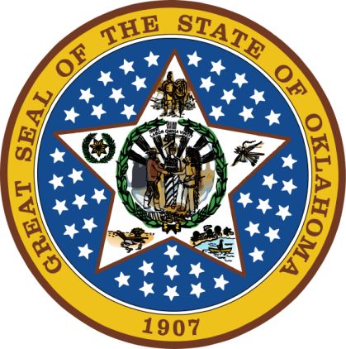
OKLAHOMA:
Our History Our Home
Chapter 9:
Trouble on the Plains
STUDY PRESENTATION
© 2020 Clairmont Press

Slide 2
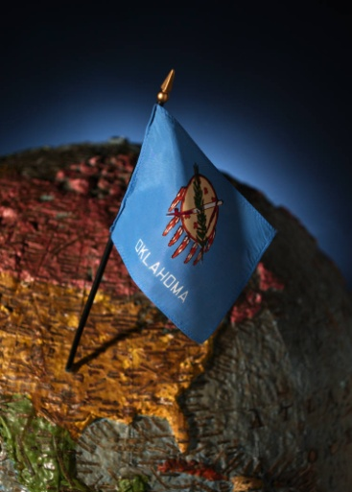
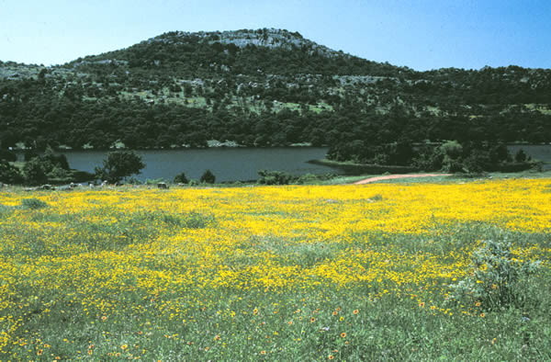
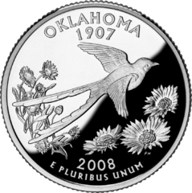
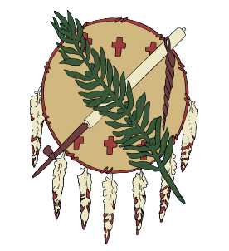
Section 1: From Destruction to Reconstruction
Section 2: War on the Plains

Slide 3
Section 1: From Destruction to Reconstruction
Essential Question:
How did Reconstruction affect life in the Indian Territory?

Slide 4
Section 1: From Destruction to Reconstruction
What terms do I need to know?
Pacific Railroad Act
Homestead Act of 1862
freedmen

Slide 5
Opening the West
The Pacific Railway Act (1862) began the process of building rail and telegraph lines across the U.S.
The Homestead Act of 1862 granted 270 million acres to homesteaders.
Homesteader requirements: over 21; pay $18 fee; build a home, make improvements and farm 5 years on the land.
Thousands of Indians were relocated as more homesteaders moved west.
After the Civil War, new treaties were influenced by politicians from areas being opened to white settlers – they wanted more space in Indian Territory for additional tribes.

Slide 6
Tribal Treaties
1866 brought new tribal treaties.
Terms included abolishing slavery, making freed slaves citizens of the tribe, railroad rights-of-way, terms for loss of land, and a plan for unified government in the Indian Territory.
Oklahoma, a Choctaw term for “red people,” was the name for this new government.
Each tribe lost land in the deal.
One-fourth of the population had died during the war.
Return to Main Menu

Slide 7
Section 2: War on the Plains
Essential Question:
How did fighting with Plains Indians affect Indian Territory?

Slide 8
Section 2: War on the Plains
What terms do I need to know?
reservation
dugout
garrison
buffalo soldiers
rapport
renegade

Slide 9
Plains Tribes during the War
Some Plains Indians took advantage of the lack of military protection along the frontier during the Civil War.
The Caddo Frontier Guard was a Confederate military group ordered to stop raids by the Comanche on the Chickasaw and others.
The Cheyenne and Arapaho joined the Comanche in raids.
Sand Creek Massacre: Colorado regiments attacked an Indian encampment. 150 Indians were killed, mostly women and children.
Cheyenne led by Chief Black Kettle moved to a reservation in Indian Territory.

Slide 10
Fort Nichols
Kit Carson established Fort Nichols to help protect wagon trains along the Cimarron Route of the Santa Fe Trail.
Camp life was very rough.
Wagons would gather and wait for a military escort to lead them on to the next stop.
The fort was never attacked and was abandoned in 1865.

Slide 11
Medicine Lodge Treaty
Medicine Lodge, Kansas (1867): site of a treaty to encourage Plains tribes to become farmers.
Kiowa, Comanche, Kiowa-Apache, Cheyenne, and Arapaho agreed to meet with U.S. leaders.
Treaties tried to force Indians to adopt white-man’s ways.
Each tribe would get its own reservation.
The Kiowa and Comanche signed treaties and agreed to live in SW Oklahoma. The Kiowa-Apache agreed to live on this reservation.
The Cheyenne and Arapaho agreed to a reservation along the North Canadian River now western Canadian County and Blaine County.

Slide 12
Sheridan’s Winter Campaign
Fighting continued between Indians and settlers despite treaties.
Major Gen. Phillip Sheridan had a plan to force tribes to reservations.
A campaign started in winter to make things harder for the Indians.
Camp Supply established to keep supplies for the campaign ready; this later became Fort Supply.

Slide 13
Sheridan’s Winter Campaign: The Battle of the Washita
Cheyenne Chief Black Kettle and others made winter camp outside the reservation.
Some warriors ignored the Medicine Lodge Treaty and continued to attack Kansas settlers and wagon trains.
Lt. Col. George Custer was charged with punishing Indian raiders.
Custer’s 800 troops’ pre-dawn attack at Washita Valley resulted in 100 Indians killed plus major loss of Indians’ supplies.
Chief Black Kettle was killed.
Nearby Indians hurried to the scene but met Maj. Joel Elliott’s troops.

Slide 14
Sheridan’s Winter Campaign: The Battle of Soldier Spring
Dec. 25, 1868: Lt. Col. A. W. Evans led an attack on Noconee Comanche at Soldier Spring Creek in SW Indian Territory.
Evans believed the Indians had been a part of raiding parties.
Food, shelter, and horses were destroyed in order to pressure Indians onto the reservations.
On reservations, the government supplied basic needs for the tribes.

Slide 15
Sheridan’s Winter Campaign: Fort Sill
Jan. 1869: Camp Wichita established in SW Indian Territory in the heart of Comanche country.
The camp was renamed Fort Sill and had many buildings including a springhouse, chapel, hospital and stone guardhouse. It housed over 500 troops.
Black troops, called Buffalo Soldiers, did much of the labor for construction.

Slide 16
A New Indian Policy
1869: President Grant approved a new “peace policy” with the Indians.
Greater effort was made to keep peace with Indians by giving them supplies.
Quakers were used as agents for the Indians because of their peaceful attitude toward Indians.
Beef, bacon, flour, coffee, sugar, soap, tobacco, and soda were a part of the rations given to tribes along with blankets, cloth, needles, thread, tin cups, pots, pans, etc.
After brief fighting, Chief Kicking Bird (Kiowa) became an advocate of peace.
Lawrie Tatum, Brinton Darlington, John Miles, and Miles Seger were among the white agents who worked to help the Indians and start schools for their children.

Slide 17
Indian Territory after the Civil War

Slide 18
The Red River War
1874: Plains Indians were considered outlaws if they were off their reservation.
This was difficult for Indians because they had nomadic culture following buffalo.
Tens of thousands of buffalo were being killed by white hunters and hides were sold to Eastern markets; meat was left to rot.
Bloody battles continued for a year.
The military finally won and killed most of the Indians’ horses to restrict the tribes’ movements.
Seventy-two captured chiefs were sent to Florida as prisoners.

Slide 19
Last Battle in the Territory
Sept. 1878: A group of Cheyenne led by Dull Knife, Little Wolf, and Morning Star attempted to lead an escape from their reservation.
The U.S. Cavalry chased the group which resulted in the Battle of Turkey Springs.
The prairie was set afire and cavalry were pushed back.
This was last battle between Indians and the military in the Indian Territory.
By this time, most of the other Cheyenne were in place on a reservation.

Slide 20
Relocating Other Tribes
Increasing numbers of tribes were forced to crowd into Indian Territory.
Among them were Potawatomi, Osage, Kaw, Pawnee, and Ponca.
Some tribes had old arguments and did not want to be together (e.g. Pawnee and Kiowa).
1865: The Ponca attacked by Sioux. Their chief requested help to end attacks. The government moved them to their reservation in Oklahoma.
1879: Nez Perce and Chief Joseph were brought to Indian Territory; however, they were allowed to move back to a reservation in Washington in 1885.
67 tribes are located in Oklahoma today; 39 have headquarters in Oklahoma.
More than 273,000 Indians live here. The only state with a larger native population is California.

Slide 21
Image Credits
Slide 1: Daniel Mayer on Wikimedia Commons; Slide 2: Public Domain; Image Credits Slide: Thomas Jones on Wikimedia Commons
Return to Main Menu

