Slide 1
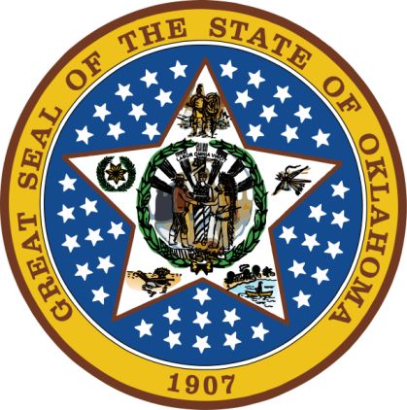
OKLAHOMA:
Our History Our Home
Chapter 10:
Rebuilding Indian Territory
STUDY PRESENTATION
© 2020 Clairmont Press

Slide 2
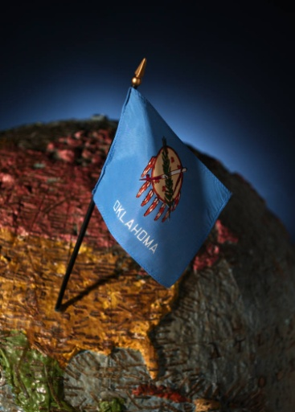
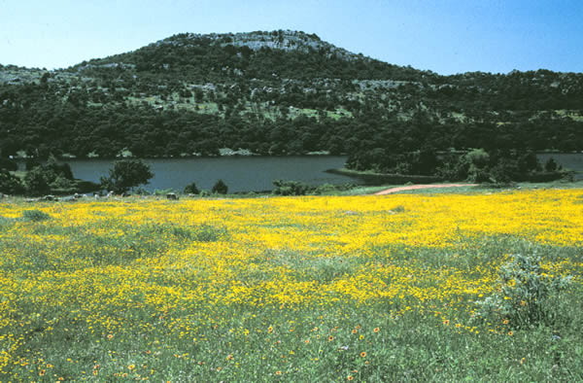
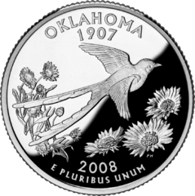
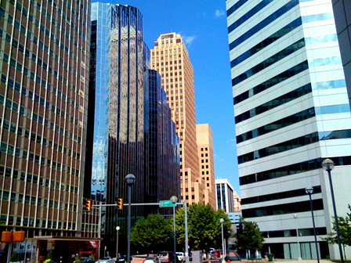
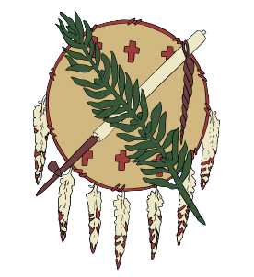
Section 1: The Five Nations Start Over
Section 2: Rebuilding the Economy
Section 3: Law and Disorder

Slide 3
Section 1: The Five Nations Start Over
Essential Question:
What steps did the Five Nations take to rebuild after the Civil War?

Slide 4
Section 1: The Five Nations Start Over
What terms do I need to know?
tenant farmer
lighthorseman
seminary
segregation

Slide 5
Seminole
Among the Seminole, some were loyal to the Union (John Chupco, Town Chief Billy Bowlegs, Opothleyahola) and some were loyal to the South (John Jumper).
The tribe elected Jumper as chief after the Civil War.
The Seminole national council formed in 1866, and Wewoka was capital.
Population: 2,105
Ramsey Mission School was started as a school for girls. It opened in 1880 near Sasakwa.

Slide 6
Chickasaw
The Chickasaw began to quickly rebuild schools and provide care of orphans (Chickasaw Orphan School).
Boarding schools reopened in 1876.
Classes were taught in English. Other subjects were reading, spelling, arithmetic, grammar, geography, and history.
“We must educate, or we must perish.”

Slide 7
Choctaw
Tribal schools and churches soon reopened.
The Choctaw owned all land “in common” but could personally own homes, fences, barns, etc.
Some whites came in as tenant farmers and worked the farm but did not own the land; they shared profits with the owners.
The Choctaw expected railroads and mining to change the way of life in their region.

Slide 8
Creek
The Upper and Lower Creeks were further divided by the war.
1867: A new constitution and chief (Samuel Checote) were chosen.
Sands Rebellion of 1871: Upper Creek Harjo and 300 men took over the capital at Okmulgee.
Lighthorsemen and federal agents put down the group.
1896: 70 neighborhood schools opened, 6 boarding schools, and an orphanage.

Slide 9
Cherokee
William Ross became chief of the Cherokee after the death of his uncle John Ross (1866).
The tribe was under pressure to open lands to settlement.
Lands were owned in common, but improvements were privately owned.
There were three classes of people: full bloods with small farms; mixed bloods had more money; whites with permits to work in the Nation.
An excellent school system was created with seminaries, orphanages, 100 primary schools, and a high school for blacks.
Tahlequah (capital) was the center of culture and education.
Cattlemen leased land for grazing.

Slide 10
Freedmen
Freedmen were treated as equals by Creek and Seminole but view was mixed among Cherokee, Chickasaw, and Choctaw.
Segregation in Indian Territory divided blacks from others in schools and sometimes entire towns.
Several all-black towns grew such as North Fork Town, Canadian Colored, and Arkansas Colored.

Slide 11
Government Schools
Government schools were started to help Indians assimilate.
Riverside Indian School was started in 1871 with 8 students; renamed Wichita-Caddo School in 1872 with 40 students.
Chilocco Indian School was a boarding school started for Plains Indians children. It grew to 1,200 students in the 1950s and served to help preserve tribal identities.
Quakers, Methodists, Baptists, Catholics were among the denominations who worked to convert Indians to their faith.
Return to Main Menu

Slide 12
Section 2: Rebuilding the Economy
Essential Question:
What factors helped to improve the economy of the Territory?

Slide 13
Section 2: Rebuilding the Economy
What terms do I need to know?
railhead
drover
quarantine
royalty
strike

Slide 14
Cattle Drives
To get cattle to market, Texans drove cattle through Indian Territory to railheads in Kansas City and St. Louis.
Cattle in Texas might sell for $2 in Texas but up to $40 elsewhere.
The open grasslands of Indian Territory were used to feed cattle along the way.
Rights-of-way and leases were worked out with tribes.

Slide 15
Cattle Drives: Crossing the Territory
A cattle drive had herds of 2,500-3,000 cattle, could move 10-15 miles/day, and lasted 1-3 months.
Drives needed 6-10 cowboys, about 6-8 horses/cowboy, a chuck wagon (food) and cook.
The chuck wagon had coffee, dried beans, meat, flour, cornmeal, salt, water and some repair tools.

Slide 16
Cattle Drives: Cattle Trails
Trails led to places along rivers where animals could safely cross.
East Shawnee was the first cattle trail but forests and marshes made it difficult to keep cattle together.
The West Shawnee trail headed more directly to Abilene, KS: “Cow Capital of the World”
The Chisholm Trail became one of the most used from 1867, because it had the most direct route from Texas to Abilene.
The Great Western Cattle Trail was further west and went to Dodge City, Kansas.
The 1886 blizzard, more settlers and railroads, and increased use of barbed wire fence contributed to decline of cattle drives.

Slide 17
Oklahoma Cattle Trails

Slide 18
Railroads
After the Civil War, the Wells Fargo Company restored stages on the old Butterfield Overland Mail route.
The restored route was short-lived.
Railroads headed toward Indian Territory.

Slide 19
Railroads: The Transcontinental Railroad
After Civil War, stage coach routes restored, but did not last long due to railroads
May 10, 1869: Promontory Summit, Utah, rails from east met rails from the west to complete a transcontinental railroad (San Francisco to New York).
Work on the project had dangers from Indians, disease, and hazardous working conditions.
Chinese immigrants worked on the west line; Mormon and Irish workers on the east.

Slide 20
Early Railroads Across the Territory

Slide 21
Railroads: Tracks Across the Territory
1865: A southern branch of the Union Pacific, later known as Missouri-Kansas-Texas (MKT, Katy) came to the territory.
1866 treaties allowed for two rails running north-south and two east-west through Indian Territory.
1871: The Atlantic & Pacific Railway ran east-west, and later became known as the Frisco line.
The Santa Fe line ran from Kansas to the Gulf coast.
The Rock Island line followed Chisholm Trail.
In the 1860s – 1880s miles of rail, bridges and roundhouses were added to the Territory.
By 1905, the Territory had over 5,000 miles of track.

Slide 22
Coal Mining
Coal was used as fuel for blacksmiths, trains, and heating homes and businesses.
James J. McAlester led the Oklahoma Mining Company with royalties split with Choctaw nation.
Miners provided increased business for tribes but also increased demand for land for settlement by whites.
1888: The Choctaw Coal and Railway Company built railroads to haul coal from mines to Crossroads (McAlester). Many communities grew from this business.
European immigrants came to the Choctaw Nation to work.
Osage Coal and Mining Company was the largest and owned by Katy railroad.
Wages were often above average, but a strike in 1884 protested wage cuts.
1892 saw the worst mining accident. One hundred men were killed and one hundred injured in an explosion at Mine #11 Osage Coal and Mining.

Slide 23
Oil Springs
Seeps, or oil springs were thought to have healing powers for arthritis, rheumatism, etc.
Spas were established at New Spring Place (Cherokee) and Boyd Springs (Chickasaw).
Early oil wells did not show much promise; the first well was near Grand Saline in 1859.
The Chickasaw Oil Company was the first oil company in 1872.
Oil was not important commercially until the invention of the automobile.
Return to Main Menu

Slide 24
Section 3: Law and Disorder
Essential Question:
What steps were taken to bring law and order to the Territory?

Slide 25
Section 3: Law and Disorder
What terms do I need to know?
jurisdiction

Slide 26
Introduction
Texas cattlemen let livestock graze on the grasses of Kansas in the Indian Territory.
Kansas ranchers drove herds across the border into Indian Territory.
Tribes realized they could make profit from grazing.
The Cherokee tried to collect lease money from grazing, but were often unsuccessful.
Owners who paid for grazing rights wanted protection from fires, thieves, and wolves.

Slide 27
Maintaining Order
Lighthorse Police from the Five Tribes enforced tribal laws.
Punishments could be lashes to the back or death.
Liquor was the source of many problems and was outlawed.
Bootleggers smuggled bottles of whisky in their high-top boots.
Many whisky traders set up shop along the border of Indian Territory.

Slide 28
Outlaws
Whites were not bound by Indian law, and U.S. law was not valid in the Territory which made the area attractive to criminals and fugitives.
Robbers, whisky peddlers, cattle rustlers, and horse thieves hid in the rugged lands of Indian Territory.
Infamous outlaws of the area included the Doolins, Daltons, Jennings brothers, Cook gang, and Turner gang.
Sam and Belle Starr (Myra Belle Shirley) owned Younger Bend, a haven for outlaws like Jesse James and Cole Younger.

Slide 29
The “Hanging Judge”
In 1871, a federal district court was established at Fort Smith, AK with jurisdiction to include Indian Territory; Isaac Parker was appointed as judge.
To bring law and order, Parker hired Indian interpreters, organized an “army” of deputy marshals, and held court 6 days/week for up to 10 hours/day.
Posses of deputies captured outlaws and brought them to court.
No funds for a prison meant poor conditions for prisoners with all ages and types crammed together in unhealthy conditions.
Newspapers reported (1885) on the conditions of “medieval barbarity” and congress gave funds for a new jail.
Parker was known as the “hanging judge”; he tried over 12,000 cases with over 9,000 convictions. 79 men were hanged.

Slide 30
“The Calm Before the Storm”
Railroads, mining, and cattle brought more whites to Indian Territory.
“Crowding” in neighboring states and territories make the “undeveloped” lands of Indian Territory attractive to new settlers.
Pressure increased to open the Indian lands to settlement.

Slide 31
Image Credits
Slide 1: Daniel Mayer on Wikimedia Commons; Slide 2: Public Domain; Image Credits Slide: Thomas Jones on Wikimedia Commons
Return to Main Menu

