Slide 1
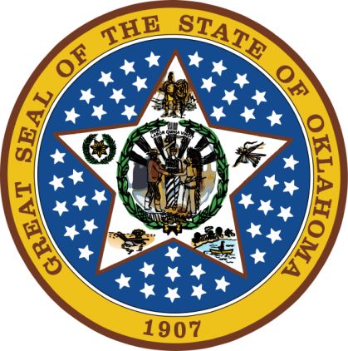
OKLAHOMA:
Our History Our Home
Chapter 13:
Growing Pains
STUDY PRESENTATION
© 2020 Clairmont Press

Slide 2
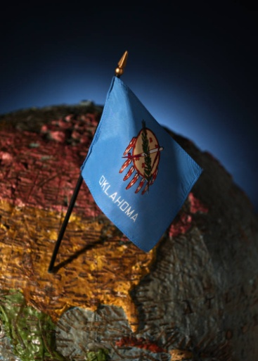
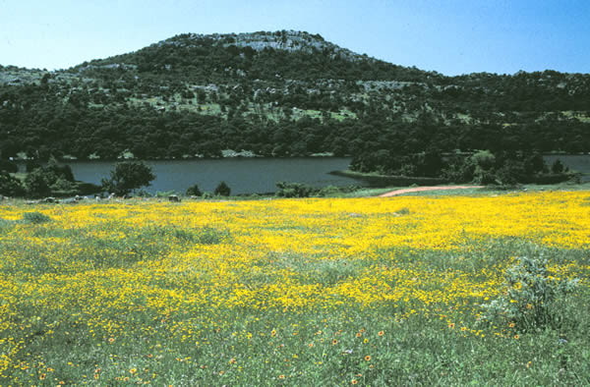
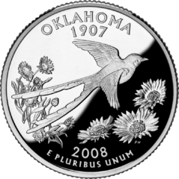
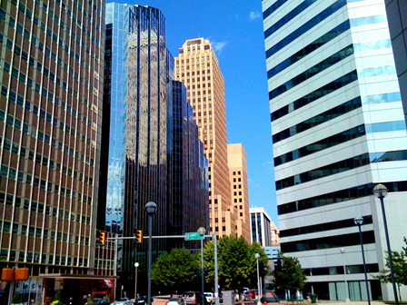
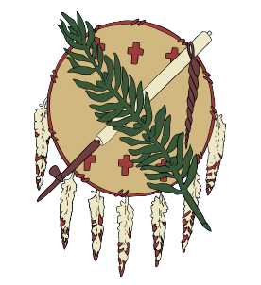
Section 1: Politics
Section 2: Industry and Progress
Section 3: World War I

Slide 3
Section 1: Politics
Essential Question:
How did political decisions affect the lives on Oklahomans in the early 1900s?

Slide 4
Section 1: Politics
What terms do I need to know?
tax
ordinance
cooperative
grandfather clause
gerrymandering
impeachment

Slide 5
First State Legislature
The Progressive movement influenced the first actions of the legislature (child labor, worker safety, public health and sanitation, convict labor, and other labor issues).
County and local governments were set up along with school districts and funding mechanisms.
Income and property taxes were authorized as well as taxes on business and industry.
A banking system was established to insure deposits.

Slide 6
Higher Education
The University of Oklahoma, University of Central Oklahoma, and Oklahoma State University were joined by other public colleges.
Private colleges existed such as Epworth (Oklahoma City University) and Henry Kendall College (became Tulsa University).
In 1909, the state established three normal schools to train teachers.
Additional schools were created for study of mining, industry, and agriculture.

Slide 7
Legal Discrimination
Plessy v. Ferguson: A Supreme Court ruling that said segregation was legal as long as equal facilities were provided for blacks (“separate but equal”).
Oklahoma began to debate and pass laws that made segregation legal; many protests began.
Oklahoma City law prohibited blacks from moving into “white” neighborhoods.
William Floyd challenged the law by purchasing a home in a white neighborhood and being arrested for trying to move in. He eventually won a court ruling in his favor.
1910: Blacks were 8% of population of OK and many all-black towns existed.

Slide 8
Political Parties
In 1907, Democrats controlled state government.
The Socialist Party had support and was made of unionists, miners, immigrants and intellectuals.
Many blamed their poverty on the wealthy and saw the Socialist Party as the answer to this problem.
Voters supported the break-up of large land holdings, government support for farmers, and cooperatives.
Republicans began to gain some power which Democrats blamed on black voters.
A.C. Hamlin (Republican) was the first black representative in 1910.
New laws were created to limit blacks’ voting power including a “grandfather clause” that said that person could not vote unless they descended from a person who could vote in 1866 or could pass a written test.

Slide 9
Social Reform
In 1907, Kate Barnard became the first woman elected to state office as commissioner of charities and corrections.
She worked to move Oklahoma’s prisoners back to the state from Kansas where they suffered in poor conditions.
McAlester was the site of the first state penitentiary.
Barnard worked on additional laws for protection of children, orphans, and the mentally ill.

Slide 10
Moving a Capital
Guthrie was made capital by the Organic Act, but Democrats did not like the Republican influence there.
Voters chose Oklahoma City as the capital.
Gov. Haskell quickly moved government offices to a hotel in the city.
The governor also worked to keep railroad rates low and prohibition laws enforced.

Slide 11
Oklahoma’s Next Governors
Lee Cruce:
started plans for a state capitol building; completed in 1917 (dome in 2002)
angered legislature by trying to cut budget
fought against gerrymandering of districts to help Democrats get re-elected
started the Oklahoma Department of Highways
Robert L. Williams:
tried to reduce state spending
expanded state highway system
created worker’s compensation system
limited women’s workday to 9 hours
funds for veterans, widows, and orphans
Return to Main Menu

Slide 12
Section 2: Industry and Progress
Essential Question:
What types of changes most affected the economy of Oklahoma in the early 1900s?

Slide 13
Section 2: Industry and Progress
What terms do I need to know?
headright

Slide 14
Black Gold
The development of the internal combustion engine increased demand for petroleum.
Nellie Johnstone No. 1 in Bartlesville was the first commercial oil discovery. It produced over 100,000 barrels of oil.
Discoveries near Tulsa made it the “Oil Capital of the World.”
Many workers moved to the region and boosted the economy.
The Glenn Pool field produced over 325 million barrels of oil.
Cushing Field was a huge source with up to 300,000 barrels a day. It created a glut of oil that pushed prices down.
Healdton oil field in southern Oklahoma had shallow wells that were cheaper to operate and became the first state-regulated oil field.
Regulators began conservation strategies that were used in other states to prevent waste.
Osage lands had mineral rights stipulations which provided money to the tribe when oil was discovered.

Slide 15
Building Roads
Automobile brought many changes and was more flexible than rail.
The Good Roads Association began work to get road improvements that would help automobiles (bridges, pavement, etc.).
1909: first “paved” highway in OK was a gravel road
1913: road plans ran north-south with one running east-west
Counties and towns levied taxes to pay for roads. There were 3,000 miles of dirt roads by the mid-1920s.
Costs for fighting World War I took funds from highway projects, and a national highway plan was still needed.
Return to Main Menu

Slide 16
Section 3: World War I
Essential Question:
What types of changes most affected the economy of Oklahoma in the early 1900s?

Slide 17
Section 3: World War I
What terms do I need to know?
draft
council of defense
dissenter
pandemic
armistice

Slide 18
Introduction
World War I involved the U.S. and many other countries.
The Central Powers were led by Germany, Austria-Hungary, Turkey, and Bulgaria.
The Allied Powers were led by Great Britain, France, Italy, and Russia.
The United States was proclaimed neutral by Woodrow Wilson in 1914, but that changed.
Allies | Central Powers
Great Britain France Italy Russia | Austria-Hungary Germany Turkey Bulgaria

Slide 19
Oklahomans in the War
1917: The Selective Service Act required men to register for a draft. Over 400,000 registered in Oklahoma.
1,064 Oklahomans died in the war; 10 million soldiers died worldwide.
Camp Doniphan and Fort Sill were set up to train field artillery.
Some Choctaw used their own language as a code to send secret messages for the Allies.

Slide 20
Council of Defense
1917: The Council of Defense was created to help with the war effort with conservation of food and energy, Liberty bonds, and savings.
The Oklahoma Loyalty Bureau was charged with locating those disloyal to the government.
Once found, men could be beaten or tarred and feathered; their homes and businesses might be painted yellow.
Speaking, teaching, or printing the German language was forbidden.
Some men refused to sign up for the draft or tried to avoid it on medical or religious grounds, or by marrying.
Green Corn Rebellion: Oklahoma farmers who refused to be drafted and leave their families; it was associated with the Socialist Party.

Slide 21
The Home Front
Farmers prospered during the war supplying food for troops.
Young boys volunteered to harvest crops; families grew “victory gardens” to supply some of their own food.
Zinc from Oklahoma went to the war effort.
Healdton field supplied ½ of the oil used by the Allies.
Women began working in jobs vacated by men gone to war; young girls and older women packed supplies to send to troops.

Slide 22
Pandemic
1918: Spanish Flu outbreak
The flu spread around the world killing 20-40 million people; 675,000 died in the U.S.
7,000 died in Oklahoma; schools, churches, and many public areas closed or had limited access.
November 11, 1918: The German army surrendered and an armistice was signed.
The Treaty of Versailles officially ended the war on June 28, 1919.
18th Amendment (1919): national prohibition amendment
19th Amendment (1920): women granted right to vote
1924: All Native Americans were granted citizenship.

Slide 23
Image Credits
Slide 1: Daniel Mayer on Wikimedia Commons; Slide 2: Public Domain; Image Credits Slide: Thomas Jones on Wikimedia Commons
Return to Main Menu

