Slide 1
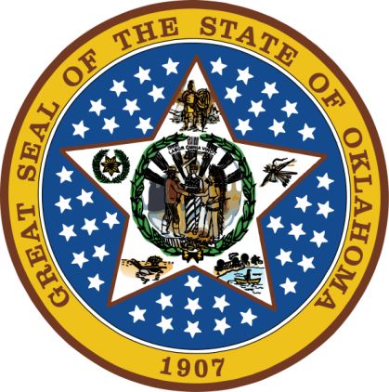
OKLAHOMA:
Our History Our Home
Chapter 15:
Wars and Baby Boomers
STUDY PRESENTATION
© 2020 Clairmont Press

Slide 2
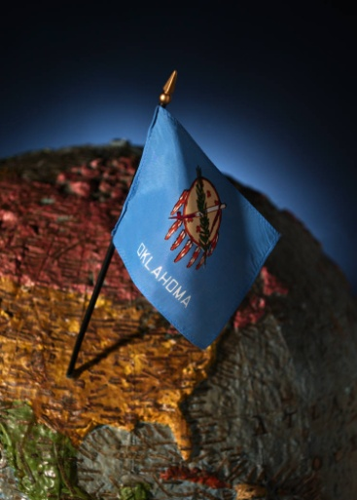
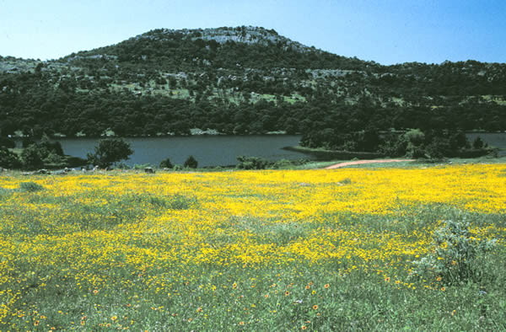
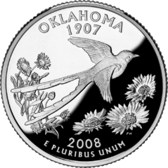
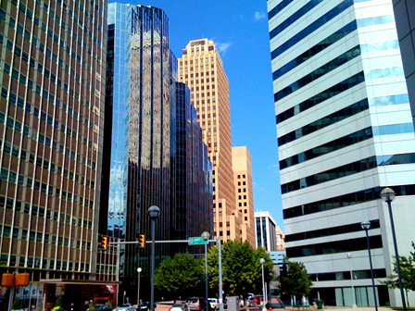
Section 1: World War II
Section 2: Social Change
Section 3: The Postwar Period

Slide 3
Section 1: World War II
Essential Question:
How did the events of WWII have an effect on Oklahomans?

Slide 4
Section 1: World War II
What terms do I need to know?
dictator
ration

Slide 5
Tensions Increase in Asia and Europe
Japan, German, and Italy were led by dictators who planned to improve their economies and strategic power by taking territory and resources from nearby countries.
Adolf Hitler (Germany) blamed Jewish citizens for the country’s problems and began a plan to remove them from society.
Germany invaded Rhineland (1936) and Austria (1938).
By 1940, Germany and Italy had acquired much of the land around their countries, and Germany had taken Paris, France.

Slide 6
Tensions Increase in Asia and Europe
 | Country | Leader
Allies | Great Britain | Winston Churchill
 | Russia | Joseph Stalin
 | United States | Franklin D. Roosevelt
Axis Powers | Germany | Adolf Hitler
 | Italy | Benito Mussolini
 | Japan | Hideki Tojo

Slide 7
War Engulfs the United States
Most Americans wanted to stay out of the troubles in Europe as we were still in recovery from WWI and the Great Depression.
1939: The U.S. began rebuilding the army and navy; the U.S. continued to assist Russia and Britain.
December 7, 1941: 180 Japanese planes attacked the navy base at Pearl Harbor, Hawaii. Over 2,400 were killed, 12 ships sunk, and 188 aircraft destroyed.
The U.S. joined the Allied powers three days later.

Slide 8
A Nation Mobilizes
Oklahoma’s climate, location, and workforce made it a good location for arms and ammunition plants and military training centers.
April 1941: Oklahoma City was named site of a supply and maintenance depot; Tinker Field opened in 1942.
Douglas Aircraft built military planes at Tinker and Tulsa.

Slide 9
A Nation Mobilizes: Oklahoma Military Facilities
80 military facilities were built in Oklahoma including Camp Gruber, Air Corps Basic Flying School, Clinton Naval Air Station, and Altus Army Air Field.
A British flying school was also in OK.
The U.S. Army accidentally bombed Boise City (July, 1943).

Slide 10
A Nation Mobilizes: Oklahomans in the War
Nearly 200,000 Oklahomans enlisted for the war and 300,000 were drafted.
Women joined the Army and Navy Nurse Corps, Women’s Army Corps (WAC) and other groups.
The 45th Infantry Division was formed of men from OK, NM, and AZ (the Thunderbirds).
Over 20,000 of these men were killed
8 received the Medal of Honor
One regiment helped liberate Dachau Concentration Camp
Bill Mauldin: Thunderbird who won Pulitzer Prize for his wartime cartoons
The 90th Infantry was mostly Texans and Oklahomans (T-O)
landed on Utah Beach at Normandy
Battle of the Bulge

Slide 11
A Nation Mobilizes: World War II Code Talkers
Different groups of Indians were used to code messages due to the success of the method in WWI.
Navajo were used in the Pacific.
Comanche were used in Europe.
The codes of these unwritten languages remained unbroken.

Slide 12
A Nation Mobilizes: Oklahoma Camps
Many Japanese-Americans were moved to relocation camps because of their race.
The government was unsure of their loyalty to the U.S.
Fort Sill, McAlester, and Stringtown were relocation camps in Oklahoma.
Prisoner of War (POW) camps were also in Oklahoma. 5,000 prisoners from Germany and Italy were at Alva camp.

Slide 13
A Nation Mobilizes: The Home Front
While soldiers were at war, others took over their jobs at home.
Women took jobs that had been men’s jobs. “Rosies” for Rosie the Riveter represented those in factories.
Victory gardens were encouraged to supplement the food supply.
Goods were rationed to make sure there was enough to go around.
Many patriotic movies and posters were made.

Slide 14
The War Ends
June 6, 1944: D-Day, Allies began attack on the Axis at Normandy, France.
3,000,000 Allied troops poured in and after 2 months liberated Paris.
The march continued until April 1945 with the Allied capture of Berlin.
War in the Pacific pushed the Japanese back toward their homeland.
The Manhattan Project was a secret U.S. effort to develop a nuclear weapon.
President Truman ordered bombings of Japan with nuclear weapons (Hiroshima and Nagasaki).
Over 100,000 were killed and Japan surrendered.
More than 62,000,000 were killed in the war, including over 6,000 Oklahomans.
Return to Main Menu

Slide 15
Section 2: Social Change
Essential Question:
What social changes made life in Oklahoma different after World War II?

Slide 16
Section 2: Social Change
What terms do I need to know?
suburbs
baby boomer

Slide 17
Postwar Society
Steady jobs with good incomes and hours were found in or near cities.
These jobs were more reliable than farming.
1944: Servicemen’s Readjustment Act (GI Bill) gave war veterans money for education, home and farm loans.
Urban growth caused a growth in housing.
Many children born after the war (1946-1964) were called “Baby Boomers”; nearly one million babies were born in Oklahoma.
More children increased the need for schools.
The number of schools has declined as small schools closed and combined to make larger ones.
Penicillin was invented to fight infections (1940s).
A polio vaccine stopped the spread of this crippling disease.
The smallpox vaccine rid our nation of this killer (1950s).

Slide 18
Social Change
Year | Population | % urban
1910 | 1,657,155 | 19
1920 | 2,028,283 | 27
1930 | 2,396,040 | 34
1940 | 2,336,434 | 51

Slide 19
Popular Entertainment
Television grew in popularity in the 1950s. It was more affordable for homes, so more stations were created.
Half of homes had TV by 1954; 90% in 1964.
1949: WKY-TV channel 4 in Oklahoma City
1953: First state education channel KETA channel 13
Rock-and-roll music was a new style made popular by Elvis Presley.
The invention of pocket-sized transistor radios spread access to music radio stations.
KOMA was large rock-and-roll format station.

Slide 20
Prosperity
The Gilcrease Museum opened in 1949 and displays over 10,000 works of art.
The Cowboy Hall of Fame opened in 1955 and is now theNational Cowboy & Western Heritage Museum.
Mickey Mantle, Allie Reynolds and Warren Spahn were famous Oklahoma baseball players.
Coach Henry Iba’s Oklahoma State University won national basketball championships in 1945 and 1946.

Slide 21
Segregation Laws Challenged
Blacks began to demand more equality after WWII.
Ada Lois Sipuel of Chickasha was a black woman denied admission to the University of Oklahoma because she was black.
Sipuel’s lawsuit and others led to the Brown v. Board of Education decision outlawing segregated schools.
George W. McLaurin won a case in 1950 that Oklahoma University could not treat him differently because of his race; he had been forced to sit outside the main classroom for lectures.
1949: Nancy Randoph Davis was enrolled in Oklahoma A&M College but had to sit in the back of the room or in the hall.
Return to Main Menu

Slide 22
Section 3: The Postwar Period
Essential Question:
In what ways was the Cold War different from other American wars?

Slide 23
Section 3: The Postwar Period
What terms do I need to know?
Cold War
sit-in

Slide 24
The Cold War
After World War II, the United States and the Soviet Union were the two big superpowers; both had nuclear missiles.
Political differences caused divisions between the two resulting in the Cold War.
The United States wanted to stop Soviet communism from spreading.
The U.S. supported South Korea against communist North Korea in a police action known as the Korean War.
400,000 U.S. troops participated; 450 Oklahomans were killed.
Fears of nuclear attack caused many to build nuclear shelters and practice nuclear attack drills.

Slide 25
Political Leaders
Gov. Johnston Murray required all state employees to swear an oath of loyalty to the U.S. and Oklahoma due to the communist scare; women were allowed on juries.
Gov. Raymond Gary improved interstate highways and abolished segregation laws.
Clara Luper led sit-ins to break down segregation and was arrested 26 times.
J. Howard Edmondson was governor when voters repealed prohibition (1959).

Slide 26
The Space Age Dawns
In 1957, the Soviet Union launched earth’s first satellite: Sputnik I.
The U.S. feared getting behind and a space race occurred.
1958: The Explorer satellite was launched by the U.S. and NASA was created.
The Mercury program was designed to put the first man in space.
Capt. Leroy Gordon Cooper, Jr. of Shawnee was pilot of Faith 7.
Geraldyn M. “Jerrie” Cobb of Oklahoma successfully completed screening to be a Mercury pilot, but rules were changed to block women astronauts.

Slide 27
Image Credits
Slide 1: Daniel Mayer on Wikimedia Commons; Slide 2: Public Domain; Image Credits Slide: Thomas Jones on Wikimedia Commons
Return to Main Menu

