Slide 1
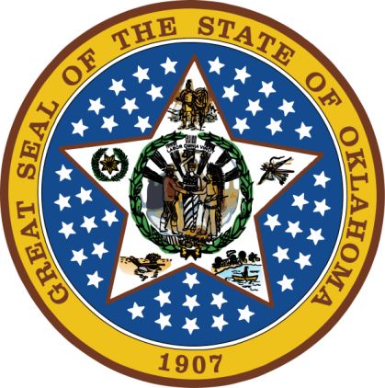
OKLAHOMA:
Our History Our Home
Chapter 16:
Politics, Protests, and Social Change
STUDY PRESENTATION
© 2020 Clairmont Press

Slide 2
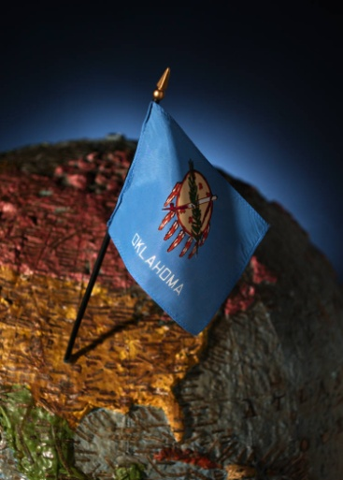
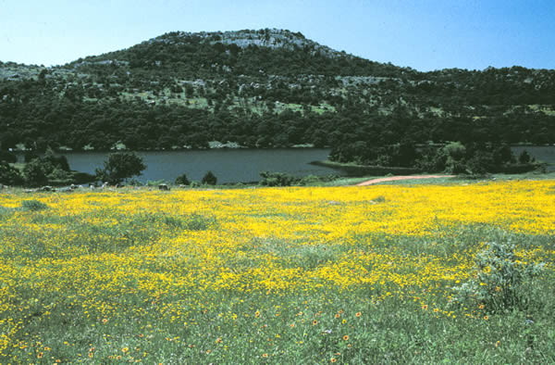
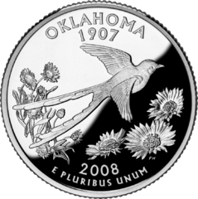
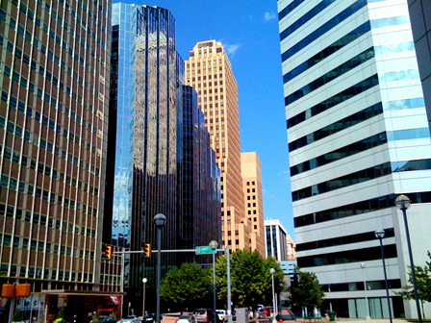
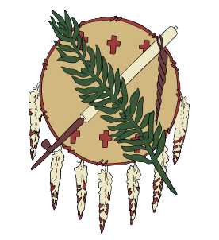
Section 1: War and Politics
Section 2: State Affairs in the 1970s

Slide 3
Section 1: War and Politics
Essential Question:
How were Oklahoma’s blacks, women, and American Indians involved in the civil rights movement?

Slide 4
Section 1: War and Politics
What terms do I need to know?
boycott
affirmative action
Civil Rights Act of 1964
Title IX
American Indian Movement

Slide 5
Civil Rights Movement
Successful service in an integrated military caused many blacks to seek equality in other areas of society.
1954: Brown v. Board of Education of Topeka – Supreme Court ruled that schools had to integrate.
1955: Montgomery bus boycott – Rosa Parks made famous for refusing to give her seat to a white passenger.

Slide 6
Desegregating Public Facilities
1958-1961: NAACP Youth Council and Clara Luper continued sit-ins to force restaurants to serve black customers.
Non-violent sit-ins were successful because owners usually lost money due to disruption of business – this protest strategy spread across the south.
Dr. Martin Luther King, Jr. encouraged nonviolent protests – some black leaders sought more aggressive solutions.
Marches were also used as nonviolent protest strategy.
Additional protests were held at the Lawton swimming pool and Wedgewood and Springlake amusement parks which were segregated on certain days.

Slide 7
School Integration
Oklahoma City schools were neighborhood schools which resulted in mostly black or mostly white schools because neighborhoods were segregated.
1972: Judge Luther Bohanon ordered schools to use busing to integrate the schools.
One result was “white flight” – white families moved out of Oklahoma City.
1957: Prentice Gautt was first black football player at the University of Oklahoma.
More black players followed, including Charlie Hunter and Jerry Lee Wells who later played professional basketball.

Slide 8
The Vietnam War
Vietnam is a country in southeast Asia and former French colony.
Ho Chi Minh, communist leader, wanted independence from France.
1954: a treaty divided the country into a communist north and democratic country in south.
20,000 U.S. military advisers were in place in South Vietnam by the early 1960s.
July 1965: President Johnson committed U.S. forces to a ground war.
1966: 400,000 U.S. troops were in Vietnam; the harsh terrain and climate supported the North’s strategy of guerilla warfare.
Television brought daily scenes of the war into Americans’ homes.
Countries of Southeast Asia in the 1960s

Slide 9
War Protests
College and university campuses became the focus of anti-war protests.
War costs increased along with the protests.
May 1970: four student protesters were killed at Kent State University in Ohio; two killed at Jackson State in Mississippi.
Oklahoma State University’s ROTC was declared off limits to protesters; security helped to protect ROTC functions near the time of Kent State’s tragedy.

Slide 10
The End of the War
1973: American troops were withdrawn from Vietnam.
Fighting continued until 1975 when Saigon, capital of South Vietnam, was captured by the communists.
Thousands of refugees left by boat and plane.
Human cost: 58,000 U.S. troops killed – 988 Oklahomans killed; 6,000,000 served – 144,000 from Oklahoma.

Slide 11
The 26th Amendment
Young men of 18 could be drafted, yet in many states they did not have the right to vote.
March 1971: Congress passed the 26th Amendment to the U.S. Constitution.
Three-fourths of the states had to approve the amendment for ratification to occur; Oklahoma’s legislature was the 39th, on July 1, 1971.
This allowed 11 million new voters; half of them voted in the 1972 presidential election.

Slide 12
Affirmative Action
1961: “Affirmative Action” began as a program to make sure that employment was fair to all races.
The Civil Rights Act of 1964, Title VII, required employment without regard to race, religion, or national origin.

Slide 13
Women’s Rights
1968: “gender” was added to the Civil Rights Act as the feminist movement worked for “equal pay for equal work.”
1971: Patience Latting first female mayor of Oklahoma City.
1973: Lelia Lelia Foley-Davis first black female mayor in Oklahoma.
1968: Hannah Atkins Atkins first black member of the Oklahoma House of Representatives.
NOW: National Organization for Women supported the Equal Rights Amendment; 35 states approved the amendment, but this was not enough to make it part of the U.S. Constitution.
Title IX: part of the Civil Rights Act requiring equal opportunities for boys and girls in educational programs helped increase the number of women in college and athletics.

Slide 14
American Indian Rights
1961: American Indian Chicago Conference (meeting of 67 tribes) issues were education, employment, and health care
Clyde Warrior (Ponca) and others created the National Indian Youth Council.
LaDonna Harris (part Comanche) founded Oklahomans for Indian Opportunity.
American Indian Movement (AIM): protests included occupying the offices of the Bureau of Indian Affairs in Washington, D.C. (1973).
AIM took over the village of Wounded Knee, South Dakota (1973) resulting in a 71-day standoff with federal authorities; 2 were killed and 12 wounded.
1968: Indian Civil Rights Act protected basic rights of Indians.
1975: American Indian Self-Determination and Education Act increased tribal control over resources and gave young American Indians more opportunities.
Return to Main Menu

Slide 15
Section 2: State Affairs in the 1970s
Essential Question:
What changes occurred in Oklahoma government in the 1970s?

Slide 16
Section 2: State Affairs in the 1970s
What terms do I need to know?
Organization of Petroleum Exporting Countries (OPEC)
embargo
deregulation
price parity

Slide 17
Introduction
1970: David Hall was elected governor and worked to improve education (reduced pupil-teacher ratio, and added more kindergarten, special education and guidance counseling).
Taxes were increased to cover the costs.
Hall was convicted of crimes related to placing state retirement money into funds controlled by a friend.
1975: Governor David Boren increased funding for schools, gifted and talented programs, and the arts.
The Physician Manpower Training Commission was established to improve medical care in rural areas.
1977: new Open Records and Open Meetings Act designed to prevent abuse of power by government officials.

Slide 18
Oil
The “Seven Sisters” were American and European oil companies that controlled oil production in the mid-20th century.
1946: America began importing more oil than it exported.
1951: Shah of Iran took control of oil production for his country; other nations followed and formed OPEC (Organization of the Petroleum Exporting Countries).
By the 1970s, OPEC was the dominant power in setting oil production and prices.
1960s: environmentalists began lobbying for cleaner sources of energy, and cleaner drilling and production operations.

Slide 19
Oil Embargo
1973: Israel was at war with Egypt and Syria.
OPEC put an embargo against countries supporting Israel, including the U.S., and quadrupled prices.
Fuel shortages were felt across the U.S.
Congress lowered the speed limit to 55 to conserve energy.
Conservation was encouraged; automakers worked on smaller, more fuel-efficient engines for cars.

Slide 20
Oklahoma Wells
Natural gas in Oklahoma was often burned off and not used.
Government rules were relaxed to encourage drilling in the state and production increased (oil and natural gas).
These wells were a boost to many small towns and the state’s overall economy.

Slide 21
Other Minerals
Zinc and lead mines were closed in 1970 because of concerns over environment damage and safety.
Copper was mined from 1965-1975 in Jackson County.
Surface Mining Control and Reclamation Act (1975): laws were designed to protect people and the environment from the bad effects of mining.

Slide 22
Agriculture
Equipment, fertilizer, and pesticides made it possible for increased farm production even with a decline in the number of farms.
Cattle and wheat were primary farm products.
Too much wheat actually hurt farmers because prices fell.
1979: U.S. embargo of wheat to U.S.S.R. hurt farmers even more.
The American Agriculture Movement organized protests to state and local government trying to make sure the costs of farm goods kept pace with other prices.

Slide 23
Education Reforms
1963: National Education Improvement Act, a result of Sputnik, increased technology education.
1964: Tulsa opened Oklahoma's first vocational-technical school.
This has grown to 29 such schools with 54 campuses; now called technology centers, they help lure businesses to the state.
By 2005, there were 25 junior colleges in the state enrolling 235,000 students

Slide 24
Business
1952: Tulsa’s Utica Square was one of the country’s first shopping centers followed by Penn Square in Oklahoma City (1960).
1964: Shepherd Mall was the first enclosed mall in Oklahoma.
Sam Walton, born in Kingfisher, purchased a small store in Arkansas in 1945; he opened his 11th Wal-Mart in Claremore, Oklahoma in 1969.
Other businesses started at this time were: Love’s Country Store, Braum’s Ice Cream and Dairy Stores, and Hobby Lobby; each of these has hundreds of stores in many states.

Slide 25
Great Oklahomans
Astronaut Thomas P. Stafford flew Gemini VI in 1965 and the Apollo ship in the Apollo-Soyuz project .
Owen Garriott was a scientist-astronaut on Skylab (1973) and Spacelab-I (1983).
William Pouge piloted Skylab 4.
Stuart Roosa was a pilot of Apollo 14 to the moon.
Dr. Shannon Lucid flew on several shuttle missions and space station Mir.
John Herrington was the first American Indian in space (2002).
S.E. Hinton & N. Scott Momaday were famous authors.
Jimmy Webb received many Grammy Awards for his music writing.
Actors from Oklahoma include James Garner, Dennis Weaver, Dale Robertson, Donna Reed, Tony Randall, Ron Howard, and Clint Howard.
Among famous athletes were Johnny Bench, Steve Owens, and Jimmy Johnson.

Slide 26
State of the State

Slide 27
Image Credits
Slide 1: Daniel Mayer on Wikimedia Commons; Slide 2: Public Domain; Image Credits Slide: Thomas Jones on Wikimedia Commons
Return to Main Menu

