Slide 1
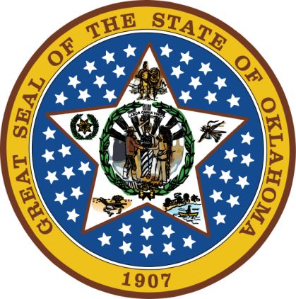
OKLAHOMA:
Our History Our Home
Chapter 17:
Oklahoma Roundup
STUDY PRESENTATION
© 2020 Clairmont Press

Slide 2
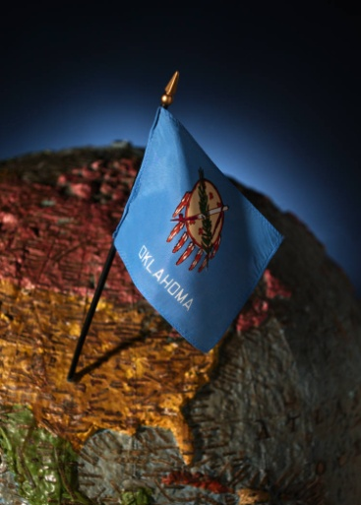
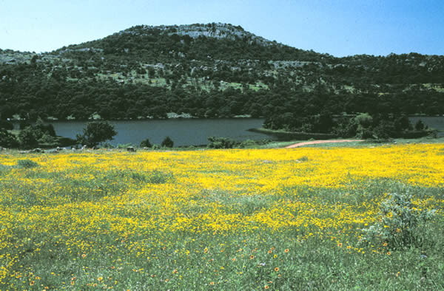
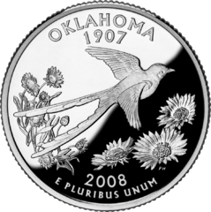
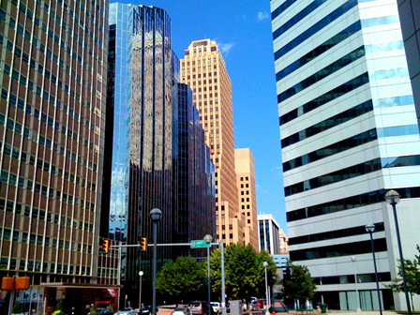
Section 1: The 1980s
Section 2: The 1990s
Section 3: Contemporary Oklahoma
Section 4: Oklahoma’s People

Slide 3
Section 1: The 1980s
Essential Question:
How did the economy of Oklahoma affect people’s lives in the 1980s?

Slide 4
Section 1: The 1980s
What terms do I need to know?
kickback

Slide 5
Oklahomans in the Reagan Administration
Jeane Kirkpatrick was foreign policy advisor to President Ronald Reagan.
Also of Oklahoma was William J. Crowe, Jr.: (1980) commander-in-chief of Allied Forces in Southern Europe; (1983) in charge of U.S. Pacific Command; (1985) Chairman of Joint Chiefs of Staff; Ambassador to the United Kingdom in the 1990s.

Slide 6
Oklahoma in the 1980s
In the 1980s, the state had a flourishing oil business.
There was also investigation of county commissioners and approval of pari-mutuel betting at horse racetracks.
Skyscrapers such as Oklahoma Tower changed the skyline of Oklahoma City in the 1980s.

Slide 7
Oklahoma in the 1980s: Politics
1978: George Nigh elected governor; David Boren elected to U.S. Senate.
1982: “County Commissioner Scandal” – 280 vendors and commissioners were convicted of fraud for taking bribes from companies to make sure the county did business with that company.

Slide 8
Oklahoma in the 1980s: Economy
Early 1980s: The economic decline because of a downturn in oil industry resulted in increased unemployment and bankruptcies.
State revenues fell causing budget problems.
Tougher environmental regulations caused some oil refineries to close.
In 1983, pari-mutuel betting was approved. It was hoped that betting on horse racing would bring revenue to the state.

Slide 9
Oklahoma in the 1980s: Small Town Oklahoma
As the number of jobs reduced, many small businesses closed; many moved to new cities to find jobs.
The Main Street Program of the National Trust for Historic Preservation brought money into some towns for needed renovation projects.
Duncan was the first Oklahoma town to get Main Street Program funds.

Slide 10
Oklahoma in the 1980s: Oklahoma’s Diamond Jubilee
1982: Oklahoma celebrated its 75th birthday.
Many celebrations were held including recreation of the marriage of Mr. Oklahoma Territory and Miss Indian Territory.
Balloon launches on November 16, 1982 at 10:30 a.m. were held at schools around the state; some balloons were found in other states, the Bahamas, and England.
Return to Main Menu

Slide 11
Section 2: The 1990s
Essential Question:
What were the major issues affecting Oklahomans in the 1990s?

Slide 12
Section 2: The 1990s
What terms do I need to know?
urban sprawl
MAPS (Metropolitan Area Projects)

Slide 13
Introduction
Operation Desert Shield was begun by President George H. W. Bush in August 1990.
Saddam Hussein, leader of Iraq, ignored options for peaceful resolution of the conflict.
Operation Desert Storm was known by its bombing of Iraq, led by United States forces.
A F-111 participates in Operation Desert Shield.

Slide 14
Education Reforms
Henry Bellmon served as governor from 1987-1991.
1990: House Bill 1017 worked for improved student achievement in schools, limiting class sizes.
1999: House Bill 1759 made a two-tier diploma system and Oklahoma Tuition Scholarship program.
1991: Sandy Garrett became State School Superintendent and decreased class size, improved reading skills, updated technology, and improved safety.

Slide 15
MAPS
1993: Metropolitan Area Projects (MAPS) – Mayor Ronald Norick: Oklahoma City’s urban renewal plan; funded by 1¢ sales tax.
Canals and Bricktown Ballpark were part of this project.
Oklahoma River waterways were improved for transportation.
Other MAPS projects were the Civic Center Music Hall, Museum of Art, and Chesapeake Boathouse.
The program was a model for other cities.

Slide 16
Domestic Terrorism
April 19, 1995: Alfred P. Murrah Federal Building was destroyed by a terrorist’s explosives.
There were 168 deaths including 19 children; 800 were injured.
2001: Execution of Timothy McVeigh, the convicted mastermind of the attack.
2000: The Oklahoma City National Memorial opened to honor the victims.
New security measures became a part of American life as a result.

Slide 17
Dangerous Weather
May 3, 1999: More than 70 tornadoes swept across Oklahoma.
Wind speeds topped 300 mph.
44 people were killed and 800 injured.
3000 buildings were destroyed, 5000 damaged with $1 billion in damages.
2000 & 2002: Ice and snow caused widespread property damage.
2005 & 2006: Wildfires damaged thousands of acres and a large number of homes.
Damage was widespread after the May 1999 tornadoes.
Return to Main Menu

Slide 18
Section 3: Contemporary Oklahoma
Essential Question:
What conditions affect the economy and citizens of Oklahoma today?

Slide 19
Section 3: Contemporary Oklahoma
What terms do I need to know?
terrorism
nanotechnology
reserves
biomass

Slide 20
The War on Terrorism
September 11, 2001 (9/11): Attacks by terrorists were made on the World Trade Center and the Pentagon using hijacked jets.
Another jet was hijacked but crashed in Pennsylvania due to passengers’ efforts.
al-Qaida: An Islamic terrorist group led by Osama bin Laden was found to be responsible.
October 2001: The U.S. led United Nations troops into Afghanistan in pursuit of the terrorists (Operation Enduring Freedom).
General Tommy R. Franks led this attack and the 2003 invasion of Iraq.

Slide 21
Economy: Technology and Research
Oklahoma’s economy is more diverse than in the last century.
The Oklahoma Center for the Advancement of Science and Technology works to advance technology use, research, and development in the state.
The Oklahoma Medical Research Foundation is known for excellent research and development.
Nanotechnology research occurs at the state’s universities.

Slide 22
Economy: Education
Janet Barresi was the second woman and first Republican as state superintendent (2011).
The state adopted the Common Core State Standards.
There were many technological changes in schools.
The incorporation of more music was included for students in schools.

Slide 23
Economy: Military Might
Fort Sill: U.S. Army Field Artillery School, air defense artillery, and armored division
Other bases: Tinker Air Force Base, Vance Air Force Base, Altus Air Force Base, and McAlester Army Ammunition Plant
Tinker is the largest OK employer.
The Oklahoma National Guard has 97 armories.
The aviation business is important to support military and civilian aircraft.
The 99s Museum of Women Pilots is at Will Rogers World Airport.
Efforts are underway to develop a spaceport in western Oklahoma.

Slide 24
Economy: Energy & Agriculture
New technology allowed access to deeper mineral deposits.
Oil, gas, and coal reserves are still abundant.
Pipelines deliver oil to refineries in Oklahoma and Texas.
Wind power and solar energy are emerging energy sources.
Biomass is energy from plant material and animal waste.
Cattle and wheat continue as top farm products.
Large corporate farms are replacing family farms.

Slide 25
Economy: The Elements in 2011
Twenty-one inches of snow fell during the winter in the northeast.
A blizzard hit the Oklahoma Panhandle.
Drought shattered records and wildfires consumed land.
The hottest summer of any state since records began in 1895 with 118 tornadoes. There were ten twisters in November.
A 5.6 magnitude earthquake was felt on November 5.

Slide 26
Economy: Centennial Celebration
The state celebrated 100 years of statehood on November 16, 2007.
Hundreds of events and projects were planned and enjoyed.
Schools, organizations, towns, and cities joined in to recognize and celebrate.
Parades were held along with a huge gathering of Oklahoma talent!
Return to Main Menu

Slide 27
Section 4: Oklahoma’s People
Essential Question:
How are people making a positive difference in the state of Oklahoma?

Slide 28
American Indians Today
1987: Cherokee Wilma Mankiller was the first woman elected leader of the large Cherokee Nation.
2006: The Cheyenne-Arapaho wrote a new constitution adding a fourth branch of government: the Tribal Council.
Many tribes added gaming casinos to generate revenue.
Living history experiences can be found at Indian City, USA and Tahlequah’s Tsa-La-Gi Ancient Village.

Slide 29
Oklahoma Talent
There are many musically talented Oklahomans in this century.
Five Oklahoma women have won Miss America.
Paul Moore is a sculptor of the Land Run Monument in Oklahoma City.
Many actors, authors, and artists have come from the state.

Slide 30
Helping Others
Oklahoma State University has received millions in cash donations to help expand programs for college students.
The Weitzenhoffer art collection was another gift to the school.
Fern Holland is known for work in women’s rights issues.
Oklahomans have a history of helping each other, helping others, and moving forward.

Slide 31
Image Credits
Slide 1: Daniel Mayer on Wikimedia Commons; Slide 2: Public Domain; Slide 6: Urbannative on Wikimedia Commons; Image Credits Slide: Thomas Jones on Wikimedia Commons; all others public domain
Return to Main Menu

