Slide 1
OKLAHOMA:
Our History Our Home
Chapter 19:
Oklahoma Government
STUDY PRESENTATION
© 2020 Clairmont Press

Slide 2
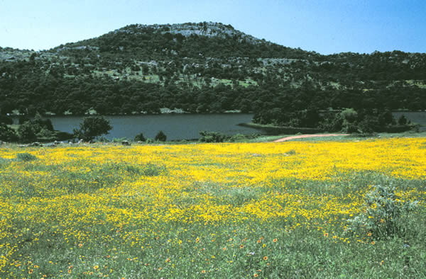
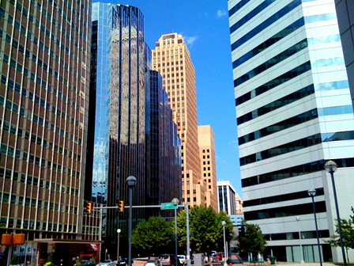
Section 1: State Government
Section 2: Local Government

Slide 3
Section 1: State Government
Essential Question:
How have the people of Oklahoma organized a government for their state?

Slide 4
Section 1: State Government
What terms do I need to know?
budget
veto
bill
criminal law
civil law

Slide 5
Introduction
Oklahoma is one of the youngest states in the U.S.
It has its original constitution which has been amended over 175 times.
The constitution states that political power is from “the people.”
Government’s role is to provide protection, security, and to promote the general welfare of the citizens.
Preamble
Invoking the guidance of Almighty God, in order to secure and perpetuate the blessing of liberty; to secure just and rightful government; to promote our mutual welfare and happiness, we, the people of the State of Oklahoma, do ordain and establish this Constitution.
Oklahoma Constitution

Slide 6
Executive Branch
The Executive Branch is led by the governor (must be 31 or older, and a voting citizen 10 years or more).
Other offices include lieutenant governor, attorney general, superintendent of public instruction.
Each are elected to four year terms.
The Secretary of State is appointed by the governor for a four year term and must have senate approval.
Responsibilities are described in the Oklahoma Constitution.
The Governor’s Cabinet includes the secretaries of state, agriculture, commerce and tourism, education, energy, environment, finance and revenue, health, human resources and administration, human services, military, safety, and security, science and technology, transportation, and veterans’ affairs.

Slide 7
Executive Branch: Governor
The governor is the chief executive of the state.
A budget is prepared by the governor’s office and presented to the legislature.
The governor serves as commander-in-chief of the state militia.
Every bill passed by the legislature must have the governor’s signature to become a law.
The governor accepts or rejects recommendations of the State Pardon and Parole Board and appoints replacements for vacated state offices.
Appointments are made by the governor to special boards and councils.

Slide 8
Executive Branch: Lieutenant Governor
The Lieutenant Governor is similar to the U.S. vice president.
The Lt. Governor replaces the governor if the governor has to leave office and serves as president of the senate.
The Lt. Governor is elected separately from the governor.

Slide 9
Executive Branch: Other Elected Officials
Treasurer: accounts for all the public money of the state, takes in taxes and distributes funds.
Auditor and Inspector: reviews the work of state government to make sure that it is working properly
Insurance Commissioner: maintains oversight of the insurance industry.
Attorney General: state’s chief legal officer.
Superintendent of Public Instruction: oversees the State Department of Education.
Commissioner of Labor: enforces laws related to protecting the workforce.

Slide 10
Legislative Branch
The legislative branch is the lawmaking body of the state, composed of the senate and house of representatives.
Representatives must be 21 years of age, senators 25; they must reside and be eligible to vote in their home districts.
The legislature meets from February to May, but special sessions may be called by the governor, if needed.
Representatives serve two-year terms with elections for all every two years; senators serve four years with elections staggered to ensure that only half of senators are up for election at a time.
The president pro tem is the senate leader; the speaker of the house is the house leader.

Slide 11
How a Bill Becomes a Law
Four types of legislation:
bill
joint resolution
concurrent resolution
simple resolution
Bills are introduced then assigned to committees; revisions are made and then they may be presented for a vote.
If passed, the bill must repeat the process in the other house.
Compromise committees work to get agreement between the two houses on a bill.
If passed, the governor must sign the bill for it to become law, or the governor can veto the bill.

Slide 12
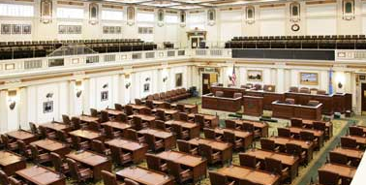
Legislative Committees
Committees allow for efficient study and debate of complicated matters.
Standing committees are permanent committees of the legislature.
Conference committees are established for special tasks and are disbanded when their work is done.
Joint committees are made of members from both houses working cooperatively on a special project.
Oklahoma Legislature

Slide 13
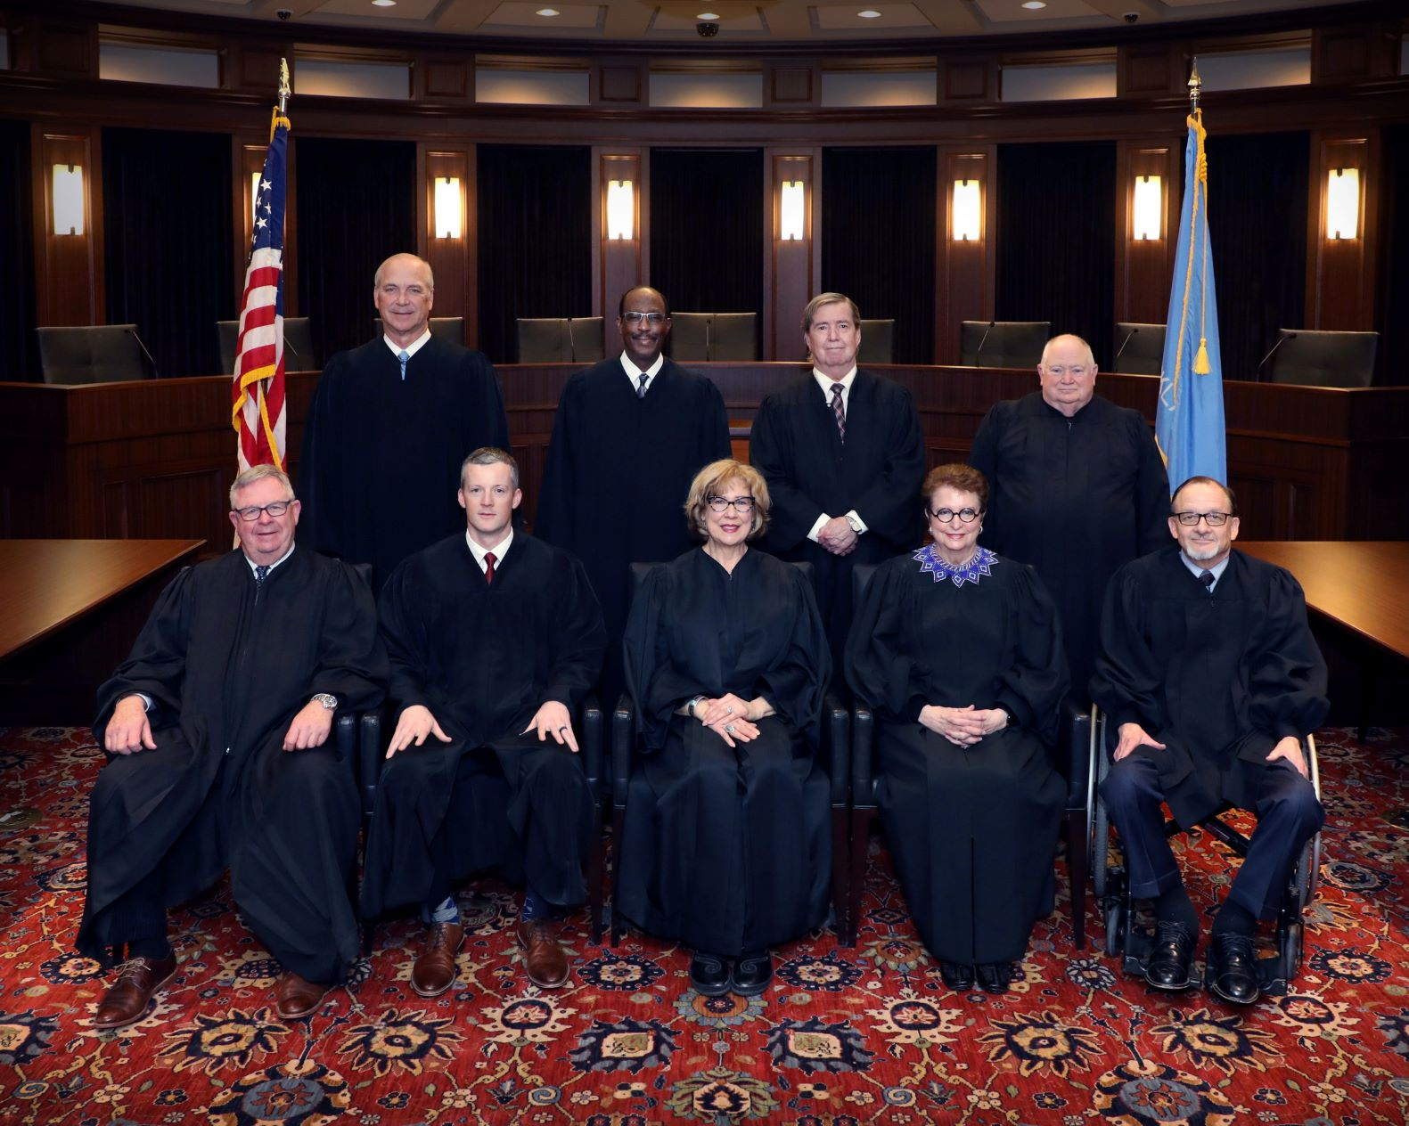
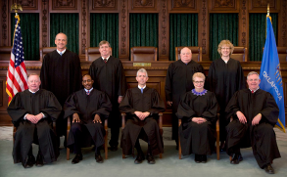
Judicial Branch
The judicial branch manages the court system of the state and is headed by the supreme court with its 9 justices and court of criminal appeals with 5 judges.
This model is different from most states which only have one “court of last resort.”

Slide 14
Civil and Criminal Law
Criminal cases involve broken laws.
Civil cases involve disputes between people.
The state supreme court hears civil cases and interprets the Oklahoma and U.S. constitutions.
The court of criminal appeals makes the final determination in the trials of accused criminals.
The supreme court decides which court will hear a case if there is a question about jurisdiction.

Slide 15
Court Responsibilities
The supreme court supervises the state’s justice system.
It also works with the federal judicial branch in the complex tribal issues related to Native Americans.
Justices are selected from each of the nine judicial districts in the state, must be at least 30 years of age, and a licensed practicing attorney or judge for the five years before taking office.
Other courts:
court of civil appeals
district court
Return to Main Menu

Slide 16
Section 2: Local Government
ESSENTIAL QUESTION:
How is government organized at the local level in Oklahoma?

Slide 17
Section 2: Local Government
What terms do I need to know?
county seat
ad valorem taxes

Slide 18
County Government
There are 77 counties in the state, each with a county seat.
Each county is run by 7 officers serving 4 year terms.
These governments manage elections, assess property values, collect taxes, maintain highways, and provide services to citizens such as health and children’s services.

Slide 19
Elected Offices
County commissioners are the chief administrators of the county.
The clerk is the record keeper of deeds and other legal documents.
The county treasurer is responsible for collecting and dispersing money.
The assessor is responsible for assessing the value of personal property and real estate for taxation purposes.
The county sheriff is the chief law enforcement officer.
The district attorney is chief prosecutor and legal counsel for the county government.

Slide 20
Non-elected County Boards
The county excise board reviews all budgets to determine if they are legal and funded correctly at the city and county level.
Other non-elected officers are:
county engineer
safety director
board of equalization
board of tax roll correction
county election board

Slide 21
Municipal Government
Many cities were begun before county governments existed.
When the state was created, the towns and cities were allowed to keep their laws and ordinances.
They are considered subdivisions of the state having legislative and judicial powers.
Types of government for large cities:
mayor-council
council manager
strong-mayor-council
Towns (less than 1000 residents) are usually governed by a board of trustees.

Slide 22
Financing Local Government
Direct revenue funds the operations of the government; bonds may be used to fund special large projects.
Ad valorem taxes on real estate and personal property fund most counties, along with fees, sales taxes, etc.
City sales and use taxes are common.
State taxes on gasoline, alcohol, and motor vehicles are shared with the cities.

Slide 23
Image Credits
Slide 1: Daniel Mayer on Wikimedia Commons; Slide 2: Public Domain; Image Credits Slide: Thomas Jones on Wikimedia Commons
Return to Main Menu

