Slide 1
Chapter 1: This is Our Home
STUDY PRESENTATION
© 2022 Clairmont Press

Slide 2
Link: Mary Beaty’s Oak
Section 1: What is Geography?
Section 2: The Geographic Regions of South Carolina
Section 3: South Carolina’s Waterways and Climate

Slide 3
Section 1: What is Geography?
Essential Question: What is Geography?

Slide 4
Section 1: What is Geography?
What terms do I need to know?
geography
latitude
longitude
absolute location
relative location
environment

Slide 5
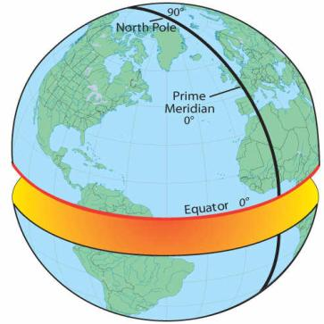
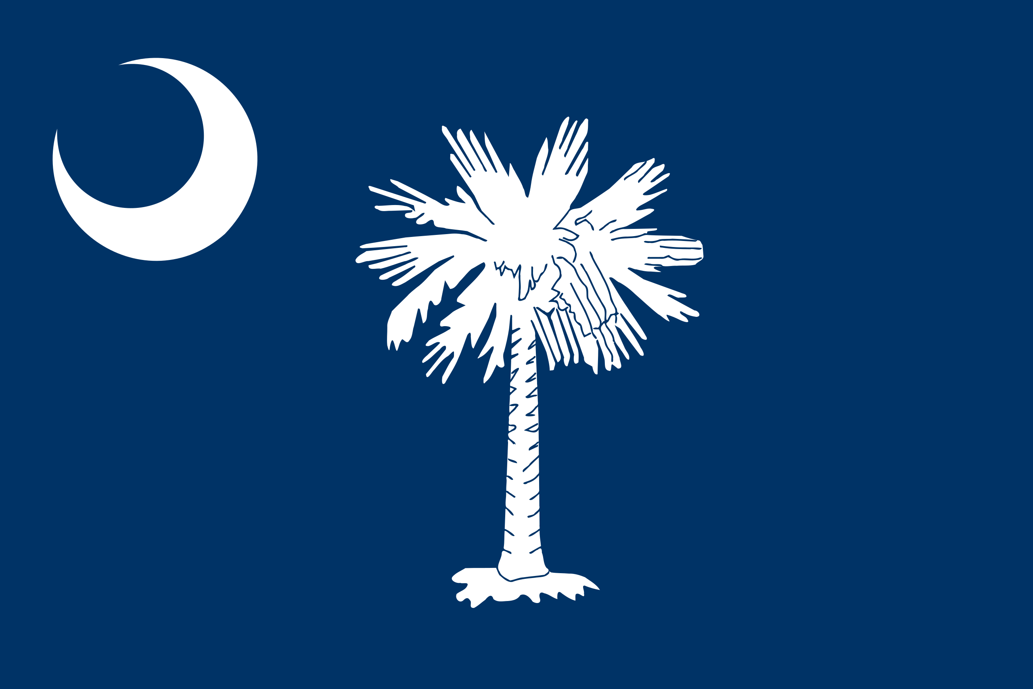
Where in the World is South Carolina?
South Carolina is:
in the Western hemisphere
in the Northern hemisphere

Slide 6
Where in the World is South Carolina?
South Carolina is:
in North America
in the southeastern United States
bounded by:
Georgia
North Carolina
Atlantic Ocean
Link to Internet map

Slide 7
Mapping South Carolina’s Location
Geography – Geo (earth) + graphy (description)
Location terms
latitude: the distance north or south of the equator
longitude: distance east or west of the prime meridian
absolute location: precise position found using latitude and longitude
relative location: position in relation to some other place

Slide 8
South Carolina’s Size and Shape
Triangle shape
Size is 40th of 50 states
Over 19 million acres of land
Mostly covered by forests
185 miles of coastline

Slide 9
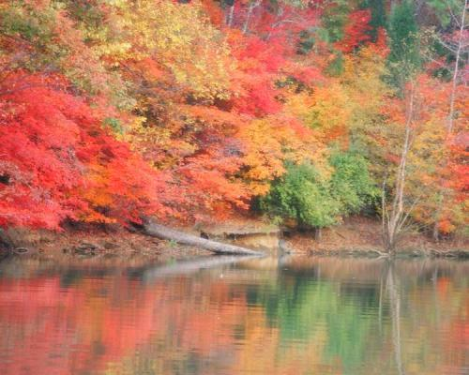
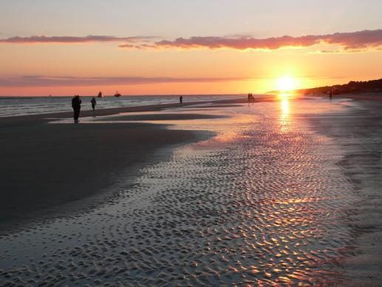
Understanding Our Environment
The term, “environment” means “surroundings.”
Geography plays a major role in our lives and in the history of our state.
Lake Wylie (top); Hilton Head Island (below)
Return to Main Menu

Slide 10
Section 2: The Geographic Regions of South Carolina
Essential Question
In what ways do South Carolina’s geographic regions differ?

Slide 11
Section 2: The Geographic Regions of South Carolina
What terms do I need to know?
flora
fauna
elevation
precipitation
monadnock
kudzu
tributary
Fall Line
Carolina bays
fault
delta
sound
barrier island

Slide 12
The Blue Ridge Region
Location: Northwest S.C.
Oldest landform in North America
Part of the Appalachian Mountain chain
Sassafras Mountain is highest (3,554 ft.)
Covered with vegetation (plants)
View from Sassafras Mountain

Slide 13
The Blue Ridge Region
Soil and terrain not good for farming
Plants are similar to those in the north due to altitude
Many birds; few game birds (e.g. turkeys)
Also bear, deer, squirrels, rabbits, and trout
Cooler and wetter than the rest of the state
Raven Cliff Falls

Slide 14
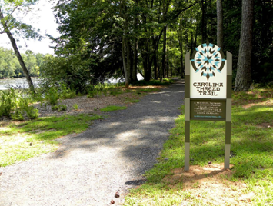
The Piedmont Region
Piedmont – “foot of the mountain”
Hilly region; covers 1/3 of South Carolina
Monadnocks: granite outcroppings
Granite is an important resource and is the state’s official stone.
Top: Carolina Thread Trail (Chester SC)
Bottom: Piedmont region farm

Slide 15
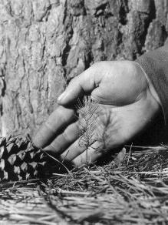
The Piedmont Region
Lands often cleared in 1800s to grow cotton or corn
20th century – much land used for pulp (timber)
Grasses used for pasture and to hold soil
Kudzu brought in to control erosion in 1930s
Kudzu now considered a nuisance
1951 Forestry Commission photo of pine seedling
Notes:
Kudzu link dosen’t work

Slide 16
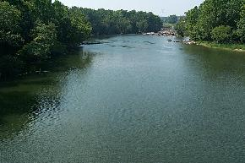
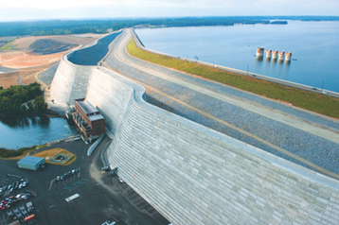
The Piedmont Region
Piedmont rivers are broad with gently sloping banks.
Appear muddy due to soil washed into the river (silt)
Humans use rivers for water, food, recreation, transportation, and power.
Saluda River (top) and
Dreher Shoals Dam (bottom)

Slide 17
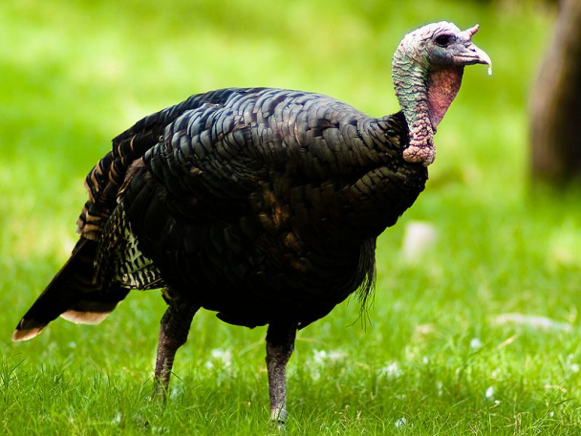
The Piedmont Region
Wildlife (fauna) includes deer, turkeys, bobcats, foxes, snakes and other reptiles
Many birds including quail, wrens, osprey, eagles, and herons
Wild turkey, the state game bird

Slide 18
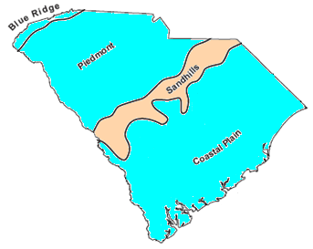
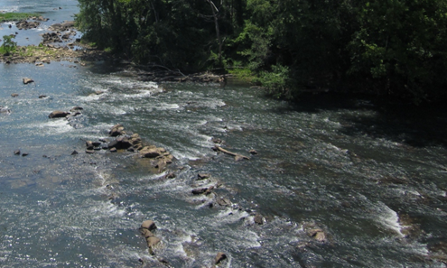
The Sandhills Region
Upcountry
Sandhills are low, rolling hills made from the sand and clay that washes from the mountains in the Piedmont region.
50-60 million years ago, area was sand dunes
Fall Line: place on a river where rocks & rapids force boats to stop when traveling from the sea
Towns formed near the Fall Line: North Augusta, Columbia, Camden, Cheraw
Columbia Canal built to move boats further up river around the falls
Lowcountry
The Sandhills were once the coastline of the ocean (top); rocks and rapids such as these blocked boats traveling upstream (bottom)

Slide 19
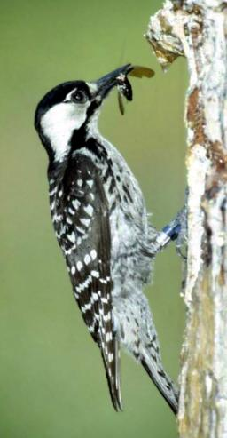
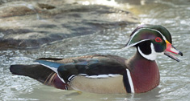
The Sandhills Region
Soils not very productive due to sand
Pine trees and scrub oaks common
Longleaf pines were cut for timber causing red-cockaded woodpecker to be endangered
Other birds are warblers, nuthatches, bluebirds, owls and wood ducks
Foxes, bobcats, rabbits, and squirrels are some of the mammals
Cockroaches (palmetto bug) are common insects
Red-cockaded woodpecker (top); the wood duck is the official duck of South Carolina (bottom)

Slide 20
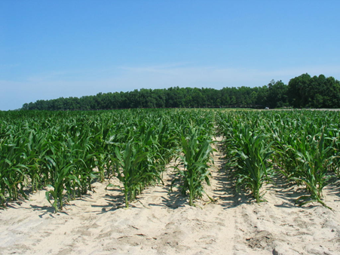
The Coastal Plain Region
Region is 100 miles across
Inner Coastal Plain: very fertile land
Outer Coastal Plain: areas nearest the ocean; very flat
Known for huge pine forests, also oak, hickory, sweet gum, and cypress trees
Carolina bays: oval shaped depressions in the land; can be a lake, swamp, or dry land
Not known how Carolina bays were formed
Many crops grow well on the coastal plain’s flat fertile lands.

Slide 21
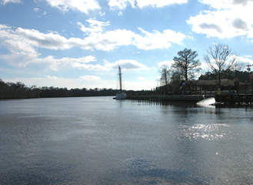
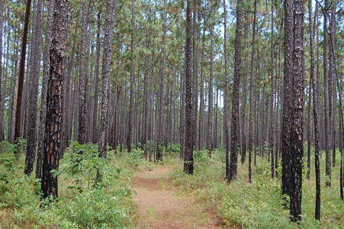
The Coastal Plain Region
Rivers spread and move slowly on the plain; large floodplains and swamps
Varied and abundant wildlife, especially in swamps
Congaree: only National Park in SC; known for old growth forest and champion trees.
Fish in Lakes Marion and Moultrie: bass, bream, & catfish
Waccamaw River (top); the Palmetto Trail crosses forests in the coastal plain (bottom)

Slide 22
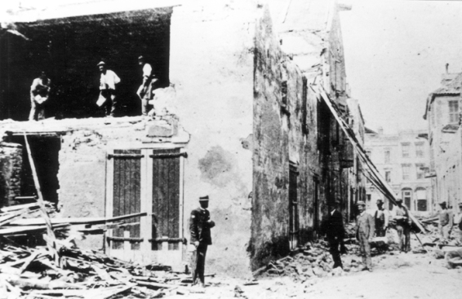
The Coastal Plain Region
Geological Fault: fracture in the Earth’s crust – source of earthquakes
1886 Charleston earthquake killed 83 people, major damage to city, felt hundreds of miles away
Men cleaning a damaged warehouse after the 1886 Charleston earthquake.

Slide 23
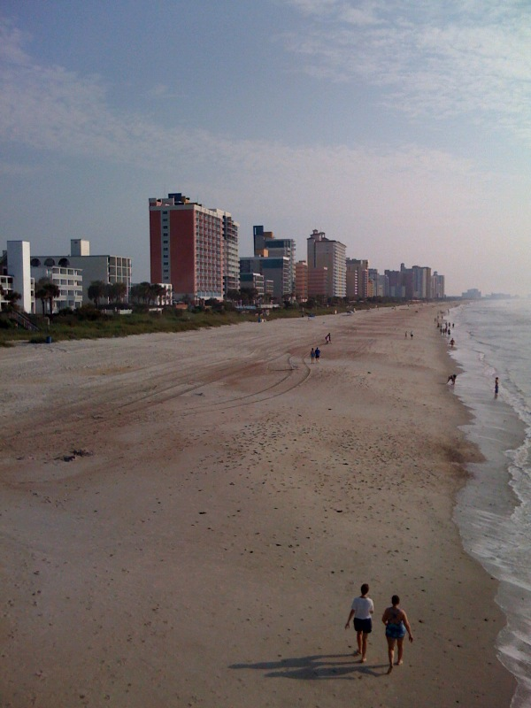
The Coastal Zone Region
Region from ocean’s edge to a few miles inland
Beautiful, high population, tourism business
Grand Strand: 60 miles of unbroken, wide, sandy beach; includes Myrtle Beach and over 100 golf courses
Santee Delta: largest river delta on Atlantic Coast; a marshy, muddy coastline
High-rise condominiums and hotels along Myrtle Beach, SC.

Slide 24
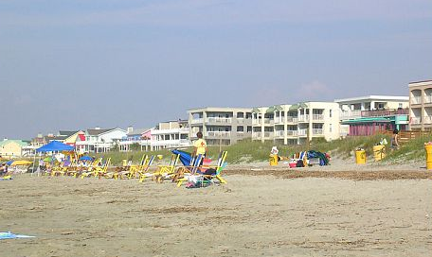
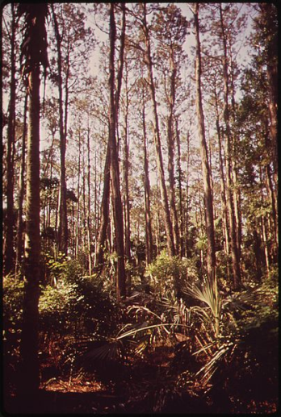
The Coastal Zone Region
Sea Islands: over 100 miles of river mouths, inlets, sounds, marshlands, and islands
Barrier Islands protect mainland from sea and winds (Isle of Palms, Folly, Sullivan’s, Kiawah, Hunting, and Fripp)
Many hotels, condominiums and private homes
Beach erosion caused by wind and sea are a major problem
Preserved islands are protected from human construction; examples are Bulls, Capers, North and South Islands
Tom Yawkey, owner of Boston Red Sox, donated North and South Islands to the state
The Isle of Palms is a popular ocean resort (top); forest on Bull’s Island (bottom)

Slide 25
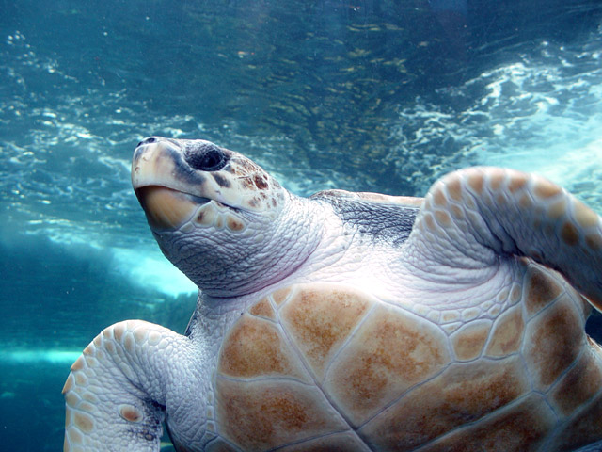
The Coastal Zone Region
Animals include alligators, eagles, ospreys, gulls, pelicans, sandpipers, oysters, crabs, bottlenose dolphins, and the loggerhead sea turtle which can weigh 300 pounds.
Laws protect this turtle and its habitat; nesting areas are marked to keep people away.
Loggerhead turtles are an endangered species.
Return to Main Menu

Slide 26
Section 3: South Carolina’s Waterways and Climate
Essential Question
How do rivers affect life in different parts of the state?
How does climate affect life in different parts of the state?

Slide 27
Section 3: South Carolina’s Waterways and Climate
What terms do I need to know?
black river
weather
climate
tornado
Bermuda high
hurricane
storm surge

Slide 28
Section 3: South Carolina’s Waterways and Climate
Three main river systems – flow from northwest to southeast
Rivers provide:
drinking water
water for industry
electrical power
recreation
home for wildlife

Slide 29
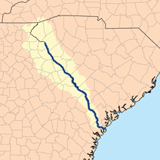
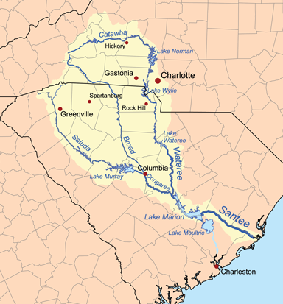
Waterways
Savannah river system forms border with Georgia; navigable for large ships
Santee system is the largest; drains about 40% of the state
Broad and Saluda Rivers form from streams in North Carolina.
Other rivers are the Pacolet, Tyger, Enoree, Reedy, Catawba, and Congaree.
Waterwheels were used to power grist mills; power companies built hydroelectric dams for electricity.
The Savannah (top) and Santee (bottom) river systems drain most of South Carolina.

Slide 30
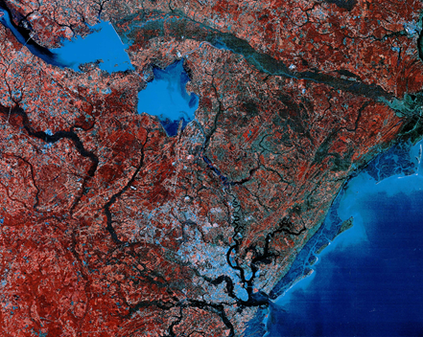
Waterways
The Santee Cooper project (1934) was a large scale project to bring electricity to the state.
Lakes Marion and Moultrie were formed.
Many jobs, along with low-cost electricity were created.
Changes in water flow have encouraged beach erosion and filled Charleston harbor with silt.
Satellite image of Lakes Marion and Moultrie. Click the image to see a larger view.

Slide 31
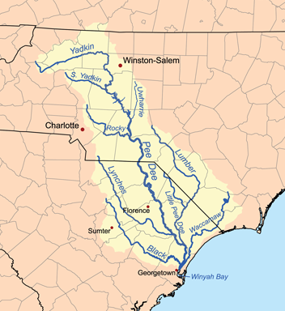
Waterways
The Pee Dee System begins in North Carolina.
Rivers include: Little Pee Dee, Great Pee Dee, Black, Lynches, and Waccamaw.
Slow-moving and clear
Called black rivers due to dark color (tannic acid)
Area of rice culture in 18th and 19th centuries
The Ashley and Cooper Rivers flow into Charleston Harbor.
ACE rivers (Ashepoo, Combahee, and Edisto): known for timber and
hunting preserves
The Pee Dee River System

Slide 32
Climate
South Carolina’s climate is subtropical (hot humid summers, mild winters).
At the coast: ocean breezes keep it cool in summer; the Gulf Stream helps keep the area warmer in winter.
Mountain areas tend to be cooler than Lowcountry.
Precipitation is about 49 inches per year – a bit more rain in summer than other seasons.
Winters are mild with few days of below-freezing temperatures.
Spring is marked by many blooming trees and shrubs (dogwood, azaleas, rhododendron, etc.)

Slide 33
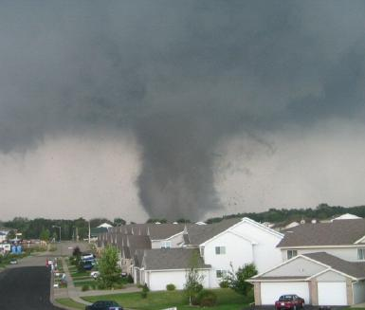
Climate
Tornadoes are funnel shaped clouds with wind speeds 65 to over 200 miles per hour.
SC averages 10 tornadoes per year.
The Fujita Scale is used to rate wind speed and damage by a tornado.
Lightning and hail may accompany tornadoes.
March 1984 tornado killed 21 people and injured 448.
Radar is used to warn South Carolinians of tornadoes.
A tornado rips through a neighborhood in 2005.

Slide 34
Climate
Summer weather is affected by the Bermuda High, a huge high pressure system that forms in the Atlantic Ocean.
The Bermuda High brings warm moist wind causing thunderstorms and wet summers.
It can cause drought (a period of little or no precipitation).
Fall is marked by the changes in leaf color and temperatures that approach freezing.

Slide 35
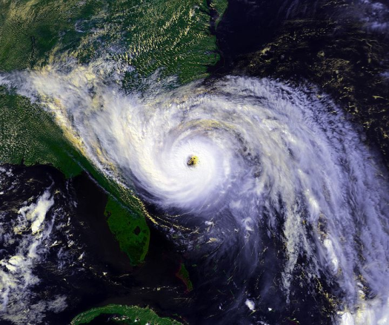
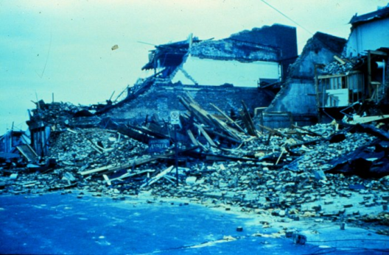
Climate
In summer and fall, tropical storms and hurricanes may hit South Carolina with damage from wind and floods.
Hurricanes are large storms of low pressure that rotate around a central “eye.”
Storms begin in warm waters of the tropical Atlantic Ocean, Gulf of Mexico, or Caribbean Sea.
Tropical storm: winds of 39-73 mph
Hurricane: winds of 74 or greater
The Saffir-Simpson Hurricane Scale is used to rate hurricanes’ wind speed and damage.
Hurricane Hugo (top) heads toward the Carolina coast in this satellite image from 1989. Below, buildings in Charleston in ruins after the storm.

Slide 36
Image Credits
Slide 1: Ted Kerwin, Wikimedia Commons; Slide 2: Public Domain Wikimedia Commons; Slide 9: Public Domain Wikimedia Commons (top) and Lee Coursey Wikimedia Commons (bottom); Slide 12: Aaron West; Slide 13: JAG on Wikimedia Commons; Slide 15: US Forest Service; Slide 16: SC Department of Natural Resources (top) and SCANA (bottom); Slide 17: Malcolm on Wikimedia Commons; Slide 19: United States Marine Corps (top) and Richard Bartz on Wikimedia Commons; Slide 20: South Carolina Department of Agriculture; Slide 21: Pollinator on Wikimedia Commons (top) and Daniel Barcelona on Wikimedia Commons; Slide 22: U.S. Geological Survey; Slide 23: Phil Guest, Wikimedia Commons; Slide 24: Cugirl, Wikimedia Commons (top); Environmental Protection Agency (bottom); Slide 25: Damien du Toit, Wikimedia Commons; Slide 29: U.S. Army Corps of Engineers; Slide 29: Karl Musser, Wikimedia Commons; Slide 30: LANDSAT image; Slide 31: Karl Musser, Wikimedia Commons; Slide 33: Colin McDermott, National Oceanic and Atmospheric Administration; Slide 35: U.S. National Oceanic and Atmospheric Administration; Slide 36: Andy Montgomery, Wikimedia Commons
Return to Main Menu

