Slide 1
Chapter 3: The Early Inhabitants of South Carolina
STUDY PRESENTATION
© 2022 Clairmont Press

Slide 2
Section 1: The Earliest Discoverers of America
Section 2: Indian Life and Cultures
Section 3: The Beginning of a New Era

Slide 3
Section 1: The Earliest Discoverers of America
Essential Question: Who were the first people to live in the Americas?

Slide 4
Section 1: The Earliest Discoverers of America
What terms do I need to know?
nomadic
mortar and pestle
midden
anthropologist
agriculture
palisade
prehistory

Slide 5
Introduction – Section 1
The discovery of America is linked to the theory of Asians coming from Siberia and going into Alaska.
Earth’s “ice ages” appear relevant to the exploration by these nomadic peoples.

Slide 6
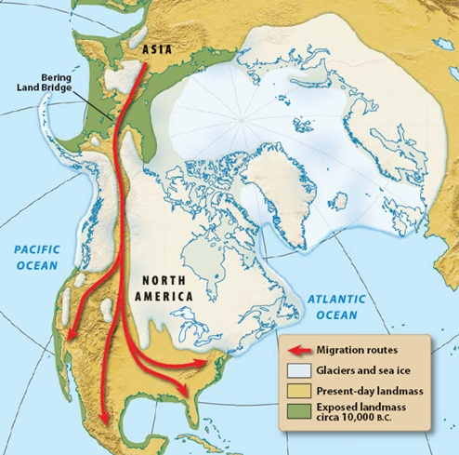

Slide 7
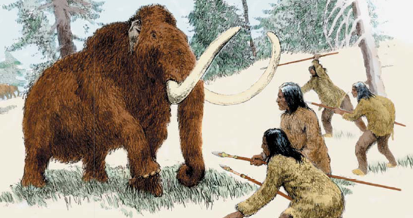
The Paleo Indian Period
During this period (c. 10,000 years ago), some of these early hunters set up camps in today’s South Carolina.
Tribes used spears to attack their prey, and stone spear points indicate the population later became more mobile.
Earth’s climate and the recession of glaciers created life changes for humans at the end of the Paleo Period (c. 12,000 to 10,000 years ago).

Slide 8
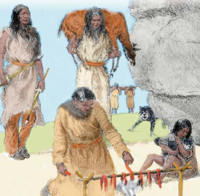
The Archaic Period
During this period – (c. 10,000 to 3,000 years ago), natives pursued smaller game, foraged for plant food, and traveled less.
Indians domesticated the dog which became a companion and hunting partner.
Tools, including a mortar and pestle, were made.
Baskets, pottery, and food storage were important, and population increased – society became more organized.
Large shell middens give evidence of long-term residences and the daily lives of these natives.

Slide 9
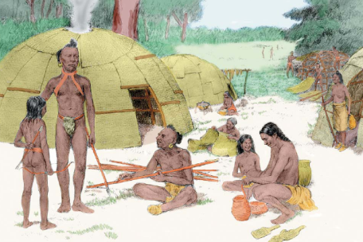
The Woodlands Period
Anthropologists call the period from c.1000 BC to AD 900 the Woodlands Period.
Advances in the era include: the bow and arrow, agriculture, sturdier houses, the storage of food, and time for artistic expression.

Slide 10
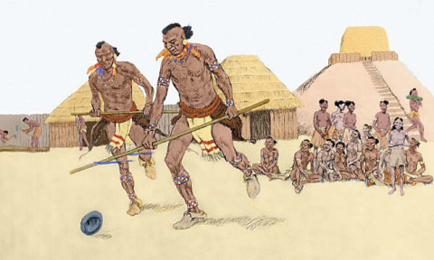
The Mississippian Period
Link: Mound builders
Link: Cahokia Mounds
This is the final period of Indian Culture (c. AD 900 to 1500) before the coming of Europeans.
Indian Culture included advances in agriculture, buildings, villages with palisades (walls), temple mounds, and class divisions.
Era of prehistory was over as European explorers and settlers found existence of this culture in the 1500s and 1600s.
Because Europeans wrote about Mississippian Indian life much more is known regarding the era.
Return to Main Menu

Slide 11
Section 2: Indian Life and Cultures
Essential Question: What was life like for the Native Americans?

Slide 12
Section 2: Indian Life and Cultures
What terms do I need to know?
maize
wigwam
wattle
daub
Green Corn Ceremony
matrilineal
nation

Slide 13
Introduction – Section 2
When Columbus arrived in 1492, between 2 and 18 million Indians of different groups were scattered across what is now the United States.
The Indians, divided into many tribes and language groups, developed lifestyles around the tribes’ needs.
When Europeans arrived in the early 1500s, between 30 – 50 tribes in four major language groups existed in the area that later became South Carolina.

Slide 14
The Economy
Economy relates to the manner in which people use available natural resources to supplement their survival and well-being.
Applying labor to the resources and using technology makes the labor more effective.

Slide 15
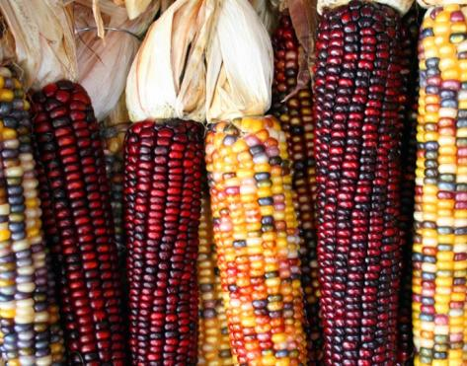
Food
South Carolina Indians were farmers and hunters, and they depended upon agriculture as a major food source.
Their diet was supplemented from several sources, among which was maize, squash, wild crops, pumpkins, sunflowers, and hickory nuts.
Common fields were tilled by both male and female, and the way crops were planted was well-planned.
To meet basic needs, most Indian groups had a balance among farming, hunting, fishing, and gathering.
Indians had excellent management of resources and used a variety of ecosystems.
Maize, along with beans and squash were known as the
“three sisters.”
Link: Three Sisters $ Coin

Slide 16
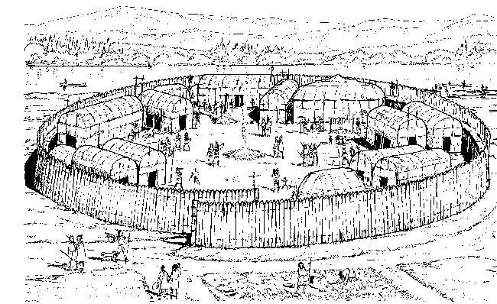
Shelter
In the Coastal Plain the most typical dwelling was the wigwam.
Tribes in the Upcountry built substantial homes using wattle and daub construction.
Cherokees used wattle and daub construction, but also built log cabins. Every village had a large public building that served as the council house or town hall (also, used for social & recreational activities).
An important feature was a protective wall erected around the perimeter of the village.
Catawba Village
Catawba Cultural Preservation

Slide 17
Clothing
Many Indians wore no clothes, or an apron for women and breechcloth for men (in warmer weather) and deerskin or bearskin (in cooler weather).
Body adornment was often through paintings, tattoos, and jewelry. Animal hair (e.g. bear or opossum) and plant fibers were used in making cloth.
Shirts, skirts, pants, robes, blankets, aprons, breechcloths, etc., were made with the cloth.

Slide 18
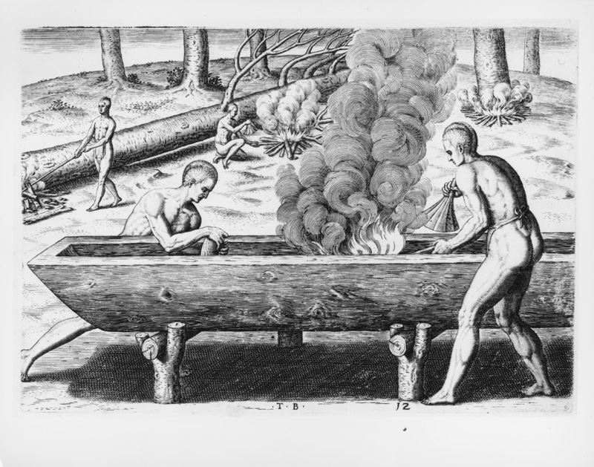
Transportation
Transportation for Indians (before contact with Europeans) was by foot or water. Villages were near rivers.
Dugout canoes were a major water transport and vital for trade amid tribes and villages.
Many trails created by foot travel later became roads (or some – highways).
Native Americans building a dugout canoe (1590).

Slide 19
Religion
All animals and humans originated as brothers in Indian mythology.
Animals were respected, and plants provided cures for illness.
Indians believed in good and evil spirits and in one Creator (or Great Spirit or Creative Force). In hope for purity and new beginnings, Cherokees and other tribes held the Green Corn Ceremony.
Music and Dance created magical powers, healed the sick, ensured a bountiful harvest, and they were used to observe rites of passage.
Green Corn Ceremony

Slide 20
Games and Recreation
Characteristics valued by Indians included courage, honor, and a life lived with dignity.
Indians were great athletes and game players, which included: ball games, racing, chunkey, and javelin throwing.
Click for video about chunkey.

Slide 21
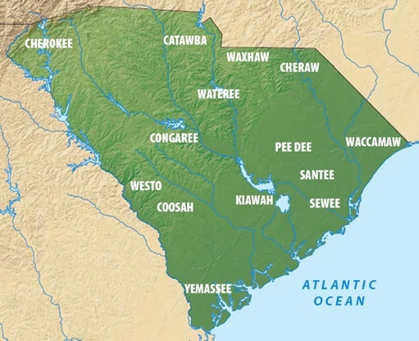

Slide 22
Social Organization
The primary unit of social organization in Native American society was the clan, whose identification depended on a native’s mother – (a matrilineal society).
A tribe (later sometimes called a nation) included many clans.
In the 17th century, some of the 30 – 50 tribes in South Carolina were large and powerful, while others were small and weak.
Government was geared toward harmony in the society, decisions were made through consensus, and women were included.

Slide 23
War
Wars, fairly common, sometimes resulted in retaliation.
A surprise attack, meant to take revenge, usually included war parties of 20 – 30 men.
The intent of a war never included total destruction of another tribe.

Slide 24
The Role of Women
Duties of Indian women included: tending the children, cooking, farming the village land, making pottery, etc.
Women took part in decision making. Some became chiefs.
In regard to marriage, a great deal more freedom was afforded to Indian women than in many cultures.

Slide 25
Childhood
Most of a child’s infancy was spent strapped onto a cradle board.
After infancy, very little physical punishment and a great amount of freedom were given.
Ridicule was the main disciplinary device used.
Boys learned to become men by hunting, running, wrestling, competing, and finally being initiated into adulthood.
Girls became women by helping with household tasks, learning to make pottery, working in the garden, etc.
Return to Main Menu

Slide 26
Section 3: The Beginning of a New Era
Essential Question: How did the arrival of Europeans change the lives of Native Americans?

Slide 27
Section 3: The Beginning of a New Era
What terms do I need to know?
New World
microbes
Old World

Slide 28
Introduction – Section 3
On October 12, 1492, Christopher Columbus and his three ships landed on the shore of San Salvador (off the tip of Florida).
Columbus and his crew sailed on large ships called the Niña, the Pinta, and the Santa Maria.
This landing was the beginning that changed the lives of the inhabitants.

Slide 29
The New Era in America
Columbus assumed he was near India (but was lost), so he called the natives Indians.
Columbus admired the island people; however, he made decisions that were often disastrous.
An Italian seaman sailing under Spain’s flag, Columbus was attempting to reach the riches of China by sailing west – around the world.
A whole New World resulted for Europeans to exploit since his discoveries failed to capture Asian trade for Spain, and yet Spain became the richest European nation for the next century.

Slide 30
The Devastation of Unfamiliar Diseases
Natives of Europe became richer by contact with America; however, not so for native Americans.
Indians, isolated for many years from the Old World, contracted illnesses brought by microbes from the Europeans.
Across North & South America millions of Indians died from smallpox, tuberculosis, measles, typhus, influenza, etc., resulting in population reduction. (Partly due to this, the population in South Carolina had dropped from 10,000 to about 300 by 1790.)

Slide 31
Trade
Native Americans had a commitment to nature; however, this changed due to bartering with white traders.
In exchange for animal skins, Indians received axes, knives, guns, blankets, etc., from European traders.
Indians thought less about subsistence and more about acquiring more wealth and goods.
Many wars between Indians and whites and among tribes resulted from conflicts over trade.

Slide 32
Indian Slavery
In South Carolina many settlers and explorers captured Indians, selling them as slaves. Payment for the slaves included English cloth, tools, trinkets, and rum.
Fortunes were made by many Carolinians in the Indian slave trade. No other colony made such a major enterprise from this unfortunate business.
Indian slaves brought better prices to buyers in New England and the West Indies, where escape was less likely. A few were kept in South Carolina.

Slide 33
Wars after the Europeans Came
Wars among Indian tribes increased in number and destruction after Europeans came to South Carolina.
Deception often ensued from plans laid out to weaken the tribes, and wars were more deadly with European guns as opposed to primitive weapons used by the Indians.
In the 17th and 18th centuries the decrease in Indian population resulted from disease, slavery, and wars. However, Indians did survive and lived in South Carolina. Today descendants retain cultural aspects.

Slide 34
Image Credits
Slide 1: Ted Kerwin, Wikimedia Commons; Slide 2: Public Domain Wikimedia Commons; Slide 15 Waugsberg Wikimedia Commons ; Slide 18 Public Domain Wikimedia Commons; Slide 34: Andy Montgomery, Wikimedia Commons
Return to Main Menu

