Slide 1
Chapter 4: Founding Colonies in North America
STUDY PRESENTATION
© 2022 Clairmont Press

Slide 2
Section 1: Changes that Prepared Europe for Expansion
Section 2: Early Explorations and Attempted Settlements
Section 3: The English Colonies in North America

Slide 3
Founding Colonies in North America
Settlement in present day South Carolina dates from 1521 when natives (in particular Francisco de Chicora) were captured as slaves.
Francisco, a personal slave of Lucas Vásquez de Ayllón, related stories of his home country (Chicora) trying to entice his owner and perhaps the king to establish a colony there.
The colony (town of San Miguel de Gualdape) founded in 1526 became the 1st colony in what is now South Carolina.

Slide 4
Section 1: Changes that Prepared Europe for Expansion
Essential Question: How did changes in Europe lead to exploration?

Slide 5
Section 1: Changes that Prepared Europe for Expansion
What terms do I need to know?
cartographer
Renaissance
capitalism

Slide 6
Technological Changes
In the 1400s, Johann Gutenberg invented the printing press which allowed ideas to be exchanged more rapidly and accurately.
The writings of Amerigo Vespucci convinced cartographers that lands being explored were not part of Asia but new continents to Europeans.
The opening of American continents to European exploration, conquest, and settlement was made possible by technological changes such as better ships, navigational devices, warfare, and gunpowder.

Slide 7
Intellectual Changes
The ancient learning of the Greeks and Romans provided significance and inspiration for Europeans during the Renaissance.
The printing press and new knowledge led to innovations, inventions, and a new confidence in individualism.
15th century printing press

Slide 8
Religious Changes
During the Middle Ages, Western Europe was loyal to the Roman Catholic Church and the Pope.
As knowledge increased among people, the Pope’s authority was questioned by Martin Luther, who sparked the Protestant Reformation.
Some Protestant denominations resulted; England became a Protestant nation with Henry VIII as head.
Effects of the Protestant movement included religious wars, intolerance, and persecution, which caused many people to leave Europe for America.

Slide 9
Political Changes
The nation-state emerged as the new type of political organization in Europe during the late Middle Ages and Renaissance.
Powerful nations included France, Spain, Portugal (Roman Catholic countries) and England, Holland, and Sweden (Protestant countries).
The exploration of Columbus in 1492 resulted through Ferdinand and Isabella’s unification efforts to develop the new nation of Spain from smaller states.

Slide 10
Economic Changes
A final set of changes for Europeans to explore and settle America was prompted by the rise of capitalism.
Exploration and expansion of horizons was enhanced by new knowledge such as astronomy, navigation, shipbuilding, weapons, the printing press, etc.
Capitalism was promoted by the new national monarchs, who granted land and exclusive trade rights to individual capitalists.

Slide 11
Europe Ready for Expansion to America
Europe was transitioned from the Middle Ages into the modern era by pivotal changes in technology, intellect, religion, politics, and economics.
With all of these changes, Europe was empowered to be more successful in one of the great migrations and conquests in human history.
Galileo Galilei introduces the telescope.
Return to Main Menu

Slide 12
Section 2: Early Explorations and Attempted Settlements
Essential Question: How did early explorations by Spain and France affect the Americas?

Slide 13
Section 2: Early Explorations and Attempted Settlements
What terms do I need to know?
caulk
garrison
prefabricated

Slide 14
Spanish Conquests
Spain, with high profits from ventures, was the 1st nation to explore and conquer large sections of the American continents.
Spanish settlers used captured slaves to establish sugar plantations in the Caribbean Islands. In Mexico and Peru Spaniards stole gold and silver from Indian civilizations.
Pirating of Spanish ships was promoted by the English, French, and other nations.
By 1650, American gold and silver provided a boost to the European economy.

Slide 15
The Spanish in Florida and Carolina
Spaniards, in pursuing more wealth, gave claim to large sections of the continent.
Ayllón sent 2 expeditions to Florida and as far north as South Carolina with little success.
(1539 – 1542) - De Soto attempted to strengthen Spain’s claim to La Florida. De Soto and his army were the 1st Europeans to explore interiors of what was to become the United States.
The armies in their searches spread disease and destruction among the Indian nations.

Slide 16
Spanish and French Competition in Florida and Carolina
In 1562, Jean Ribault built a small fort on Parris Island. Some settlers stayed, and some sailed to France for more colonists and supplies.
Scarcity in food at the fort and a decision to sail for France led to building a boat made of wood caulked with Spanish moss and pine rosin. Juan Pardo set up settlements and left small garrisons in his forts.
After Spanish-Indian conflicts on settlement, the Spaniards finally erected a fort using prefabricated sections.
For nearly 80 years, Indians in South Carolina had no intrusion by Europeans.

Slide 17
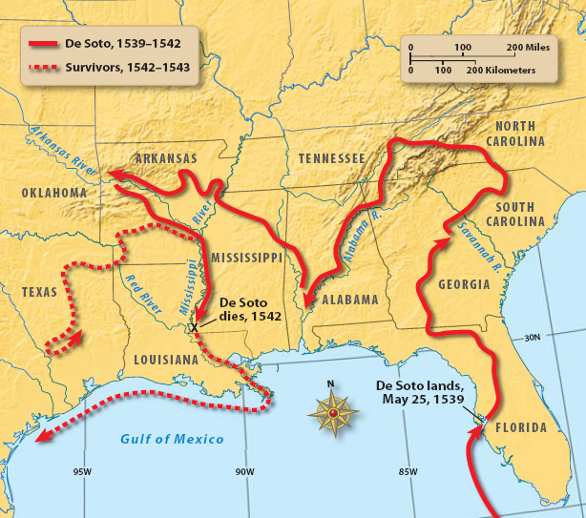
Return to Main Menu

Slide 18
Section 3: The English Colonies in North America
Essential Question: Why were the different English colonies established?

Slide 19
Section 3: The English Colonies in North America
What terms do I need to know?
Lost Colony
joint-stock company
indentured servant
headright system
Puritans
Pilgrims
Quakers

Slide 20
The Unsuccessful Colonies of North America
On the Outer Banks of North Carolina, the English tried to establish a colony.
Sir Walter Raleigh, having been granted land by Queen Elizabeth I, sent some soldiers to this area in 1585.
Colony attempts failed; then in 1587, Raleigh sent men, women, children, and soldiers to establish the settlement of Roanoke (on the NC coast).
The whole settlement of Roanoke disappeared, and this Lost Colony was never found.

Slide 21
Jamestown in Virginia
1607 – Jamestown became the first permanent English settlement in America.
Jamestown was in Virginia, which was named in honor of Queen Elizabeth I.
The colony was owned and operated by a joint-stock company and had the potential to make a profit.
The Virginia Company of London Seal

Slide 22
Jamestown in Virginia: Poor Leadership and Poor Conditions
Jamestown encountered difficulties that included inept leadership, poor preparation for wilderness living, unrealistic expectations about wealth, diseases, and malnutrition.
1616- Economic conditions improved as settlers realized Indian tobacco could be exported to Europe.
The Powhatans were prominent in Virginia.

Slide 23
Jamestown in Virginia: The Promise of Free Land and the Headright System
Settlers coming to America often paid their way for the voyage by becoming indentured servants, which was practiced in Virginia and adopted in other English colonies.
Another practice adopted was the headright system.
Out of these practices, a system built for widespread ownership of land ended up creating a small class of large, wealthy landowners spread along the rivers of eastern Virginia.

Slide 24
Jamestown in Virginia: The Beginning of Representative Government
Representative government in America essentially began in Virginia, as settlers demanded their local affairs be run by a representative assembly.
1619 – the House of Burgesses was established, which promoted the interests of large landowners; it also set a precedent for local control.

Slide 25
Jamestown in Virginia: The Arrival of Women and Slaves
1619 – Two other precedents held significance for Virginia: (1) a boatload of young women were sent there to provide brides for the men and (2) a boatload of African slaves arrived – and continued to arrive.
Following these actions, Virginia’s economy eventually depended largely on tobacco cultivation and the labor of black slaves and white servants.

Slide 26
Jamestown in Virginia: Relations with the Indians
Disrespectful relations with Indians continued for English colonies, as the standard set by Virginia.
Food supplies and land were taken from the Indians, who would occasionally retaliate.
Indian attacks in 1622, 1644, and 1675 killed many settlers. Each time the whites won because of their superior firepower.
Less than 1,000 Indians remained in Virginia by the end of the century.

Slide 27
Maryland
Maryland was a neighbor of Virginia, and the two colonies had much in common; however, there was a difference in origin and governance.
Maryland wasn’t a corporate colony but a proprietary colony under the direction of Cecilius Calvert, Lord Baltimore, who was a Catholic.
Most Englishmen were prejudiced against Catholics, so Maryland became a place of religious liberty for different Christian denominations.

Slide 28
The New England Colonies
Englishmen migrating to New England were more interested in religion than most settlers in the Chesapeake Bay area.
The dominant religious group in New England was a radical group of Protestants known as Puritans.
For many decades, the official church of England was Protestant; it was called the Anglican Church. It had no connection to the Pope or Roman Catholic Church though many of their ceremonies and practices were retained.

Slide 29
The New England Colonies: Puritans
Puritans wanted to cleanse the Anglican Church of all reminders of Catholicism.
They emphasized personal salvation, individual devotion and honest labor.
The congregation and government tried to impose strict standards of moral behavior.
One of the core values in the American dream was based on this “work ethic” created by the Puritans.
Cotton Mather, Puritan leader

Slide 30
The New England Colonies: Pilgrims
The Separatists, a smaller, more radical group than the Puritans, thought the Anglican Church too corrupt to purify and that good Christians should separate themselves from it.
November 1620 – a group of Separatists sailed on the Mayflower and arrived at Plymouth in Massachusetts to set up homes.
Despite hardships, the community survived only to be overshadowed in numbers, vitality, and wealth by the new settlement established at Boston.

Slide 31
The New England Colonies: The Massachusetts Bay Colony
1630 – The Puritan settlement at Boston by the Massachusetts Bay Company was an ambitious project:
large, well-planned, decisions made at town meetings
adequate food, local government in place
settlers from middle ranks of English society – were successful in businesses – brought families with them
Ambitious plans for education set by the Company
Puritans considered their venture a religious beacon to the entire Christian world; Massachusetts’ leadership was almost dictatorial about religion.

Slide 32
The New England Colonies: Other New England Colonies
There were several other colonies in New England produced by Massachusetts: Connecticut, by Thomas Hooker and Rhode Island, established by Roger Williams.
Williams, who was later joined by Anne Hutchinson, was a strong advocate of religious freedom and the principle of separation of church and state.
These two ideas eventually became fundamental to American life.

Slide 33
The Middle Colonies
In the 17th century, England was developing colonies along the North American coast, and other European countries also desired colonies there.
The area around Manhattan Island and the Hudson River was claimed by the Netherlands (or Holland, home of the Dutch).
The English Middle Colonies

Slide 34
The Middle Colonies: New Netherland/New York
1624 – The Dutch set up a trading post at Albany. 1625 – The Dutch set up another post on Manhattan Island, calling the town “New Amsterdam” and the colony “New Netherland.”
The pursuit of trade and profit caused the people of New Amsterdam to accept different languages, religions and nationalities.
1664 – New Amsterdam was captured by the English, and King Charles II gave New Netherland to his brother James, Duke of York. The colony was renamed New York with James as proprietor.

Slide 35
The Middle Colonies: New Jersey
The territory of New Jersey was part of King Charles’ grant to James, Duke of York. James divided the land between two friends.
Settlers were encouraged into this area by promises of inexpensive land, religious freedom, and political participation. Thus, New Jersey became a colony of prosperous farmers on fertile lands.
James, Duke of York

Slide 36
The Middle Colonies: Pennsylvania
1640s – Quakers had formed a new sect in England, and they desired a more pure Christian religion and a more just society.
With a belief in the equality of people, they refused to recognize social rank, rejected violence, refused to serve in the military, and considered individual conscience more important than church authority or scripture.
As a Quaker champion, William Penn was granted land (almost the size of England) and established Pennsylvania, which set the standard for pluralism.

Slide 37
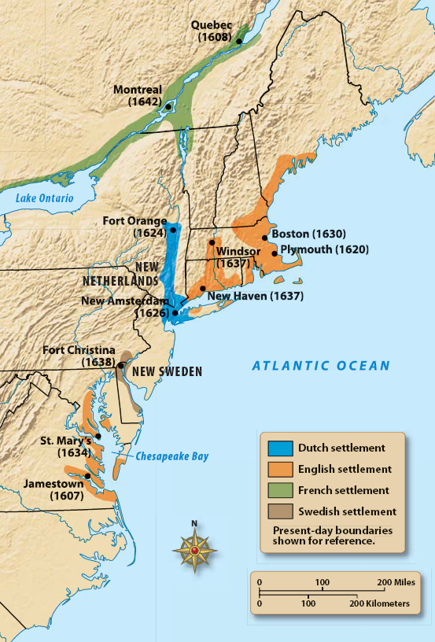

Slide 38
Image Credits
Slide 1: Ted Kerwin Wikimedia Commons; Slide 2: Public Domain Wikimedia Commons; Slide 7: Public Domain Wikimedia Commons, Slide 11: Public Domain Wikimedia Commons; Slide 21: Public Domain Wikimedia Commons; Slide 22: Public Domain Wikimedia Commons; Slide 29: Public Domain Wikimedia Commons; Slide 33: Public Domain Wikimedia Commons; Slide 35: Public Domain Wikimedia Commons; Slide 38: Andy Montgomery Wikimedia Commons
Return to Main Menu

