Slide 1
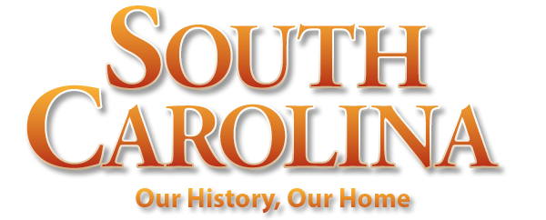
Chapter 6: A Rich and Royal Colony
STUDY PRESENTATION
© 2022 Clairmont Press

Slide 2
Section 1: Growing as a Royal Colony
Section 2: Slavery and Wealth
Section 3: How the People Lived
Section 4: Two Great Struggles: Upcountry versus Lowcountry; England versus France

Slide 3
Section 1: Growing as a Royal Colony
Essential Question: How did changes in government affect South Carolina?

Slide 4
Section 1: Growing as a Royal Colony
What terms do I need to know?
Township Plan
Scots-Irish
Pennsylvania Dutch
Great Wagon Road

Slide 5
The Rise of the Commons House
By 1775 – the dominant factor in South Carolina’s government was the Commons House, which was a move toward more democracy: • appointed local officials, controlled local affairs • collected taxes, decided how to spend funds
From its Colonial experience, South Carolina government inherited these characteristics: • power in hands of upper class property owners • control over government by lower house (General Assembly) • control of local governments by legislature

Slide 6
A Diverse Population
In South Carolina’s first 60 years: • white and black populations were diverse • each group had various languages and cultural characteristics
By 1730 – Native Americans losing numbers – were the smallest group of the three

Slide 7
The Township Plan
1731 – the purpose of the Township Plan suggested by Governor Robert Johnson: • to bring in more white setters to balance growing slave population • to provide a buffer against Spaniards, French, and Indians
One group attracted to Upcountry – Scots-Irish
Townships were not permanent towns, but helpful especially for defense

Slide 8
A New Neighbor
New colony of Georgia – buffer between South Carolina and Spanish Florida
James Oglethorpe, an English military officer – was granted the new colony of Georgia by King George II
Goals of Oglethorpe – use Georgia as base of military operations against Spaniards in St. Augustine – and a utopia (perfect society)
Savannah, Georgia - 1734

Slide 9
Other Settlers of the Upcountry
1750s / 1760s – largest population movement into Upcountry; the majority were Scots-Irish
2nd largest ethnic group German, often known as Pennsylvania Dutch
Great Wagon Road – used by migrants: one of most traveled roads in 13 colonies
Great Wagon Road

Slide 10
Differences between Upcountry and Lowcountry
1775 – South Carolina population nearly 180,000 – split between Upcountry and Lowcountry
Differences (often causing friction): • Religion – Upcountry (Presbyterians, Lutherans, Baptists, Quakers); Lowcountry (Anglican Church) • Way of Life – Upcountry (not slaveholders – worked their own farms); Lowcountry (slaves, plantations) • Government – Upcountry (whites had little voice); Lowcountry (domination by whites)
Return to Main Menu

Slide 11
Section 2: Slavery and Wealth
Essential Question: What was the nature of slavery in South Carolina?

Slide 12
Section 2: Slavery and Wealth
What terms do I need to know?
Middle Passage
chattel
artisan
Gullah
Stono Rebellion
manumission
driver

Slide 13
Slaves from Africa
Slaves to South Carolina – captured, sold to traders
The Middle Passage - slaves’ introduction to their new life
4-8 weeks on ship – landed on Sullivan Island – quarantined for 10 days – sold at slave auction
Some remained in Charles Town – most taken to rice plantations between Beaufort and Georgetown

Slide 14
The Nature of American Slavery
Slavery (in human history): slaves captured in wars, not slaves for life, children not automatically slaves
Slavery (in American history): slaves for life, considered chattel, no rights to travel, legally marry, etc., almost all were black people from Africa, children automatically slaves
Black slavery – existed in all 13 colonies

Slide 15
Slavery in South Carolina: Urban Slaves & Plantation Slaves
1730s – black slaves outnumbered whites 2:1 in colony
Urban Slaves – mainly artisans & household servants – established standards of excellence in trades or handicrafts (hired out by owners to other people to perform tasks)
Plantation Slaves – taken mainly to rice plantations – housed in little self-built cabins – clustered in small “settlements” (took charge of personal lives, as much as possible, including religion and ways of coping with the system of slavery)

Slide 16
Slave Communication & A Mixing Bowl of Cultures
The Gullah language – rooted in pidgin language – allowed slaves to talk to each other and whites – recognized as new creole language
New cultural patterns – influenced by Africans, Europeans, and Native Americans – contributed to a unique South Carolina culture

Slide 17
Slave Punishment and Resistance
Punishment – usually in public – included whipping, confinement, branding, being sold away from one’s family, etc.
Resistance – hardly noticeable gestures, comments, murder, slowing work pace, breaking tools, arson, physical attacks on white persons, running away, etc.

Slide 18
The Stono Rebellion & Tougher Slave Laws
Most whites feared organized slave rebellion, were required to carry guns even to church
1739 – slaves on Stono River took guns, ammunition – organized a rebellion called the Stono Rebellion – a pivotal moment for slaves (the largest, most significant slave uprising in South Carolina history)
The revolt unified whites; new steps taken to enforce system of slavery – new laws and tighter control, manumission done only by General Assembly

Slide 19
The Rice Fields
Slave knowledge and labor made South Carolina prosperous
Labor on rice plantations divided into tasks: slaves of different ages assigned daily workload, had free time remainder of the day, system encouraged hard work that was assigned by white overseers or a black driver
By 1740, rice production boomed.
A rice field partially under water

Slide 20
Indigo
Indigo – widely grown in 1740s and a significant factor in South Carolina economy
1775 – over one million pounds exported, with Beaufort and Georgetown as centers of indigo-growing regions
An excellent complement to rice cultivation, as each needed different types of soil

Slide 21
The Wealth of South Carolina
Wealth largely based on labor and skills of slaves
Many wealthy families lived in South Carolina – 9 of the richest 10 men in the 13 British colonies lived in South Carolina (at the end of the colonial era)
Return to Main Menu

Slide 22
Section 3: How the People Lived
Essential Question: What was life like for South Carolinians in the royal colony?

Slide 23
Section 3: How the People Lived
What terms do I need to know?
apprentice
Dock Street Theatre
Great Awakening

Slide 24
Growing Population
In South Carolina – not much population growth from natural increase – death rate about as high as birth rate – unhealthy environment, producing yellow fever, smallpox, malaria, and other diseases during colonial era
1760 – Many Cherokee and Catawba Indians as well as soldiers in Charles Town killed by smallpox

Slide 25
Charles Town Enters a “Golden Age”
Charles Town – began a “Golden Age” (mid-18th century) – one of premier cities in America for decades – home to wealthy residents
Community Life – clubs, societies promoted education, cultural activities; Library Society (est. 1755) provided materials for reading, education, new ideas
Homes / Lots – patterns of homes (single house or double house); deep lots (allowed smaller buildings for cooking, washing, housing slaves and horses); elaborate furnishings for houses
18th Century Charleston

Slide 26
Education
South Carolina – ranked low among the 13 colonies in educating its people; assumed parents to be responsible; usually private tutors hired by the wealthy; sons sent to England for further education
Teens of white artisans – placed as apprentices; parents paid for training
More opportunity in Lowcountry and Charles Town for formal education; in Upcountry very little opportunity
Majority of Carolinians – illiterate until near end of 19th century

Slide 27
Recreation
South Carolina society – wanted to enjoy life here and now – engaged in various activities (concerts, balls, opera)
Charles Town recreational activities – theatre (Dock Street Theatre opened 1736), drinking, billiards, card games, etc.
Activities beyond Charles Town and Lowcountry – cockfighting, bear-baiting, horseracing, hunting, fishing, fairs, etc.

Slide 28
Religion
Christian religion important in South Carolina
Reading material religious in nature; practical books on agriculture and medicine included in homes of literate Carolinians
St. Philip’s and St. Michael’s (two Anglican Churches in Charles Town); other areas also had churches
More denominations included: Presbyterians, Congregationalists, Baptists, Lutherans, Huguenots, Quakers, and Jews
The Great Awakening: the main religious movement of the mid 18th-century in American colonies
Return to Main Menu

Slide 29
Section 4: Two Great Struggles: Upcountry versus Lowcountry England versus France
Essential Question: How did conflicts shape the lives of people in the royal colony?

Slide 30
Section 4: Two Great Struggles: Upcountry versus Lowcountry England versus France
What terms do I need to know?
Regulators
Circuit Court Act of 1769
French and Indian War
Treaty of Paris of 1763

Slide 31
Introduction & The Cherokee War
Cherokee: allied with the British
France: competed with Carolina traders among the Indians; a military threat – especially after the beginning of the French and Indian War
Governor James Glen: made great diplomatic efforts to keep the Cherokee as friendly allies
Cherokee War: resulted as white settlers became more crowded and mistreatment more frequent
1759 – 1761: many settlers killed; homesteads looted & burned (also, Indian villages destroyed) – resulting in northwestern corner as Cherokee territory

Slide 32
Upcountry versus Lowcountry
Since 1670 – controversies / conflicts over government control, class distinction, and sectional struggles between rich, developed East and poor, frontier West
1760s – complaints of frontier Carolinians: (1) little representation of Upcountry in Commons House (2) their farmland taxed at same rate as more cash-producing lands (3) part of taxes supported Anglican Church, though they were mostly dissenters (4) most money used for coastal fortifications, not protection from Indians & French (5) lack of law enforcement and courts in Upcountry

Slide 33
The Regulators
Inadequate protection and no help from Charles Town – vigilante groups (called Regulators) formed by frontier settlers helped drive out criminal gangs
The Circuit Court Act of 1769: • Set up 6 new courts (3 in Lowcountry – Charles Town, with one already, Beaufort, Georgetown) & (4 in Upcountry – Orangeburg, Ninety Six, Camden, Cheraw) • Regulators were pardoned – reasonable order restored – peaceful relations – still long-term sectional and class tensions

Slide 34
The Mighty Struggle for Empire
18th Century – empires of Britain, France, Spain worldwide in scope; most powerful nations in Europe, each seeking dominance
Immediate threat to South Carolina: Spanish from St. Augustine and French
A battle royal for control of North America soon to happen

Slide 35
The Wars for Empire
1689 to 1763 – 4 major wars among powers in Europe
Mid 18th Century – aggressive competition between Britain & France for control of North America
1754 – French and Indian War: British vs. French & Indians
1756 – Seven Years War in Europe started – 1st truly global war in history involving all great powers in Europe – leaving Britain deeply in debt
Treaty of Paris of 1763 – the British Empire became the mightiest empire on earth; received the entire North American continent east of Mississippi River, except New Orleans

Slide 36
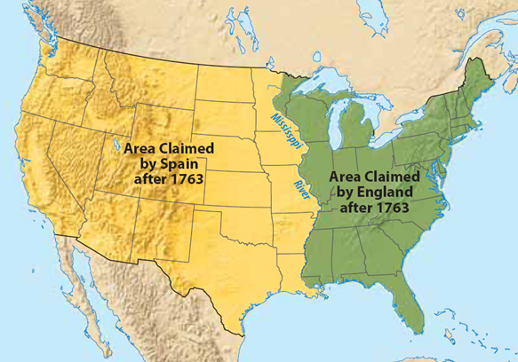

Slide 37
Image Credits
Slide 1: Ted Kerwin Wikimedia Commons; Slide 2: Public Domain Wikimedia Commons; Slide 19: University of North Carolina; Slide 37: Andy Montgomery Wikimedia Commons
Return to Main Menu

