Slide 1
Chapter 10: Reconstructing the Nation and the State
STUDY PRESENTATION
© 2022 Clairmont Press

Slide 2
Section 1: Political Reconstruction on the National Level
Section 2: Reconstruction in South Carolina
Section 3: The Economy During Reconstruction
Section 4: The Violent End of Reconstruction

Slide 3
Section 1: Political Reconstruction on the National Level
Essential Question: What competing beliefs affected the reconstruction of the South after the Civil War?

Slide 4
Section 1: Political Reconstruction on the National Level
What terms do I need to know?
Reconstruction
Freedmen’s Bureau
Black Codes
Radical Republicans
impeach
carpetbaggers
scalawags

Slide 5
Introduction
Robert Smalls and Martin W. Gary were important in South Carolina politics after the Civil War.
Robert Smalls:
runaway slave, Republican
His political power weakened when white Democrats regained control of the state government in 1877.
Martin W. Gary:
white lawyer, Democrat
His actions helped Democrats regain control of the state government, removing politicians like Robert Smalls.

Slide 6
Presidential Reconstruction & The Freedman’s Bureau
Reconstruction means “a period of rebuilding.”
President Abraham Lincoln wanted two things:
to rebuild the Union by winning over the seceded Southern states
the South to accept the freedom of slaves
Lincoln helped to establish The Freedmen’s Bureau.
main purpose was to help poor blacks (and many poor whites)
provided food and medical services, gave means of transportation to broken slave families, set up schools, helped freedmen find fair work

Slide 7
The Black Codes
Black Codes were a series of harsh laws meant to restrict freedmen.
took away many rights already given to freedmen
differed from state to state
meant to restrict relations between black and white people
Whites did not want blacks to have the same rights and status.
This Civil War map marks the line between the North (blue) and the South (red).

Slide 8
An Age of Anxiety
Whites were nervous about a society made up mostly of former slaves.
Whites feared retaliation from former, mistreated slaves, and they wanted blacks to be carefully watched.
Blacks feared that whites would re-establish something similar to slavery.
Some freedmen, who worked under white landowners, were still treated with violence like slaves.

Slide 9
Northern Reaction to the Black Codes
The North had a negative reaction to the Black Codes.
The North had fought for the end of slavery, and they did not want something similar to be established.
Northerners in favor of the freedmen and changes in the behavior of the South were called Radical Republicans.
In 1866, the Civil Rights Act was passed by Congress; it removed state laws, like the Black Codes, which were discriminatory on the basis of race.

Slide 10
The President versus the Congress
President Johnson’s (1865-1869) administration operated under confusion, strain, and disorder.
Republican Congress and Johnson disagreed.
President Johnson was impeached, but he kept his presidency.
impeach – to bring charges against a public official who is still in office
The Fourteenth Amendment, 1866
gave citizenship to black Americans (the Dred Scott decision [1857] said that blacks were not citizens)
gave equal protection to all citizens under the law
Radical Republicans in Congress placed new requirements on seceded states.

Slide 11
Congressional Reconstruction (or Radical Reconstruction)
New state governments were created by the former Confederate states.
New state governments consisted mainly of:
Carpetbaggers - name given by white southerners to northerners, black or white, who came to the south after the war
Scalawags – name given to southern whites who cooperated with blacks and Republicans
Blacks
All former Confederates states under Republican control, but for different spans of time
Democratic Party was associated with southerners and the traumatic Civil War.

Slide 12
Congressional Reconstruction (or Radical Reconstruction) - continued
President Ulysses S. Grant (1869-1877)
Grant was honest, but his administration has been called one of the most corrupt in American history.
corruption among his cabinet members, including personal secretary
Grant had difficulty dealing with Reconstruction in the South because of corruption problems.
The nation was conflicted as to how Reconstruction of southern states should occur.
Return to Main Menu

Slide 13
Section 2: Reconstruction in South Carolina
Essential Question: How did Reconstruction affect the lives of South Carolinians?

Slide 14
Section 2: Reconstruction in South Carolina
What terms do I need to know?
propaganda
discrimination
amnesty

Slide 15
Introduction & South Carolina under Presidential Reconstruction, 1865-1867
Was difficult because South Carolina had largest number of freedmen in the South.
When the Confederacy collapsed, President Johnson temporarily appointed Benjamin F. Perry as governor of South Carolina, until a constitution could be written and elections held.
President Andrew Johnson

Slide 16
The Benjamin F. Perry Administration
Benjamin F. Perry
allowed former Confederate state officials to keep their old positions
allowed organization of white, volunteer militia companies
recommended that the state ratify the Thirteenth Amendment
called a constitutional convention
White people in South Carolina were determined to maintain their southern way of life; they did not want northerners to change their ways.

Slide 17
The James L. Orr Administration
James L. Orr
first governor elected under new constitution, not the General Assembly, and first governor elected directly by the state’s voters
presided over reopening of South Carolina College, and the opening of the new state penitentiary
United States Congress required new constitutional conventions to be held in South Carolina and other southern states, because:
The General Assembly ratified the Thirteenth Amendment, but went on to pass the Black Codes.
legislature refused to ratify the Fourteenth Amendment
white citizens showed resistance – formation of armed night patrols

Slide 18
South Carolina under Congressional (Radical) Reconstruction
1868 was a time of great turmoil in South Carolina.
Blacks were hopeful about having some control over their own destiny and were working toward political equality.
Whites were anxious about black and white equality, because it threatened their superiority and the previous structure of South Carolina.

Slide 19
The Constitution of 1868
South Carolina’s new constitutional convention was composed of 73 black delegates and 51 white delegates.
A democratic constitution was created in 1868.
Gave equal voting rights, political opportunities for all men, and men without property could hold political office
General Assembly representation based on population, rather than wealth
local people could elect own officials and officials could tax for local needs
statewide public education system implemented, available equally to all children
Most whites resented the equality outlined by the new constitution in South Carolina .

Slide 20
Republican Rule in South Carolina
The first general election in South Carolina was held in 1868.
Republican Party was dominant, over 80% Republican in General Assembly - with 75 out of 124 in the House black, and 10 out of 32 in the Senate black
Robert K. Scott elected governor
white Union officer, head of Freedmen’s Bureau in South Carolina; held favor with black voters
Francis L. Cardozo elected secretary of state
first black man to hold a statewide office in South Carolina, member of the constitutional convention of 1868, showed interest in establishing a public school system

Slide 21
Republican Rule in South Carolina -continued
General Assembly ratified the Fourteenth Amendment, and circuit courts were established across the state.
South Carolina met the new requirements of Congress.
Military supervision was suspended in South Carolina.
Problems faced by the mostly Republican government:
threatened opposition from white minority who controlled wealth
violence, threats, beatings, and overall intimidation by whites after blacks were given voting rights; whites determined to uphold their civilization
The 12 years of Reconstruction in South Carolina was similar in intensity to the Civil War.

Slide 22
The Peak of Black Participation
After 1868, blacks became increasingly involved in the political life of South Carolina.
served on various committees, offices of lieutenant governor, secretary of state, secretary of treasury, and attorney general
On a national level, The Fifteenth Amendment to the Constitution guaranteed the right of African Americans to vote.
The election of Jonathan J. Wright, a black attorney, as justice of the South Carolina Supreme Court shocked many Conservatives.
white scalawags and carpetbaggers also important in the Republican majority

Slide 23
Propaganda against Radical Reconstruction
Conservatives thought poorly of Republicans, which helped to unify white opinion against Reconstruction.
Propaganda was used against Republicans, who were often corrupt and not suited for political leadership.
propaganda – accusations spread deliberately to further a cause or damage an opposing cause
Many northerners believed the propaganda, causing them to lose enthusiasm for their biracial democracy.
Many believed that the propaganda was initiated by revengeful congressmen and was carried out by blacks, carpetbaggers, and scalawags; this contributed to future segregation and discrimination against blacks.

Slide 24
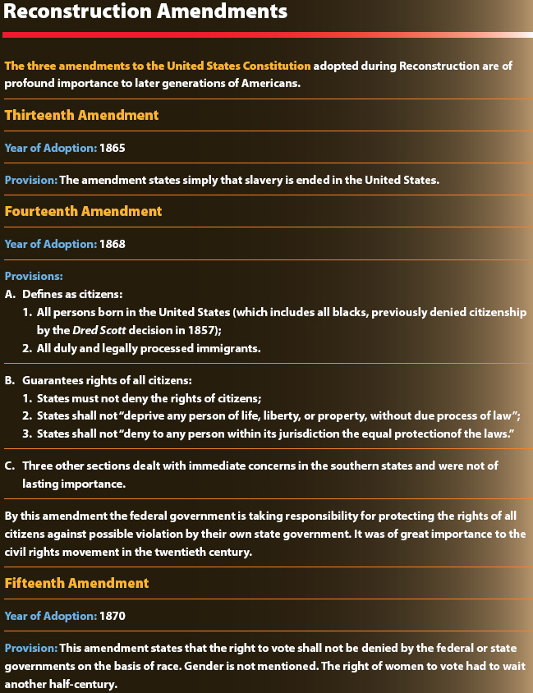

Slide 25
Black Leadership
Some black leaders were well-suited to be politicians, but others weren’t.
Robert Brown Elliot: distinguished legislator, (Congress for two terms) and powerful speechmaker
Joseph Hayne Rainey was the first black man elected to Congress. He voted for amnesty (pardon granted to a large group of individuals) for former Confederate officials.
Alonzo Jacob Ransier: first black lieutenant governor
Benjamin Franklin Randolph served in the state Senate and state Republican Party, and he was one of four Republican leaders assassinated in 1868.
Other black leaders include church leaders, newspaper editors, and political organizers.

Slide 26
Successes of Radical Reconstruction
Some black leaders, scalawags, and carpetbaggers, experienced success during Reconstruction in South Carolina; they provided an example of what biracial democracy might look like.
new statewide public school system
most not racially integrated, did not attract all school-age children immediately
Race relations became more open and integrated during Reconstruction in South Carolina, but integration did not sit well with many white people.
A small, professional black upper class developed: lawyers, ministers, doctors, nurses, teachers, even firemen and policemen in some areas.

Slide 27
Successes of Radical Reconstruction (continued)
Additional accomplishments of Radical Reconstruction:
Debtor’s home could not be taken to satisfy their debt.
People could not be put in jail for their debt.
Black people were allowed to serve on juries, and their testimony could be accepted in court.
Women, single or married, could own and control property.
A woman’s property could not be taken to satisfy her husband’s debt.
Divorce could be instituted by judges.
Temporary racial integration of the University of South Carolina

Slide 28
Religion and Race during Reconstruction
After emancipation, freedmen commonly established their own churches, exercising their freedom from white control.
Church became a social and political safe haven for black communities, and they were heavily attended (especially Baptist churches).
Many new churches adopted northern denominations (Methodists, Baptists, Presbyterians), rather than southern denominations.
The African Methodist Episcopal (AME) Church and the AME Zion Church were two national, solely black churches.
Both white and black denominations showed interest in education; several founded colleges and universities.
Return to Main Menu

Slide 29
Section 3: The Economy during Reconstruction
Essential Question: How did farming in South Carolina change during Reconstruction?

Slide 30
Section 3: The Economy during Reconstruction
What terms do I need to know?
depression
sharecrop system
tenant farmer
crop-lien system

Slide 31
Introduction & The National Economy during the Reconstruction Era
Rebuilding the economy was a significant concern during Reconstruction; the South received very little help from the federal government.
Tremendous economic transition during the Civil War and Reconstruction
Industry increased rapidly in the North during the Civil War; the federal government encouraged this growth and took several steps to see the North progress economically.
In 1873, a temporary depression negatively affected laborers and businesses; federal, state, and local governments had little help to offer.
While the North recovered, the South still experienced poverty and insufficient economic success.

Slide 32
The South Carolina Economy during Reconstruction
After war, South Carolina’s economy was chaotic.
Enormous destruction in towns, cities, farms, and plantations
Need to get crops growing again, for food and economic purposes
Main problem: no money for landowners to hire laborers, and many laborers had no land of their own
Many freedmen remained where they were in slavery.
Blacks hoped for and whites feared government takeover and redistribution of land – this did not happen.

Slide 33
The Sharecrop System
Dominant solution between landowners and workers
Sharecrop system - a landowner divided up his property into workable farms; laborer and family worked the individual farms
Landowner and worker each got a share; the worker usually got 1/3 to 1/2 harvest.
Sharecropping created production, not prosperity.
Sharecropping in 1941

Slide 34
The Crop-Lien System
Common alongside sharecrop system
Crop-lien system: landowners and sharecroppers with little money bought items on credit from a store, merchant got a lien or mortgage on the crop and was paid first at harvest, landowners and sharecroppers divided up the remaining
Often very little remained, caused debt
Merchant insisted that farmers plant nonperishable crops which meant survival, not prosperity.

Slide 35
Difficulties for All Classes
Many who were formerly rich declared bankruptcy and lost property
Small farm owners competed with sharecroppers
Women often overworked because their sons or husbands were killed or disabled in the war.
Difficulties caused class and racial tensions.

Slide 36
Railroad Development
Railroad network being rebuilt
The state government supported railroad development with loans and grants.
Cotton production expanded.
Commerce in South Carolina remained weak during Reconstruction.
Few manufacturing advances
Depression starting in 1873 was a hindrance to commerce.
Return to Main Menu

Slide 37
Section 4: The Violent End of Reconstruction
Essential Question: How did Reconstruction end in South Carolina?

Slide 38
Section 4: The Violent End of Reconstruction
What terms do I need to know?
Ku Klux Klan (KKK)
Red Shirt campaign

Slide 39
The Rising Opposition
The Congressional (Radical) Reconstruction (1868) led to increased violence, opposition, and intimidation methods by Democrats against Republicans.
The Republicans were partly to blame for the opposition of Democrats.
They allowed corruption to enter into the government.
Governor Robert K. Scott was corrupt, but his successor, Franklin J. Moses Jr., was probably the most corrupt governor ever to serve in South Carolina.

Slide 40
The Ku Klux Klan
Organized in South Carolina in 1868
Secret racist organization that used threats and violence to influence the behavior of citizens; beatings, torture, and terror
Targets were politically active republicans, usually black men
Acted mainly at night, mounted horses, wore robes and masks, worked in groups
Some efforts to control the KKK, but the organization was only further provoked – “like throwing gasoline on fire”
Klan organizations disbanded, but similar groups continued – all in an effort to promote white supremacy.
Hundreds of Klan members ended up in prison

Slide 41
The Hamburg Massacre
Ultimately demonstrated that the republican government was unable to protect its own citizens
What happened?
Two white men felt insulted by the black militia drilling in the town of Hamburg; the men looked for help in Edgefield from former confederate general Matthew C. Butler and Benjamin Ryan Tillman.
Butler arrived in Hamburg with two hundred armed white men; they surrounded the black militia, and firing broke out. A white man was killed, and more armed white men arrived.
The armed white men captured around three dozen black militiamen and killed six of those captured.

Slide 42
The Election of 1876
Democratic party nominated Confederate war hero general Wade Hampton III
They claimed they wanted to cooperate with every person in the state, including blacks, and promised to respect the rights of all citizens.
Everywhere Hampton campaigned, hundreds of mounted horsemen met him, wearing red shirts; meant to intimidate republican voters
The red shirts interfered with Governor Chamberlain’s campaign as well.
Both sides were willing to use fraud to win
Chamberlain and Hampton both sworn in as governor by supporters – dangerous dual government for a short period

Slide 43
The End of Reconstruction
Hampton held key resources- backed by people who paid most taxes, owned most guns; encouraged supporters to pay taxes for his benefit, and they complied
Chamberlain lacked money, most supporters not willing to pay taxes for his benefit
Presidential election of 1876, one of the most controversial in history
Democratic candidate Samuel Tilden, Republican candidate Rutherford B. Hayes
The federal government and North gave up effort to reform South Carolina and protect rights of black citizens.
Hayes won election, Chamberlain left the states, Hampton become state governor

Slide 44
Image Credits
Slide 1: Ted Kerwin Wikimedia Commons; Slide 2: Public Domain Wikimedia Commons; Slide 7: Chris 73 on Wikimedia Commons; Slide 15: Tom on Wikimedia Commons; Slide 33: Davepape on Wikimedia Commons; Slide 35: Magnues Manske on Wikimedia Commons; Slide 44: Andy Montgomery Wikimedia Commons
Return to Main Menu

