Slide 1
Chapter 12: The Progressive Era
STUDY PRESENTATION
© 2022 Clairmont Press

Slide 2
Section 1: Life at the Turn of the Century
Section 2: Politics in the Progressive Era
Section 3: America and South Carolina at War

Slide 3
Section 1: Life at the Turn of the Century
Essential Question: How did inventions change the lives of South Carolinians at the start of the 20th century?

Slide 4
Section 1: Life at the Turn of the Century
What terms do I need to know?
Rural Free Delivery (RFD)
hydroelectric
streetcar
trolley
pandemic
pellagra

Slide 5
Introduction & Resistance to Immigration
Factors affecting change
Technology
Cultural interaction
Immigration
Resentment of immigration
Devaluation of contributions
Resentment of low wages
Chinese Exclusion Act
Nativist sentiment

Slide 6
Rural Life in South Carolina & Diversions
Untouched by immigration
Isolated rural homes
Mostly tenants or sharecroppers
Widespread poverty
Entertainment
Fairs, quilting bees
Horseraces, cockfights, hunting
Segregated churches
Orphanages, missionaries, prohibitions
Camp meetings

Slide 7
The Country Store
Social meeting place
Post office
Polling place
Variety store
Food, clothing, tools, kerosene
Patent medicine-aspirin
Bank
Credit extended
Farms lost

Slide 8
Farm Life Improves
Prosperity in first two decades
Tobacco cultivation for cigarette manufacturing
Cotton increases due to demands of WWI

Slide 9
Rural Free Delivery
Federal government creation
National mail and package delivery to rural areas
Growth of catalog shopping

Slide 10
Villages and Towns
All had livery stable, hitching rails, and watering trough.
Most had a little hotel, restaurant, stores, cotton gins, churches, and a doctor.
Townspeople participated in organized leisure activities, like baseball.
Towns provided parks, bandstands, parades, and an occasional opera house.

Slide 11
Advances in Technology: The Telephone and Electricity
Telephone provided jobs for women and more rapid communication.
Electricity used initially for mill machinery.
James Buchanan Duke founded the Duke Power Company.
Streetcars replaced by trolleys.
Railroad remained most convenient form of land transportation.

Slide 12
The Automobile
Expensive cars
Impassable roads
Ferryboats
Manufacturing in Rock Hill, SC
Ford’s assembly line

Slide 13
Tourism
Train travel
Attractions
Climate
Sports associated with horses
Beach

Slide 14
Health
Residents had poor health.
Resistance to vaccinations
Influenza epidemic
Pellagra
Worst outbreaks in mill villages
Economic hard times correlated to higher outbreaks
Exact cause – niacin deficiency

Slide 15
Violence and Murder
High rate
Many causes
Frontier beginnings
Southern traditions
Civil War and Reconstruction’s illegal rebellion against authority
Access to guns and liquor
Acceptance of murder
Return to Main Menu

Slide 16
Section 2: Politics in the Progressive Era
Essential Question: What beliefs and ideals affected politics in the progressive era?

Slide 17
Section 2: Politics in the Progressive Era
What terms do I need to know?
Progressive Era
direct primary
referendum
recall
trust
Federal Reserve System
women’s suffrage

Slide 18
The Progressive Response
Societal problems
Overcrowded, unsanitary, and unsafe living and working conditions
Child labor and lack of worker security
Corruption
Economic gap
Progressive beliefs
Planned progress
Education
Human problem solving
Democratic government as a change agent.

Slide 19
Progressivism in Action in the Cities
Led by middle class city dwellers
Reforms in education, health and safety
Creation of parks and transportation systems
Support for prohibition
Government of experts, not cronies
Commission city government
City Manager form of government

Slide 20
Progressivism at the State Level
States were a testing ground for new ideas.
Direct primary was adopted.
In SC led to primary being the only meaningful election due to the overwhelming Democratic majority.
States adopted secret ballot, referendum, and recall.
Recall was not adopted in SC.

Slide 21
Progressivism at the National Level
Theodore Roosevelt
Sherman Antitrust Act broke up railroad monopoly.
Interstate Commerce Commission set railroad rates.
Coal strike intervention
Regulations in food and drug industry (The Jungle by Sinclair)
William Howard Taft
Trust breaker
Roosevelt’s Bull Moose Party
Woodrow Wilson
Federal Reserve System
Federal Trade Commission
16th Amendment
Support for agriculture
Women’s suffrage – 19th Amendment

Slide 22
Politics in South Carolina: Progressive and Regressive
Governor Heyward
Improved education
Abolished child labor under 10
Lowered mill work week to 60 hours
Governor Ansel
Abolished Dispensary
Governor Blease
Blocked reforms in education and labor
Created tuberculosis sanatorium
Accepted SC Medical College as state supported

Slide 23
The Progressive Administrations of Richard I. Manning
Passed laws to help working-class
Labor board
Insurance compensation to laid-off workers
Minimum child labor age raised to 14
Improved State Hospital
Established State Tax Commission
Created State Highway Commission

Slide 24
The Progressives and Education
Doubled funding for education
Mandated compulsory school attendance
Created special schools
Required teacher certification and increased teacher salaries
Made uneven progress across state
Cooperated with Julius Rosenwald to build schools for rural black children

Slide 25
South Carolina and Women’s Suffrage
Virginia Durant Young
pioneer of movement
South Carolina Equal Rights Association
Susan Pringle Frost
Anita Pollitzer
Eulalie Chafee Salley
19th Amendment
Ratified nationally, but not in SC
SC women could vote, but not serve on juries

Slide 26
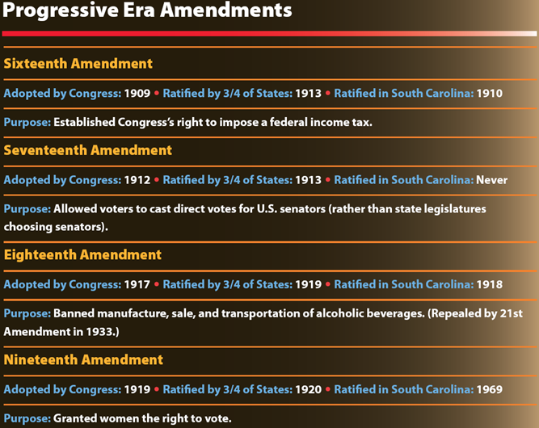
Return to Main Menu

Slide 27
Section 3: America and South Carolina at War
Essential Question: How did World War I affect South Carolina?

Slide 28
Section 3: America and South Carolina at War
What terms do I need to know?
trench warfare
League of Nations
isolationists

Slide 29
Introduction & America Goes to War
America enters the war in 1917 due to continued sinking of American ships.
America joined the Allied Powers and fought the Central Powers.
Wilson created agency to propagandize to increase American support of war.
Government suppressed opposition to war through laws, confiscation, and even imprisonment.
Military was mobilized and men were drafted.
War was mostly fought with trench warfare in Belgium and France.
New tools of war were employed.

Slide 30
South Carolina in the War
State Council of Defense by Gov. Manning
Speakers bureau for patriotic rallies
Return of July 4th celebration
Strong anti-German attitudes

Slide 31
South Carolinians’ Contributions
Manpower – over 65,000
Segregated units
Government bonds
Liberty gardens
Meatless and wheatless days
Job replacements by women
African American northern migration to war industries
Bernard Baruch, native son
Chairman of War Industries Board
Advisor to President Wilson

Slide 32
War’s Effect on the Economy
Huge increase in employment
Agricultural and industrial production increases
Best economy since 1861

Slide 33
Disappointments at War’s End
Halfhearted European support for League of Nations
Rejection of Treaty of Versailles and League of Nations by U.S. Senate isolationists

Slide 34
Image Credits
Slide 1: Ted Kerwin Wikimedia Commons; Slide 2: Public Domain Wikimedia Commons; Slide 34: Andy Montgomery Wikimedia Commons
Return to Main Menu

