Slide 1
Chapter 13: The Transition Twenties and Depression Thirties
STUDY PRESENTATION
© 2022 Clairmont Press

Slide 2
Section 1: The Twenties: An Era of Transition
Section 2: The Economy: From Hard Times to Desperate Times
Section 3: The New Deal
Section 4: Politics of the Twenties and Thirties

Slide 3
Section 1: The Twenties: An Era of Transition
Essential Question: What changes in culture emerged in the 1920s?

Slide 4
Section 1: The Twenties: An Era of Transition
What terms do I need to know?
jazz
Jazz Age
Roaring Twenties
flapper
Harlem Renaissance
Southern Literary Renaissance

Slide 5
Introduction & Nationalization of Culture
Age of consumerism, credit, and materialism - mass production, clever advertising, installment plans
New urban culture - changing morals, instant celebrity, rural resistance
Blending of cultures - mass media, jazz

Slide 6
The Jazz Age or the Roaring Twenties
New trends
Flappers
Jazz
New dances
More automobiles
More leisure - reduction of working hours, increase in golf and spectator sports

Slide 7
A Literary Renaissance & The Harlem Renaissance
Explosion of literature
Disillusioned writers
Critics of materialism, conformity, and consumerism
Harlem Renaissance
Increase in African American writers
Rise of black intellectuals in Harlem - W. E. B. Du Bois, James Weldon Johnson, Langston Hughes, Zora Neale Hurston

Slide 8
The Southern Literary Renaissance
Poetry Society of South Carolina
Archibald Rutledge, first poet laureate
Julia Mood Peterkin, female Pulitzer prize winner
Outside of South Carolina
William Faulkner, 2 Pulitzer Prizes and Nobel Prize in Literature
Margaret Mitchell – Pulitzer Prize
Thomas Wolfe
Fugitives or Agrarians
Defenders of southern traditions
Robert Penn Warren
Allen Tate

Slide 9
Defense of Traditional Values
Widespread in rural areas and South Carolina
Viewed cities as evil
Wanted enforcement of blue laws and prohibition
Insisted men control their families
Rebirth of the KKK
Dedicated to controlling blacks, Jews, Catholics, immigrants, and radicals
Tried to enforce their own values
Gained political importance in several states
Declined after 1925
Disillusioned with leadership
Rejected nationally due to violence
Limited mostly to Upcountry in South Carolina

Slide 10
The Failure of Prohibition
Became law in 1919 with 18th Amendment
Violated widely in all states
Led to disrespect for law
Corrupted law enforcement and public officials
rumrunners, bootleggers, speakeasies
Repealed in 1933
Return to Main Menu

Slide 11
Section 2: The Economy: From Hard Times to Desperate Times
Essential Question: How did scarcity affect South Carolinians in the 1920s and 1930s?

Slide 12
Section 2: The Economy: From Hard Times to Desperate Times
What terms do I need to know?
boll weevils
Great Migration
Great Depression

Slide 13
Not-So-Roaring Twenties
Agricultural depression
Drop in cotton prices
Plague of boll weevils
Drought wiped out crops being grown
Erosion began to occur in the soil on farms
There was an abundance of abandonment of farms

Slide 14
The Great Migration
Black movement to the north
Began during WWI
Lured by better jobs and more freedom
Ceased to be majority in SC by 1925
Conditions in the north
Discrimination on raises and promotions
Crowded living conditions
Crime and disease was rampant
Political clout
Higher wages to workers

Slide 15
The Textile Industry Triumphs, Then Slumps
Growth from 1880 to 1920
Tax breaks to mills
Lax safety and sanitation regulations in mills due to the laissez-faire policy
Cheap labor provided by struggling farmers and starving sharecroppers
Nation’s leader by 1920

Slide 16
Improvements in Mill Village Life & Worsening Conditions inside the Mills
Positive improvements
Reduction in working hours
Electricity and running water
Increased ownership of luxury items
Negative conditions
Speed-up and stretch-out – management decided to speed up the machines and increase the number of machines that each worker tended
Protests and strikes
Legislative investigation

Slide 17
The Great Depression
Downward economic spiral
Overproduction/underconsumption
Lay-offs and slowdowns
Declining share values
Bank closing
Rise in unemployment
Lack of money to buy food
Declining per capita income
Signs of the times
Hoboes
Hoovervilles

Slide 18
Return to Main Menu

Slide 19
Section 3: The New Deal
Essential Question: How did the New Deal change the lives of South Carolinians?

Slide 20
Section 3: The New Deal
What terms do I need to know?
New Deal
collective bargaining
Social Security Act

Slide 21
Introduction & Relief, Recovery, and Reform
Herbert Hoover
Not the cause of the Depression
Ineffective in improving conditions
Franklin Roosevelt
Elected by landslide in 1932
Dealt with crisis on the first day
Reducing fears
Giving hope
Franklin Roosevelt

Slide 22
The Banking Crisis
Roosevelt’s plan
Ordered a bank holiday
Closed banks
Send in federal inspectors
Reopened healthy banks
Gave assistance to others
Reformed banking system - federal laws, Federal Deposit Insurance Corporation

Slide 23
Emergency Relief
Forms of relief
Cash to needy families
Creation of agencies to create jobs
Purpose of relief
Get money into hands of people
Create a demand for goods
Prime the pump
Prevent starvation and suffering
Purpose of recovery and reform
Growth of private, profitable enterprise
Avoidance of another collapse

Slide 24
Relief and Jobs
Federal relief grants to South Carolina
Built and repaired bridges, sewer lines, schools, and courthouses
Hired teachers and funded school lunches
Problems with grants
Favoritism
Political connections
FDR’s Fireside Chats
Explained programs
Built confidence
Proved usefulness of radio

Slide 25
The CCC
Civilian Conservation Corps
Hired young men from needy families
Sent money home
Provided food, clothing, shelter, and educational opportunities
Worked on state parks
The CCC renovating a canal in Washington, D.C.

Slide 26
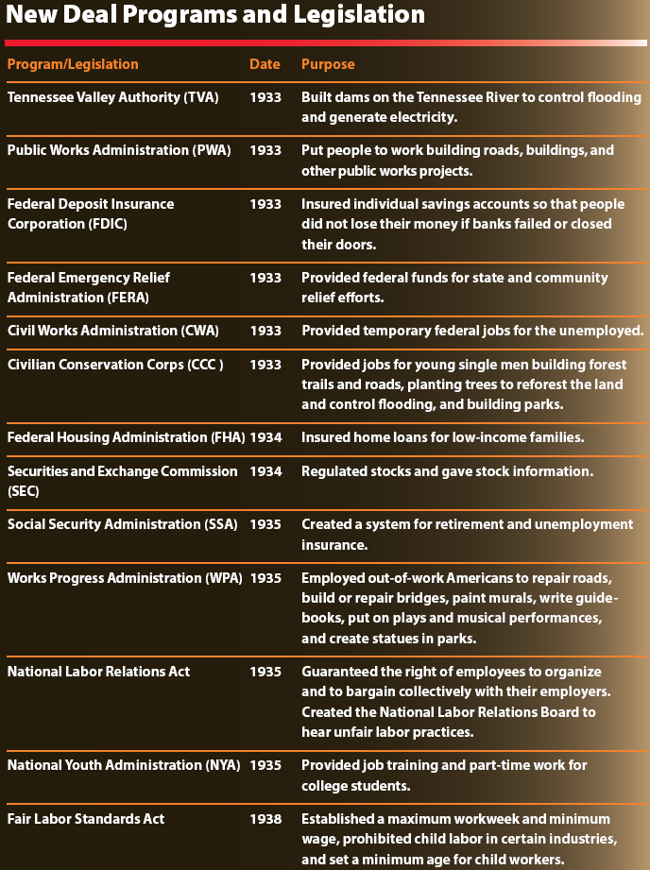

Slide 27
The PWA and WPA
Public Works Administration
Provided immediate employment
Built schools, libraries, and courthouses
Works Progress Administration
Built hospitals, highways, bridges, sewer systems, parks, and airports
Supported artists, writers, musicians, and teachers
Employed more people in the state than any other
Provided funding for historic Charleston theatre

Slide 28
Labor Troubles
A nationwide General Textile Strike was called by United Textile Workers.
Purpose was to force mill owners to honor new federal standards
Violence erupted between strikers and strikebreakers, the South Carolina National Guard, law officers, and factory owners at a mill in South Carolina.
The Union lost, and some disheartened workers refused to participate in collective bargaining.

Slide 29
The Santee Cooper Project
State owned utility company providing electricity to rural areas
Known as South Carolina Public Service Authority
Biggest New Deal project in state
Built Lakes Marion and Moultrie

Slide 30
Reforms
The role of the federal government increased in the economy and in individuals’ lives.
Agricultural legislation - support for crop prices, reduced crop acreage, increased crop prices
Labor legislation - right to join labor unions, Fair Labor Standards Act
Social Security Act - federal retirement system, payments for disabled persons and children of deceased workers, safety net
Housing reforms - insured loans, affordable mortgage rates

Slide 31
The Legacy of the New Deal
Positive
Survival of the individual
Minimal South Carolina bank failure
Building projects
Labor reforms
Renewal of confidence in government
Negative
No full economic recovery
WWII spending

Slide 32
Section 4: Politics of the Twenties and Thirties
Essential Question: What beliefs affected politics in the 1920s and 1930s?

Slide 33
Section 4: Politics of the Twenties and Thirties
What terms do I need to know?
Solid South
bond issue
Workers’ compensation law

Slide 34
Introduction & John G. Richards
South Carolina part of the Solid South
Electoral support for only Democrats
All elected officials only Democrats
Richards as governor
Tried to impose his moral values
Increased road building with bond issues

Slide 35
Ellison Durant “Cotton Ed” Smith
Was a southern progressive Democrat
Supportive of progressive farm legislation
Opposed New Deal
Appalled by black members in Democratic Party
Ellison Durant Smith

Slide 36
Olin D. Johnston
Former mill worker
Graduate of USC law school
Credible with mill workers
Supporter of New Deal
Creator of department of labor
Promoter of workers’ compensation law
Brought electricity to rural state

Slide 37
James F. Byrnes
U. S. Representative and Senator
U.S. Supreme Court Justice
Director of WWII Office of War Mobilization
U. S. Secretary of State
Governor
Ally of President Roosevelt
Promoter of New Deal and Santee Cooper
James F. Byrnes

Slide 38
Image Credits
Slide 1: Ted Kerwin Wikimedia Commons; Slide 2: Public Domain Wikimedia Commons; Slide 21: Public Domain Wikimedia Commons; Slide 25: Public Domain Wikimedia Commons; Slide 35: Public Domain Wikimedia Commons; Slide 37: Public Domain Wikimedia Commons; Slide 38: Andy Montgomery Wikimedia Commons
Return to Main Menu

