Slide 1
Chapter 1: This is Our Home
STUDY PRESENTATION
© 2022 Clairmont Press

Slide 2
Link: Mary Beaty’s Oak
Section 1: What is Geography?
Section 2: The Geographic Regions of South Carolina
Section 3: South Carolina’s Waterways and Climate

Slide 3
Section 1: What is Geography?
Essential Question: What is Geography?

Slide 4
Section 1: What is Geography?
What terms do I need to know?
geography
latitude
longitude
absolute location
relative location
environment

Slide 5
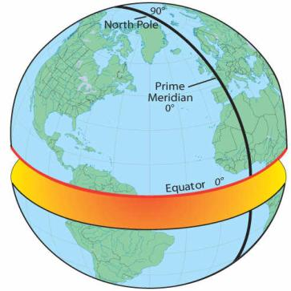
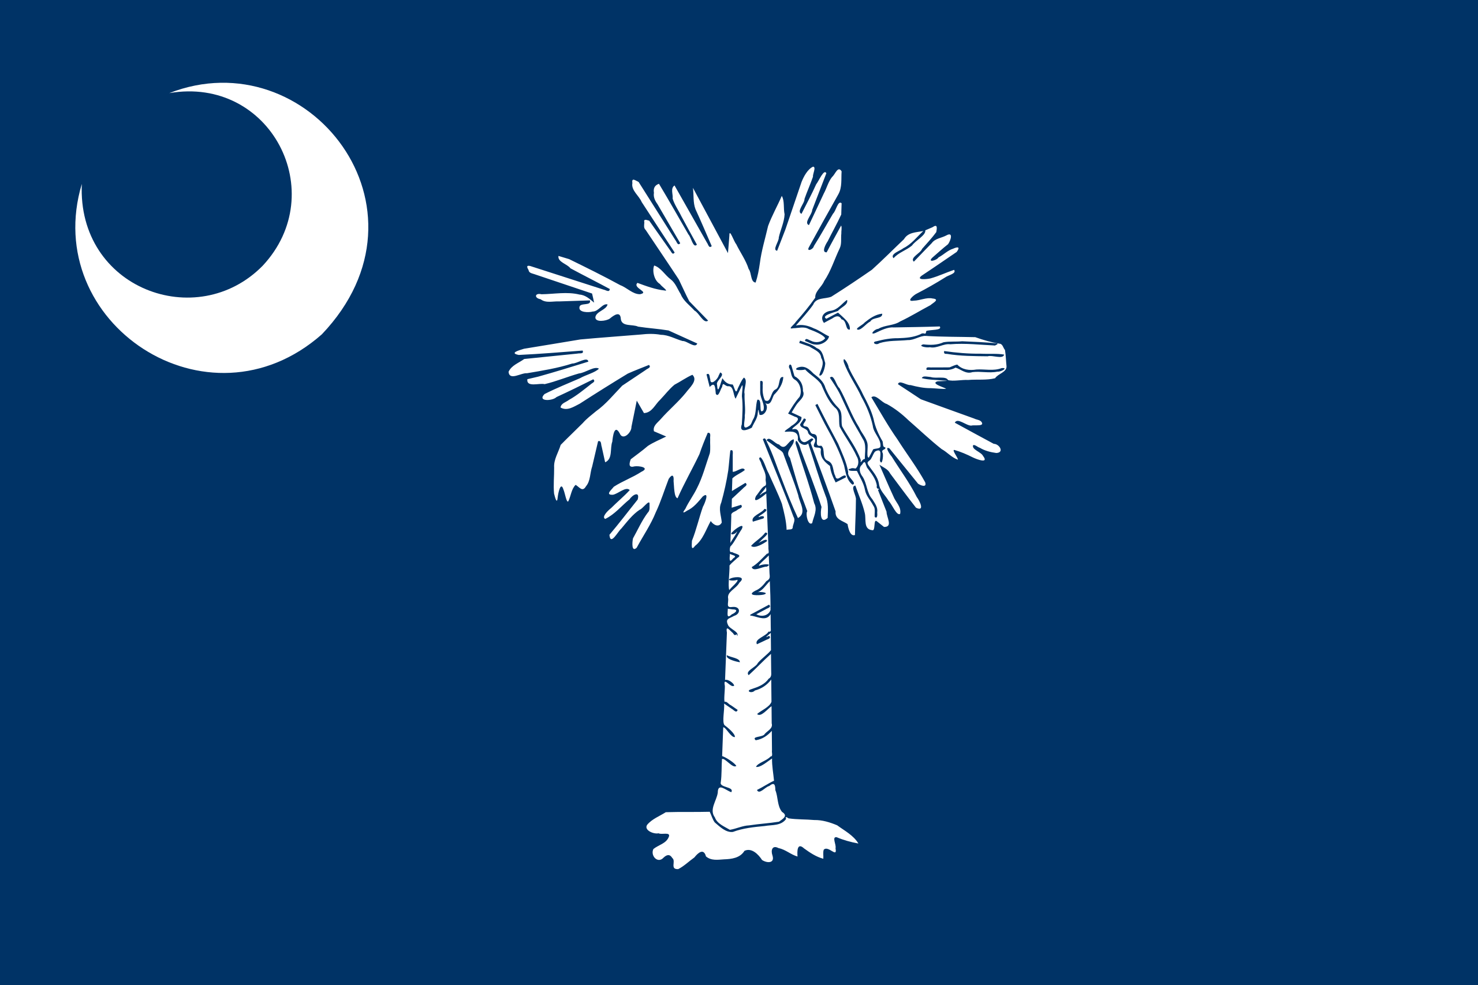
Where in the World is South Carolina?
South Carolina is:
in the Western hemisphere
in the Northern hemisphere

Slide 6
Where in the World is South Carolina?
South Carolina is:
in North America
in the southeastern United States
bounded by:
Georgia
North Carolina
Atlantic Ocean
Link to Internet map

Slide 7
Mapping South Carolina’s Location
Geography – Geo (earth) + graphy (description)
Location terms
latitude: the distance north or south of the equator
longitude: distance east or west of the prime meridian
absolute location: precise position found using latitude and longitude
relative location: position in relation to some other place

Slide 8
South Carolina’s Size and Shape
Triangle shape
Size is 40th of 50 states
Over 19 million acres of land
Mostly covered by forests
185 miles of coastline

Slide 9
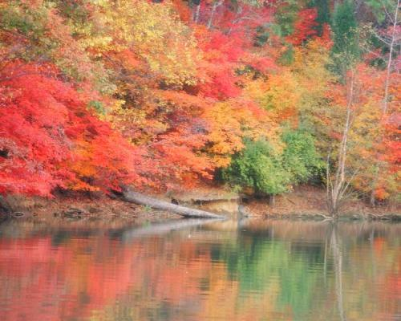
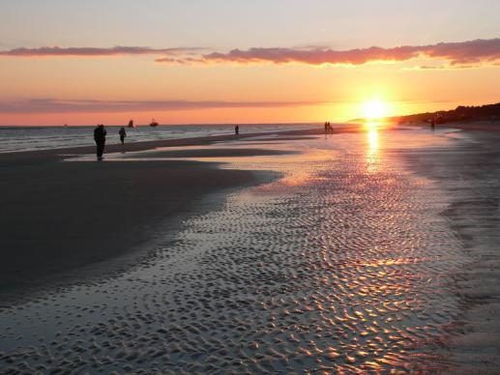
Understanding Our Environment
The term, “environment” means “surroundings.”
Geography plays a major role in our lives and in the history of our state.
Lake Wylie (top); Hilton Head Island (below)
Return to Main Menu

