Slide 1
Chapter 1: This is Our Home
STUDY PRESENTATION
© 2022 Clairmont Press

Slide 2
Link: Mary Beaty’s Oak
Section 1: What is Geography?
Section 2: The Geographic Regions of South Carolina
Section 3: South Carolina’s Waterways and Climate

Slide 3
Section 2: The Geographic Regions of South Carolina
Essential Question
In what ways do South Carolina’s geographic regions differ?

Slide 4
Section 2: The Geographic Regions of South Carolina
What terms do I need to know?
flora
fauna
elevation
precipitation
monadnock
kudzu
tributary
Fall Line
Carolina bays
fault
delta
sound
barrier island

Slide 5
The Blue Ridge Region
Location: Northwest S.C.
Oldest landform in North America
Part of the Appalachian Mountain chain
Sassafras Mountain is highest (3,554 ft.)
Covered with vegetation (plants)
View from Sassafras Mountain

Slide 6
The Blue Ridge Region
Soil and terrain not good for farming
Plants are similar to those in the north due to altitude
Many birds; few game birds (e.g. turkeys)
Also bear, deer, squirrels, rabbits, and trout
Cooler and wetter than the rest of the state
Raven Cliff Falls

Slide 7
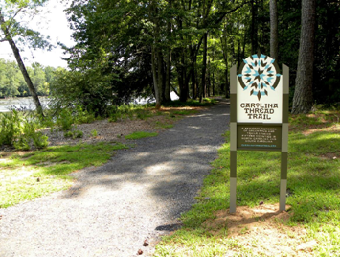
The Piedmont Region
Piedmont – “foot of the mountain”
Hilly region; covers 1/3 of South Carolina
Monadnocks: granite outcroppings
Granite is an important resource and is the state’s official stone.
Top: Carolina Thread Trail (Chester SC)
Bottom: Piedmont region farm

Slide 8
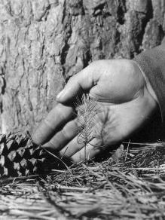
The Piedmont Region
Lands often cleared in 1800s to grow cotton or corn
20th century – much land used for pulp (timber)
Grasses used for pasture and to hold soil
Kudzu brought in to control erosion in 1930s
Kudzu now considered a nuisance
1951 Forestry Commission photo of pine seedling
Notes:
Kudzu link dosen’t work

Slide 9
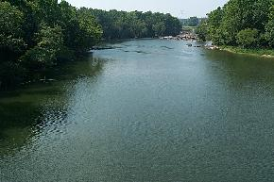
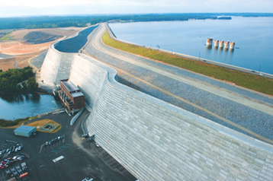
The Piedmont Region
Piedmont rivers are broad with gently sloping banks.
Appear muddy due to soil washed into the river (silt)
Humans use rivers for water, food, recreation, transportation, and power.
Saluda River (top) and
Dreher Shoals Dam (bottom)

Slide 10
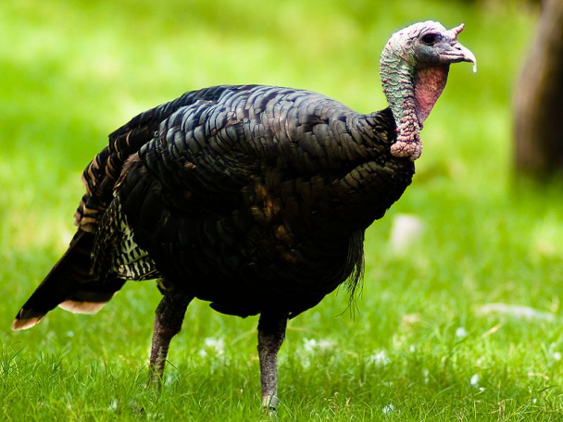
The Piedmont Region
Wildlife (fauna) includes deer, turkeys, bobcats, foxes, snakes and other reptiles
Many birds including quail, wrens, osprey, eagles, and herons
Wild turkey, the state game bird

Slide 11
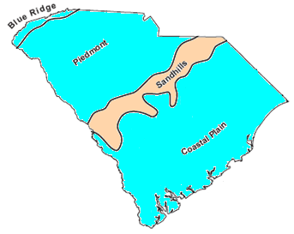
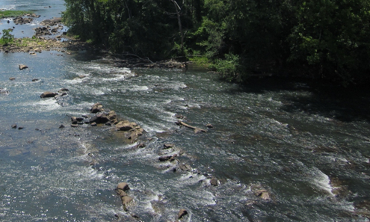
The Sandhills Region
Upcountry
Sandhills are low, rolling hills made from the sand and clay that washes from the mountains in the Piedmont region.
50-60 million years ago, area was sand dunes
Fall Line: place on a river where rocks & rapids force boats to stop when traveling from the sea
Towns formed near the Fall Line: North Augusta, Columbia, Camden, Cheraw
Columbia Canal built to move boats further up river around the falls
Lowcountry
The Sandhills were once the coastline of the ocean (top); rocks and rapids such as these blocked boats traveling upstream (bottom)

Slide 12
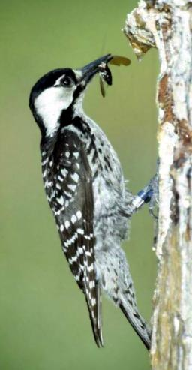
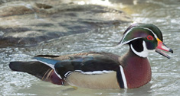
The Sandhills Region
Soils not very productive due to sand
Pine trees and scrub oaks common
Longleaf pines were cut for timber causing red-cockaded woodpecker to be endangered
Other birds are warblers, nuthatches, bluebirds, owls and wood ducks
Foxes, bobcats, rabbits, and squirrels are some of the mammals
Cockroaches (palmetto bug) are common insects
Red-cockaded woodpecker (top); the wood duck is the official duck of South Carolina (bottom)

Slide 13
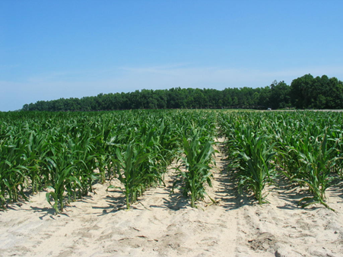
The Coastal Plain Region
Region is 100 miles across
Inner Coastal Plain: very fertile land
Outer Coastal Plain: areas nearest the ocean; very flat
Known for huge pine forests, also oak, hickory, sweet gum, and cypress trees
Carolina bays: oval shaped depressions in the land; can be a lake, swamp, or dry land
Not known how Carolina bays were formed
Many crops grow well on the coastal plain’s flat fertile lands.

Slide 14
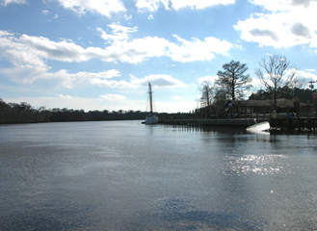
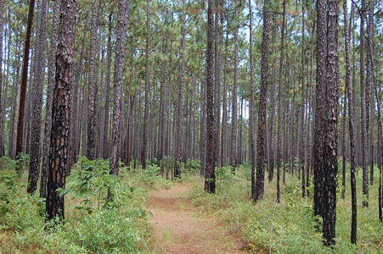
The Coastal Plain Region
Rivers spread and move slowly on the plain; large floodplains and swamps
Varied and abundant wildlife, especially in swamps
Congaree: only National Park in SC; known for old growth forest and champion trees.
Fish in Lakes Marion and Moultrie: bass, bream, & catfish
Waccamaw River (top); the Palmetto Trail crosses forests in the coastal plain (bottom)

Slide 15
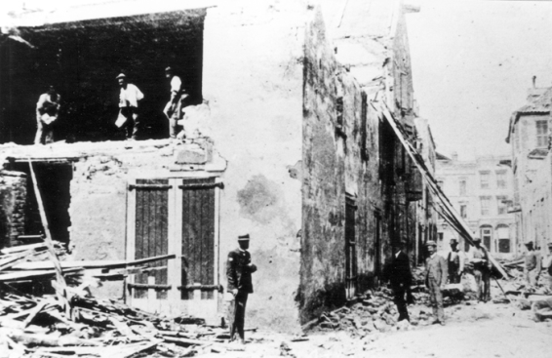
The Coastal Plain Region
Geological Fault: fracture in the Earth’s crust – source of earthquakes
1886 Charleston earthquake killed 83 people, major damage to city, felt hundreds of miles away
Men cleaning a damaged warehouse after the 1886 Charleston earthquake.

Slide 16
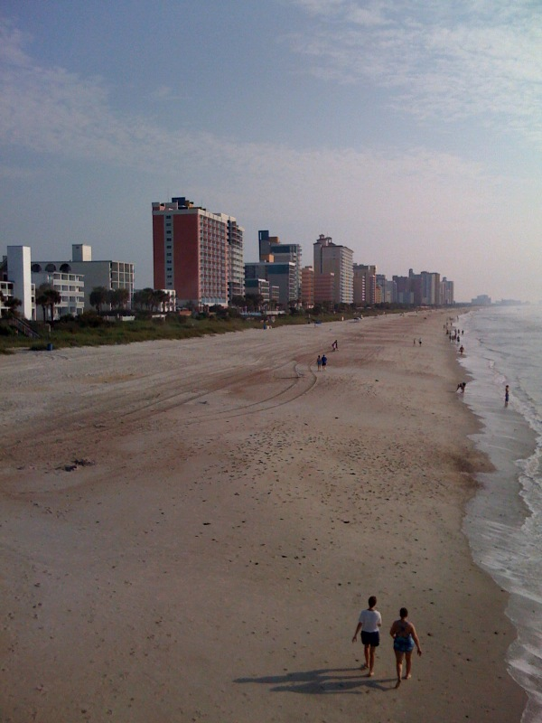
The Coastal Zone Region
Region from ocean’s edge to a few miles inland
Beautiful, high population, tourism business
Grand Strand: 60 miles of unbroken, wide, sandy beach; includes Myrtle Beach and over 100 golf courses
Santee Delta: largest river delta on Atlantic Coast; a marshy, muddy coastline
High-rise condominiums and hotels along Myrtle Beach, SC.

Slide 17
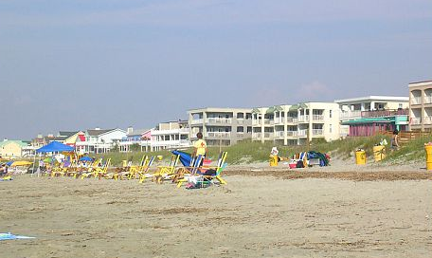
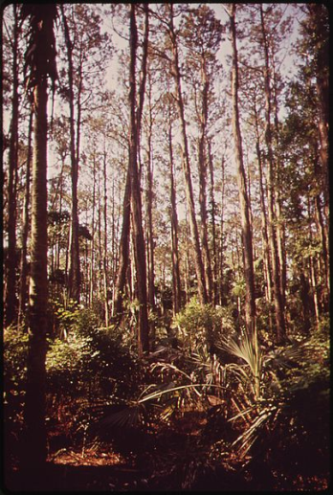
The Coastal Zone Region
Sea Islands: over 100 miles of river mouths, inlets, sounds, marshlands, and islands
Barrier Islands protect mainland from sea and winds (Isle of Palms, Folly, Sullivan’s, Kiawah, Hunting, and Fripp)
Many hotels, condominiums and private homes
Beach erosion caused by wind and sea are a major problem
Preserved islands are protected from human construction; examples are Bulls, Capers, North and South Islands
Tom Yawkey, owner of Boston Red Sox, donated North and South Islands to the state
The Isle of Palms is a popular ocean resort (top); forest on Bull’s Island (bottom)

Slide 18
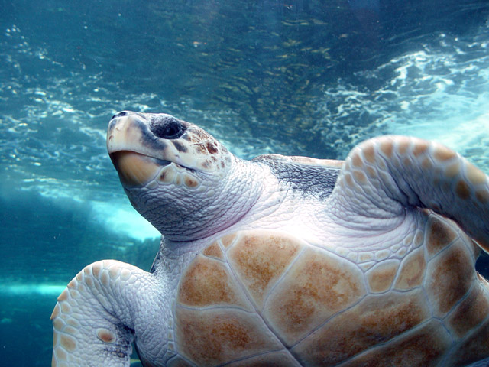
The Coastal Zone Region
Animals include alligators, eagles, ospreys, gulls, pelicans, sandpipers, oysters, crabs, bottlenose dolphins, and the loggerhead sea turtle which can weigh 300 pounds.
Laws protect this turtle and its habitat; nesting areas are marked to keep people away.
Loggerhead turtles are an endangered species.
Return to Main Menu

