Slide 1
Chapter 1: This is Our Home
STUDY PRESENTATION
© 2022 Clairmont Press

Slide 2
Link: Mary Beaty’s Oak
Section 1: What is Geography?
Section 2: The Geographic Regions of South Carolina
Section 3: South Carolina’s Waterways and Climate

Slide 3
Section 3: South Carolina’s Waterways and Climate
Essential Question
How do rivers affect life in different parts of the state?
How does climate affect life in different parts of the state?

Slide 4
Section 3: South Carolina’s Waterways and Climate
What terms do I need to know?
black river
weather
climate
tornado
Bermuda high
hurricane
storm surge

Slide 5
Section 3: South Carolina’s Waterways and Climate
Three main river systems – flow from northwest to southeast
Rivers provide:
drinking water
water for industry
electrical power
recreation
home for wildlife

Slide 6
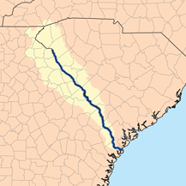
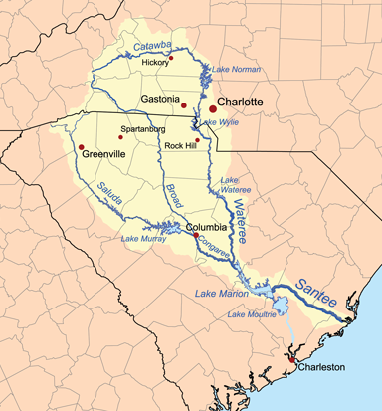
Waterways
Savannah river system forms border with Georgia; navigable for large ships
Santee system is the largest; drains about 40% of the state
Broad and Saluda Rivers form from streams in North Carolina.
Other rivers are the Pacolet, Tyger, Enoree, Reedy, Catawba, and Congaree.
Waterwheels were used to power grist mills; power companies built hydroelectric dams for electricity.
The Savannah (top) and Santee (bottom) river systems drain most of South Carolina.

Slide 7
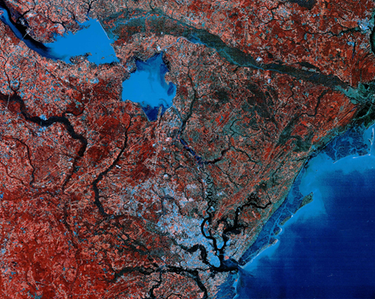
Waterways
The Santee Cooper project (1934) was a large scale project to bring electricity to the state.
Lakes Marion and Moultrie were formed.
Many jobs, along with low-cost electricity were created.
Changes in water flow have encouraged beach erosion and filled Charleston harbor with silt.
Satellite image of Lakes Marion and Moultrie. Click the image to see a larger view.

Slide 8
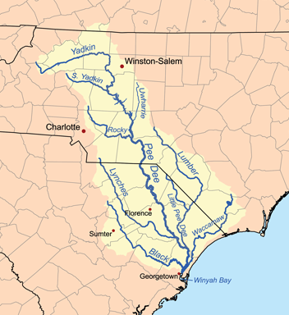
Waterways
The Pee Dee System begins in North Carolina.
Rivers include: Little Pee Dee, Great Pee Dee, Black, Lynches, and Waccamaw.
Slow-moving and clear
Called black rivers due to dark color (tannic acid)
Area of rice culture in 18th and 19th centuries
The Ashley and Cooper Rivers flow into Charleston Harbor.
ACE rivers (Ashepoo, Combahee, and Edisto): known for timber and
hunting preserves
The Pee Dee River System

Slide 9
Climate
South Carolina’s climate is subtropical (hot humid summers, mild winters).
At the coast: ocean breezes keep it cool in summer; the Gulf Stream helps keep the area warmer in winter.
Mountain areas tend to be cooler than Lowcountry.
Precipitation is about 49 inches per year – a bit more rain in summer than other seasons.
Winters are mild with few days of below-freezing temperatures.
Spring is marked by many blooming trees and shrubs (dogwood, azaleas, rhododendron, etc.)

Slide 10
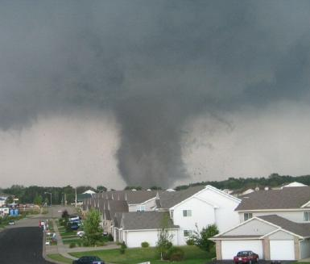
Climate
Tornadoes are funnel shaped clouds with wind speeds 65 to over 200 miles per hour.
SC averages 10 tornadoes per year.
The Fujita Scale is used to rate wind speed and damage by a tornado.
Lightning and hail may accompany tornadoes.
March 1984 tornado killed 21 people and injured 448.
Radar is used to warn South Carolinians of tornadoes.
A tornado rips through a neighborhood in 2005.

Slide 11
Climate
Summer weather is affected by the Bermuda High, a huge high pressure system that forms in the Atlantic Ocean.
The Bermuda High brings warm moist wind causing thunderstorms and wet summers.
It can cause drought (a period of little or no precipitation).
Fall is marked by the changes in leaf color and temperatures that approach freezing.

Slide 12
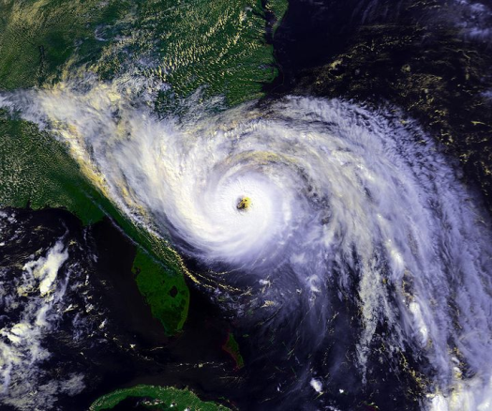
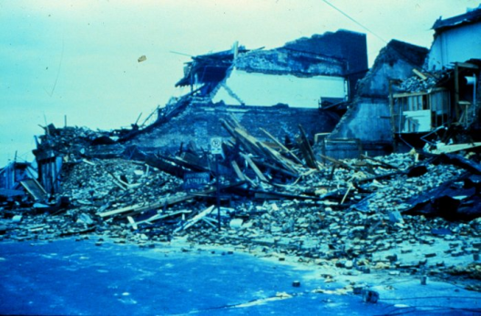
Climate
In summer and fall, tropical storms and hurricanes may hit South Carolina with damage from wind and floods.
Hurricanes are large storms of low pressure that rotate around a central “eye.”
Storms begin in warm waters of the tropical Atlantic Ocean, Gulf of Mexico, or Caribbean Sea.
Tropical storm: winds of 39-73 mph
Hurricane: winds of 74 or greater
The Saffir-Simpson Hurricane Scale is used to rate hurricanes’ wind speed and damage.
Hurricane Hugo (top) heads toward the Carolina coast in this satellite image from 1989. Below, buildings in Charleston in ruins after the storm.

Slide 13
Image Credits
Slide 1: Ted Kerwin, Wikimedia Commons; Slide 2: Public Domain Wikimedia Commons; Slide 9: Public Domain Wikimedia Commons (top) and Lee Coursey Wikimedia Commons (bottom); Slide 12: Aaron West; Slide 13: JAG on Wikimedia Commons; Slide 15: US Forest Service; Slide 16: SC Department of Natural Resources (top) and SCANA (bottom); Slide 17: Malcolm on Wikimedia Commons; Slide 19: United States Marine Corps (top) and Richard Bartz on Wikimedia Commons; Slide 20: South Carolina Department of Agriculture; Slide 21: Pollinator on Wikimedia Commons (top) and Daniel Barcelona on Wikimedia Commons; Slide 22: U.S. Geological Survey; Slide 23: Phil Guest, Wikimedia Commons; Slide 24: Cugirl, Wikimedia Commons (top); Environmental Protection Agency (bottom); Slide 25: Damien du Toit, Wikimedia Commons; Slide 29: U.S. Army Corps of Engineers; Slide 29: Karl Musser, Wikimedia Commons; Slide 30: LANDSAT image; Slide 31: Karl Musser, Wikimedia Commons; Slide 33: Colin McDermott, National Oceanic and Atmospheric Administration; Slide 35: U.S. National Oceanic and Atmospheric Administration; Slide 36: Andy Montgomery, Wikimedia Commons
Return to Main Menu

