Slide 1


Chapter 2: The Government of South Carolina: How it Works Today
STUDY PRESENTATION
© 2022 Clairmont Press

Slide 2
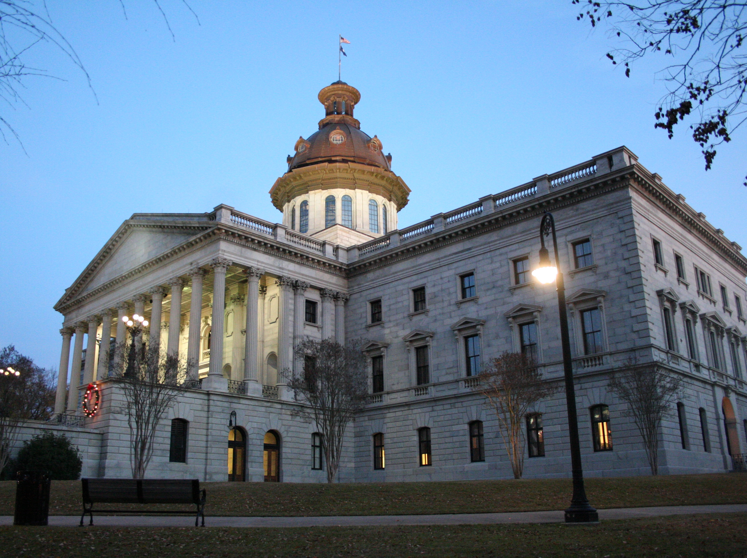
Section 1: South Carolina Government Today
Section 2: Local Government and You, the Citizen

Slide 3
Section 1: South Carolina Government Today
Essential Question: How is power to govern divided into three branches of government in South Carolina?

Slide 4
Section 1: South Carolina Government Today
What terms do I need to know?
  special purpose district
  filibuster
  president pro tempore
  conference committee
  patronage
  Magistrate Court
  probate cause
  bail
  Municipal Court
  Probate Court
  Family Court
  Circuit Court
  masters-in-equity
  Court of Appeals
  appeal
  Supreme Court

Slide 5
South Carolina Government Today
Government: the means by which a society makes and enforces decisions about how its people must behave.
Levels of government: National, State, Local
Authoritarian rule: monarchy, aristocracy, oligarchy, dictatorship
Democracy: rule by the people
South Carolina government is representative with three branches of power.
Each branch has a way to hold back (check) and balance the power of the other branches.

Slide 6
The Legislative Branch:
The General Assembly
Makes laws, raises money (revenue) by taxes, fees, and fines, and spends the state’s money
Controls many parts of our lives: schools, roads, restaurant sanitation, air quality, etc.
 | House of Representatives | Senate
Age to be Elected | 21 | 25
Number of Members | 124 | 46
Length of Term (years) | 2 | 4
Maximum Terms | None | None

Slide 7
The Legislative Branch:
The General Assembly
filibuster: a special rule in the senate that allows a member or small group of members to have unlimited debate or speech; this can hold up or kill a bill.
All revenue bills must start in the House of Representatives.
Most work done in committees
House has 11 committees; the Senate 15
Committee leaders are very powerful.
Lieutenant Governor is leader of the Senate; can only vote in case of tie
The House is led by a Speaker, chosen from the members; a very powerful position in South Carolina

Slide 8
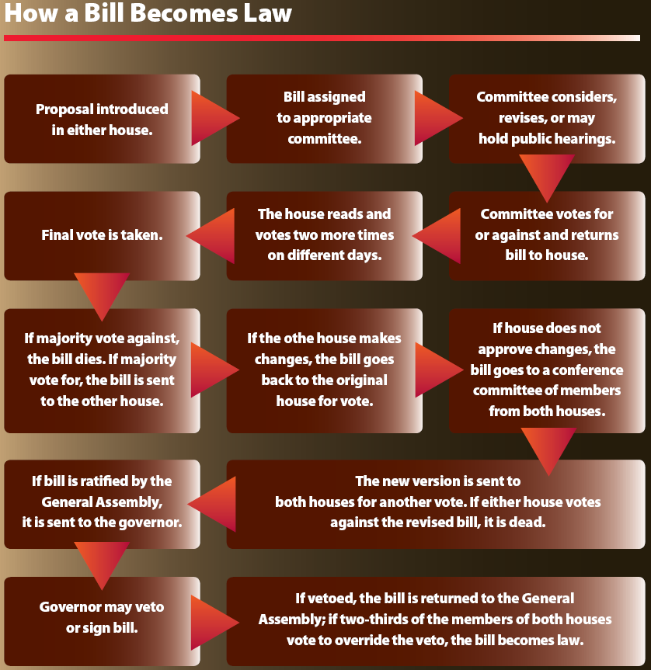
XXXXXXX

Slide 9
The Legislative Branch:
The General Assembly
Other duties: electing judges, appointing boards and commissions, approving governor’s appointments
Oversight duties: makes sure acts are being carried out and money spent correctly

Slide 10
The Executive Branch: The Governor
Carries out the laws passed by the General Assembly and acts as spokesperson for the state; submits budget to the General Assembly, selects some department heads
South Carolina has a history of limiting the power of the governor.
Can serve two four-year terms
Must be a U.S. citizen, at least 33 years old, and lived in S.C. for at least five years

Slide 11
The Executive Branch: The Governor
The governor has special powers in a crisis such as a riot or disaster.
Can call out the National Guard
Can veto acts of the General Assembly
Governors use their personality and political skills to get work done.
One-third of the budget comes from the federal government to support health care for children and the elderly. The governor has much control over these funds.

Slide 12
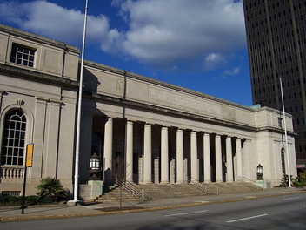
The Judicial Branch: The Courts
This branch is led by the chief justice of the South Carolina Supreme Court.
There are four tiers (levels) of courts in the state.
South Carolina Supreme Court Building

Slide 13
Tier | Court Name(s) | Duties & Jurisdiction
Top Tier | Supreme Court | hears appeals from lower courts, admits new attorneys to the practice of law, sets standards of behavior for the profession, disciplines lawyers and judges who are unethical
Third Tier | Court of Appeals | hears appeals from circuit and family court
Second Tier | Family Court | divorce, child custody and visitation, alimony, property settlements, and termination of parental rights
 | Circuit Court | all cases not heard first tier courts and appeals from those courts
 | Masters-in-Equity | property cases
Lower Tier | Magistrate, Municipal | traffic violations, minor criminal and civil cases, hearings for more serious cases and setting bail, search and arrest warrants
 | Probate | wills and estates, guardianships, marriages

Slide 14
The Judicial Branch: The Courts
The Supreme Court has a chief justice and four associate justices.
Elected for 10 year terms by General Assembly
No limit on re-election
New judges face a screening
Judicial branch more independent from the legislature than in the past

Slide 15
The Concept of Democracy
“Democracy” means rule by the people.
Democratic ideals include:
  freedom of speech, press, worship, and assembly
  respect of the rights of others
  equity before the law
  trial by jury
  majority rule with protection of minority rights
  voting to decide issues or elect representatives to govern
  right to vote
  responsibility of citizens to participate
Return to Main Menu

