Slide 1
Chapter 2: The Government of South Carolina: How it Works Today
STUDY PRESENTATION
© 2022 Clairmont Press

Slide 2
Section 1: South Carolina Government Today
Section 2: Local Government and You, the Citizen

Slide 3
Section 2: Local Government and You, the Citizen
Essential Question: What are my rights and responsibilities in local government?

Slide 4
Section 2: Local Government and You, the Citizen
What terms do I need to know?
incorporated
municipality
political party
special interest group
lobbyist
United States Constitution
Bill of Rights

Slide 5
Counties
There are over 800 local governments in South Carolina (46 counties, 269 towns and cities, 85 school districts, etc.
Counties keep records (e.g. births, deaths, etc.), maintain roads, enforce laws, and operate courts.
Counties are run by councils elected by citizens.

Slide 6
Municipalities & School Districts
Municipalities (towns, cities) are run by a city council and mayor.
Larger cities have a city manager appointed by the city council to run the city.
School districts support area schools.
School districts are usually run by a school board who hires a superintendent.
Schools are funded by local, state, and federal tax money.

Slide 7
Special Purpose Districts
498 Special Purpose Districts
Boards for these districts are appointed.
Examples are fire protection, conservation, sanitation, water, gas, airports, and emergency services.
An individual could not provide all of these services.
Government is a human intervention to help meet citizens’needs.

Slide 8
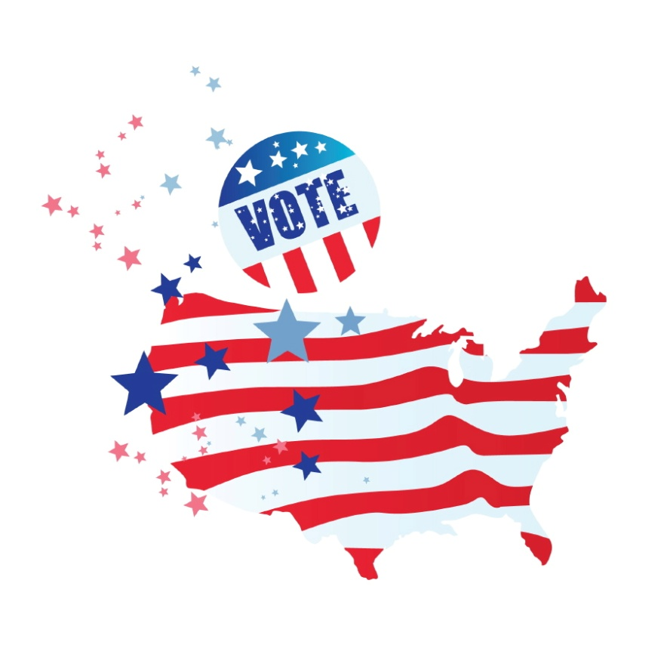
Politics and Political Parties
Political Party: group of people with similar ideas about how the government should be run
Party members work together to get their candidates elected.
Democrats and Republicans are the two main parties in South Carolina.

Slide 9
Special Interest Groups and Lobbyists
Special Interest Group: a group concerned with one particular set of political issues.
Such groups try to convince legislators to vote in a way to support the group’s point of view.
Lobbyist: a person hired by a special interest group to influence lawmakers’decisions.
Ethics laws have been designed to prevent lobbyists from bribing lawmakers.

Slide 10
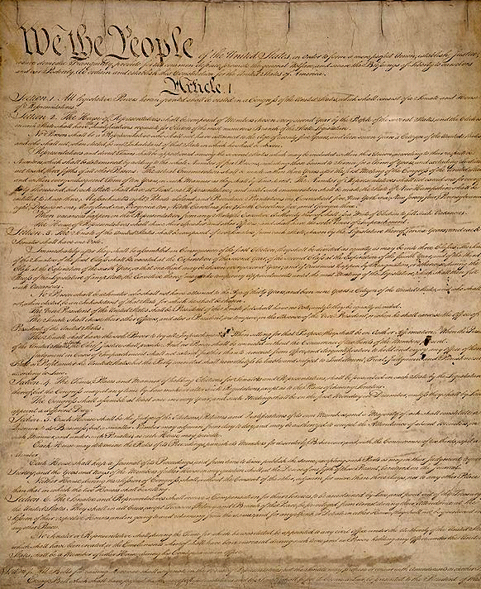
You as a Citizen
The United States Constitution established a government that defends your rights and maintains law and order and defense of the nation.
The Bill of Rights lists many of our citizens’ most important rights.
It is your responsibility as a citizen to obey laws, defend the nation, tell the truth, follow the terms of contracts, and pay taxes.
At any age, citizens can work to make a better community.
Link: National Archives

Slide 11
Image Credits
Slide 1: Ted Kerwin, Wikimedia Commons; Slide 2: Public Domain Wikimedia Commons; Slide 12: Public Domain Wikipedia Commons; Slide 24: Andy Montgomery Wikimedia Commons
Return to Main Menu

