Slide 1
Chapter 3: The Early Inhabitants of South Carolina
STUDY PRESENTATION
© 2022 Clairmont Press

Slide 2
Section 1: The Earliest Discoverers of America
Section 2: Indian Life and Cultures
Section 3: The Beginning of a New Era

Slide 3
Section 1: The Earliest Discoverers of America
Essential Question: Who were the first people to live in the Americas?

Slide 4
Section 1: The Earliest Discoverers of America
What terms do I need to know?
nomadic
mortar and pestle
midden
anthropologist
agriculture
palisade
prehistory

Slide 5
Introduction – Section 1
The discovery of America is linked to the theory of Asians coming from Siberia and going into Alaska.
Earth’s “ice ages” appear relevant to the exploration by these nomadic peoples.

Slide 6
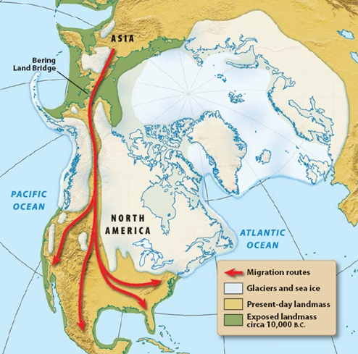

Slide 7
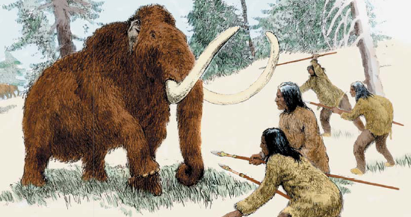
The Paleo Indian Period
During this period (c. 10,000 years ago), some of these early hunters set up camps in today’s South Carolina.
Tribes used spears to attack their prey, and stone spear points indicate the population later became more mobile.
Earth’s climate and the recession of glaciers created life changes for humans at the end of the Paleo Period (c. 12,000 to 10,000 years ago).

Slide 8
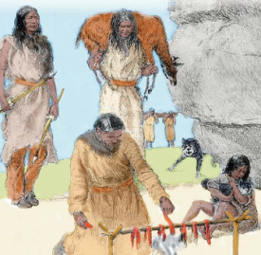
The Archaic Period
During this period – (c. 10,000 to 3,000 years ago), natives pursued smaller game, foraged for plant food, and traveled less.
Indians domesticated the dog which became a companion and hunting partner.
Tools, including a mortar and pestle, were made.
Baskets, pottery, and food storage were important, and population increased – society became more organized.
Large shell middens give evidence of long-term residences and the daily lives of these natives.

Slide 9
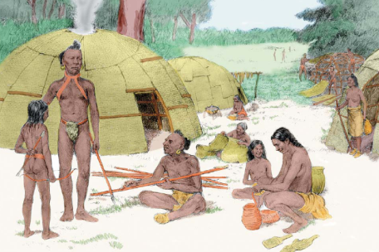
The Woodlands Period
Anthropologists call the period from c.1000 BC to AD 900 the Woodlands Period.
Advances in the era include: the bow and arrow, agriculture, sturdier houses, the storage of food, and time for artistic expression.

Slide 10
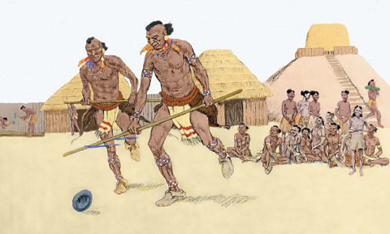
The Mississippian Period
Link: Mound builders
Link: Cahokia Mounds
This is the final period of Indian Culture (c. AD 900 to 1500) before the coming of Europeans.
Indian Culture included advances in agriculture, buildings, villages with palisades (walls), temple mounds, and class divisions.
Era of prehistory was over as European explorers and settlers found existence of this culture in the 1500s and 1600s.
Because Europeans wrote about Mississippian Indian life much more is known regarding the era.
Return to Main Menu

