Slide 1
Chapter 3: The Early Inhabitants of South Carolina
STUDY PRESENTATION
© 2022 Clairmont Press

Slide 2
Section 1: The Earliest Discoverers of America
Section 2: Indian Life and Cultures
Section 3: The Beginning of a New Era

Slide 3
Section 2: Indian Life and Cultures
Essential Question: What was life like for the Native Americans?

Slide 4
Section 2: Indian Life and Cultures
What terms do I need to know?
maize
wigwam
wattle
daub
Green Corn Ceremony
matrilineal
nation

Slide 5
Introduction – Section 2
When Columbus arrived in 1492, between 2 and 18 million Indians of different groups were scattered across what is now the United States.
The Indians, divided into many tribes and language groups, developed lifestyles around the tribes’ needs.
When Europeans arrived in the early 1500s, between 30 – 50 tribes in four major language groups existed in the area that later became South Carolina.

Slide 6
The Economy
Economy relates to the manner in which people use available natural resources to supplement their survival and well-being.
Applying labor to the resources and using technology makes the labor more effective.

Slide 7
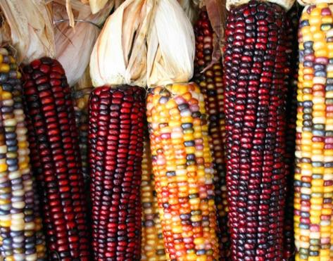
Food
South Carolina Indians were farmers and hunters, and they depended upon agriculture as a major food source.
Their diet was supplemented from several sources, among which was maize, squash, wild crops, pumpkins, sunflowers, and hickory nuts.
Common fields were tilled by both male and female, and the way crops were planted was well-planned.
To meet basic needs, most Indian groups had a balance among farming, hunting, fishing, and gathering.
Indians had excellent management of resources and used a variety of ecosystems.
Maize, along with beans and squash were known as the
“three sisters.”
Link: Three Sisters $ Coin

Slide 8
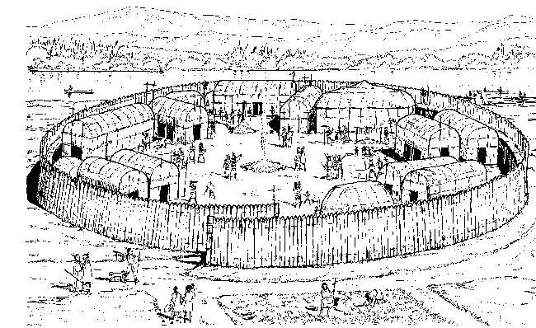
Shelter
In the Coastal Plain the most typical dwelling was the wigwam.
Tribes in the Upcountry built substantial homes using wattle and daub construction.
Cherokees used wattle and daub construction, but also built log cabins. Every village had a large public building that served as the council house or town hall (also, used for social & recreational activities).
An important feature was a protective wall erected around the perimeter of the village.
Catawba Village
Catawba Cultural Preservation

Slide 9
Clothing
Many Indians wore no clothes, or an apron for women and breechcloth for men (in warmer weather) and deerskin or bearskin (in cooler weather).
Body adornment was often through paintings, tattoos, and jewelry. Animal hair (e.g. bear or opossum) and plant fibers were used in making cloth.
Shirts, skirts, pants, robes, blankets, aprons, breechcloths, etc., were made with the cloth.

Slide 10
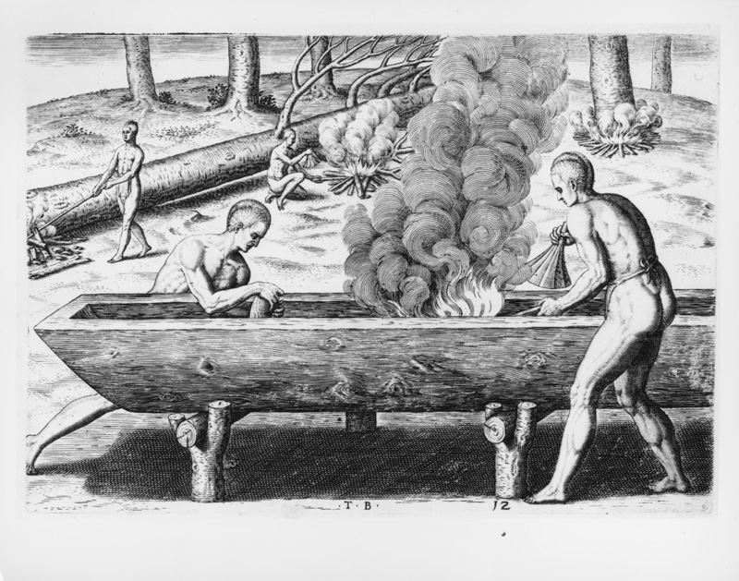
Transportation
Transportation for Indians (before contact with Europeans) was by foot or water. Villages were near rivers.
Dugout canoes were a major water transport and vital for trade amid tribes and villages.
Many trails created by foot travel later became roads (or some – highways).
Native Americans building a dugout canoe (1590).

Slide 11
Religion
All animals and humans originated as brothers in Indian mythology.
Animals were respected, and plants provided cures for illness.
Indians believed in good and evil spirits and in one Creator (or Great Spirit or Creative Force). In hope for purity and new beginnings, Cherokees and other tribes held the Green Corn Ceremony.
Music and Dance created magical powers, healed the sick, ensured a bountiful harvest, and they were used to observe rites of passage.
Green Corn Ceremony

Slide 12
Games and Recreation
Characteristics valued by Indians included courage, honor, and a life lived with dignity.
Indians were great athletes and game players, which included: ball games, racing, chunkey, and javelin throwing.
Click for video about chunkey.

Slide 13
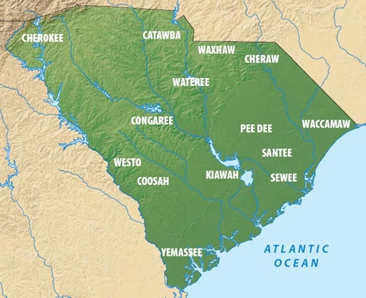

Slide 14
Social Organization
The primary unit of social organization in Native American society was the clan, whose identification depended on a native’s mother – (a matrilineal society).
A tribe (later sometimes called a nation) included many clans.
In the 17th century, some of the 30 – 50 tribes in South Carolina were large and powerful, while others were small and weak.
Government was geared toward harmony in the society, decisions were made through consensus, and women were included.

Slide 15
War
Wars, fairly common, sometimes resulted in retaliation.
A surprise attack, meant to take revenge, usually included war parties of 20 – 30 men.
The intent of a war never included total destruction of another tribe.

Slide 16
The Role of Women
Duties of Indian women included: tending the children, cooking, farming the village land, making pottery, etc.
Women took part in decision making. Some became chiefs.
In regard to marriage, a great deal more freedom was afforded to Indian women than in many cultures.

Slide 17
Childhood
Most of a child’s infancy was spent strapped onto a cradle board.
After infancy, very little physical punishment and a great amount of freedom were given.
Ridicule was the main disciplinary device used.
Boys learned to become men by hunting, running, wrestling, competing, and finally being initiated into adulthood.
Girls became women by helping with household tasks, learning to make pottery, working in the garden, etc.
Return to Main Menu

