Slide 1
Chapter 4: Founding Colonies in North America
STUDY PRESENTATION
© 2022 Clairmont Press

Slide 2
Section 1: Changes that Prepared Europe for Expansion
Section 2: Early Explorations and Attempted Settlements
Section 3: The English Colonies in North America

Slide 3
Section 2: Early Explorations and Attempted Settlements
Essential Question: How did early explorations by Spain and France affect the Americas?

Slide 4
Section 2: Early Explorations and Attempted Settlements
What terms do I need to know?
caulk
garrison
prefabricated

Slide 5
Spanish Conquests
Spain, with high profits from ventures, was the 1st nation to explore and conquer large sections of the American continents.
Spanish settlers used captured slaves to establish sugar plantations in the Caribbean Islands. In Mexico and Peru Spaniards stole gold and silver from Indian civilizations.
Pirating of Spanish ships was promoted by the English, French, and other nations.
By 1650, American gold and silver provided a boost to the European economy.

Slide 6
The Spanish in Florida and Carolina
Spaniards, in pursuing more wealth, gave claim to large sections of the continent.
Ayllón sent 2 expeditions to Florida and as far north as South Carolina with little success.
(1539 – 1542) - De Soto attempted to strengthen Spain’s claim to La Florida. De Soto and his army were the 1st Europeans to explore interiors of what was to become the United States.
The armies in their searches spread disease and destruction among the Indian nations.

Slide 7
Spanish and French Competition in Florida and Carolina
In 1562, Jean Ribault built a small fort on Parris Island. Some settlers stayed, and some sailed to France for more colonists and supplies.
Scarcity in food at the fort and a decision to sail for France led to building a boat made of wood caulked with Spanish moss and pine rosin. Juan Pardo set up settlements and left small garrisons in his forts.
After Spanish-Indian conflicts on settlement, the Spaniards finally erected a fort using prefabricated sections.
For nearly 80 years, Indians in South Carolina had no intrusion by Europeans.

Slide 8
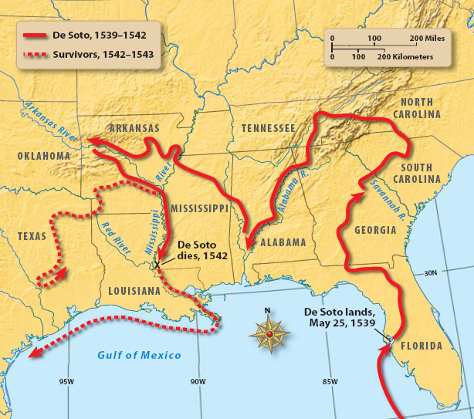
Return to Main Menu

