Slide 1
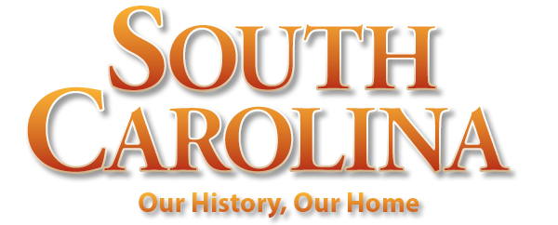
Chapter 6: A Rich and Royal Colony
STUDY PRESENTATION
© 2022 Clairmont Press

Slide 2
Section 1: Growing as a Royal Colony
Section 2: Slavery and Wealth
Section 3: How the People Lived
Section 4: Two Great Struggles: Upcountry versus Lowcountry; England versus France

Slide 3
Section 1: Growing as a Royal Colony
Essential Question: How did changes in government affect South Carolina?

Slide 4
Section 1: Growing as a Royal Colony
What terms do I need to know?
Township Plan
Scots-Irish
Pennsylvania Dutch
Great Wagon Road

Slide 5
The Rise of the Commons House
By 1775 – the dominant factor in South Carolina’s government was the Commons House, which was a move toward more democracy: • appointed local officials, controlled local affairs • collected taxes, decided how to spend funds
From its Colonial experience, South Carolina government inherited these characteristics: • power in hands of upper class property owners • control over government by lower house (General Assembly) • control of local governments by legislature

Slide 6
A Diverse Population
In South Carolina’s first 60 years: • white and black populations were diverse • each group had various languages and cultural characteristics
By 1730 – Native Americans losing numbers – were the smallest group of the three

Slide 7
The Township Plan
1731 – the purpose of the Township Plan suggested by Governor Robert Johnson: • to bring in more white setters to balance growing slave population • to provide a buffer against Spaniards, French, and Indians
One group attracted to Upcountry – Scots-Irish
Townships were not permanent towns, but helpful especially for defense

Slide 8
A New Neighbor
New colony of Georgia – buffer between South Carolina and Spanish Florida
James Oglethorpe, an English military officer – was granted the new colony of Georgia by King George II
Goals of Oglethorpe – use Georgia as base of military operations against Spaniards in St. Augustine – and a utopia (perfect society)
Savannah, Georgia - 1734

Slide 9
Other Settlers of the Upcountry
1750s / 1760s – largest population movement into Upcountry; the majority were Scots-Irish
2nd largest ethnic group German, often known as Pennsylvania Dutch
Great Wagon Road – used by migrants: one of most traveled roads in 13 colonies
Great Wagon Road

Slide 10
Differences between Upcountry and Lowcountry
1775 – South Carolina population nearly 180,000 – split between Upcountry and Lowcountry
Differences (often causing friction): • Religion – Upcountry (Presbyterians, Lutherans, Baptists, Quakers); Lowcountry (Anglican Church) • Way of Life – Upcountry (not slaveholders – worked their own farms); Lowcountry (slaves, plantations) • Government – Upcountry (whites had little voice); Lowcountry (domination by whites)
Return to Main Menu

