Slide 1
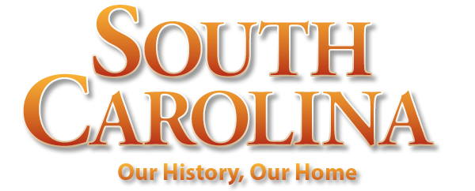
Chapter 6: A Rich and Royal Colony
STUDY PRESENTATION
© 2022 Clairmont Press

Slide 2
Section 1: Growing as a Royal Colony
Section 2: Slavery and Wealth
Section 3: How the People Lived
Section 4: Two Great Struggles: Upcountry versus Lowcountry; England versus France

Slide 3
Section 3: How the People Lived
Essential Question: What was life like for South Carolinians in the royal colony?

Slide 4
Section 3: How the People Lived
What terms do I need to know?
apprentice
Dock Street Theatre
Great Awakening

Slide 5
Growing Population
In South Carolina – not much population growth from natural increase – death rate about as high as birth rate – unhealthy environment, producing yellow fever, smallpox, malaria, and other diseases during colonial era
1760 – Many Cherokee and Catawba Indians as well as soldiers in Charles Town killed by smallpox

Slide 6
Charles Town Enters a “Golden Age”
Charles Town – began a “Golden Age” (mid-18th century) – one of premier cities in America for decades – home to wealthy residents
Community Life – clubs, societies promoted education, cultural activities; Library Society (est. 1755) provided materials for reading, education, new ideas
Homes / Lots – patterns of homes (single house or double house); deep lots (allowed smaller buildings for cooking, washing, housing slaves and horses); elaborate furnishings for houses
18th Century Charleston

Slide 7
Education
South Carolina – ranked low among the 13 colonies in educating its people; assumed parents to be responsible; usually private tutors hired by the wealthy; sons sent to England for further education
Teens of white artisans – placed as apprentices; parents paid for training
More opportunity in Lowcountry and Charles Town for formal education; in Upcountry very little opportunity
Majority of Carolinians – illiterate until near end of 19th century

Slide 8
Recreation
South Carolina society – wanted to enjoy life here and now – engaged in various activities (concerts, balls, opera)
Charles Town recreational activities – theatre (Dock Street Theatre opened 1736), drinking, billiards, card games, etc.
Activities beyond Charles Town and Lowcountry – cockfighting, bear-baiting, horseracing, hunting, fishing, fairs, etc.

Slide 9
Religion
Christian religion important in South Carolina
Reading material religious in nature; practical books on agriculture and medicine included in homes of literate Carolinians
St. Philip’s and St. Michael’s (two Anglican Churches in Charles Town); other areas also had churches
More denominations included: Presbyterians, Congregationalists, Baptists, Lutherans, Huguenots, Quakers, and Jews
The Great Awakening: the main religious movement of the mid 18th-century in American colonies
Return to Main Menu

