Slide 1
Chapter 6: A Rich and Royal Colony
STUDY PRESENTATION
© 2022 Clairmont Press

Slide 2
Section 1: Growing as a Royal Colony
Section 2: Slavery and Wealth
Section 3: How the People Lived
Section 4: Two Great Struggles: Upcountry versus Lowcountry; England versus France

Slide 3
Section 4: Two Great Struggles: Upcountry versus Lowcountry England versus France
Essential Question: How did conflicts shape the lives of people in the royal colony?

Slide 4
Section 4: Two Great Struggles: Upcountry versus Lowcountry England versus France
What terms do I need to know?
Regulators
Circuit Court Act of 1769
French and Indian War
Treaty of Paris of 1763

Slide 5
Introduction & The Cherokee War
Cherokee: allied with the British
France: competed with Carolina traders among the Indians; a military threat – especially after the beginning of the French and Indian War
Governor James Glen: made great diplomatic efforts to keep the Cherokee as friendly allies
Cherokee War: resulted as white settlers became more crowded and mistreatment more frequent
1759 – 1761: many settlers killed; homesteads looted & burned (also, Indian villages destroyed) – resulting in northwestern corner as Cherokee territory

Slide 6
Upcountry versus Lowcountry
Since 1670 – controversies / conflicts over government control, class distinction, and sectional struggles between rich, developed East and poor, frontier West
1760s – complaints of frontier Carolinians: (1) little representation of Upcountry in Commons House (2) their farmland taxed at same rate as more cash-producing lands (3) part of taxes supported Anglican Church, though they were mostly dissenters (4) most money used for coastal fortifications, not protection from Indians & French (5) lack of law enforcement and courts in Upcountry

Slide 7
The Regulators
Inadequate protection and no help from Charles Town – vigilante groups (called Regulators) formed by frontier settlers helped drive out criminal gangs
The Circuit Court Act of 1769: • Set up 6 new courts (3 in Lowcountry – Charles Town, with one already, Beaufort, Georgetown) & (4 in Upcountry – Orangeburg, Ninety Six, Camden, Cheraw) • Regulators were pardoned – reasonable order restored – peaceful relations – still long-term sectional and class tensions

Slide 8
The Mighty Struggle for Empire
18th Century – empires of Britain, France, Spain worldwide in scope; most powerful nations in Europe, each seeking dominance
Immediate threat to South Carolina: Spanish from St. Augustine and French
A battle royal for control of North America soon to happen

Slide 9
The Wars for Empire
1689 to 1763 – 4 major wars among powers in Europe
Mid 18th Century – aggressive competition between Britain & France for control of North America
1754 – French and Indian War: British vs. French & Indians
1756 – Seven Years War in Europe started – 1st truly global war in history involving all great powers in Europe – leaving Britain deeply in debt
Treaty of Paris of 1763 – the British Empire became the mightiest empire on earth; received the entire North American continent east of Mississippi River, except New Orleans

Slide 10
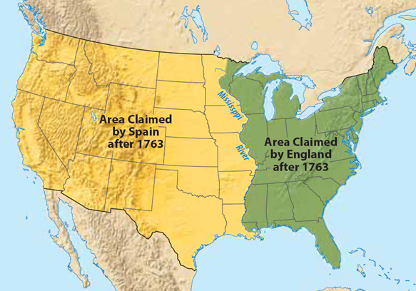

Slide 11
Image Credits
Slide 1: Ted Kerwin Wikimedia Commons; Slide 2: Public Domain Wikimedia Commons; Slide 19: University of North Carolina; Slide 37: Andy Montgomery Wikimedia Commons
Return to Main Menu

