Slide 1
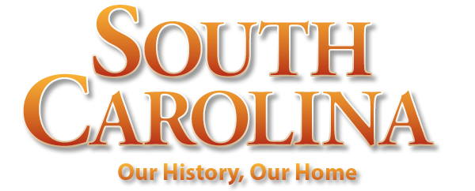
Chapter 7: A Revolutionary Generation
STUDY PRESENTATION
© 2022 Clairmont Press

Slide 2
Section 1: Conflict in the Making
Section 2: The Fight Begins
Section 3: The War Moves to the South
Section 4: South Carolina in the Building of a New Nation

Slide 3
Section 1: Conflict in the Making
Essential Question: How did conflicts lead to the American Revolution?

Slide 4
Section 1: Conflict in the Making
What terms do I need to know?
Proclamation Line of 1763
Stamp Act
Sons of Liberty
Tea Act
monopoly
First Continental Congress
Second Continental Congress
South Carolina Provincial Congress
Loyalist

Slide 5
Introduction & The Proclamation of 1763
1763, after the French and Indian War
The thirteen colonies had secure markets for their goods.
Their taxes were accepted.
American population was youthful, with 60% under 21.
The Proclamation Line of 1763 – established by government of George III
John Stuart
Superintendent of Indian Affairs for the Southern Department, met with governors
Indian representatives in Augusta meant to establish peace between whites and Native Americans by explaining the Proclamation Line

Slide 6
The Question of Taxes: The Sugar Act & The Stamp Act
Britain felt that the colonists should help pay off their debt as a country. New acts were passed by Parliament, and colonists argued about the new, unfair taxes.
The Sugar Act (Revenue Act of 1764) – placed import duty on luxury items, such as sugar brought from abroad
The Stamp Act of 1765 – levied direct tax on colonists (all paper items like newspapers, books, wills, playing cards, etc.)
All classes were affected by the taxes, especially the urban class.

Slide 7
Protests and Repeal & The Townshend Acts
“No taxation without representation” – slogan of Americans in response to the Stamp Act
explosive protests happened
Sons of Liberty organizations formed, threatening implementers of the Stamp Act.
1766 - Stamp Act repealed by Parliament, Declaratory Act passed same day (Parliament had constitutional rights to tax)
1767 –The Townshend Acts passed by Parliament (placed import duty on tea, paint, lead, and glass)
Repeal of the Stamp Act: a humorous depiction the death of “Miss America Stamp”

Slide 8
The Wilkes Fund Controversy
Conflict over Commons House expenditure of tax money:
John Wilkes (editor of a London newspaper) criticized the king and was arrested.
Commons House contributed money for his defense, further angering King George III.
The king ordered the colony not to spend money without royal approval.
South Carolina resisted the authority of the royal government.

Slide 9
The Tea Act and Its Consequences
1773 – Tea Act: designed to save English East India Company from bankruptcy, gave the company a monopoly to sell their tea in the colonies
Objections from Americans: (1) unfair to cut out competing tea shippers, and (2) tea still taxed
Boston Tea Party: most famous symbol of American defiance of Britain, citizens disguised as Indians dumping tea (stored by Governor William Bull) into the Boston harbor
Boston Tea Party

Slide 10
The Intolerable Acts
Overreaction to Tea Party by British government:
Coercion Acts passed to punish Massachusetts (called Intolerable Acts by Americans)
Changes in Boston due to Coercion Acts:
Boston Harbor closed
the Massachusetts charter of government changed
town meetings restricted to one per year
During this crisis, Boston was helped by other colonies.

Slide 11
Continental and Provincial Congresses
1774 – the First Continental Congress met in Philadelphia
comprised of distinguished men in America from all the colonies
agreed to cut off imports from Britain until Intolerable Acts were repealed
urged local communities to set up committees to enforce shutdown of trade
1775 – the Second Continental Congress held
comprised of 5 re-elected delegates
election of representatives to a South Carolina Provincial Congress (a new legislature, in defiance of royal authority)

Slide 12
Choosing Sides
Names used to identify sides in the struggle:
Patriots, partisans, rebels (favored American rights, willing to fight for them)
Loyalists or Tories (those loyal to Britain)
Redcoats (British Soldiers)
Continentals (official American troops authorized by Continental Congress)
Most Patriot troops in South Carolina were militia, local fighters not directly under Continental Army, who seldom had standard uniforms.
Return to Main Menu

